Slide 1
Digi school Geomorfology
2020-1-SK01-KA226-SCH-094350

Slide 2
SUBJECT: Geography
SPECIFICATION: may be used for presentation and self-education
AGE OF STUDENTS: 15 – 16
1 LESSON : 45 min
2020-1-SK01-KA226-SCH-094350

Slide 3
Terrain, topographical relief
3

Slide 4
Obsah lekce
01
Terrain
02
Terrain formation
03
Geomorphological cycle
04
Tasks
04

Slide 5
Terrain
Terrain = the Earth’s surface
On land – land surface
In the ocean and seas – the ocean floor

Slide 6
Land surface
Hypsometry (relative to sea level):
lowland – up to 200 above the sea level
highland – above 200 above the sea level
According to the difference between maximum and minimum elevation:
plain – up to 30 m
upland (Hugelland) – up to 150 m
highland – up to 300 m
mountains – up to 600 m
High mountains – more than 600 m

Slide 7
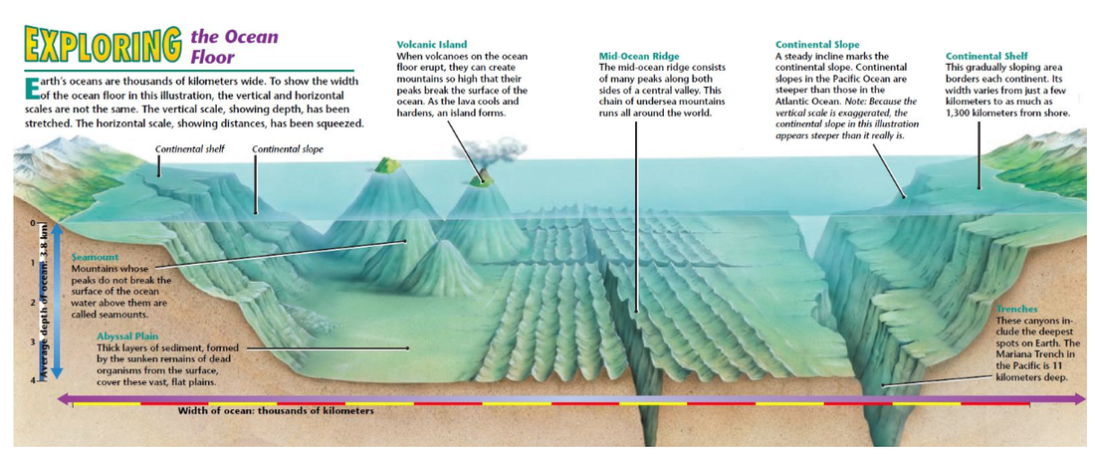
The Ocean floor

Slide 8
Terrain formation
Geomorphology = a scientific discipline, part of physical geography which describes and classifies form of the Earth’s surface and explains their formation and development over time
Terrain is a result of outer and inner geological powers activities

Slide 9
Inner geological powers
Volcanoes, earthquakes, orogenies
Source of energy:
The Earth’s core
Huge amount of energy is released during radioactive decay creating heat that escapes towards the surface and creates currents in the mantle
Are active on the surface and in the core
Are active just once at a time
Are not active at the same time all over the world
Create initial unevenness of the surface

Slide 10
Outer geological powers
Wind, glaciers and icebergs, gravity, living organisms
Source of energy: the Sun
Are active only on the surface
Are active all the time
Are active at the same time everywhere just the intensity varies
Cause erosion of rock, its transport, and its deposition smoothing and flattening of the surface

Slide 11
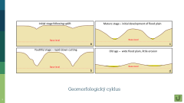
Geomorphological cycle
A scientific theory about the development of terrain
1. young country stage
Country is lifted up by the inner geological powers processes and the outer geological powers have been working for a short period of time – there are deep valleys and very steep slopes, high mountain peaks
2. mature country stage
Outer geological powers processes work to level the country and smooth the landscape
3. old country stage
Outer geological powers make the area flatter, lower, and smoother
The following inner geological processes finish the cycle and make begin again
This photo is by an unknown author with the licence CC BY-SA-NC

Slide 12
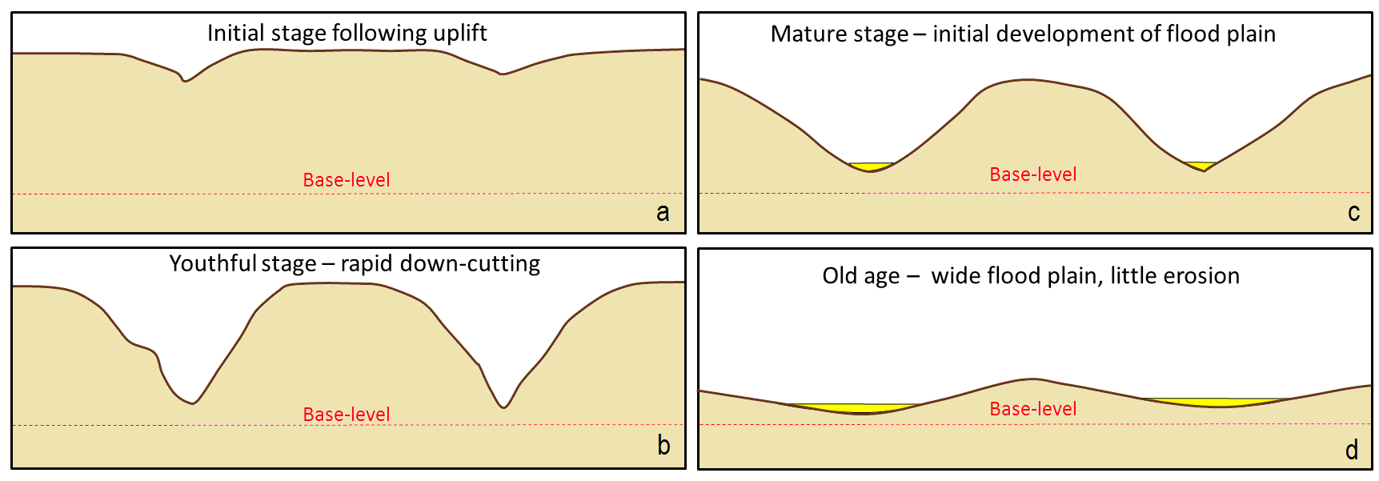
Geomorfologický cyklus

Slide 13
Tasks
https://wordwall.net/play/25534/747/714
https://wordwall.net/play/25534/686/807

Slide 14
Resources:
MS Office gallery
2020-1-SK01-KA226-SCH-094350

Slide 15
2020-1-SK01-KA226-SCH-094350 DIGI SCHOOL
Délka projektu: 01. 03. 2021 – 28. 02. 2023
Rozpočet partnerství: 101.092,-€
Rozpočet GJŠ Zlín: 20.829,- €
Intelektuální výstupy všech partnerů: ANJ, NEJ, FRJ,SPJ, DEJ, OBN, CHE, GEO, MAT, BIO, EKN, ITK,
HUV, ETV
Intelektuální výstupy GJŠ Zlín v předmětech MAT, GEO, CHE, SPJ
2020-1-SK01-KA226-SCH-094350

Slide 16
EN The European Commission's support for the production of this publication does not constitute an endorsement of the contents, which reflect the views only of the authors, and the Commission cannot be held responsible for any use which may be made of the information contained therein.
ČR Podpora Evropské komise na zhotovení této práce nevyjadřuje názor Komise, obsah je názorem autora a Komise není zodpovědná za informace v práci obsažené.
2020-1-SK01-KA226-SCH-094350

