Slide 1
PHYSICAL EDUCATION Hydration DIGI PROJECT
Teachers:
Óscar Cambralla
Eduardo Galindo

Slide 2
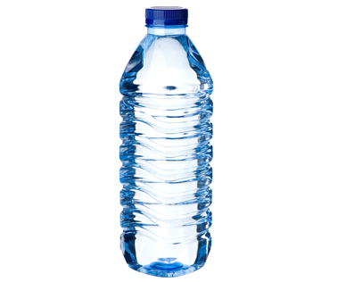
Importance of hydration in sport
Burn calories
Increased of body temperatures
Sweating = elimination of water and mineral salts
FLUID LOSS AFTER 1H OF INTENSE PHYSICAL ACTIVITY
CONSECUENCIAS NEGATIVAS DE UNA MALA HIDRATACIÓN
Run = 1,8 L
Increase HR
Football= 1,5 L
Hypertemia
Basketball = 1,5 L
Cramps
Swimming= 0,5 L
Headache
Variation according to factors such as:
Age, gender, intensity, temperature, ambiental humidity, kind of clothes and the person

Slide 3
Benefits of hydration
Improve the transport of nutrients, vitamins and minerals through the body.
It activates essential enzymes to supply the energy the body needs.
Improve the elimination of impurities and toxins from the body.
Lubricates and provides structural support to tissues and joints.

Slide 4
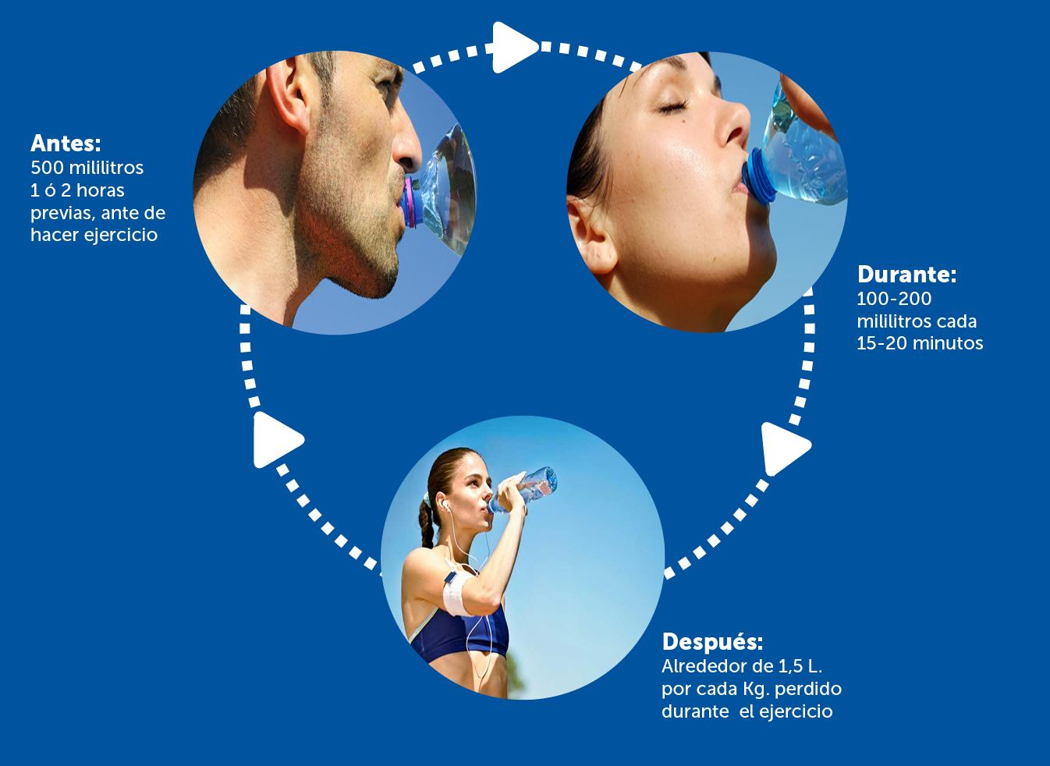
Hydration: Before, during and after of a physical activity

Slide 5
Symptoms of dehydration
Mild dehydration
Moderate Dehydration
Severe Dehydration
Thirst is a late symptom
Loss of appetite
Discomfort
Fatigue
Headache
1%-5% water loss
Dry skin
Loss of elasticity
Low or dark urine
6%-8% water loss
Muscles spasms
Loss of balance
Mental confusion
Difficulty speaking
Increased HR
Increased temperature
Death risk
9%-11% water loss

Slide 6
Tips for good hydration
Bring your bottle of water always
Drink water before, during and after of a physical activity
Drink water before feeling thirsty
The proper temperature of water is 10-15°C
Drink in small sips and regularly
Avoid drinking when high heart rate (hyperventilation)
Keeping hydrated increase the sport performance
Maintain adequate guidelines of rehydration

Slide 7
What the isotonic drinks are?
They are liquid preparations that promote hydration and replacement of electrolytes in the body when significant losses, because they contain a quantity of water, carbohydrates and minerals similar to that found in the blood.
In the intestine they are absorbed immediately and pass into the blood quickly, improving hydration and maintaining digestive functionality.
Water
Sugar
Minerals
Glucose
Sodium
Chlorine
Fructose
Potassium
Saccharose
Magnesium
Calcium
Maltose
Phosphorum

Slide 8
For what we use isotonic drinks?
Reposition of loss water, sugar and electrolytes fast
Loss of fluids after diarrhea and vomiting
For physical activities lasting more than one hour
Improve the sport performance in competition
Physical activities in conditions of high temperature and humidity
Before
Works improving the later performance
During
Prevents the replation of reserves
After
Is the reposition of the lost elements

Slide 9
What are hypertonic or energy drinks?
They are those that contain an exciting element of the nervous system, usually a high concentration of caffeine, sugars, taurine, group B vitamins, and whose purpose is to increase the level of attention or reduce fatigue, tiredness or sleep.
Poisonings
Cardiac arrythmia
Nervous system alteration
Addiction
Inhibition of sleep and fatigue
Stress
Insomnia
Anxiety
HR increased
Diuretic effect
Dehydration
Caffeine
1 coffe = 1oo ml / 1 Red Bull = 500 ml

