Slide 1
Digi School HISTORY
DIGI SCHOOL 2020-1-SK01-KA226-SCH-094350 Dejepis

Slide 2
Subject: History
Specification: History Seminar
Age group: 15- 16
1 Lesson: 45 minutes
2020-1-SK01-KA226-SCH-094350

Slide 3
01
Islam
02
Arab Empire
03
Culture in the Arab Empire
04
Teaching Materials
2020-1-SK01-KA226-SCH-094350

Slide 4
Islam
1
2020-1-SK01-KA226-SCH-094350

Slide 5
ISLAM
2020-1-SK01-KA226-SCH-094350
7th century
Allah = God; Muhammad – the Prophet
Quran
Islam – subordination to the God´s will; Muslim – the one who subordinates
5 duties of a Muslim
Sunni and Shia

Slide 6
Arab Empire
2
2020-1-SK01-KA226-SCH-094350

Slide 7
ARAB EMPIRE
history – connection of religious and political power
geographic and climatic conditions of the Arabian Peninsula
blood kinships - sheikhs
Mecca - Quraysh
Muhammad- monotheistic religion
2020-1-SK01-KA226-SCH-094350

Slide 8
622 escape to Medina hidžra – Islamic Calendar- explanation
subordination to the God's will
630 conquest of Mecca Arab state Omar
Caliphs - Quraysh, Ummayad, Abbasid
India Iberian Peninsula - Reconquista
Emirates - Emir; Vizier
2020-1-SK01-KA226-SCH-094350

Slide 9
Culture in the Arab Empire
3
2020-1-SK01-KA226-SCH-094350

Slide 10
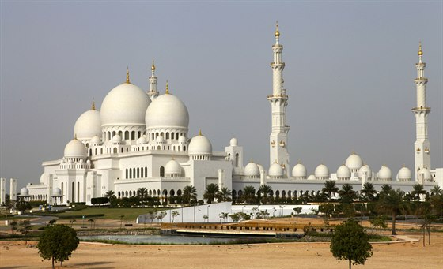
CULTURE IN THE ARAB EMPIRE
2020-1-SK01-KA226-SCH-094350
geography, astronomy, philosophy
mathematics - Arabic numerals
medicine - Avicenna
new crops and plants
Thousand and one night
palaces and sacral buildings - mosques
https://www.idnes.cz/cestovani/kolem-sveta/velka-mesita-v-abu-zabi.A150112_135829_kolem-sveta_tom

Slide 11
Teaching Materials
4
2020-1-SK01-KA226-SCH-094350

Slide 12
TEACHING MATERIALS
Crossword- Arab Empire learningapps.org
Arab Empire
2020-1-SK01-KA226-SCH-094350

Slide 13
SOURCES:
Damankoš, Marián. 2008. Svetové dejiny I. Bratislava, Prešov: Eurolitera, 2008. 322 s. ISBN: 978-80-968520-9-3.
Kurcinová, Ľudmila- Sobek, Ľubomír. 2019. Úspešná maturita: Dejepis. Košice: TAKTIK, 2019. 338 s. ISBN 978- 80-8180-131-0.
Sochrová, Mária- Virdzeková, Alica. 2009. Dejepis I. Bratislava: Fragment, 2009. 144 s. ISBN 978-80-8089-296-8.
2020-1-SK01-KA226-SCH-094350

Slide 14
EN The European Commission's support for the production of this publication does not constitute an endorsement of the contents, which reflect the views only of the authors, and the Commission cannot be held responsible for any use which may be made of the information contained therein.
SK Podpora Európskej komisie na výrobu tejto publikácie nepredstavuje súhlas s obsahom, ktorý odráža len názory autorov, a Komisia nemôže byť zodpovedná za prípadné použitie informácií, ktoré sú v nej obsiahnuté.
2020-1-SK01-KA226-SCH-094350

