Slide 1
Digi school MUSIC CHANSON
2020-1-SK01-KA226-SCH-094350

Slide 2
SUBJECT: MUSIC
SPECIFICATION: in ENGLISH via CLIL method (level in languages)
AGE OF STUDENTS: 11-13
1 LESSON : 45 min
2020-1-SK01-KA226-SCH-094350
2

Slide 3
C O N T E N T
CHANSON
01
EDITH PIAF
02
HANA HEGEROVÁ
03
2020-1-SK01-KA226-SCH-094350
3

Slide 4
CHANSON
1
2020-1-SK01-KA226-SCH-094350
4

Slide 5
BASIC INFORMATION
Chanson means song in French (comes from poetry);
Chansonniers were large manuscripts where chansons were preserved (before 1500);
The poems consisted of short monotonous paragraphs;
Not very many singers actually sing chanson.
5
2020-1-SK01-KA226-SCH-094350

Slide 6
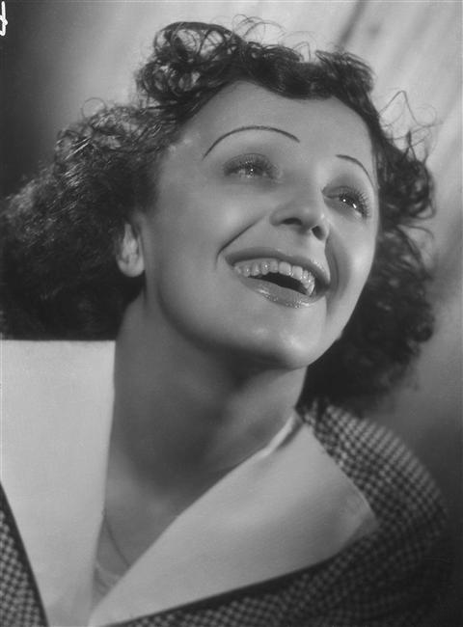
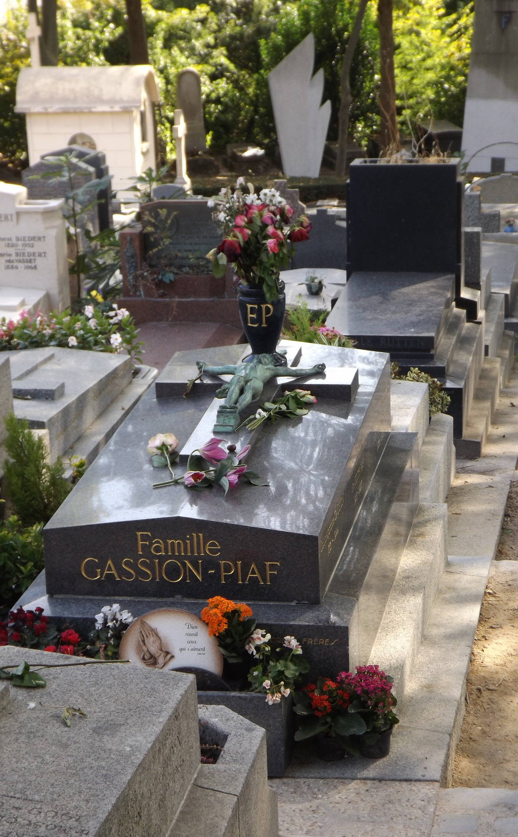
EDITH PIAF
2
1915 - 1963
2020-1-SK01-KA226-SCH-094350
6

Slide 7
BASIC INFORMATION
Rough childhood brought up by her father, the comedian;
She had good relations with her sister Simone;
Chanson – French ballad made her internationally famous;
Her songs reflected her struggles in her own life.
7
2020-1-SK01-KA226-SCH-094350

Slide 8
MUSIC EXTRACTS
Non, je ne regrette rien
Ne me quitte pas
2020-1-SK01-KA226-SCH-094350
8

Slide 9
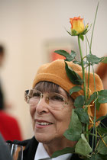
HANA HEGEROVÁ
3
1931 - 2021
2020-1-SK01-KA226-SCH-094350
9

Slide 10
BASIC INFORMATION
She was the so-called “queen of chanson”;
She got a professional artistic education at the State Theater Conservatory;
She performed in several well-known theatres such as the Semafor and the Rokoko;
She appeared in the jazz opera “Dobře placená Procházka” and in the film “If a Thousand Clarinets”.
10
2020-1-SK01-KA226-SCH-094350

Slide 11
EDUCATIONAL MATERIALS :
EDITH PIAF – QUESTIONS
HANA HEGEROVÁ - reading comprehension
E.Piaf - reading comprehension
Chansonquiz
11

Slide 12
R E S O U R C E S
W.Thomson: The Great Composers ISBN 1-84309-211-5
Hudobná výchova pre 8.ročník
Edith Piaf picture by Studio Harcourt - RMN, public domain, https://commons.wikimedia.org/w/index.php?curid=76188563
2020-1-SK01-KA226-SCH-094350
12

Slide 13
EN The European Commission's support for the production of this publication does not constitute an endorsement of the contents, which reflect the views only of the authors, and the Commission cannot be held responsible for any use which may be made of the information contained therein.
SK Podpora Európskej komisie na výrobu tejto publikácie nepredstavuje súhlas s obsahom, ktorý odráža len názory autorov, a Komisia nemôže byť zodpovedná za prípadné použitie informácií, ktoré sú v nej obsiahnuté.
2020-1-SK01-KA226-SCH-094350
13

