Slide 1
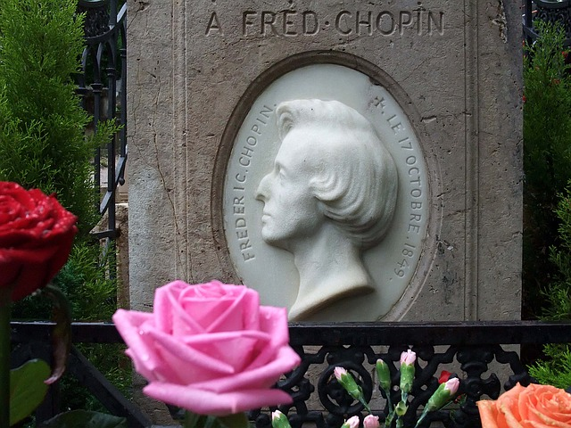
Digi school MUSIC F. CHOPIN
2020-1-SK01-KA226-SCH-094350

Slide 2
C O N T E N T
01
CLIL method
02
ROMANTICISM
03
F. CHOPIN
04
EDUCATIONAL MATERIALS
2020-1-SK01-KA226-SCH-094350
2

Slide 3
CLIL method
1
Content Language Integrated Learning
2020-1-SK01-KA226-SCH-094350
3

Slide 4
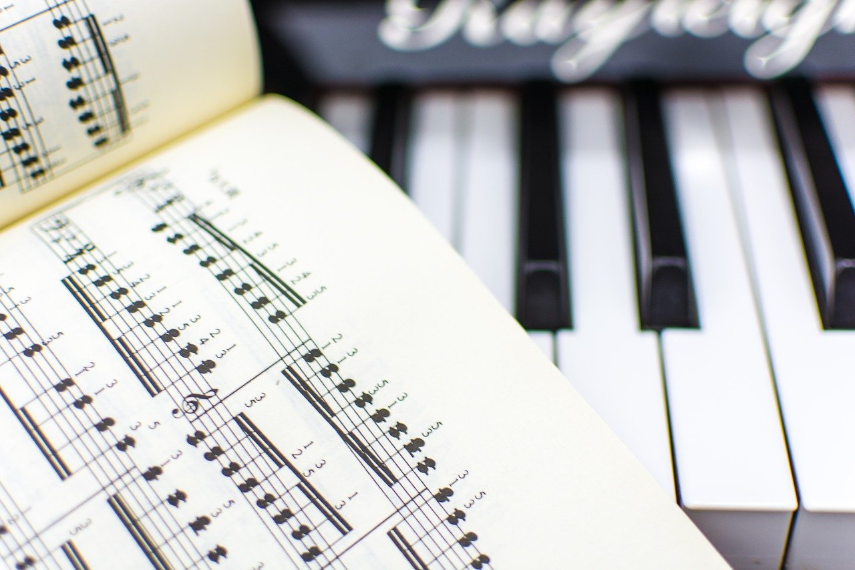
CLASSICISM
Music lessons presented here:
are taught via CLIL method
English is the means of communication to learn the Music content .
2020-1-SK01-KA226-SCH-094350
4

Slide 5
ROMANTICISM
2
1800 - 1910
2020-1-SK01-KA226-SCH-094350
5

Slide 6
GENERAL INFORMATION
Musical romanticism emphasized the individual
either a composer or a performer;
The great topic was a response to a nature;
The beauty of a natural world and human emotions such as –love, happiness, and sorrow – are the main themes.
6
2020-1-SK01-KA226-SCH-094350

Slide 7
F. CHOPIN
3
HIS LIFE AND WORK
2020-1-SK01-KA226-SCH-094350
7

Slide 8
BASIC INFORMATION
He was born in Poland to a Polish mother, French father.
His country Poland influenced Chopin because he wrote many Mazurkas and Polonaises.
They are typical Polish dances.
The other country he lived in is France. His father was French.
8
2020-1-SK01-KA226-SCH-094350

Slide 9
HIS WORKS :
Ballade g minor
Nocturne op.9 No.1
Waltz Op.64 No.2
Polonaises
Mazurkas
Ballades
Nocturnes
Waltzes
2020-1-SK01-KA226-SCH-094350
9

Slide 10
EDUCATIONAL MATERIALS
Romanticism - wordwall quiz
Quizz - F. Chopin
2020-1-SK01-KA226-SCH-094350
10

Slide 11
MUSIC EXTRACTS:
Polonaise Heroic in A flat
Ballade in G minor
Mazurka in A minor
2020-1-SK01-KA226-SCH-094350
11

Slide 12
R E S O U R C E S
W.Thomson: The Great Composers ISBN 1-84309-211-5
R.Bennett: Discovering Music Book Two ISBN 0-582-22313-X
2020-1-SK01-KA226-SCH-094350
12

Slide 13
EN The European Commission's support for the production of this publication does not constitute an endorsement of the contents, which reflect the views only of the authors, and the Commission cannot be held responsible for any use which may be made of the information contained therein.
SK Podpora Európskej komisie na výrobu tejto publikácie nepredstavuje súhlas s obsahom, ktorý odráža len názory autorov, a Komisia nemôže byť zodpovedná za prípadné použitie informácií, ktoré sú v nej obsiahnuté.
2020-1-SK01-KA226-SCH-094350
13

