Slide 1
Digi School Ethics Conflict – Definition, Subdivision, Stages
2020-1-SK01-KA226-SCH-094350

Slide 2
Conflict – Definition, Subdivision , Stages
SUBJECT: Ethics
SPECIFICATION: Conflict – Definition, Subdivision , Stages
AGE GROUP: 14-15
1 LESSON: 45 min
2020-1-SK01-KA226-SCH-094350

Slide 3
CONTENTS
01
Definition of Conflict
02
Subdivision of Conflicts
03
Stages of Conflict
04
TEACHING MATERIALS
2020-1-SK01-KA226-SCH-094350

Slide 4
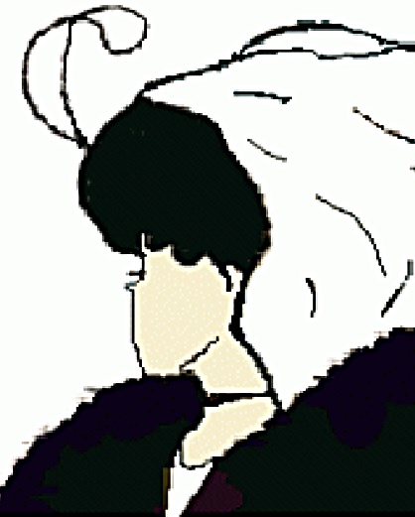
What is a Conflict?
1
Definition of Conflict
2020-1-SK01-KA226-SCH-094350

Slide 5
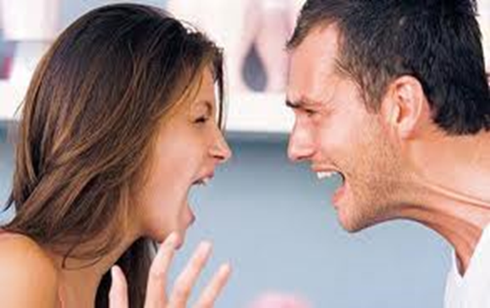
BASIC INFORMATION
Disagreement, meeting of two opposing opinions.
It is completely natural in interpersonal relationships.
2020-1-SK01-KA226-SCH-094350

Slide 6
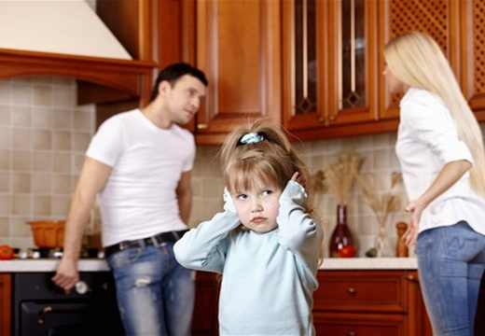
BASIC INFORMATION
when we misunderstand each other,
when we have opposing views and cannot reach agreement,
Half truths, unsaid truths,
carelessness (not keeping the word, or responsibility),
intention (it is the most powerful source of conflict),
Fear is the source of many conflicts (it can be found behind dishonesty, carelessness, or not creating personal boundaries).
2020-1-SK01-KA226-SCH-094350

Slide 7
Subdivision of Conflicts
2
2020-1-SK01-KA226-SCH-094350

Slide 8
VŠEOBECNÉ INFORMÁCIE
Intrapersonal – inside of a person
Interpersonal- between two people
Group – within a group
Between groups – two or more
Conflict of interest
Conflict of information
Structural conflict
Conflict of values
Relationship conflict
2020-1-SK01-KA226-SCH-094350

Slide 9
GENERAL INFORMATION
Pluses and minuses of a conflict
arguments, leading to possible physical assault,
psychological problems.
+ solution of a long-term or a short-term conflict,
+ tightening the relationship,
+ learning the truth
2020-1-SK01-KA226-SCH-094350

Slide 10
Stages of Conflict
3
2020-1-SK01-KA226-SCH-094350

Slide 11
GENERAL INFORMATION
Symptoms of a conflict
Accident, contradiction, opening
Polarisation
Separation, isolation
Destruction
Disappointment, tiredness, disillusionment
2020-1-SK01-KA226-SCH-094350

Slide 12
Teaching Material
4
2020-1-SK01-KA226-SCH-094350

Slide 13
TEACHING MATERIALS
<
Conflict – definition, subdivision, stages
2020-1-SK01-KA226-SCH-094350

Slide 14
INTERACTIVE EXERCISES
<
Students create teams (2 – 4).
They draw the order.
In wordwall they will answer the true/false statements on the wheel.
2020-1-SK01-KA226-SCH-094350

Slide 15
INTERACTIVE EXERCISES
<
Students create teams (2 – 4).
They draw the order.
In wordwall they will answer the quiz questions.
2020-1-SK01-KA226-SCH-094350

Slide 16
SOURCES
Hartmannová, E, Petrufová, M: Spoločenská komunikácia pre 2. ročník obchodných akadémií
BEDNAŘÍK, A. 2001. Riešenie konfliktov. Bratislava: -PDCS. ISBN 80-968095-4-7.

Slide 17
EN The European Commission's support for the production of this publication does not constitute an endorsement of the contents, which reflect the views only of the authors, and the Commission cannot be held responsible for any use which may be made of the information contained therein.
SK Podpora Európskej komisie na výrobu tejto publikácie nepredstavuje súhlas s obsahom, ktorý odráža len názory autorov, a Komisia nemôže byť zodpovedná za prípadné použitie informácií, ktoré sú v nej obsiahnuté.
2020-1-SK01-KA226-SCH-094350

