Slide 1
Digi School Ethics Conflict – Setting the Boundaries
2020-1-SK01-KA226-SCH-094350

Slide 2
Conflict – Setting the Boundaries
SUBJECT: Ethics
SPECIFICATION: Conflict – Setting the Boundaries
AGE GROUP: 14-15
1 LESSON : 45 min
2020-1-SK01-KA226-SCH-094350

Slide 3
CONTENTS
01
Conflict Definition
02
Definition of Boundaries in Communication
03
How to Set the Boundaries
04
TEACHING MATERIALS
2020-1-SK01-KA226-SCH-094350

Slide 4
What is Conflict?
1
Definition of conflict
2020-1-SK01-KA226-SCH-094350

Slide 5
BASIC INFORMATION
It is a clash of two opposing views.
It is absolutely natural in human relationships.
2020-1-SK01-KA226-SCH-094350

Slide 6
Definition of Boundaries in Communication
2
2020-1-SK01-KA226-SCH-094350

Slide 7
GENERAL INFORMATION
It is a limit that we set to ourselves. What we will tolerate from others and what we won´t.
Under the term boundary we understand our personal zone.
Our safety, competences, rights in relation to other people and the world.
Physical boundaries define who can touch us or approach us.
Emotional boundaries define where our feelings end and where the feelings of the other person begin.
2020-1-SK01-KA226-SCH-094350

Slide 8
GENERAL INFORMATION
Find out how many of the following statements apply to you:
Often it happens that I do the work for my friends, family and colleagues.
I get easily influenced and affected by the emotions of others.
I often find myself doing something that I initially didn´t want to do at all.
Other people often misuse my kindness and willingness.
I have a problem to say no.
I value the opinion of others more than my own.
2020-1-SK01-KA226-SCH-094350

Slide 9
How to Set the Boundaries
3
2020-1-SK01-KA226-SCH-094350

Slide 10
GENERAL INFORMATION
Self-knowledge, self-control.
Assertive communication about your own needs.
Searching for compromises, not at all costs.
2020-1-SK01-KA226-SCH-094350

Slide 11
GENERAL INFORMATION
Self-knowledge, self-control.
Understand your feelings and emotions.
Know yourself, your positive and negative sides.
Know your desires, goals.
2020-1-SK01-KA226-SCH-094350

Slide 12
GENERAL INFORMATION
Assertive communication about your own needs.
Compliance between verbal and non-verbal communication; be authentic, true.
I am not responsible for the feelings of others.
Do not harm others, don´t get harmed.
2020-1-SK01-KA226-SCH-094350

Slide 13
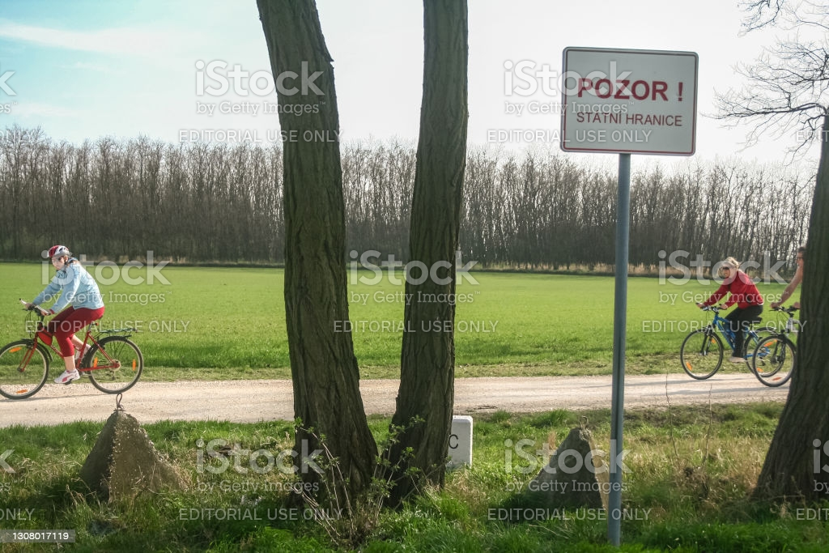
GENERAL INFORMATION
Searching for compromises, not at all costs
Set the boundaries unequivocally.
Without anger.
Do not explain.
Do not apologize for it.
Do not argue.
Set the boundary calmly, clearly, firmly and with respect.
2020-1-SK01-KA226-SCH-094350

Slide 14
Teaching Materials
4
2020-1-SK01-KA226-SCH-094350

Slide 15
TEACHING MATERIALS
<
Conflicts – setting the boundaries
2020-1-SK01-KA226-SCH-094350

Slide 16
INTERACTIVE EXERCISES
<
Students create teams (2 – 4).
In wordwall they will find the terms on setting the boundaries
2020-1-SK01-KA226-SCH-094350

Slide 17
INTERACTIVE EXERCISES
<
Students create teams (2 – 4).
In wordwalle they will answer the qiuz questions
2020-1-SK01-KA226-SCH-094350

Slide 18
SOURCES
https://eduworld.sk/cd/miroslava-zilinska/6824/zdrave-hranice-potrebujeme-mat-aj-v-dospelosti
http://www.liecenieduse.sk/blog/nastavenie-si-hranic.html
BEDNAŘÍK, A. 2001. Riešenie konfliktov. Bratislava: -PDCS. ISBN 80-968095-4-7.

Slide 19
EN The European Commission's support for the production of this publication does not constitute an endorsement of the contents, which reflect the views only of the authors, and the Commission cannot be held responsible for any use which may be made of the information contained therein.
SK Podpora Európskej komisie na výrobu tejto publikácie nepredstavuje súhlas s obsahom, ktorý odráža len názory autorov, a Komisia nemôže byť zodpovedná za prípadné použitie informácií, ktoré sú v nej obsiahnuté.
2020-1-SK01-KA226-SCH-094350

