Slide 1
TEACHING LANGUAGES WITH THE 4C’s
DIGISCHOOL PROJECT ENGLISH
2020-1-SK01-KA226-SCH-094350

Slide 2
SUBJECT: ENGLISH AND FRENCH
SPECIFICATION: Teaching Languages with the 4 C‘s.
AGE OF STUDENTS: 11-13
10 LESSONS : 50 min. each lesson.
2020-1-SK01-KA226-SCH-094350

Slide 3
THE KEY OF A SUCCESSFUL LESSON: CURIOSITY+EXPLORATION= MOTIVATION
INTERESTING LESSONS HAVE SOME KEY INGREDIENTS:
EMOTIONAL.
SURPRISING.
FUN.
PERSONAL.
CONNECTED TO REAL LIFE.
2020-1-SK01-KA226-SCH-094350

Slide 4
THE 4 C‘s
COMMUNICATION
COLLABORATION
CREATIVE THINKING
CRITICAL THINKING
2020-1-SK01-KA226-SCH-094350

Slide 5
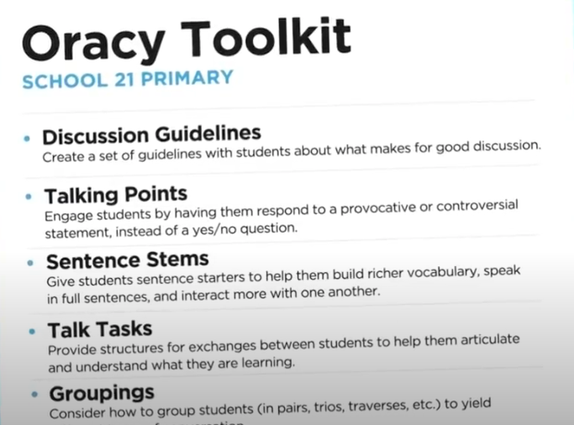
COMMUNICATION Lessons 1 and 2: Effective Communication Activity. Time: 50’ each lesson.
TO KEEP IN MIND BEFORE THE LESSON:
’Oracy’ is one of the biggest indicators of a child’s success later in life.
Aim: to improve the 4 skills of any language: speaking, listening, writing and reading.
Activity:
1. Find the 3 most popular movies at the moment.
2. Give the students an ‘oracy toolkit’:
Discussion guidelines.
Talking points.
Sentence stems, starters (to encourage active listening and collaboration during discussions).
Talk structures.
Etc.
2020-1-SK01-KA226-SCH-094350

Slide 6
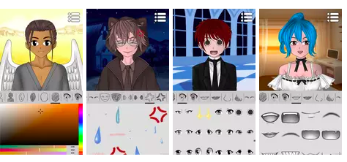
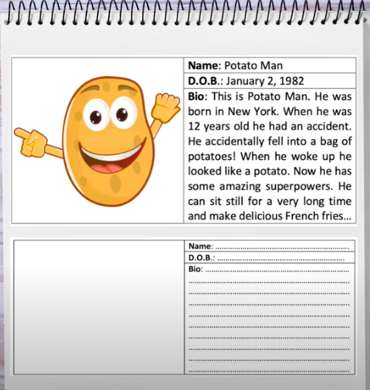
COMMUNICATION Lessons 1 and 2: Effective Communication Activity.
3. Teach the students some of the fundamentals of communication:
Empathy.
Pausing.
Introspection.
Turn-talking.
Respectful vocabulary.
Conversation skills.
4. Group students in pairs, threes, or circles and get them talking using the ‘oracy toolkit’.
5. After the discussion, each group should create new characters/ superheroes including their biography with the app: ‘Avatar Maker: Anime’.
Groups show their new characters and they vote for the best/most original one.
2020-1-SK01-KA226-SCH-094350

Slide 7
COLLABORATION
Lessons 3, 4 and 5: ‘TV News Programme’.
Time: 50’ each lesson.
ACTIVITY:
PRESENTING A TV NEWS PROGRAMME What if you had 360 seconds to broadcast the most important news event in the world today? How would you present it so your viewers would remember it forever?
.
2020-1-SK01-KA226-SCH-094350

Slide 8
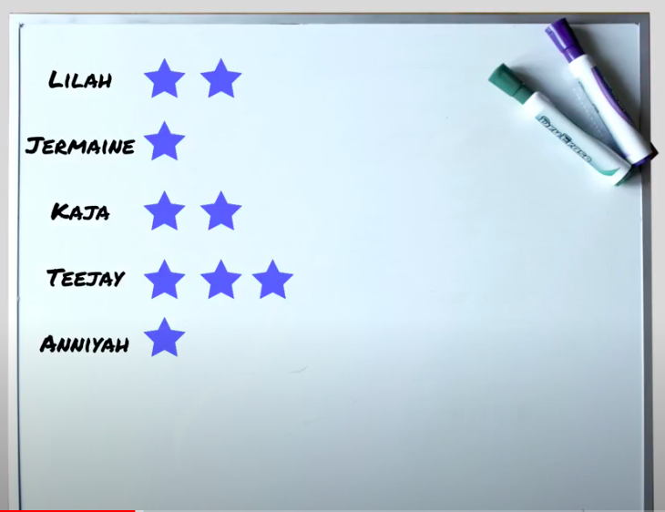
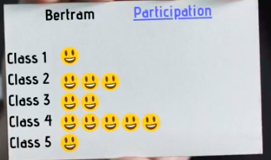
COLLABORATION
Lessons 3, 4 and 5: ‘TV News Programme’.
AIM: Make students write, listen, read and talk about different topics, using the grammar structures learnt during that term.
The key points for a successful collaborative lesson:
If we tend to prepare our lessons in a similar way, following a similar structure, in a classroom set-up that generally stays the same... We are at risk of losing our enthusiasm and deteriorating
our ability to reach our students.
Groups of 3 (use https://www.randomlists.com/team-generator).
Reward students (cards with their names and happy faces/stars when they participate).
Roles: our students are all different so they can decide their role in the group and change it throughout the course.
2020-1-SK01-KA226-SCH-094350

Slide 9
COLLABORATION
Lessons 3, 4 and 5: ‘‘TV News Programme’.
.
PROCESS:
Students will be given a rubric so they know which grammar structures and vocabulary they will be required to use: https://docs.google.com/document/d/1p2cUi7x6uS1AMP39r_ojnM7gGGUnNpgq/edit?usp=sharing&ouid=104127819155236369167&rtpof=true&sd=true
They need a chromebook or a digital device to search for the information on the web. During the first two lessons they will write the articles so the teacher can correct them.
Practice: students will have a 3rd lesson to practice being reporters.
Last lesson: they should record the TV News programme (they can use different settings for different news bulletins: office, playground, park, etc.).
During the last lesson all the students will watch their classmates´ TV News Programmes and they will talk about the results and overall experience (they can use the rubric for the evaluation and co—evaluation).
2020-1-SK01-KA226-SCH-094350

Slide 10
CRITICAL THINKING
Lessons 6 and 7: ‘Use your head’ activity.
Time: 50’ each lesson.
What is Critical Thinking?
Critical thinking is the ability to think in an organized and rational manner in order to understand connections between ideas and /or facts.
This “thinking about thinking“ teaches us to identify, analyze, evaluate, choose thoughtfully.
All necessary skills in every aspect of our lives, from choosing what to study at university, to organizing our creative activities, to being a thoughtful- and yes, skeptical- consumer of goods, services and media.
2020-1-SK01-KA226-SCH-094350

Slide 11
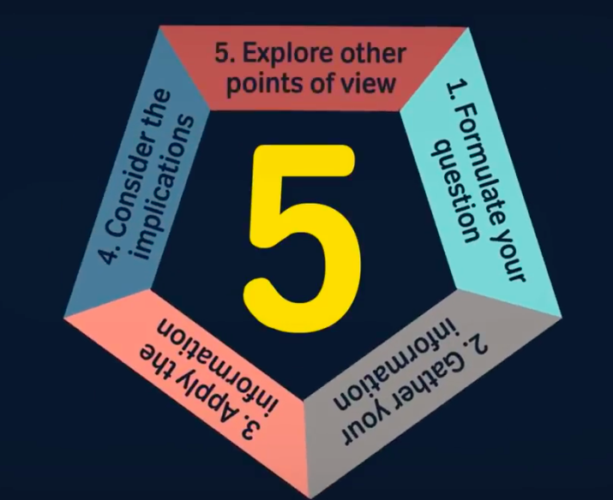
CRITICAL THINKING
Lessons 6 and 7: ‘Use your head’ activity.
5 TIPS TO IMPROVE OR STUDENTS CRITICAL THINKING:
2020-1-SK01-KA226-SCH-094350

Slide 12
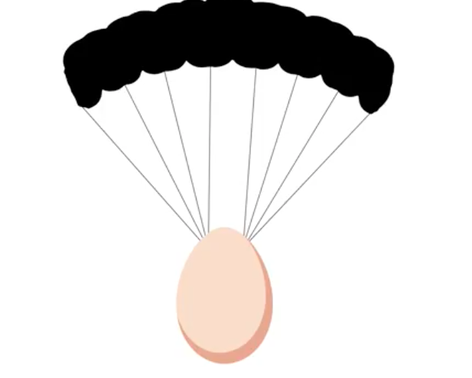
CRITICAL THINKING
Lessons 6 and 7: ‘Use your head’ activity.
ACTIVITY (lesson 6)
“The Egg Drop“.
AIM: To practise the grammar structures learnt during the last lesson and get students talking, reading and writing through the critical thinking.
PROCESS: Students must find a strategy to prevent an egg from falling and cracking. They must create a structure that will stop the egg breaking when it drops out of the window.
First, they must brainstorm ideas and after analyzing them, put them into practice.
Students will be given a sheet to write all the ideas and develop the process. They should include the grammar structures learnt during the last lessons.
ACTIVITY (lesson 8)
“Shrinking space“.
2020-1-SK01-KA226-SCH-094350

Slide 13
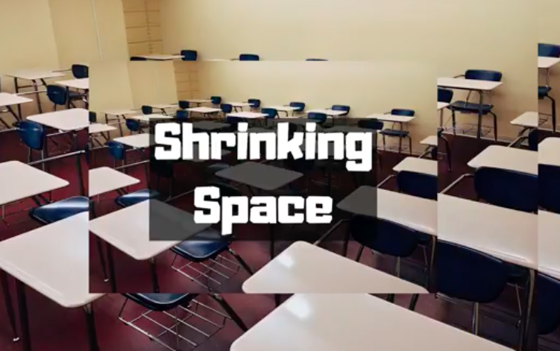
CRITICAL THINKING
Lessons 6 and 7: ‘Use your head’ activity.
ACTIVITY (lesson 7).
“Fake news“
AIM: To make students write, speak, read and listen while using the critical thinking.
PROCESS: Students are given different news, some real and some fake news. They will have to find out which ones are false by following the next steps (they will need a digital device):
Consider the source.
Read beyond.
Check the author.
Supporting sources.
Check the date.
Is it a joke?
Check your biases.
2020-1-SK01-KA226-SCH-094350

Slide 14
CREATIVE THINKING
Lessons 8, 9 and 10: ‘You too are creative”.
Time: 50’ each lesson.
2020-1-SK01-KA226-SCH-094350

Slide 15
CREATIVE THINKING
Lessons 8, 9 and 10: ‘You too are creative”.
2020-1-SK01-KA226-SCH-094350

Slide 16
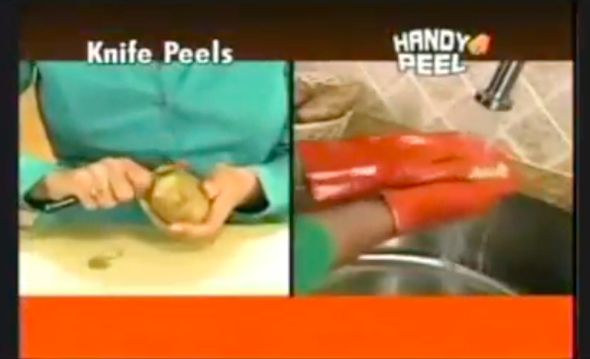
CREATIVE THINKING
Lessons 8, 9 and 10: ‘You too are creative”.
ACTIVITY: Show students 5 infomertials: what are the problems and solutions?
AIM: To use both, creative thinking and critical thinking to create new inventions after identifying the problems.
PROCESS: After watching the infomercials, students generate ideas for 3 new inventions. Then, they are organised into groups, they share their ideas and they must choose one of the ideas. They can now start working on a digital poster using the ‘genially app‘.
https://www.youtube.com/watch?v=b4xw8dJkicI
https://www.youtube.com/watch?v=gw1g2yKxb0I
https://www.youtube.com/watch?v=eqDXlYxSdLc
2020-1-SK01-KA226-SCH-094350

Slide 17
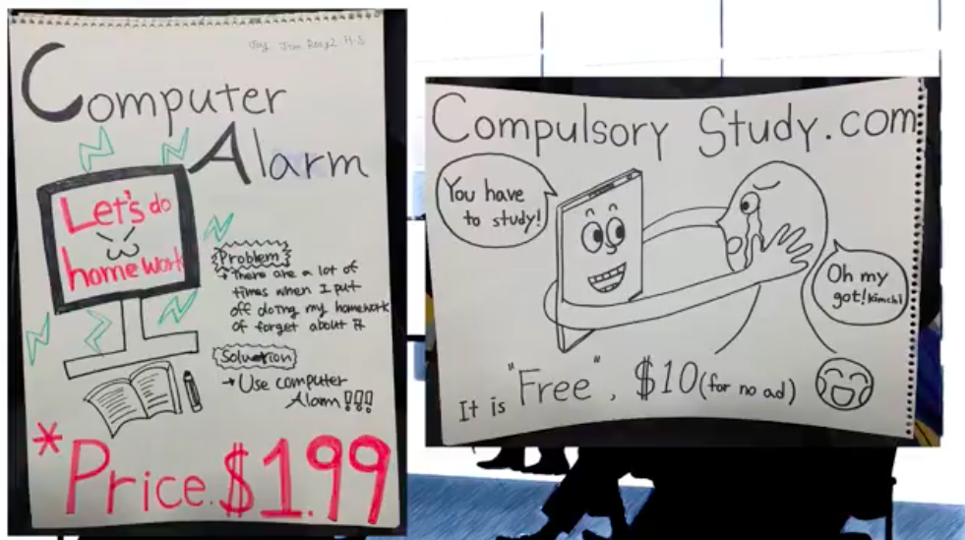
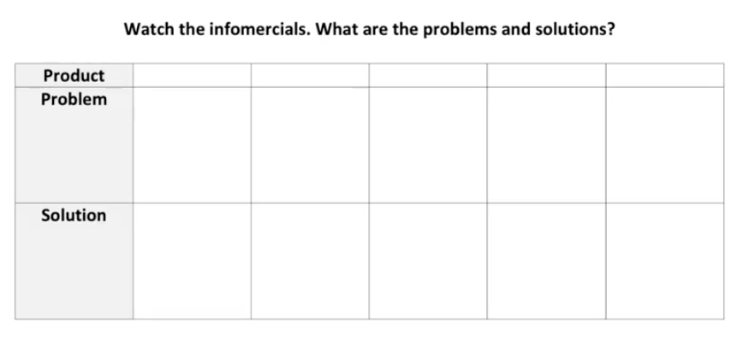
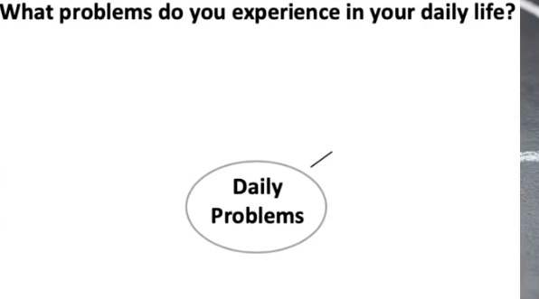
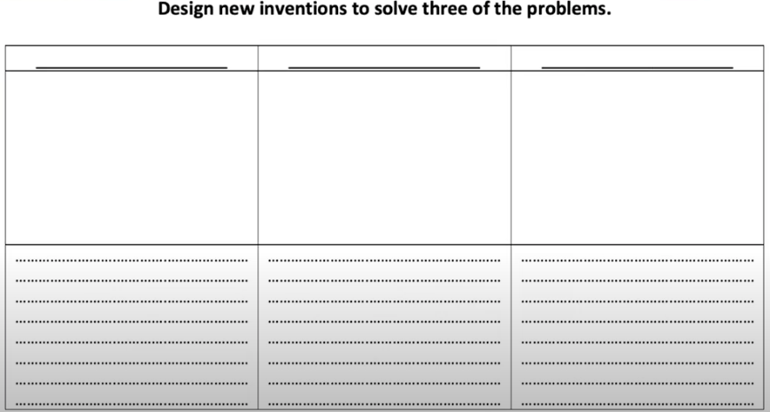
CREATIVE THINKING
Lessons 8, 9 and 10: ‘You too are creative”.
https://docs.google.com/document/d/1ZnXmqFrkiQH3mnZL651IWkmRQun-e0XA/edit?usp=sharing&ouid=108676336606472719787&rtpof=true&sd=true
https://docs.google.com/document/d/1VG2cwXIahoJVbMnY1E5kTLPO8MazUBre/edit?usp=sharing&ouid=108676336606472719787&rtpof=true&sd=true
https://docs.google.com/document/d/1cnVyfMOWtWV4fbb9DcIj6dKyssKOwB5O/edit?usp=sharing&ouid=108676336606472719787&rtpof=true&sd=true
2020-1-SK01-KA226-SCH-094350

Slide 18
R E S O U R C E S
EUROPASS TEACHER ACADEMY ONLINE
COURSES:
- Introduction to the 4 Cs.
- Teaching languages with the 4 C‘s.
2020-1-SK01-KA226-SCH-094350

Slide 19
EN The European Commission's support for the production of this publication does not constitute an endorsement of the contents, which reflect the views only of the authors, and the Commission cannot be held responsible for any use which may be made of the information contained therein.
2020-1-SK01-KA226-SCH-094350

