Slide 1
Digischool Civics Democracy and its Principles
2020-1-SK01-KA226-SCH-094350

Slide 2
Subject: Civics
Specification: Civics Seminar
Age group: 17-19
Lesson: 45 minutes
2020-1-SK01-KA226-SCH-094350

Slide 3
Content
01
Democracy
02
Basic Principles of Democracy
03
Forms of Democracy
04
Teaching Materials
2020-1-SK01-KA226-SCH-094350

Slide 4
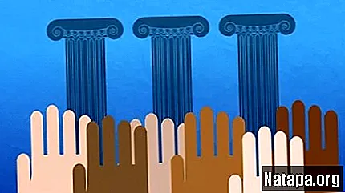
Democracy
1
2020-1-SK01-KA226-SCH-094350

Slide 5
Origins of democracy – in ancient Greece – between 6th – 4th century BC
Democracy – the notion consists of two Greek words:
demos = people,
kratos = to rule
literal translation = "rule of the people".
Democracy – a form of political establishment, that enables the citizens to enjoy the full right to participate in the running of the state.
2020-1-SK01-KA226-SCH-094350

Slide 6
Basic Principles of Democracy
2
2020-1-SK01-KA226-SCH-094350

Slide 7
Basic Principles of Democracy:
Guarantee of basic human rights and civil liberties;
Sovereignty of people;
Government of the majority;
Division of the state power;
Regular free elections;
Right to be part of public administration;
Political pluralism;
Economic pluralism.
2020-1-SK01-KA226-SCH-094350

Slide 8
Forms of Democracy
3
2020-1-SK01-KA226-SCH-094350

Slide 9
Direct democracy – direct attendance in political decision-making.
Forms of direct democracy:
Referendum
Plebiscite
Initiative
Indirect democracy - the citizens take part in decision-making indirectly through chosen officials (deputies).

Slide 10
Teaching Materials
4
2020-1-SK01-KA226-SCH-094350

Slide 11
Teaching Material
1. Democracy
2. Principles of democracy
3. Democratic institutions
4. Democracy – notes
2020-1-SK01-KA226-SCH-094350

Slide 12
Sources:
Bojnák, Š.: Občianska náuka pre stredné školy I. časť. Bratislava: Orbis Pictus Istropolitána, 2018. ISBN 978-80-8120-671-9.
Ďurajková, D. a kol.: Občianska náuka pre 3. ročník gymnázia. Bratislava: SPN, 2011. ISBN 978-80-10-02052-2.
https://oskole.detiamy.sk/clanok/demokracia
2020-1-SK01-KA226-SCH-094350

Slide 13
EN The European Commission's support for the production of this publication does not constitute an endorsement of the contents, which reflect the views only of the authors, and the Commission cannot be held responsible for any use which may be made of the information contained therein.
SK Podpora Európskej komisie na výrobu tejto publikácie nepredstavuje súhlas s obsahom, ktorý odráža len názory autorov, a Komisia nemôže byť zodpovedná za prípadné použitie informácií, ktoré sú v nej obsiahnuté.
2020-1-SK01-KA226-SCH-094350

