Slide 1
Digi School CHEMISTRY – Factors Influencing the Speed of Reactions
2020-1-SK01-KA226-SCH-094350

Slide 2
SUBJECT: CHEMISTRY
SPECIFICATION: th STEM method
AGE GROUP: 12-13
1 LESSON: 45 min
2020-1-SK01-KA226-SCH-094350

Slide 3
CONTENTS
01
Concentration,
Temperature and Surface Area
02
Catalyst and Inhibitor
03
Teaching Materials
2020-1-SK01-KA226-SCH-094350

Slide 4
Concentration, Temperature and Surface Area
1
2020-1-SK01-KA226-SCH-094350

Slide 5
BASIC INFORMATION
With a higher concentration in a certain volume the number of reacting particles increases, so for a time the number of colliding particles increases, too. Under these circumstances the reaction will become faster.
With a higher temperature the particles have a higher energy and move faster, so the speed of the reaction will increase.
With an increasing surface area the number of reacting particles increases, too. That causes a higher number of collisions and so the with a larger surface, the reaction will be faster.
2020-1-SK01-KA226-SCH-094350

Slide 6
Catalysts and Inhibitors
2
2020-1-SK01-KA226-SCH-094350

Slide 7
BASIC INFORMATION
A catalyst is a chemical substance that increases the speed of a reaction. It remains unchanged at the end of the reaction. For example, manganese dioxide is used when decomposing hydrogen peroxide. In a chemical equation, the catalyst is written above the arrow.
An inhibitor is a substance that slows down a chemical reaction. For example, they are used in food industry to prolong the shelf life of food.
2020-1-SK01-KA226-SCH-094350

Slide 8
Teaching Materials
3
2020-1-SK01-KA226-SCH-094350

Slide 9
GENERAL INFORMATION
Students make teams of 2 – 4.
Their order is picked randomly.
The teacher plays the video with the experiment.
The teacher shares the wordsearch activity and the teams look for as many words as they can find.
The highest scoring team wins.
2020-1-SK01-KA226-SCH-094350

Slide 10
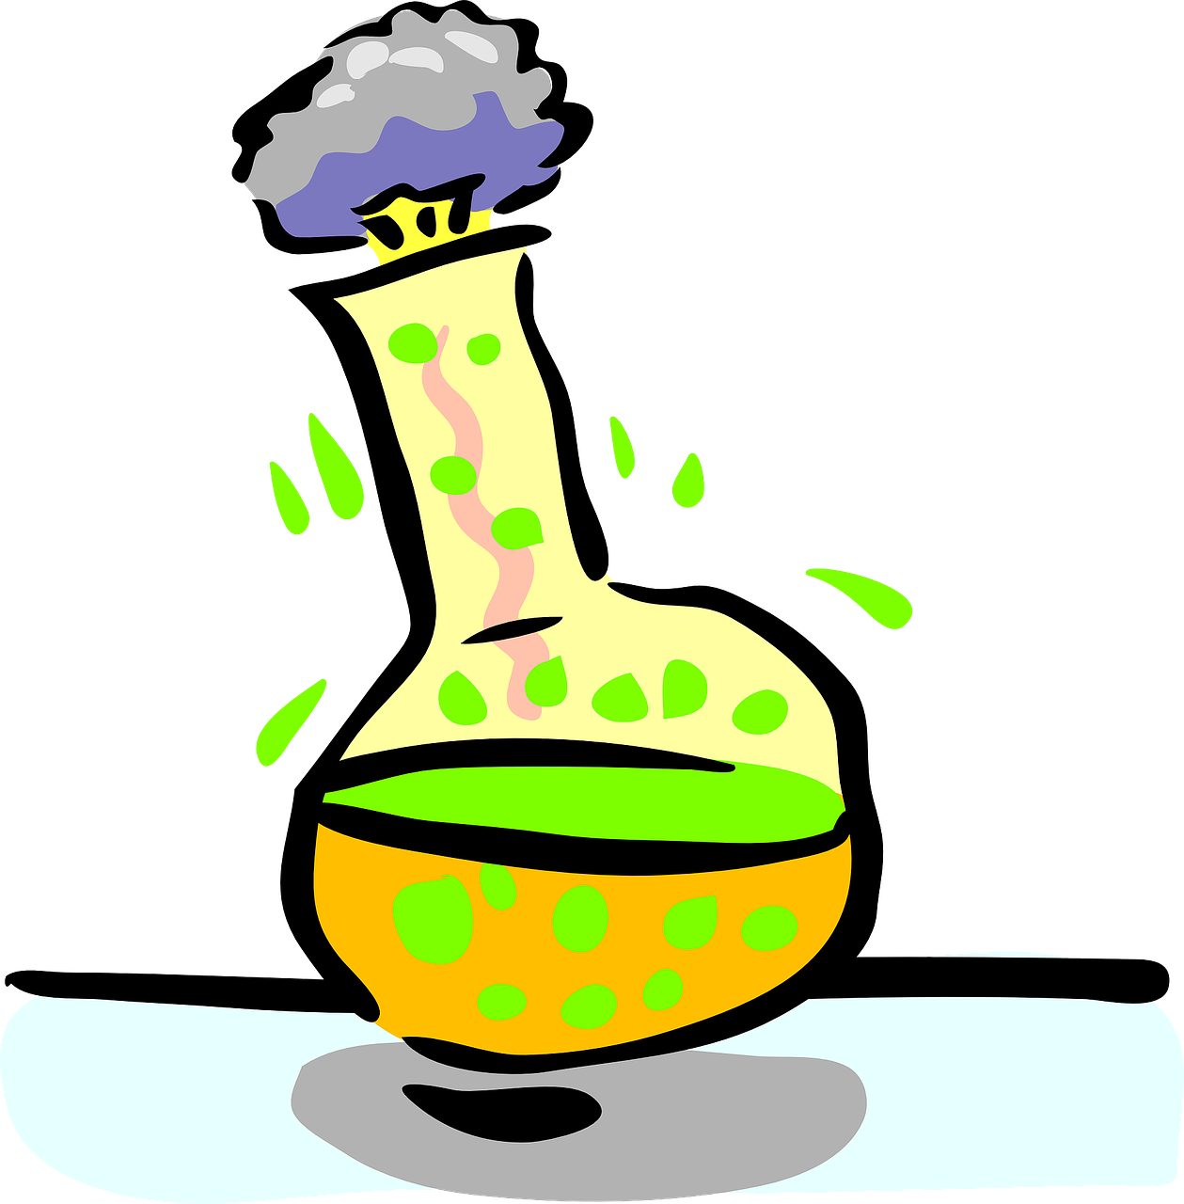
TEACHING MATERIALS
2020-1-SK01-KA226-SCH-094350

Slide 11
SOURCES
H. Vicenová, M. Ganajová: Chémia pre 7. ročník základnej školy a 2. ročník gymnázia s osemročným štúdiom ISBN 978-80-8091-427-1
2020-1-SK01-KA226-SCH-094350

Slide 12
EN The European Commission's support for the production of this publication does not constitute an endorsement of the contents, which reflect the views only of the authors, and the Commission cannot be held responsible for any use which may be made of the information contained therein.
SK Podpora Európskej komisie na výrobu tejto publikácie nepredstavuje súhlas s obsahom, ktorý odráža len názory autorov, a Komisia nemôže byť zodpovedná za prípadné použitie informácií, ktoré sú v nej obsiahnuté.
2020-1-SK01-KA226-SCH-094350

