Slide 1
Digi School BIOLOGY – CIRCULATORY SYSTEM
2020-1-SK01-KA226-SCH-094350

Slide 2
SUBJECT: BIOLOGY SEMINAR
SPECIFICATION: Circulatory System
AGE GROUP: 18-19
1 LESSON : 45 min
2020-1-SK01-KA226-SCH-094350

Slide 3
Or use diagrams to explain complex ideas
01
Parts and Functions of the Circulatory System
02
Blood vessels
03
Blood Circulation
04
Teaching Materials
2020-1-SK01-KA226-SCH-094350

Slide 4
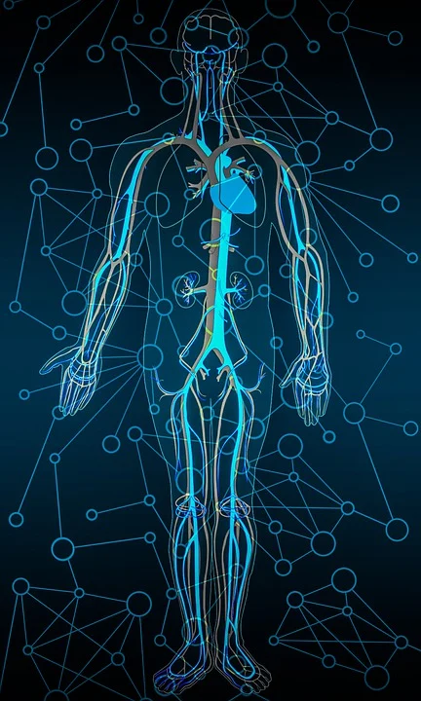
Parts and Functions of the Circulatory System
1
2020-1-SK01-KA226-SCH-094350

Slide 5
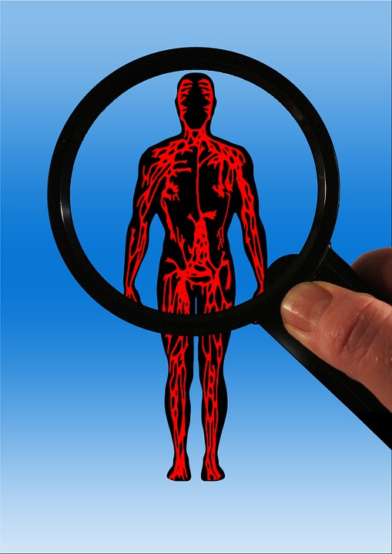
BASIC INFORMATION
Provides blood circulation
The main parts are:
1. heart
2. blood vessels
3. blood
2020-1-SK01-KA226-SCH-094350

Slide 6
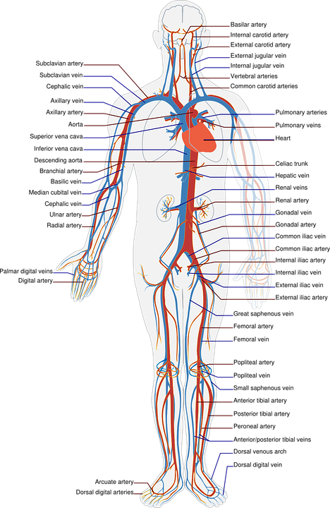
Blood Vessels
2
2020-1-SK01-KA226-SCH-094350

Slide 7
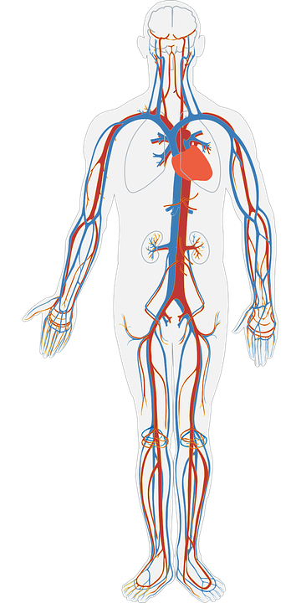
BASIC INFORMATION
A closed system of tubes
Have three layers
Three types by function:
1. arteries
2. veins
3. capillaries
2020-1-SK01-KA226-SCH-094350

Slide 8
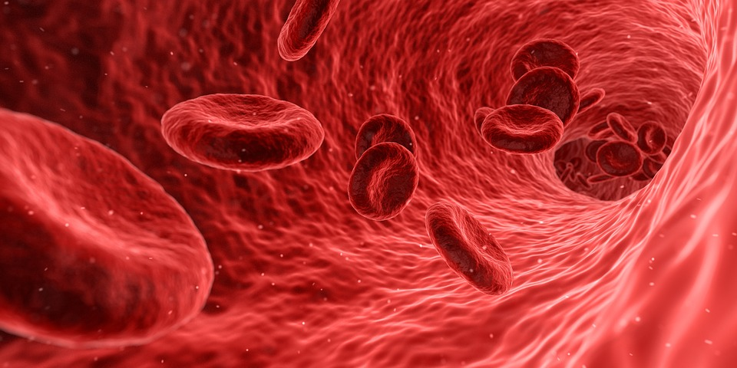
Blood Circulation
3
2020-1-SK01-KA226-SCH-094350

Slide 9
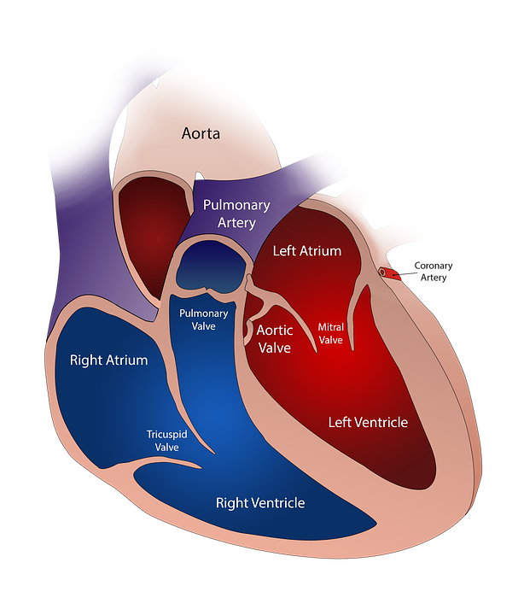
BASIC INFORMATION
Divided into 2 types:
1. pulmonary – provides oxygenation of the blood in the lungs
2. systemic – provides oxygen distribution and collecting carbon dioxide
Blood circulation is propelled by the heart
2020-1-SK01-KA226-SCH-094350

Slide 10
Teaching Materials
4
2020-1-SK01-KA226-SCH-094350

Slide 11
BASIC INFORMATION
Students work in groups.
Every group has to do both activities at worldwall.net.
The groups draw lots to determine their order.
Activity 1: They mark the statements true or false. True/False
Activity 2: In the random wheel they answer 4 questions out of 8. Random wheel
The group with the highest score in the shortest time wins.
2020-1-SK01-KA226-SCH-094350

Slide 12
TEACHING MATERIALS
Notes
2020-1-SK01-KA226-SCH-094350

Slide 13
SOURCES
K. Ušáková a kol: Biológia pre gymnáziá 6 ISBN 978-80-8091-110-2
J. Križan: Maturita z biológie ISBN 80-07-01145-5
2020-1-SK01-KA226-SCH-094350

Slide 14
EN The European Commission's support for the production of this publication does not constitute an endorsement of the contents, which reflect the views only of the authors, and the Commission cannot be held responsible for any use which may be made of the information contained therein.
SK Podpora Európskej komisie na výrobu tejto publikácie nepredstavuje súhlas s obsahom, ktorý odráža len názory autorov, a Komisia nemôže byť zodpovedná za prípadné použitie informácií, ktoré sú v nej obsiahnuté.
2020-1-SK01-KA226-SCH-094350

