Slide 1
Digischool Science in English - Welcome to Reality – Laura Collado e Irene Velasco
2020-1-SK01-KA226-SCH-094350

Slide 2
SUBJECT: SCIENCE
SPECIFICATION: in ENGLISH via CLIL method (level in languages)
AGE OF STUDENTS: 11-12
1 LESSON : 45 min
2020-1-SK01-KA226-SCH-094350
2

Slide 3
INTRODUCTION
The objective of this learning unit is to demonstrate how the CLIL methodology could be integrated with Science. By applying this method students would improve their English skills and be better motivated in the learning process.
2020-1-SK01-KA226-SCH-094350
3

Slide 4
CONTEXTUALIZATION AND JUSTIFICATION
This learning will be implemented in Nuestra Señora del Rosario school located in Valencia, Spain.
It has been designed for a Primary 6 class of 25 students and will be lead by two teachers.
The unit is included in this course because students at this level have the necessary skills to understand abstract content. It will be taught at the end of the second term, and the content will be taken from the second block of the Science subject, titled "The Human Body and Health”.
2020-1-SK01-KA226-SCH-094350
4

Slide 5
OBJECTIVES
To provide tools for the students to develop their skills in the search for information.
To create a good atmosphere where students can interact with each other and encourage cooperative learning.
To improve linguistic competence by combining the learning of Science with the learning of the English language.
2020-1-SK01-KA226-SCH-094350
5

Slide 6
KEY COMPETENCES
01
Lingüistic Communication
02
Digital
03
Learning to learn
04
Social and civic
2020-1-SK01-KA226-SCH-094350
6

Slide 7
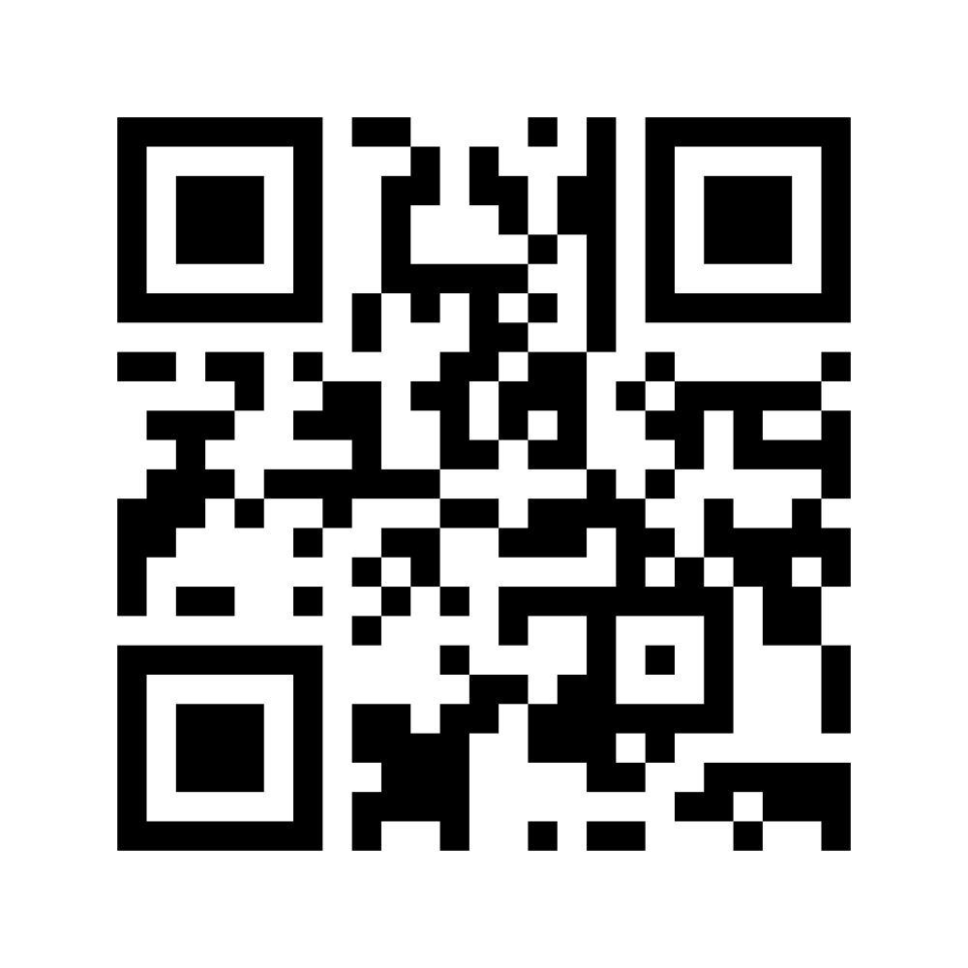
BODYPARTS
LESSON 1
2020-1-SK01-KA226-SCH-094350
7

Slide 8
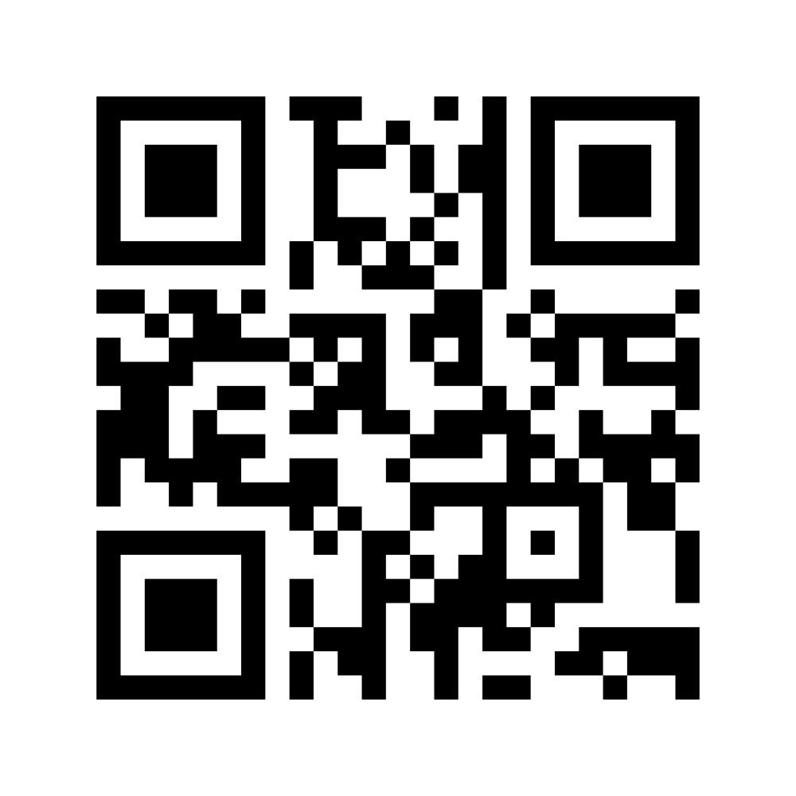
DIGESTIVE SYSTEM
CLICK HERE
https://www.youtube.com/watch?v=js06sdAV2-8
LESSON 2
2020-1-SK01-KA226-SCH-094350
8

Slide 9
RESPIRATORY SYSTEM
LESSON 3
Annex 2
2020-1-SK01-KA226-SCH-094350
9

Slide 10
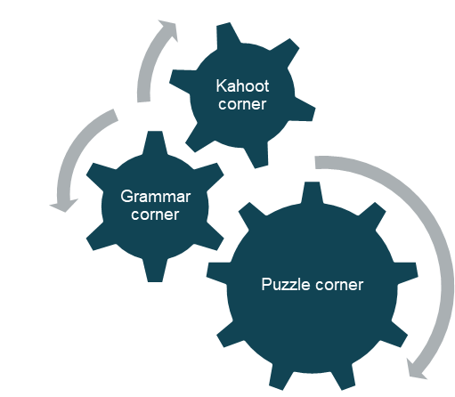
CIRCULATORY AND EXCRETORY SYSTEM
LESSON 4 and 5
2020-1-SK01-KA226-SCH-094350
10

Slide 11
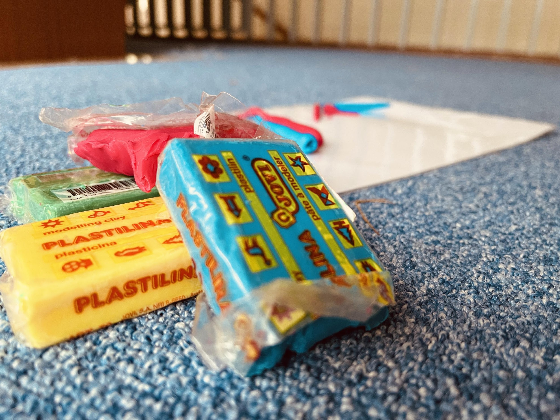
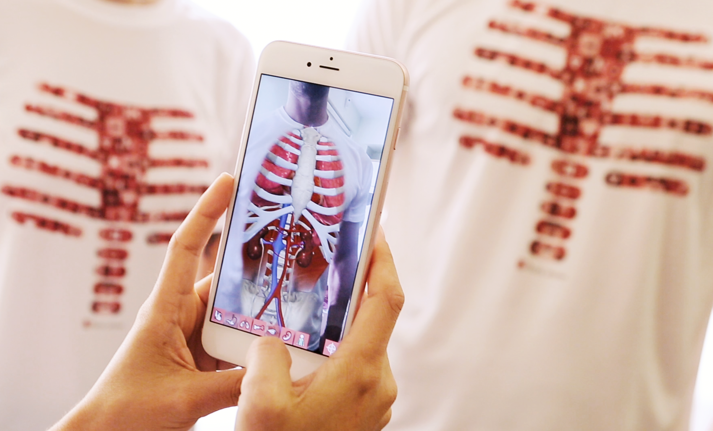
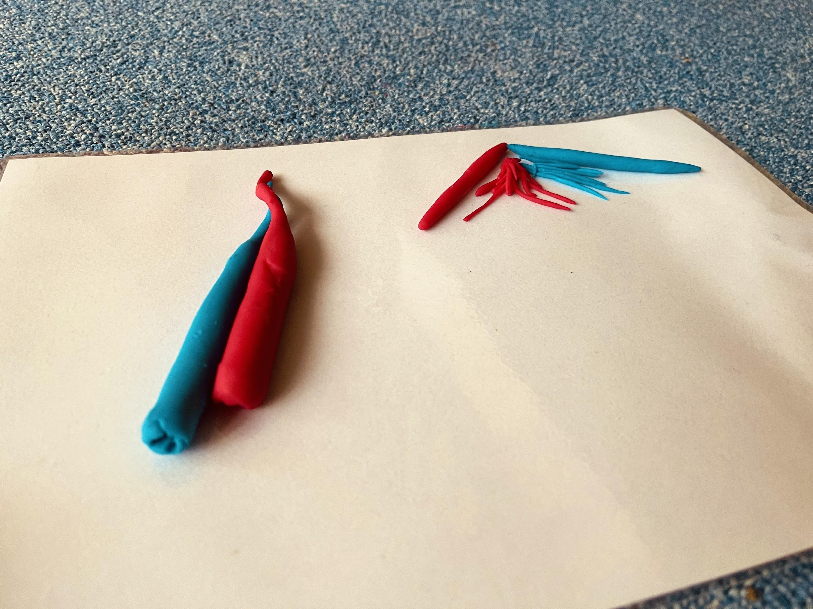
PLAYDOUGH CORNER
KAHOOT CORNER
Link Kahoot
AUGMENTED REALITY CORNER

Slide 12
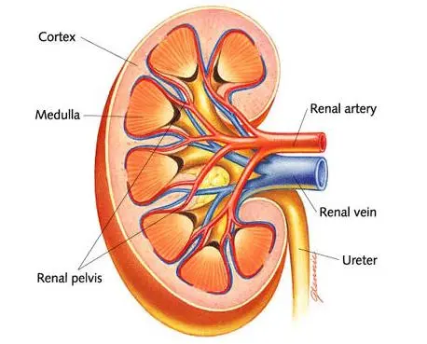
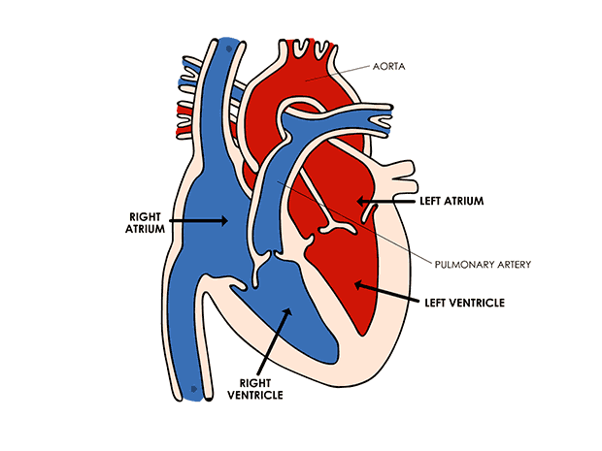
PUZZLE CORNER
GRAMMAR CORNER
“The heart is bigger than the kidneys”.

Slide 13
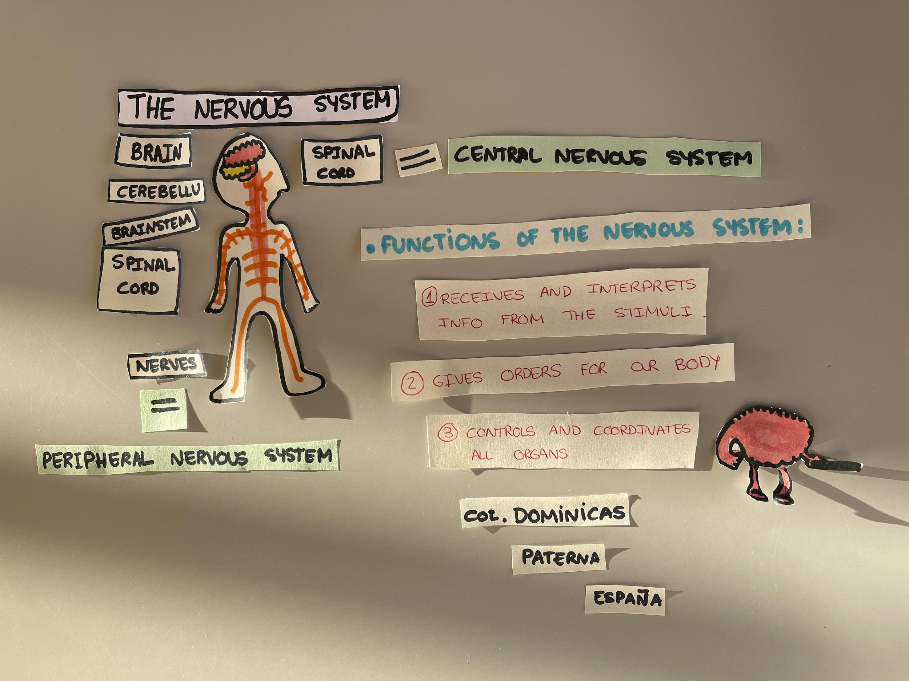
NERVOUS SYSTEM
CLICK HERE
https://www.youtube.com/watch?v=Hn4VkgQH1WQ
LESSON 6
2020-1-SK01-KA226-SCH-094350
13

Slide 14
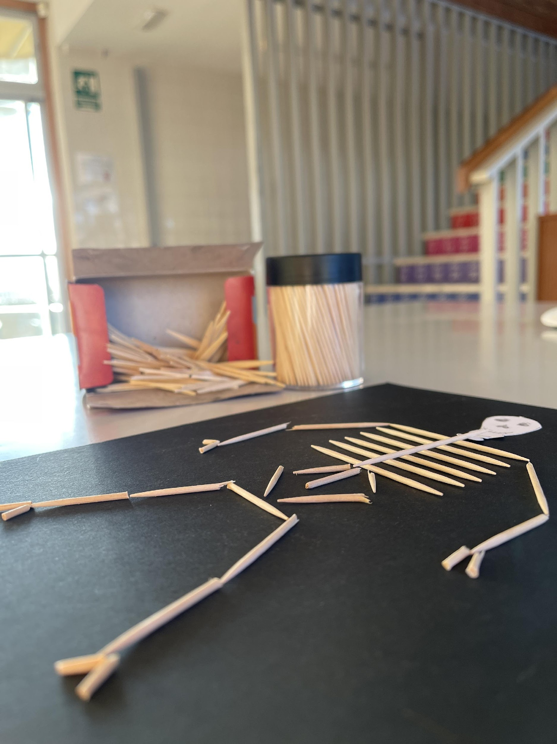
SKELETON SYSTEM
CLICK HERE
https://www.youtube.com/watch?v=3h8E8Y9omYY
LESSON 7
“CREATE YOUR OWN SKELETON SYSTEM USING STICKS”
2020-1-SK01-KA226-SCH-094350
14

Slide 15
MUSCULAR SYSTEM
CLICK HERE
LESSON 8
https://www.youtube.com/watch?v=npq410SvImk
https://www.youtube.com/watch?v=npq410SvImk
2020-1-SK01-KA226-SCH-094350
15

Slide 16
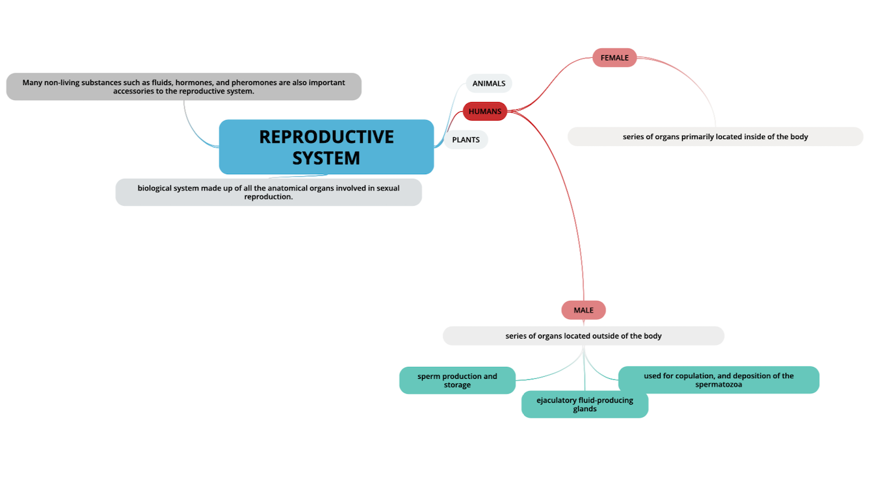
REPRODUCTIVE SYSTEM
LESSON 9
2020-1-SK01-KA226-SCH-094350
16

Slide 17
FINAL TASK
LESSON 10
2020-1-SK01-KA226-SCH-094350
17

Slide 18
R E S O U R C E S
PÁGS WEB + APPS MATERIALS
QR Generator
Mentimeter
Toothpicks
Cardboards
Markers
Google images
Kahoot
Playdough
2020-1-SK01-KA226-SCH-094350
18

