Slide 1
Digi School Ethics Etiquette, Business Etiquette – History, Importance, Greetings, Addressing, Introducing
2020-1-SK01-KA226-SCH-094350

Slide 2
Etiquette, Business Etiquette – History, Importance, Greetings, Addressing, Introducing
SUBJECT: Ethics
SPECIFICATION: Etiquette, Business Etiquette – History, Importance, Greetings, Addressing, Introducing
AGE GROUP: 14-15
1 LESSON: 45 min
2020-1-SK01-KA226-SCH-094350

Slide 3
CONTENTS
01
Etiquette, History, Importance
02
Etiquette- Greeting, Addressing, Introducing
03
Business Etiquette
04
TEACHING MATERIALS
2020-1-SK01-KA226-SCH-094350

Slide 4
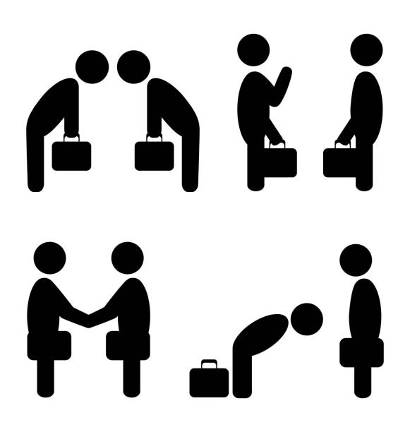
Etiquette
1
History, and importance
2020-1-SK01-KA226-SCH-094350

Slide 5
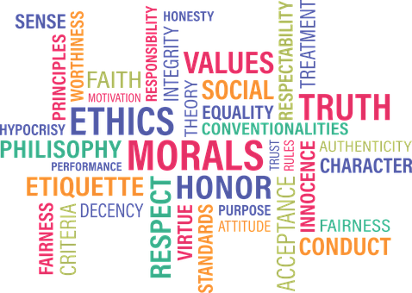
BASIC INFORMATION
The word etiquette originates from old French „estiquer“,
its predecessor was the old German „stehen“,
Both words have similar meaning – label, message board,
describes what is suitable and what is not.
2020-1-SK01-KA226-SCH-094350

Slide 6
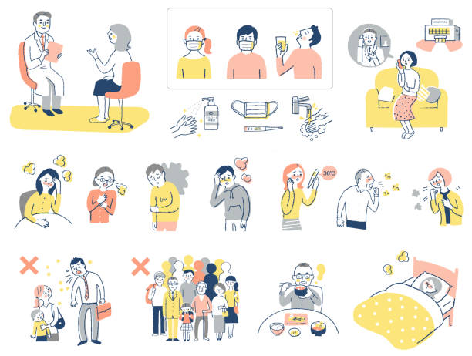
BASIC INFORMATION
Etiquette is a compilation of historically created and traditionally fixed rules of behaviour.
2020-1-SK01-KA226-SCH-094350

Slide 7
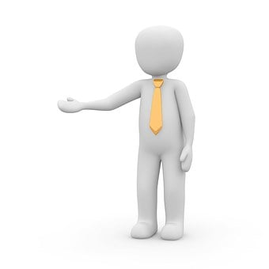
BASIC INFORMATION
The court of the King Louis XIV (1643-1715), known as the Sun King, is considered the cradle of etiquette.
King Louis XIV introduced the seating order,
The tie became a part of men´s attire.
2020-1-SK01-KA226-SCH-094350

Slide 8
Etiquette
2
Greeting, addressing, introducing
2020-1-SK01-KA226-SCH-094350

Slide 9
GENERAL INFORMATION
Greeting:
During the greeting we look into the eyes, or we look at least at the person that we greet.
Our greeting should be clear and not partial
At the working place the subordinate always greets the superior regardless of the age.
2020-1-SK01-KA226-SCH-094350

Slide 10
GENERAL INFORMATION
Greeting:
The one wholeaves the working place greets first,
Sitting man always stands up,
Woman may remain seated,
The one aproaching a group of people always greets first.
2020-1-SK01-KA226-SCH-094350

Slide 11
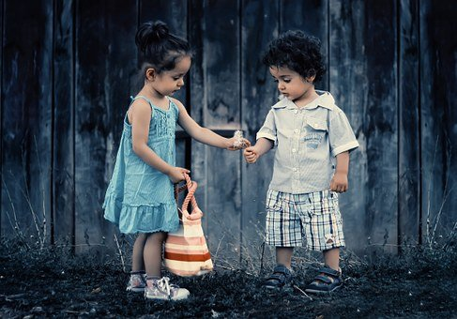
GENERAL INFORMATION
Addressing:
Mister, Missis, Miss – only people that we don´t know, i.e., those we haven´t been introduced to
In other cases, we either add the academic title, function or surname
Calling someone Miss is not used in business etiquette in majority of European countries.
2020-1-SK01-KA226-SCH-094350

Slide 12
GENERAL INFORMATION
Introducing is not necessary:
If every participant knows everybody,
When askin for simple information,
When providing some sort of help,
When a larger group is gathered.
2020-1-SK01-KA226-SCH-094350

Slide 13
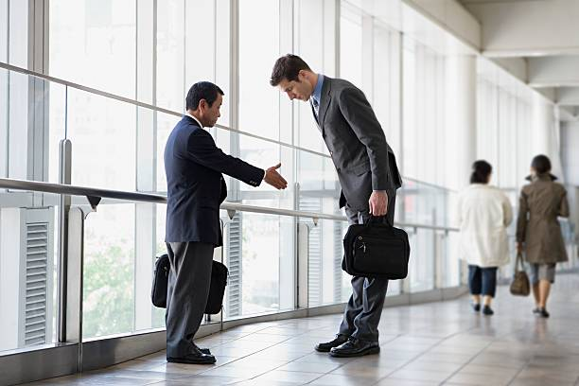
Business Etiquette
3
.
2020-1-SK01-KA226-SCH-094350

Slide 14
GENERAL INFORMATION
Business etiquette:
States the rules that should be followed during a successful business meeting,
Has different rules than the social etiquette
2020-1-SK01-KA226-SCH-094350

Slide 15
Teaching Materials
4
2020-1-SK01-KA226-SCH-094350

Slide 16
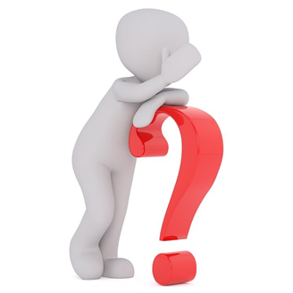
TEACHING MATERIALS
<
Etiquette, business etiquette – history, importance, greeting, addressing, introducing
2020-1-SK01-KA226-SCH-094350

Slide 17
INTERACTIVE EXERCISES
<
Students create teams (2 – 4).
In wordwall they will check the rules about introducing and greeting
2020-1-SK01-KA226-SCH-094350

Slide 18
INTERACTIVE EXERCISES
<
Students create teams (2 – 4).
In wordwalle they will put the sentences about greeting, addressing, and introducing in the right order.
2020-1-SK01-KA226-SCH-094350

Slide 19
SOURCES
https://dress-sk.techinfus.com/etiket/istoriya/
Bódis, A, Štubňová,B: Nie som barbar. Etiketa pre každého. Bratislava: ISBN 978- 80 – 8170 – 033 -0
Borec, T: Moderná biznis etiketa pre manažérov: ISBN 978 – 80 – 969817 – 6 -2

Slide 20
EN The European Commission's support for the production of this publication does not constitute an endorsement of the contents, which reflect the views only of the authors, and the Commission cannot be held responsible for any use which may be made of the information contained therein.
SK Podpora Európskej komisie na výrobu tejto publikácie nepredstavuje súhlas s obsahom, ktorý odráža len názory autorov, a Komisia nemôže byť zodpovedná za prípadné použitie informácií, ktoré sú v nej obsiahnuté.
2020-1-SK01-KA226-SCH-094350

