Slide 1
Digi School Ethics Etiquette, Business Etiquette– Table Manners
2020-1-SK01-KA226-SCH-094350

Slide 2
Etiquette, Business Etiquette– Table Manners
SUBJECT: Ethics
SPECIFICATION: Etiquette, Business Etiquette – Table Manners
AGE GROUP: 14-15
1 LESSON: 45 min
2020-1-SK01-KA226-SCH-094350

Slide 3
CONTENTS
01
History and Importance of Etiquette
02
Table Manners
03
Business Etiquette
04
TEACHING MATERIALS
2020-1-SK01-KA226-SCH-094350

Slide 4
Etiquette
1
History and importance of etiquette
2020-1-SK01-KA226-SCH-094350

Slide 5
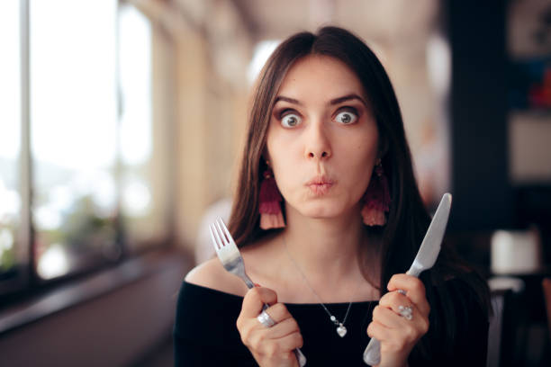
BASIC INFORMATION
Etiquette is a compilation of historically created and traditionally fixed rules of behaviour. Those are the rules of courtesy adopted in particular society.
Etiquette can be significantly different depending on specific era and cultural background.
2020-1-SK01-KA226-SCH-094350

Slide 6
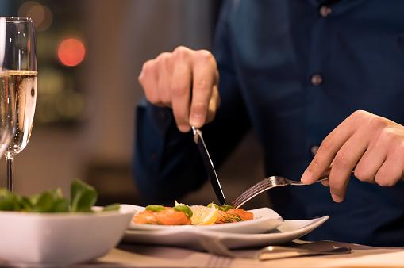
Table Manners
2
2020-1-SK01-KA226-SCH-094350

Slide 7
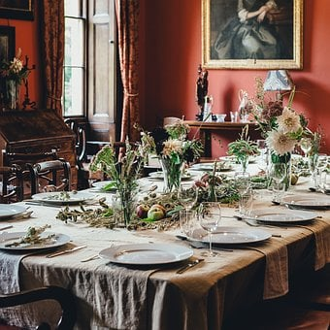
BASIC INFORMATION
Setting of the dining table:
The right formal table manners mean a clean and sufficiently large space with the right number of chairs
We recognize for example French and English seating plans
To the right-hand side of the male host the most important female guest is seated,
To the right-hand side of the hostess the main male guest is seated
The more important is the guest, the closer he is seated to the hosts.
2020-1-SK01-KA226-SCH-094350

Slide 8
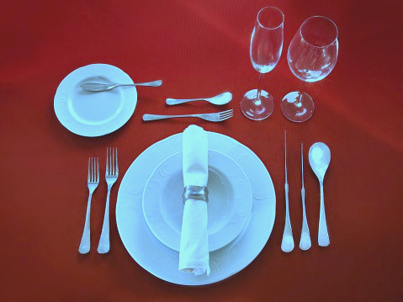
BASIC INFORMATION
Placement of the dishes on the table:
On a large shallow plate for the main course, we put a deep plate for soup.
Left from the plates the forks are placed, the largest being closest to the plate
We place a large knife to the right from the plates, sharp edge turned to the plate, an appetizer knife and a spoon bottom down. Right in this order.
2020-1-SK01-KA226-SCH-094350

Slide 9
BASIC INFORMATION
Placement of the dishes on the table:
Above the main plate on the left, there should be a small plate for the pastries with appropriate cutlery and to its right there should be the glasses
Left from the plates the forks are placed, the largest being closest to the plate
Paper or fabric napkins can be placed directly on the plates or next to the forks.
2020-1-SK01-KA226-SCH-094350

Slide 10
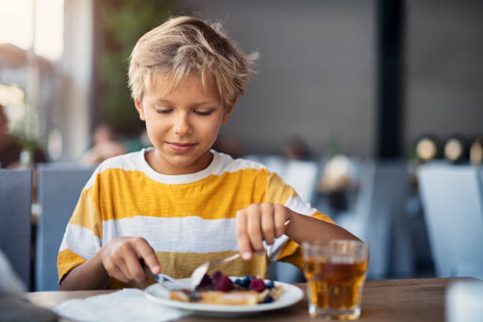
BASIC INFORMATION
Basic rules while dining:
We don´t swing on the chair, don´t go under the table, don´t kick the neighbours,
We don´t make sounds with our mouths while eating, we don’t burp
Our elbows are placed next to us, not on the table
We start eating together, when the host says “enjoy your meal”
2020-1-SK01-KA226-SCH-094350

Slide 11
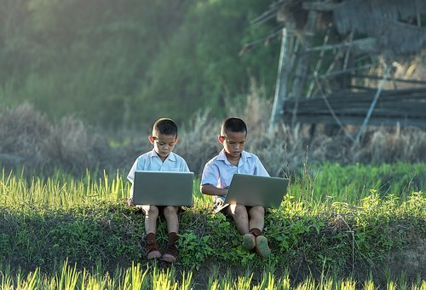
Business Etiquette
3
.
2020-1-SK01-KA226-SCH-094350

Slide 12
GENERAL INFORMATION
Rules of the business etiquette:
The host sits at the head of the table, opposing him or to the right-hand side of him sits the guest of honour – business partner of the highest ranking
The host doesn´t say anything before the meal, the host grabs the cutlery, can add a smile, nods his head.
During a business lunch or dinner, it is inappropriate to stand up, except when it is inevitable
In business etiquette the rule applies that who invites is also the one who pays
2020-1-SK01-KA226-SCH-094350

Slide 13
Teaching Materials
4
2020-1-SK01-KA226-SCH-094350

Slide 14
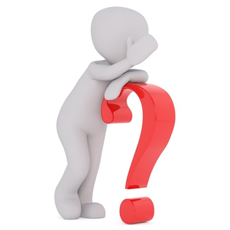
TEACHING MATERIALS
<
Etiquette, business etiquette – table manners
2020-1-SK01-KA226-SCH-094350

Slide 15
INTERACTIVE EXERCISES
<
Students create teams (2 – 4).
In kahoot they do the quiz on table manners
2020-1-SK01-KA226-SCH-094350

Slide 16
INTERACTIVE EXERCISES
<
Students create teams (2 – 4).
In wordwalle they will recognize the table manners.
2020-1-SK01-KA226-SCH-094350

Slide 17
SOURCES
https://dress-sk.techinfus.com/etiket/istoriya/
https://www.pohodo.sk/blog/6_spravne-stolovanie-a-jeho-zasady
Borec, T: Moderná biznis etiketa pre manažérov: ISBN 978 – 80 – 969817 – 6 -2
Bódis, A, Štubňová,B: Nie som barbar. Etiketa pre každého. Bratislava: ISBN 978- 80 – 8170 – 033 -0

Slide 18
EN The European Commission's support for the production of this publication does not constitute an endorsement of the contents, which reflect the views only of the authors, and the Commission cannot be held responsible for any use which may be made of the information contained therein.
SK Podpora Európskej komisie na výrobu tejto publikácie nepredstavuje súhlas s obsahom, ktorý odráža len názory autorov, a Komisia nemôže byť zodpovedná za prípadné použitie informácií, ktoré sú v nej obsiahnuté.
2020-1-SK01-KA226-SCH-094350

