Slide 1


Digi School
Information Technologies – Formulas
2020-1-SK01-KA226-SCH-094350

Slide 2
SUBJECT: IT
SPECIFICATION: Formulas
AGE GROUP: 13-14
1 LESSON : 45 min
2020-1-SK01-KA226-SCH-094350

Slide 3

Or use diagrams to explain complex ideas
01
Formulas
02
Copying Formulas
03
Referencing
04
Teaching Materials
2020-1-SK01-KA226-SCH-094350

Slide 4



Formulas
1
2020-1-SK01-KA226-SCH-094350

Slide 5
BASIC INFORMATION
cell reference – its name according to the column and row in which it lies
the expression of a calculation is called the formula
a formula always begins with the symbol of = (equals).
Mathematical operations of of addition (+), multiplication (*), distraction (-), division (/) and squaring (^) are used
squaring is written by pressing Shift + 6 on an English keyboard
the priority of operations is the same as in mathematics
2020-1-SK01-KA226-SCH-094350

Slide 6
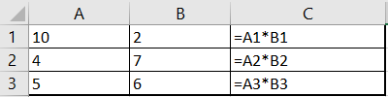
Copying Formulas
2
2020-1-SK01-KA226-SCH-094350

Slide 7
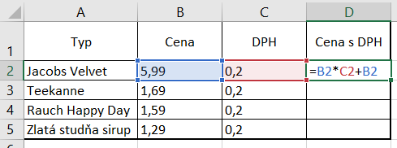
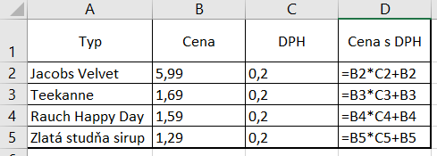
BASIC INFORMATION
automaticky sa upravujú adresy buniek
2020-1-SK01-KA226-SCH-094350

Slide 8

Referencing
3
2020-1-SK01-KA226-SCH-094350

Slide 9
BASIC INFORMATION
relative (e.g., B2, changes when copying)
absolute (e.g., $B$2, does not change when copying)
mixed (e.g., B$2 or $B2, one of the references does not change)
the absolute address is marked by pressing the F4 key
2020-1-SK01-KA226-SCH-094350

Slide 10
Teaching Materials
4
2020-1-SK01-KA226-SCH-094350

Slide 11
TEACHING MATERIALS
Students do the test at Learningapps.
Formulas worksheet.
2020-1-SK01-KA226-SCH-094350

Slide 12

TEACHING MATERIALS
Notes
2020-1-SK01-KA226-SCH-094350

Slide 13

SOURCES
Mgr. Štefan Máté, Informatika pre 7. ročník, 2011
2020-1-SK01-KA226-SCH-094350

Slide 14
EN The European Commission's support for the production of this publication does not constitute an endorsement of the contents, which reflect the views only of the authors, and the Commission cannot be held responsible for any use which may be made of the information contained therein.
SK Podpora Európskej komisie na výrobu tejto publikácie nepredstavuje súhlas s obsahom, ktorý odráža len názory autorov, a Komisia nemôže byť zodpovedná za prípadné použitie informácií, ktoré sú v nej obsiahnuté.
2020-1-SK01-KA226-SCH-094350

