Slide 1
Digi School Information Technologies – History of Computers
2020-1-SK01-KA226-SCH-094350

Slide 2
SUBJECT: IT
SPECIFICATION: History of Computers
AGE GROUP: 12-13
1 LESSON : 45 min
2020-1-SK01-KA226-SCH-094350

Slide 3
Or use diagrams to explain complex ideas
01
First Calculators
02
Predecessors of Computers
03
First Computers
04
Teaching Materials
2020-1-SK01-KA226-SCH-094350

Slide 4
First Calculators
1
2020-1-SK01-KA226-SCH-094350

Slide 5
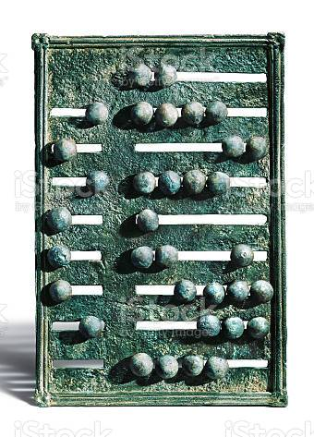
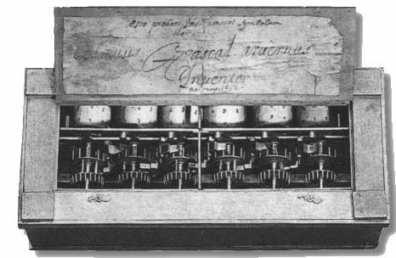
BASIC INFORMATION
Mechanical tools:
abacus
slide ruler
First mechanical calculators:
Schickard’s calculating clock
Pascaline
Leibniz’s calculator
2020-1-SK01-KA226-SCH-094350

Slide 6
Predecessors of Computers
2
2020-1-SK01-KA226-SCH-094350

Slide 7
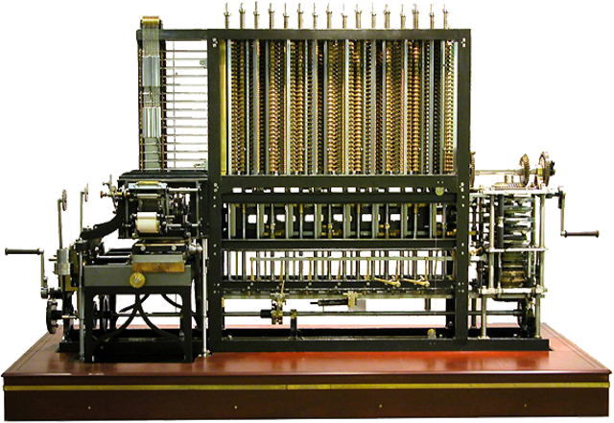
BASIC INFORMATION
Analytical Engine by CH. Babbage (only a design, never fully built)
Electromechanical tabulator by H. Hollerith
First programs designed by Augusta Ada King
2020-1-SK01-KA226-SCH-094350

Slide 8
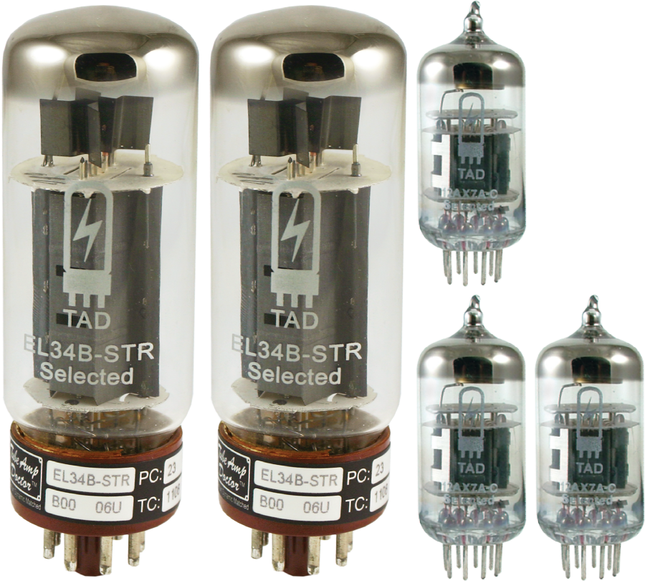
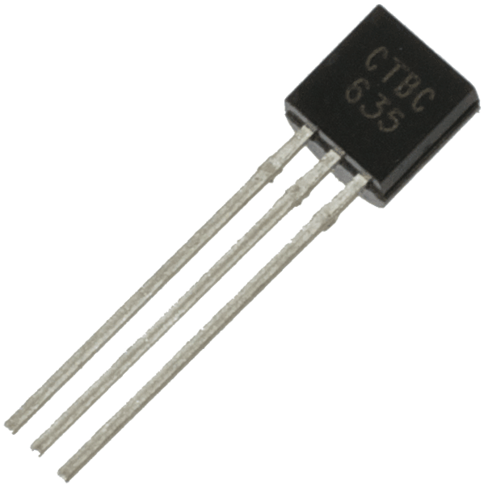
First Computers
3
2020-1-SK01-KA226-SCH-094350

Slide 9
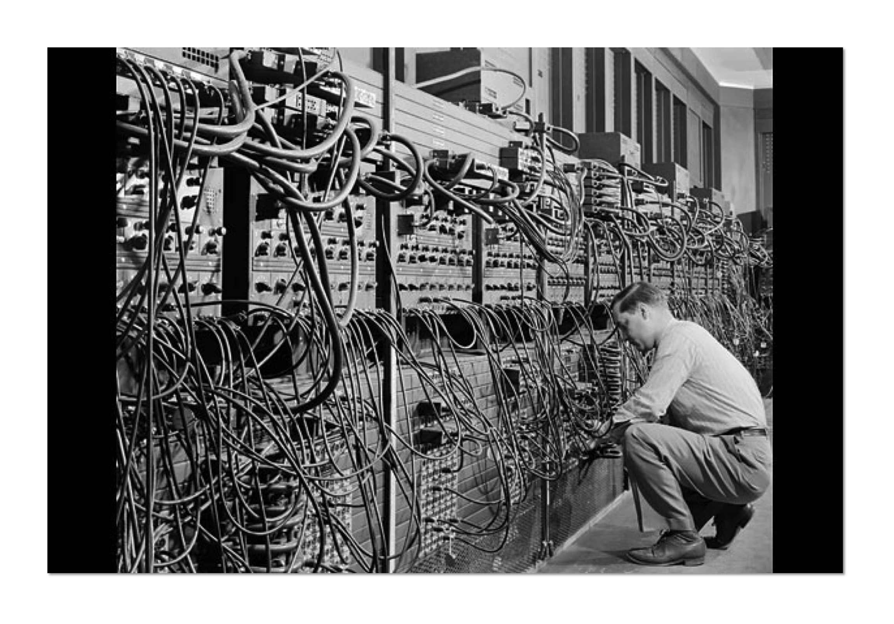
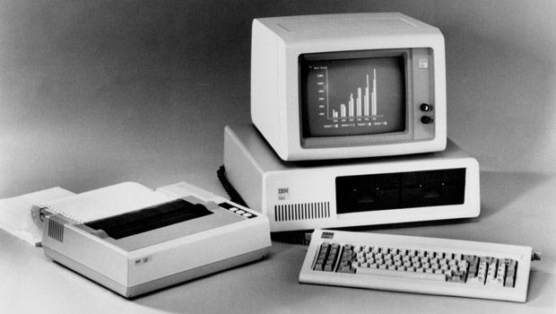
BASIC INFORMATION
Z1 – first programmable computer
Mark I - relays (inductors and switches) as a building block
ENIAC – electronic computer
IBM 701 – transistors as building blocks
integrated circuits bring computers as we know them today
2020-1-SK01-KA226-SCH-094350
https://tech.sme.sk/c/2843860/prvy-pocitac-predstavila-spolocnost-ibm-pred-25-rokmi.html

Slide 10
Teaching Materials
4
2020-1-SK01-KA226-SCH-094350

Slide 11
TEACHING MATERIALS
To revise, students do:
the matching activity at LearningApps
the missing word activity at Wordwalle
2020-1-SK01-KA226-SCH-094350

Slide 12
TEACHING MATERIALS
Notes
2020-1-SK01-KA226-SCH-094350

Slide 13
SOURCES
Kalaš, I. – Winczer, M,: Tvorivá informatika Informatika okolo nás,Slovenské pedagogické nakladateľstvo, 2007, ISBN 978-80-10-00887-2
https://sites.google.com/site/rosicova/studijne-materialy/hardware/historia-pocitacov-1
2020-1-SK01-KA226-SCH-094350

Slide 14
EN The European Commission's support for the production of this publication does not constitute an endorsement of the contents, which reflect the views only of the authors, and the Commission cannot be held responsible for any use which may be made of the information contained therein.
SK Podpora Európskej komisie na výrobu tejto publikácie nepredstavuje súhlas s obsahom, ktorý odráža len názory autorov, a Komisia nemôže byť zodpovedná za prípadné použitie informácií, ktoré sú v nej obsiahnuté.
2020-1-SK01-KA226-SCH-094350

