Slide 1
Digi School Civics Human Rights Protection
2020-1-SK01-KA226-SCH-094350

Slide 2
Subject: Civics
Specification: Civics Seminar
Age group: 17-19
Lesson: 45 minutes
2020-1-SK01-KA226-SCH-094350

Slide 3
CONTENTS
01
Human Rights Revision
02
Human Rights Protection
03
Teaching Materials
04
Vzdelávacie materiály
2020-1-SK01-KA226-SCH-094350

Slide 4
Human Rights
1
Revision (concerning Slovakia only)
2020-1-SK01-KA226-SCH-094350

Slide 5
Human Rights Protection
2
2020-1-SK01-KA226-SCH-094350

Slide 6
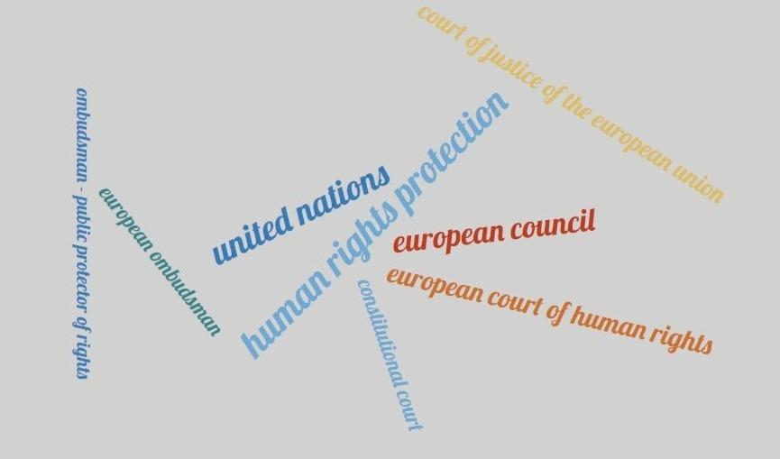
2020-1-SK01-KA226-SCH-094350

Slide 7
Human rights protection is implemented in three stages:
In declarations;
In international resolutions, treaties, pacts, conventions;
Establishment of international organs.
2020-1-SK01-KA226-SCH-094350

Slide 8
Global level of human rights protection:
United Nations
Established: 24 October 1945
Member states: 193
Headquarters: New York, USA
Official web page: http://www.un.org
https://upload.wikimedia.org/wikipedia/commons/thumb/2/2f/Flag_of_the_United_Nations.svg/290px-Flag_of_the_United_Nations.svg.png
2020-1-SK01-KA226-SCH-094350

Slide 9
Regional level of human rights protection:
European Council (1949)
European Court of Human Rights (Strasbourg)
European Court of Justice (Luxembourg)
European Ombudsman
https://zemavek.sk/wp-content/uploads/2021/05/Rada-Europy-e1621640037475.jpg
https://www.sudnarada.gov.sk/data/files/566_echr.gif
https://encrypted-tbn0.gstatic.com/images?q=tbn:ANd9GcTBbfCGMdk9yPOhXFV6Pf332EA3Bx0oreJXOFLNAi1B_FeLbDAG6pAmnR8AgqHq1mxcTUo&usqp=CAU
2020-1-SK01-KA226-SCH-094350

Slide 10
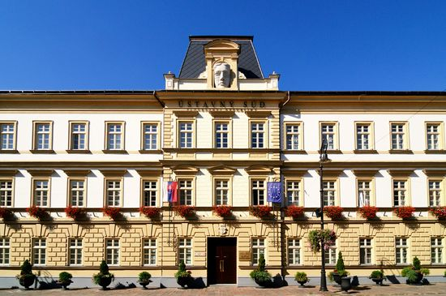
Domestic system of human rights protection:
Controlling mechanisms of political power – police, prosecutor's office, judiciary
Public protector – ombudsman
https://www.ustavnysud.sk/documents/10182/991967/budova.jpg/48273bcd-e867-491b-b9d1-625b073258de?t=1439237650308
2020-1-SK01-KA226-SCH-094350

Slide 11
Teaching Materials
3
2020-1-SK01-KA226-SCH-094350

Slide 12
Teaching Materials
1. Human Rights - revision
2. Human Rights Protection
3. Human Rights - notes
2020-1-SK01-KA226-SCH-094350
https://encrypted-tbn0.gstatic.com/images?q=tbn:ANd9GcQLwPcRt7BkI3LduXJqbUy8ALkxvcv2Jsa-4B76Soo_iFqR-mLumxZl2ooJJnrYRO4U1sE&usqp=CAU

Slide 13
Sources:
Bojnák, Š.: Občianska náuka pre stredné školy I. časť. Bratislava: Orbis Pictus Istropolitána, 2018. ISBN 978-80-8120-671-9.
Ďurajková, D. a kol.: Občianska náuka pre 3. ročník gymnázia. Bratislava: SPN, 2011. ISBN 978-80-10-02052-2.
Vávrová Martinská, A.: Maturita z občianskej náuky. Bratislava: Ikar, 2016. ISBN 978-80-55-15000-0.
https://sk.wikipedia.org/wiki/Organiz%C3%A1cia_Spojen%C3%BDch_n%C3%A1rodov
2020-1-SK01-KA226-SCH-094350

Slide 14
EN The European Commission's support for the production of this publication does not constitute an endorsement of the contents, which reflect the views only of the authors, and the Commission cannot be held responsible for any use which may be made of the information contained therein.
SK Podpora Európskej komisie na výrobu tejto publikácie nepredstavuje súhlas s obsahom, ktorý odráža len názory autorov, a Komisia nemôže byť zodpovedná za prípadné použitie informácií, ktoré sú v nej obsiahnuté.
2020-1-SK01-KA226-SCH-094350

