Slide 1
Modal verbs pt. 2
2020-1-SK01-KA226-SCH-094350 font ARIEL

Slide 2
Subject: English language
Specification: ESL
Level: intermediate
Age of students: 15-16
Lesson length: 45 minutes
2020-1-SK01-KA226-SCH-094350 font ARIEL
‹#›

Slide 3
Theory
1
‹#›

Slide 4
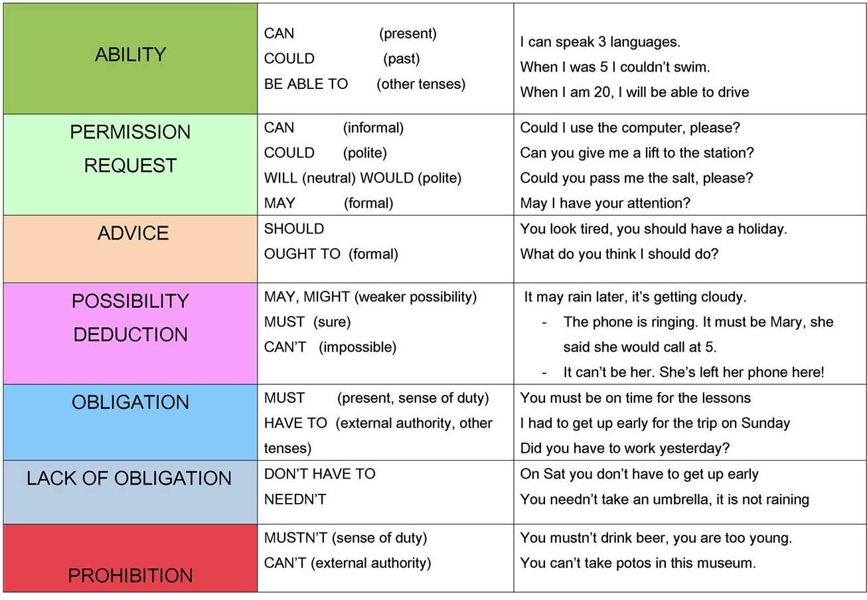
SUMMARY
‹#›

Slide 5
Educational materials
2
‹#›

Slide 6
ACTIVITIES
ART quiz - wordwall
ART - wordwall
MODAL VERBS - wordwall
Modal verbs II - TEST - liveworksheets
‹#›

Slide 7
SOURCES
https://en.islcollective.com/english-esl-worksheets/grammar/modals/modal-verbs-basic-chart/102390
‹#›

Slide 8
EN The European Commission's support for the production of this publication does not constitute an endorsement of the contents, which reflect the views only of the authors, and the Commission cannot be held responsible for any use which may be made of the information contained therein.
SK Podpora Európskej komisie na výrobu tejto publikácie nepredstavuje súhlas s obsahom, ktorý odráža len názory autorov, a Komisia nemôže byť zodpovedná za prípadné použitie informácií, ktoré sú v nej obsiahnuté.
2020-1-SK01-KA226-SCH-094350
‹#›

