Slide 1
Lifestyle Renewal Project
2020-1-SK01-KA226-SCH-094350

Slide 2
The objective of the LifeStyle Renewal Project is to give our students a better understanding of their bodies, and how to take care of them correctly and safely. Also the benefits their bodies can provide them with on a physical, cognitive and social level.
2020-1-SK01-KA226-SCH-094350
2

Slide 3
SUBJECT: BIOLOGY PHYSICAL EDUCATION
SPECIFICATION: in ENGLISH via CLIL method (level in languages)
AGE OF STUDENTS: 12-14
1 LESSON : 45 min
2020-1-SK01-KA226-SCH-094350
3

Slide 4
C O N T E N T
01
BENEFITS OF PHYSICAL ACTIVITY
02
NERVOUS SYSTEM
03
ANAEROBIC ENERGY SYSTEM
04
AEROBIC ENERGY SYSTEM
05
REST AND HEALTH
2020-1-SK01-KA226-SCH-094350
4

Slide 5
C O N T E N T
06
FIRST AID MEASURES
07
RISKS PREVENTION
08
SOCIAL MEDIA AND ME
09
MYTHS I
10
MYTHS II
2020-1-SK01-KA226-SCH-094350
5

Slide 6
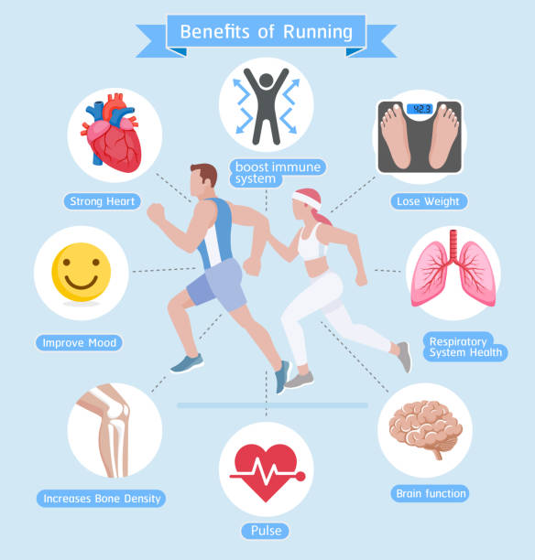
BENEFITS OF
PHYSICAL ACTIVITY
1
Let’s start!
2020-1-SK01-KA226-SCH-094350
6

Slide 7
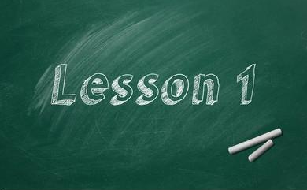
BASIC INFORMATION
General benefits
Unknown benefits
Our brain
The Triune Brain
2020-1-SK01-KA226-SCH-094350
7

Slide 8
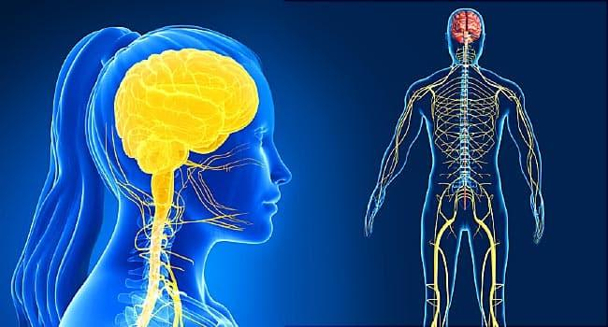
2
Let’s sense!
NERVOUS SYSTEM
2020-1-SK01-KA226-SCH-094350
8

Slide 9
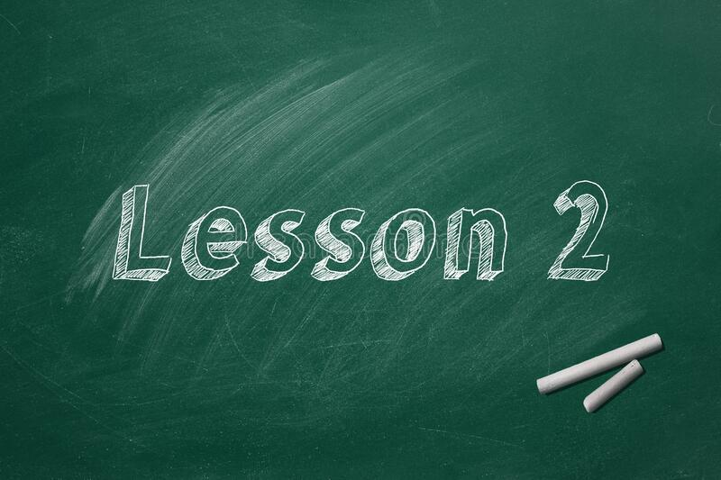
BASIC INFORMATION
Composition
Central Nervous System
How do we receive (get) the information?
How do we process it?
How do we respond to different stimuli?
2020-1-SK01-KA226-SCH-094350
9

Slide 10
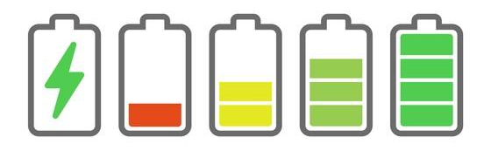
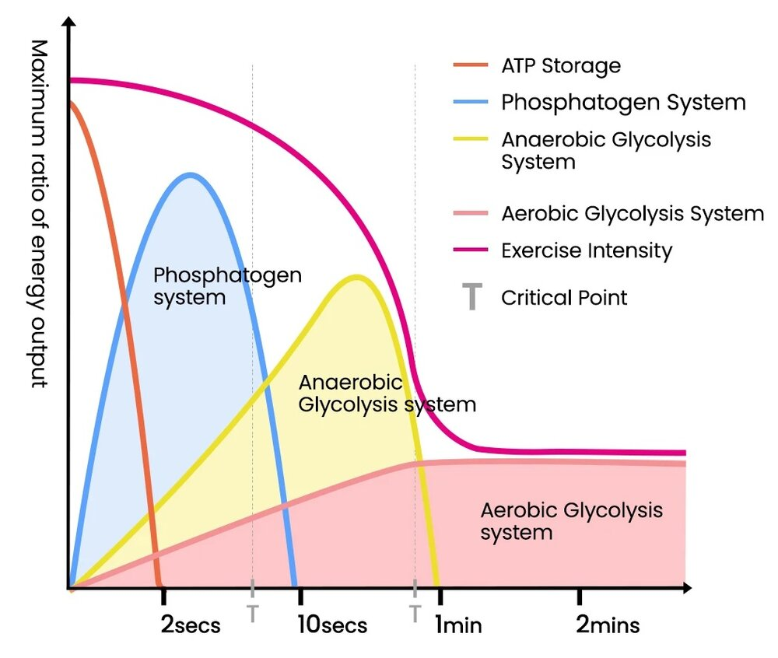
ANAEROBIC SYSTEM
3
Let’s move fast!
2020-1-SK01-KA226-SCH-094350
10

Slide 11
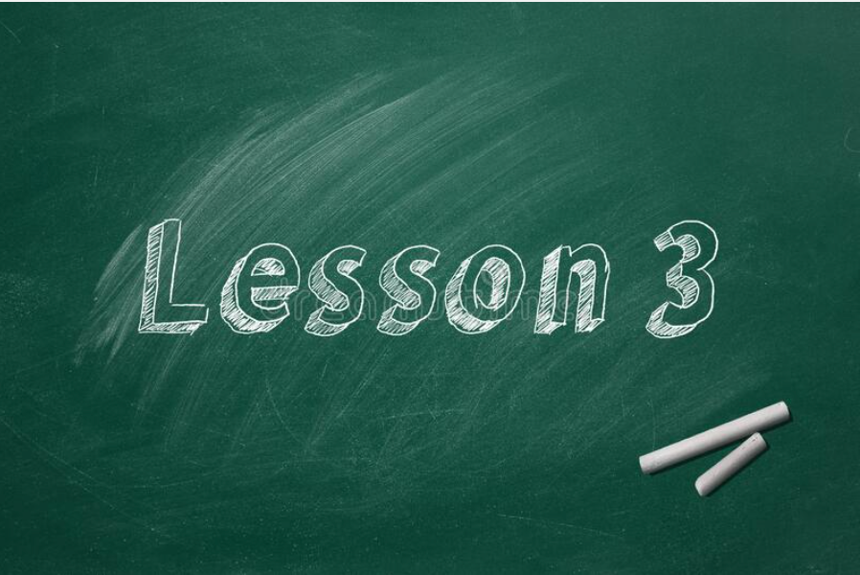
BASIC INFORMATION
Our body needs energy to move
Origin of energy. Sources
Where do we get the energy from?
Practice and reflection
2020-1-SK01-KA226-SCH-094350
11

Slide 12
AEROBIC SYSTEM
4
Let’s move long!
2020-1-SK01-KA226-SCH-094350
12

Slide 13
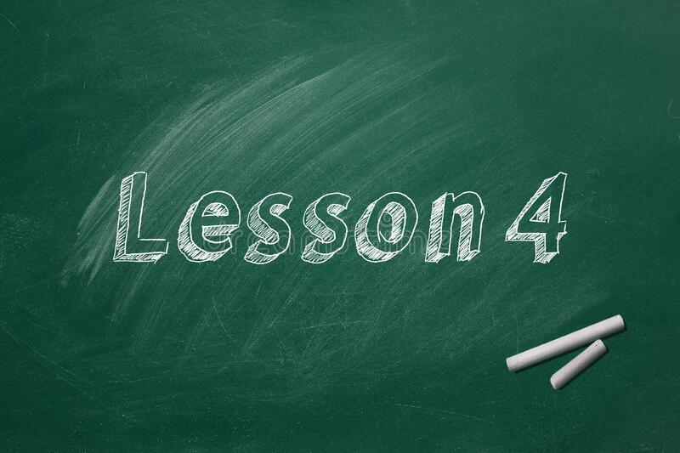
BASIC INFORMATION
Our body needs energy to move
Origin of energy
Where do we get the energy from?
App Strava: Cooperative challenges
2020-1-SK01-KA226-SCH-094350
13

Slide 14
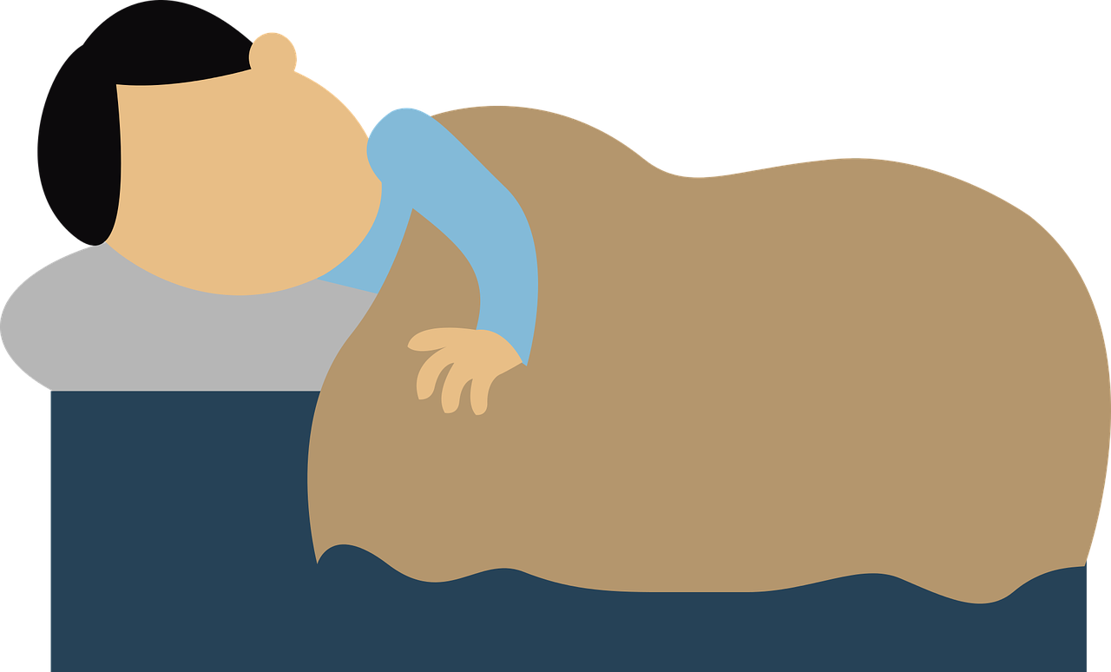
REST AND HEALTH
5
Let’s rest!
2020-1-SK01-KA226-SCH-094350
14

Slide 15
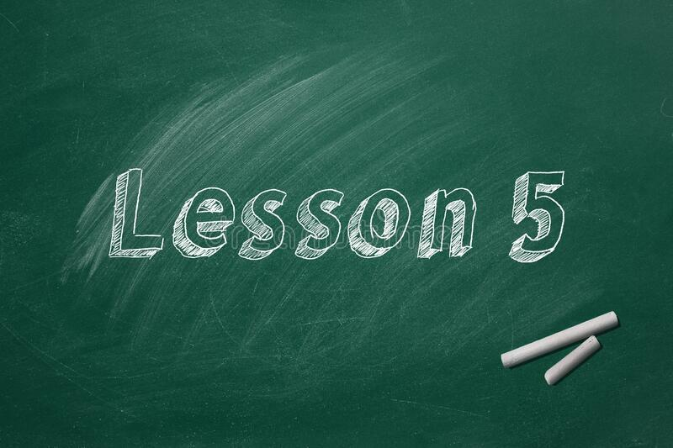
BASIC INFORMATION
Time and quality
Benefits
Contraindications
Sleep well perform better
2020-1-SK01-KA226-SCH-094350
15

Slide 16
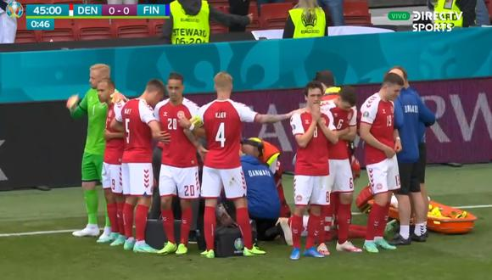
FIRST AID MEASURES
6
Let’s take care of ourselves!
2020-1-SK01-KA226-SCH-094350
16

Slide 17
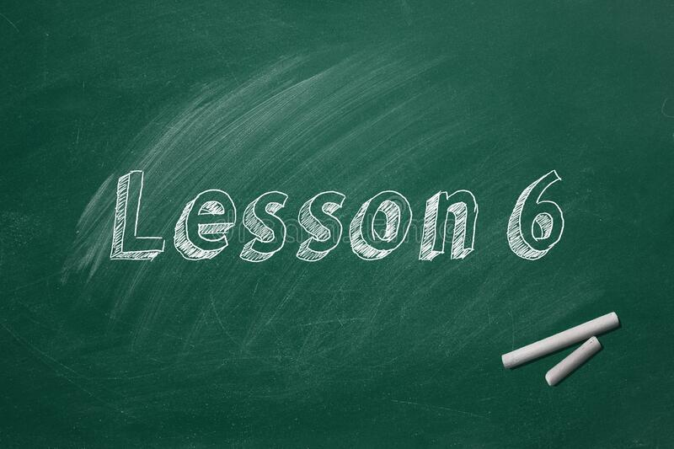
BASIC INFORMATION
Actions and techniques that allow immediate attention
Protocols, protect, advice, aid
Cardiopulmonary resuscitation technique
17
2020-1-SK01-KA226-SCH-094350

Slide 18
RISKS PREVENTION
7
Let’s prevent!
2020-1-SK01-KA226-SCH-094350
18

Slide 19
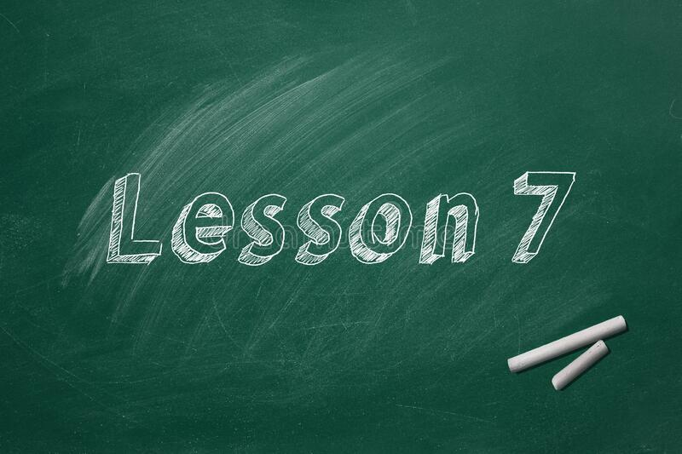
BASIC INFORMATION
What can we do to avoid accidents?
Make students aware of the importance of risk prevention
Safety equipment
Prevention posters
19
2020-1-SK01-KA226-SCH-094350

Slide 20
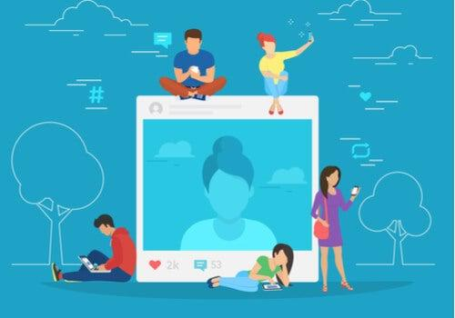
SOCIAL MEDIA AND ME
8
Let’s debate!
2020-1-SK01-KA226-SCH-094350
20

Slide 21
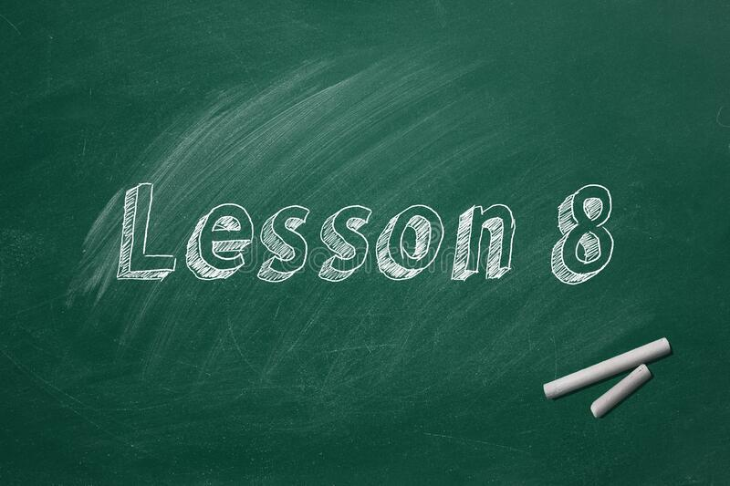
BASIC INFORMATION
Influencers
Social networks
Trends and likes
Beauty ideals
21
2020-1-SK01-KA226-SCH-094350

Slide 22
MYTHS AND FALSE BELIEFS I
9
Let’s make sure!
2020-1-SK01-KA226-SCH-094350
22

Slide 23
BASIC INFORMATION
Sweat
Muscle soreness
Flatus
Health and performance
23
2020-1-SK01-KA226-SCH-094350

Slide 24
MYTHS AND FALSE BELIEFS II
10
Let’s make sure!
2020-1-SK01-KA226-SCH-094350
24

Slide 25
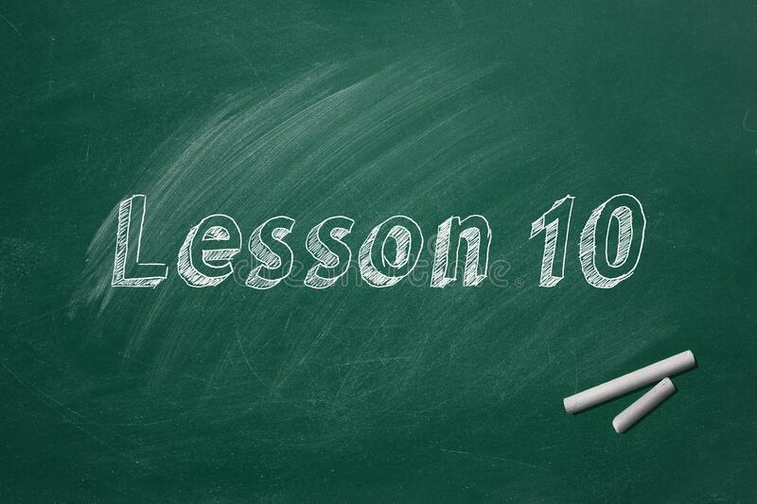
BASIC INFORMATION
Diets
Isotonic drinks
Energy drinks
Diets to lose weight
25
2020-1-SK01-KA226-SCH-094350

Slide 26
EDUCATIONAL MATERIALS
Mobile devices or teenage dream thieves
Teaching program: First aid
Kahoot 1: First aid
Mitos y falsas creencias de la práctica deportiva
2020-1-SK01-KA226-SCH-094350
26

Slide 27
VIDEO RESOURCES:
Video 1: How playing sports benefits your body ... and your brain
Video 2: The Triune Brain In Evolution
Video 3: The Nervous System
Video 4: Energy Systems
Video 5: Más seguidores
2020-1-SK01-KA226-SCH-094350
27

Slide 28
EN The European Commission's support for the production of this publication does not constitute an endorsement of the contents, which reflect the views only of the authors, and the Commission cannot be held responsible for any use which may be made of the information contained therein.
SK Podpora Európskej komisie na výrobu tejto publikácie nepredstavuje súhlas s obsahom, ktorý odráža len názory autorov, a Komisia nemôže byť zodpovedná za prípadné použitie informácií, ktoré sú v nej obsiahnuté.
2020-1-SK01-KA226-SCH-094350
28

