Slide 1
Digi School Civics Law as a System
2020-1-SK01-KA226-SCH-094350

Slide 2
Subject: Civics
Specification: Civics Seminar
Age group: 17-19
Lesson: 45 minutes
2020-1-SK01-KA226-SCH-094350

Slide 3
CONTENT
01
The Law
02
The Legal Norm
03
Legal Regulation
04
Law System
05
Teaching Material
2020-1-SK01-KA226-SCH-094350

Slide 4
The Law
1
2020-1-SK01-KA226-SCH-094350

Slide 5
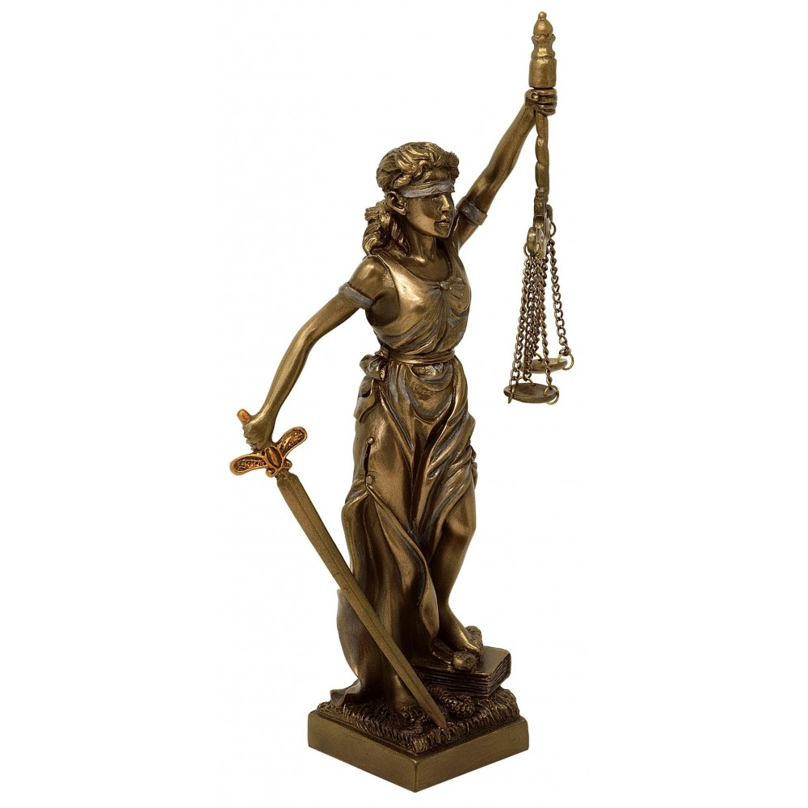
Symbol of law – Iustitia – Roman goddess of justice.
Law – the body of legal norms valid in a specific country.
Features of law:
Monism
State coercion
Form set by the state
2020-1-SK01-KA226-SCH-094350
https://www.pravoshop.sk/wp-content/uploads/2020/03/malaStvorecPodstavec2.jpg

Slide 6
Legal Norm
2
2020-1-SK01-KA226-SCH-094350

Slide 7
Legal norm – basic unit of law.
Features of legal norms:
Obligatory effect
Universality
Effectivity
Normativeness
State coercion
2020-1-SK01-KA226-SCH-094350

Slide 8
Types of legal forms:
Normative
Individual
Constitutive
Declaratory
Validity of a legal norm
Effectiveness of a legal norm
2020-1-SK01-KA226-SCH-094350
https://www.do24hodin.sk/wp-content/uploads/2015/09/paragraf-pod-lupou.jpg

Slide 9
Legal Regulation
3
2020-1-SK01-KA226-SCH-094350

Slide 10
Legal regulation – the body of valid legal norms in a state.
Hierarchy of legal regulations:
Constitution and constitutional laws
Laws and legal measures
Decrees
Ministry decrees and regulations
Mandatory regulations
2020-1-SK01-KA226-SCH-094350

Slide 11
Legal System
4
2020-1-SK01-KA226-SCH-094350

Slide 12
Legal system – it comprises valid legal norms, that form the individual legal branches.
International law
Law
Public law
Domestic law
Private law
2020-1-SK01-KA226-SCH-094350

Slide 13
Teaching Material
5
2020-1-SK01-KA226-SCH-094350

Slide 14
Teaching material
1. Symbol of the law
2. Legal norm I.
3. Legal norm II.
4. Legal regulation
5. System of the law
6. Law as a system - revision
7. Law as a system - notes
https://encrypted-tbn0.gstatic.com/images?q=tbn:ANd9GcR5xfr_RR_OQr3yiZrrPFVd9Zri_nor1GcX2IEHBn8hiU11n0zi4ZYJE9tlYsFbTARY0_Q&usqp=CAU
2020-1-SK01-KA226-SCH-094350

Slide 15
Sources:
Bojnák, Š.: Občianska náuka pre stredné školy I. časť. Bratislava: Orbis Pictus Istropolitána, 2018. ISBN 978-80-8120-671-9.
Ďurajková, D. a kol.: Občianska náuka pre 3. ročník gymnázia. Bratislava: SPN, 2011. ISBN 978-80-10-02052-2.
Vávrová Martinská, A.: Maturita z občianskej náuky. Bratislava: Ikar, 2016. ISBN 978-80-55-15000-0.
https://oskole.detiamy.sk/clanok/pravny-system
2020-1-SK01-KA226-SCH-094350

Slide 16
EN The European Commission's support for the production of this publication does not constitute an endorsement of the contents, which reflect the views only of the authors, and the Commission cannot be held responsible for any use which may be made of the information contained therein.
SK Podpora Európskej komisie na výrobu tejto publikácie nepredstavuje súhlas s obsahom, ktorý odráža len názory autorov, a Komisia nemôže byť zodpovedná za prípadné použitie informácií, ktoré sú v nej obsiahnuté.
2020-1-SK01-KA226-SCH-094350

