Slide 1
Digi School Information Technologies – Micro:bit
2020-1-SK01-KA226-SCH-094350

Slide 2
SUBJECT: IT
SPECIFICATION: Micro:bit
AGE GROUP: 15-16
1 LESSON : 45 min
2020-1-SK01-KA226-SCH-094350

Slide 3
Or use diagrams to explain complex ideas
01
Micro:bit
02
Blocks of the Basic Library
03
Blocks of the Input Library
04
Teaching Materials
2020-1-SK01-KA226-SCH-094350

Slide 4
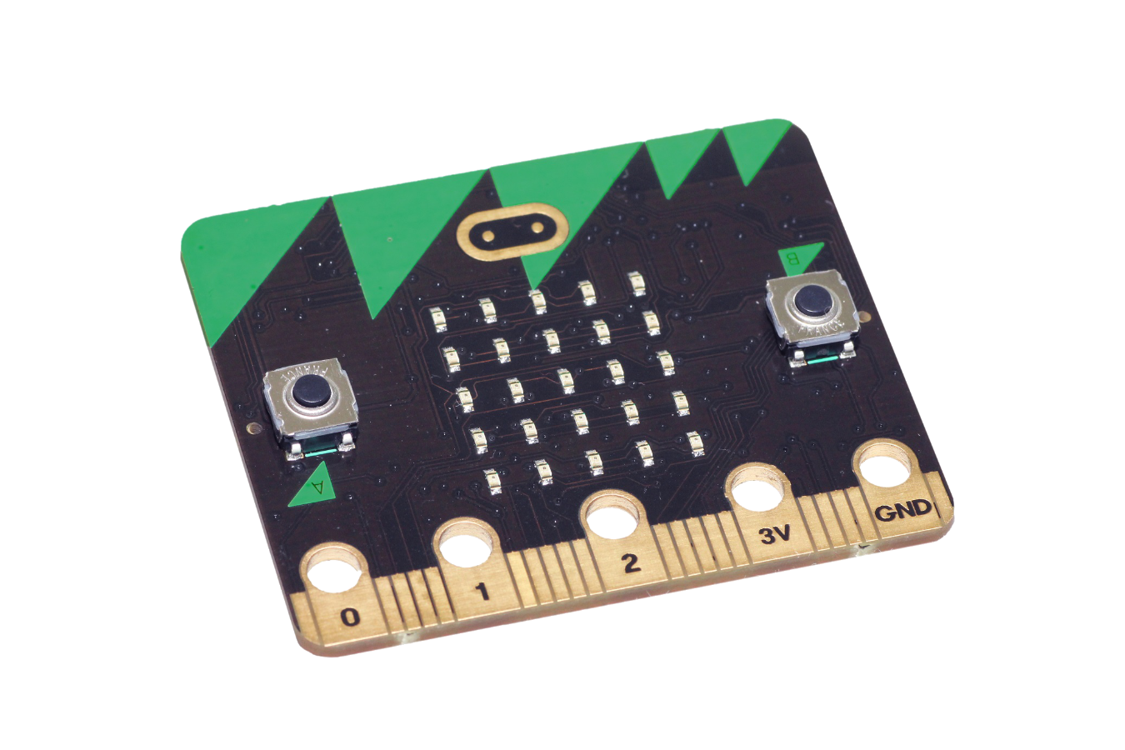
Micro:bit
1
2020-1-SK01-KA226-SCH-094350

Slide 5
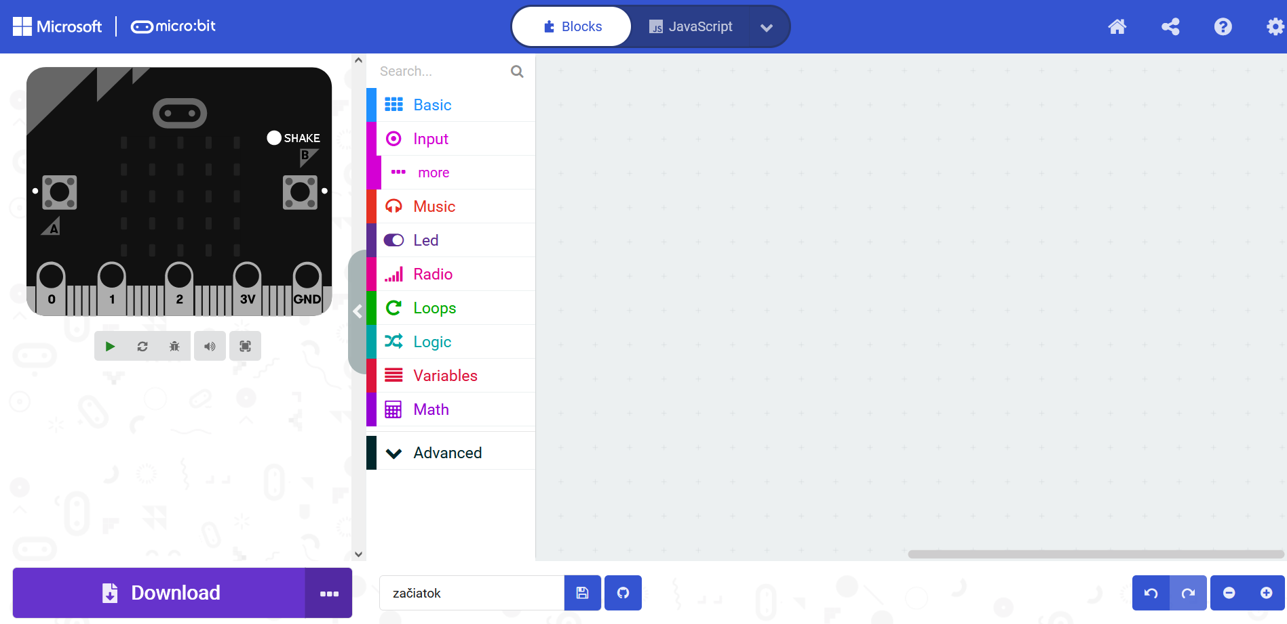
BASIC INFORMATION
Programmable minicomputer
The user can see the program immediately
Various sensors inbuilt
Programmable in various environments
The online block environment MakeCode https://makecode.microbit.org
2020-1-SK01-KA226-SCH-094350

Slide 6
Blocks of the Basic Library
2
2020-1-SK01-KA226-SCH-094350

Slide 7
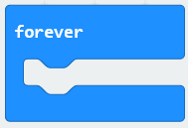
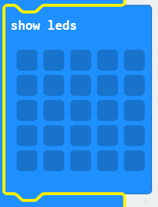
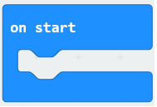
BASIC INFORMATION
2020-1-SK01-KA226-SCH-094350

Slide 8
Blocks of the Input Library
3
2020-1-SK01-KA226-SCH-094350

Slide 9
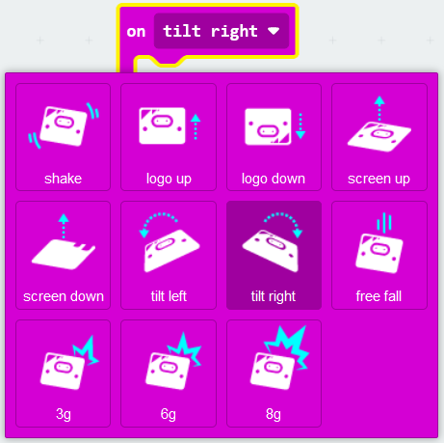
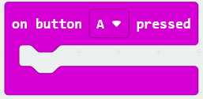
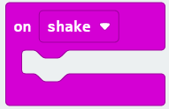
BASIC INFORMATION
2020-1-SK01-KA226-SCH-094350

Slide 10
Teaching Materials
4
2020-1-SK01-KA226-SCH-094350

Slide 11
TEACHING MATERIALS
Students do the test v Learningapps. They can use the MakeCode editor simultaneously.
They do the matching activity at Wordwalle afterwards.
2020-1-SK01-KA226-SCH-094350

Slide 12
TEACHING MATERIALS
Notes
2020-1-SK01-KA226-SCH-094350

Slide 13
SOURCES
https://www.ucimeshardverom.sk/materialy/microbit_makecode/
https://makecode.microbit.org/#editor
2020-1-SK01-KA226-SCH-094350

Slide 14
EN The European Commission's support for the production of this publication does not constitute an endorsement of the contents, which reflect the views only of the authors, and the Commission cannot be held responsible for any use which may be made of the information contained therein.
SK Podpora Európskej komisie na výrobu tejto publikácie nepredstavuje súhlas s obsahom, ktorý odráža len názory autorov, a Komisia nemôže byť zodpovedná za prípadné použitie informácií, ktoré sú v nej obsiahnuté.
2020-1-SK01-KA226-SCH-094350

