Slide 1
Digi School Ethics Non-verbal Communication – Facial Expression
2020-1-SK01-KA226-SCH-094350

Slide 2
Non-verbal Communication – Facial Expression
SUBJECT: Ethics
SPECIFICATION: Non-verbal Communication- Facial Expression
AGE GROUP: 14-15
1 LESSON: 45 min
2020-1-SK01-KA226-SCH-094350

Slide 3
CONTENTS
01
Communication
02
Non-verbal Communication
03
Facial Expression
04
Teaching Materials
2020-1-SK01-KA226-SCH-094350

Slide 4
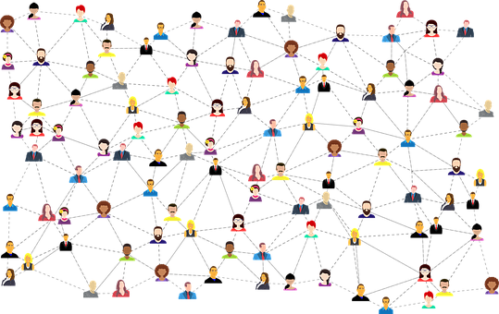
Communication
1
The aim of communication
2020-1-SK01-KA226-SCH-094350

Slide 5
BASIC INFORMATION
The aim of communication is a process that conveys messages of which purpose is understanding. It has existed in human community since its beginning.
Its task is to interchange as much content-based information between the communicators within certain period of time as possible – effective communication.
2020-1-SK01-KA226-SCH-094350

Slide 6
Non-verbal Communication
2
The importance of non-verbal communication
2020-1-SK01-KA226-SCH-094350

Slide 7
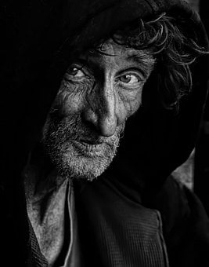
GENERAL INFORMATION
The most frequent subdivision of communication:
Verbal communication – uses words
Non-verbal communication – using other means than words
Communication using deeds – effect of deeds
2020-1-SK01-KA226-SCH-094350

Slide 8
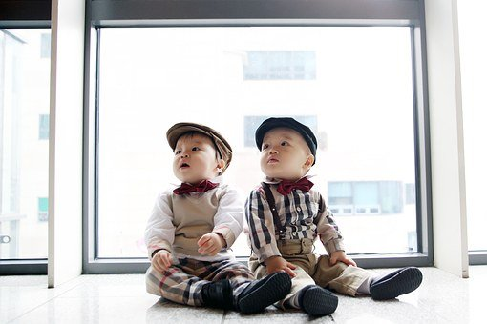
GENERAL INFORMATION
Non-verbal communication (the communication without words) can serve a variety of social purposes that can be divided into four groups:
Helping the speech
Substituting the speech
Expressing attitude
Expressing emotions
2020-1-SK01-KA226-SCH-094350

Slide 9
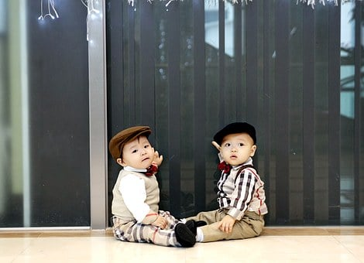
Facial Expression
3
.
2020-1-SK01-KA226-SCH-094350

Slide 10
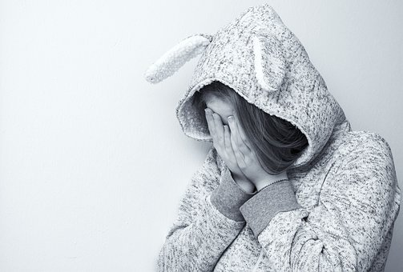
GENERAL INFORMATION
Facial expression
The term originates from the Greek word „mímos“ which means „gently mimicking“
It is always an activity of facial muscles.
Facial expression is a smile, cry, grin, laughter, nod, rejection, turning pale, blushing.
2020-1-SK01-KA226-SCH-094350

Slide 11
Teaching Materials
4
2020-1-SK01-KA226-SCH-094350

Slide 12
TEACHING MATERIALS
<
Non-verbal communication – Facial Expression
2020-1-SK01-KA226-SCH-094350

Slide 13
INTERACTIVE EXERCISES
<
Students create teams (2 – 4).
In wordwall activity choose the right emotions.
2020-1-SK01-KA226-SCH-094350

Slide 14
INTERACTIVE EXERCISES
<
Students create teams (2 – 4).
In wordwall choose the wrong statement
2020-1-SK01-KA226-SCH-094350

Slide 15
SOURCES
Hartmannová, E, Petrufová, M: Spoločenská komunikácia pre 2. ročník obchodných akadémií
BEDNAŘÍK, A. 2001. Riešenie konfliktov. Bratislava: -PDCS. ISBN 80-968095-4-7.

Slide 16
EN The European Commission's support for the production of this publication does not constitute an endorsement of the contents, which reflect the views only of the authors, and the Commission cannot be held responsible for any use which may be made of the information contained therein.
SK Podpora Európskej komisie na výrobu tejto publikácie nepredstavuje súhlas s obsahom, ktorý odráža len názory autorov, a Komisia nemôže byť zodpovedná za prípadné použitie informácií, ktoré sú v nej obsiahnuté.
2020-1-SK01-KA226-SCH-094350

