Slide 1
Digi School Ethics Non-verbal Communication- Posture
2020-1-SK01-KA226-SCH-094350

Slide 2
Non-verbal Communication- Posture
SUBJECT: Ethics
SPECIFICATION: Non-verbal Communication - Posture
AGE GROUP: 14-15
1 LESSON: 45 min
2020-1-SK01-KA226-SCH-094350

Slide 3
CONTENTS
01
Communication
02
Non-verbal Communication
03
Posture
04
Teaching Materials
2020-1-SK01-KA226-SCH-094350

Slide 4
Communication
1
The Aim of Communication
2020-1-SK01-KA226-SCH-094350

Slide 5
BASIC INFORMATION
Communication is a term originating from the Latin communicare, that can be defined as to make something common, to consult, to negotiate, to understand, to inform, or exchange the information.
Communication is one of the most important factors of human active work.
2020-1-SK01-KA226-SCH-094350

Slide 6
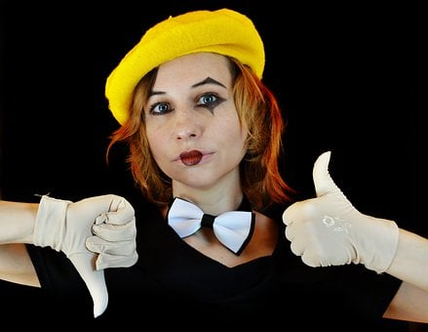
Non- verbal Commuication
2
The importance of non-verbal communication
2020-1-SK01-KA226-SCH-094350

Slide 7
GENERAL INFORMATION
The most frequent subdivision of communication:
Verbal communication – uses words
Non-verbal communication – using other means than words
Communication using deeds – effect of deeds
2020-1-SK01-KA226-SCH-094350

Slide 8
GENERAL INFORMATION
Non-verbal communication (communication without words) can be of different importance to us, postures can:
Influence the interest in communication,
Influence the course of a meeting.
2020-1-SK01-KA226-SCH-094350

Slide 9
Posture
3
.
2020-1-SK01-KA226-SCH-094350

Slide 10
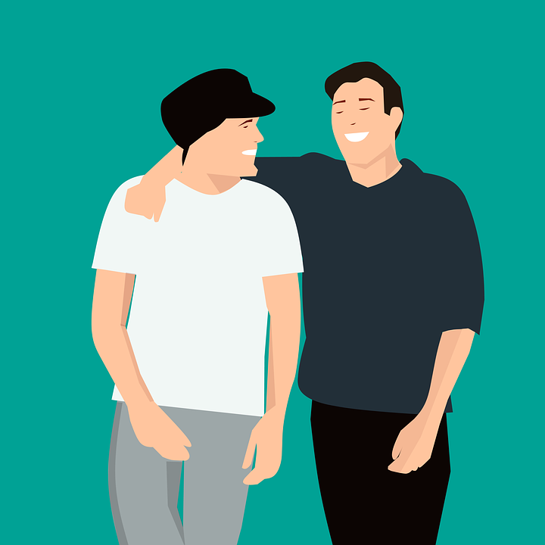
GENERAL INFORMATION
Posture deals with:
Transfer of information expressed with body position
Configuration of body parts,
Position of arms and legs; mutual position of the trunk, limbs, and head,
Together they create some sort of a characteristic set that is called a pose.
2020-1-SK01-KA226-SCH-094350

Slide 11
Teaching Materials
4
2020-1-SK01-KA226-SCH-094350

Slide 12
TEACHING MATERIALS
<
Non-verbal communication - posture
2020-1-SK01-KA226-SCH-094350

Slide 13
Neverbálna komunikácia –INTERACTIVE EXERCISES
<
Students create teams (2 – 4).
In the kahoot quiz choose the right answer about posture.
2020-1-SK01-KA226-SCH-094350

Slide 14
INTERACTIVE EXERCISES
<
Students create teams (2 – 4).
In wordwalle they will connect the posture to the right statement.
2020-1-SK01-KA226-SCH-094350

Slide 15
INTERACTIVE EXERCISES
<
Students create teams (2 – 4).
In wordwalle they will assign the right answers about the body posture to the right statement.
2020-1-SK01-KA226-SCH-094350

Slide 16
SOURCES
Hartmannová, E, Petrufová, M: Spoločenská komunikácia pre 2. ročník obchodných akadémií
BEDNAŘÍK, A. 2001. Riešenie konfliktov. Bratislava: -PDCS. ISBN 80-968095-4-7.
Janáčková, L: Praktická komunikace pro každý den. Praha: ISBN 978 – 80 – 247 – 2479 – 9
http://www.nocka.sk/wp-content/uploads/2020/04/Komunik%C3%A1cia-vo-VD.pdf

Slide 17
EN The European Commission's support for the production of this publication does not constitute an endorsement of the contents, which reflect the views only of the authors, and the Commission cannot be held responsible for any use which may be made of the information contained therein.
SK Podpora Európskej komisie na výrobu tejto publikácie nepredstavuje súhlas s obsahom, ktorý odráža len názory autorov, a Komisia nemôže byť zodpovedná za prípadné použitie informácií, ktoré sú v nej obsiahnuté.
2020-1-SK01-KA226-SCH-094350

