Slide 1
Digi school HISTORY
2020-1-SK01-KA226-SCH-094350

Slide 2
Subject: History
Specification: History Seminar
Age group: 16 -17
1 lesson: 45 minutes
2020-1-SK01-KA226-SCH-094350

Slide 3
01
Origin of the Slavs
02
Life of the Slavs
03
Religion of the Slavs
04
Teaching Material
2020-1-SK01-KA226-SCH-094350

Slide 4
Origin of the Slavs
1
2020-1-SK01-KA226-SCH-094350

Slide 5
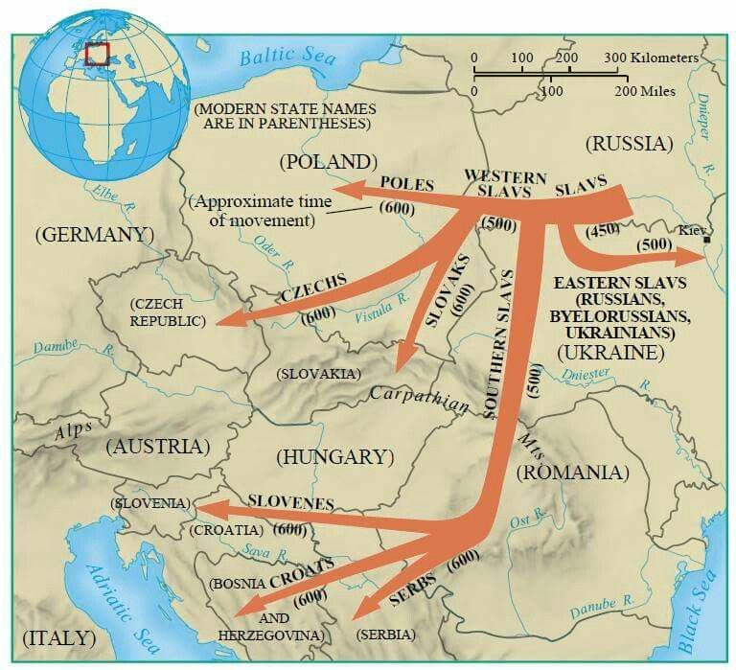
Division of the Slavs into subgroups
https://sk.pinterest.com/pin/828803137650299650/
2020-1-SK01-KA226-SCH-094350

Slide 6
ORIGIN OF THE SLAVS
Indo-European origin
Veneti, Viniti, Antes
Origin – north of the Carpathians, Dnieper, Vistula, Oder
The Great Migration – Slavic settlements in Europe
Major subgroups of the Slavs wordwall.ch
2020-1-SK01-KA226-SCH-094350

Slide 7
ORIGIN OF THE SLAVS
In Slovakia
5th century
coming from the east and south – settled in the south and west of the country
coming from the north – settled in the north
the third direction crossed the Moravian gate
2020-1-SK01-KA226-SCH-094350

Slide 8
Life of the Slavs
2
2020-1-SK01-KA226-SCH-094350

Slide 9
LIFE OF THE SLAVS
families, tribes
veča (people´s assembly) tribe elders chiefs
monogamy
unprotected settlements
(polo) zemnice (dugouts or pit-houses)- simple dwellings
Slavic dwelling - interior, Slavic dwelling - exterior
2020-1-SK01-KA226-SCH-094350

Slide 10
agriculture and livestock keeping
grain pits
fishing, hunting and forest beekeeping
skilled craftsmen carpenters, blacksmiths, potters
didn´t know the potters wheel – thick-walled ceramics
2020-1-SK01-KA226-SCH-094350

Slide 11
Religion of the Slavs
3
2020-1-SK01-KA226-SCH-094350

Slide 12
RELIGION OF THE SLAVS
believed in afterlife
natural phenomena, death = supernatural beings
polytheism
2020-1-SK01-KA226-SCH-094350

Slide 13
Teaching Materials
4
2020-1-SK01-KA226-SCH-094350

Slide 14
TEACHING MATERIALS
Slavs and their way of life wordwall.ch
Slavic Gods wordwall.ch
The Slavs and their way of life
Slavic Gods supplementary material
2020-1-SK01-KA226-SCH-094350

Slide 15
SOURCES:
Elschek, Kristian- Hunka, Ján. 2009. Slovenské dejiny I. Bratislava: Eurolitera, 2009. 258 s. ISBN: 978-80-970193-0-3.
Kurcinová, Ľudmila- Sobek, Ľubomír. 2019. Úspešná maturita: Dejepis. Košice: TAKTIK, 2019. 338 s. ISBN 978- 80-8180-131-0.
Sochrová, Mária- Virdzeková, Alica. 2009. Dejepis I. Bratislava: Fragment, 2009. 144 s. ISBN 978-80-8089-296-8.
2020-1-SK01-KA226-SCH-094350

Slide 16
EN The European Commission's support for the production of this publication does not constitute an endorsement of the contents, which reflect the views only of the authors, and the Commission cannot be held responsible for any use which may be made of the information contained therein.
SK Podpora Európskej komisie na výrobu tejto publikácie nepredstavuje súhlas s obsahom, ktorý odráža len názory autorov, a Komisia nemôže byť zodpovedná za prípadné použitie informácií, ktoré sú v nej obsiahnuté.
2020-1-SK01-KA226-SCH-094350

