Slide 1
Digi School HISTORY
2020-1-SK01-KA226-SCH-094350

Slide 2
Subject: History
Specification: History Seminar
Age group: 16- 17
1 lesson: 45 minutes
2020-1-SK01-KA226-SCH-094350

Slide 3
01
Solun Brothers
02
Constantine and Methodius
03
Activities of Solun Brothers
04
Teaching Materials
2020-1-SK01-KA226-SCH-094350

Slide 4
Puzzle learningapps.org- motivation
2020-1-SK01-KA226-SCH-094350

Slide 5
Solun Brothers
1
2020-1-SK01-KA226-SCH-094350

Slide 6
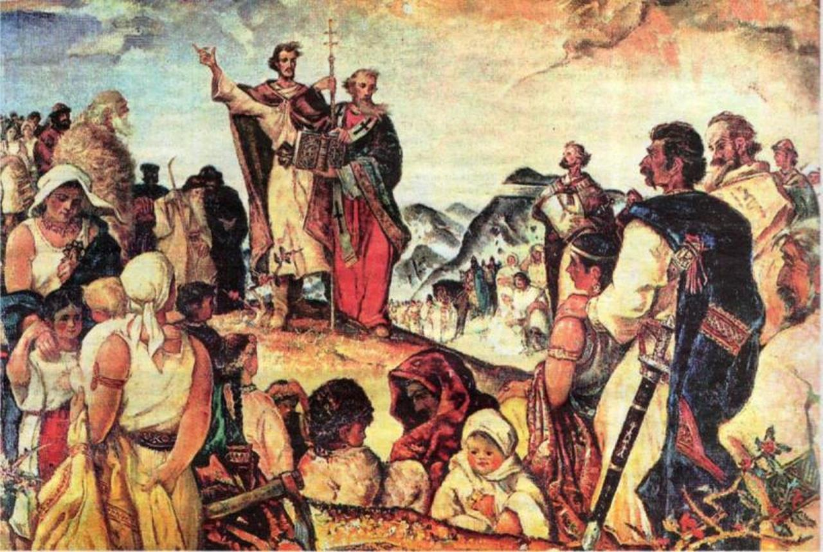
SOLUN BROTHERS
Solun/ Thessalonika
father: Leo – deputy county administrator
mother: Maria – probably of Slavic origin
seven children
Constantine and Methodius mastered Greek, Old Slavonic, and Latin
https://www.bystricoviny.sk/titulka/slavime-prichod-cyrila-metoda-velku-moravu/
2020-1-SK01-KA226-SCH-094350

Slide 7
Constantine and Methodius
2
2020-1-SK01-KA226-SCH-094350

Slide 8
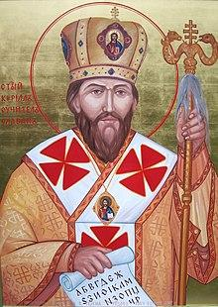
CONSTANTINE/CYRIL
The youngest ( 826/ 827)
college in Constantinople
refused marriage, dedicated student
librarian, later professor of philosophy
member of diplomatic missions
died in 869 https://sk.wikipedia.org/wiki/Kon%C5%A1tant%C3%ADn_Filozof
2020-1-SK01-KA226-SCH-094350

Slide 9
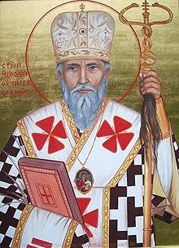
METHODIUS
The oldest ( 815)
studied law in Constantinople
provincial administrator in Macedonia https://sk.wikipedia.org/wiki/Metod_(svätec)
member of diplomatic missions
archbishop of Pannonia and Great Moravia
died in 885
2020-1-SK01-KA226-SCH-094350

Slide 10
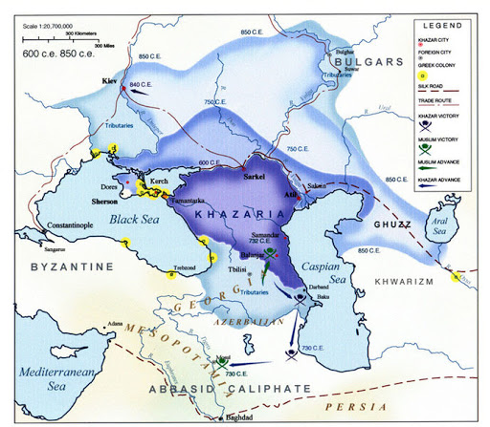
after 855 both brothers in a monastery on the Olympus
mission to Khazars ( Caspian sea)
mission to Great Moravia
journey to Rome
fates of Constantine and Methodius
Right or wrong wordwall.ch
http://ema.blog.portal.sk/detail.html?a=29178d69b6572286aac14a2c6fac8724
2020-1-SK01-KA226-SCH-094350

Slide 11
Activities of the Solun Brothers
3
2020-1-SK01-KA226-SCH-094350

Slide 12
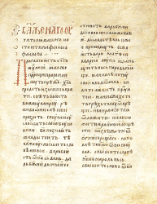
ACTIVITIES OF THE SOLUN BROTHERS
diplomacy, Christianisation, teaching
literary activities, translation of liturgical books
Constantine - Proglas- first Old Slavonic poem
Proglas learningapps.org
Methodius – Admonition of the Rulers; Zakon Sudnyj Liudem
http://www.medievalica.com/stranky/historica/slovaks/dokumenty/dok5.htm
2020-1-SK01-KA226-SCH-094350

Slide 13
ACTIVITIES OF THE SOLUN BROTHERS
works and translations of students
Kliment – The Life of Constantine
Gorazd – The life of Methodius
Moravian - Pannonian Legends
Kievan Letters
https://readgur.com/doc/329576/moravsko-pan%C3%B3nske-legendy
2020-1-SK01-KA226-SCH-094350

Slide 14
Teaching Materials
4
2020-1-SK01-KA226-SCH-094350

Slide 15
TEACHING MATERIALS
Solun Brothers wordwall.ch
Solun brothers
2020-1-SK01-KA226-SCH-094350

Slide 16
SOURCES:
Elschek, Kristian- Hunka, Ján. 2009. Slovenské dejiny I. Bratislava: Eurolitera, 2009. 258 s. ISBN: 978-80-970193-0-3.
Kurcinová, Ľudmila- Sobek, Ľubomír. 2019. Úspešná maturita: Dejepis. Košice: TAKTIK, 2019. 338 s. ISBN 978- 80-8180-131-0.
Sochrová, Mária- Virdzeková, Alica. 2009. Dejepis I. Bratislava: Fragment, 2009. 144 s. ISBN 978-80-8089-296-8.
2020-1-SK01-KA226-SCH-094350

Slide 17
EN The European Commission's support for the production of this publication does not constitute an endorsement of the contents, which reflect the views only of the authors, and the Commission cannot be held responsible for any use which may be made of the information contained therein.
SK Podpora Európskej komisie na výrobu tejto publikácie nepredstavuje súhlas s obsahom, ktorý odráža len názory autorov, a Komisia nemôže byť zodpovedná za prípadné použitie informácií, ktoré sú v nej obsiahnuté.
2020-1-SK01-KA226-SCH-094350

