Slide 1
Digi School Information Technologies – Sorting and Filtering
2020-1-SK01-KA226-SCH-094350

Slide 2
SUBJECT: IT
SPECIFICATION: Sorting and Filtering
AGE GROUP: 13-14
1 LESSON : 45 min
2020-1-SK01-KA226-SCH-094350

Slide 3
Or use diagrams to explain complex ideas
01
Sorting
02
Filtering
03
Teaching Materials
04
Edukačné materiály
2020-1-SK01-KA226-SCH-094350

Slide 4
Sorting
1
2020-1-SK01-KA226-SCH-094350

Slide 5
BASIC INFORMATION
when sorting, the values on the spreadsheet are ordered by selected criteria
ways of sorting:
A to Z (ascending)
Z to A (descending)
Custom (choosing the required criteria)
2020-1-SK01-KA226-SCH-094350

Slide 6
Filtering
2
2020-1-SK01-KA226-SCH-094350

Slide 7
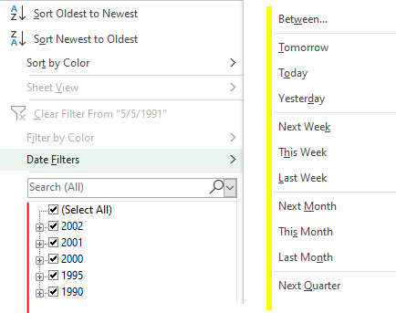
BASIC INFORMATION
when filtering, the data not falling under the selected criteria are hidden
2020-1-SK01-KA226-SCH-094350

Slide 8
Teaching Materials
3
2020-1-SK01-KA226-SCH-094350

Slide 9
TEACHING MATERIALS
Students do the worksheet.
Next, they do the matching activity at Learningapps.
2020-1-SK01-KA226-SCH-094350

Slide 10
TEACHING MATERIALS
Notes
2020-1-SK01-KA226-SCH-094350

Slide 11
SOURCES
https://support.microsoft.com/sk-sk/office/filtrovanie-%C3%BAdajov-v-rozsahu-alebo-tabu%C4%BEke-01832226-31b5-4568-8806-38c37dcc180e
2020-1-SK01-KA226-SCH-094350

Slide 12
EN The European Commission's support for the production of this publication does not constitute an endorsement of the contents, which reflect the views only of the authors, and the Commission cannot be held responsible for any use which may be made of the information contained therein.
SK Podpora Európskej komisie na výrobu tejto publikácie nepredstavuje súhlas s obsahom, ktorý odráža len názory autorov, a Komisia nemôže byť zodpovedná za prípadné použitie informácií, ktoré sú v nej obsiahnuté.
2020-1-SK01-KA226-SCH-094350

