Slide 1
Digi School Ethics Communication – Preparation of Public Speech
2020-1-SK01-KA226-SCH-094350

Slide 2
Communication – Preparation of Public Speech
SUBJECT: Ethics
SPECIFICATION: Communication – Preparation of Public Speech
AGE GROUP: 14-15
1 LESSON: 45 min
2020-1-SK01-KA226-SCH-094350

Slide 3
CONTENTS
01
Assertive Communication
02
Rhetoric
03
Preparation of Public Speech
04
Teaching Materials
2020-1-SK01-KA226-SCH-094350

Slide 4
Assertive Communication
1
Principles of assertive communication
2020-1-SK01-KA226-SCH-094350

Slide 5
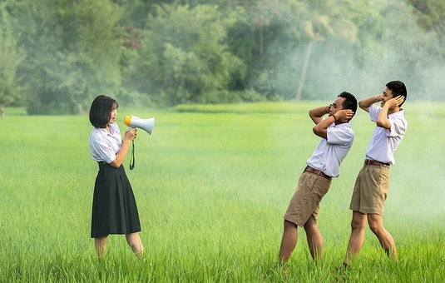
BASIC INFORMATION
A person has the right to judge their own behaviour, thoughts, emotions, and to be responsible for them
You have the right to say NO.
A person has the right to evaluate to what extent they are responsible for solving the problems of others
A person has the right to change their opinion.
A person has the right to say I DON´T KNOW.
2020-1-SK01-KA226-SCH-094350

Slide 6
BASIC INFORMATION
A person has the right to be independent of the goodwill of others.
A person has the right to make mistakes and to be responsible for them.
A person has the right to make illogical decisions.
A person has the right to say I DON´T UNDERSTAND.
A person has the right to say I DON´T CARE.
A person has the right to decide whether to be assertive.
2020-1-SK01-KA226-SCH-094350

Slide 7
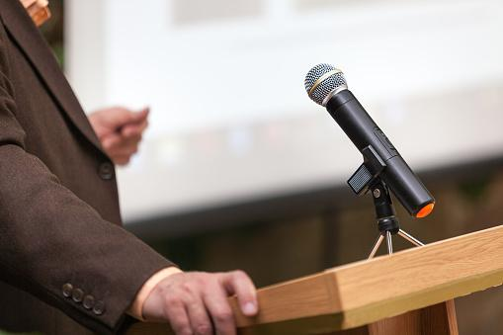
Rhetoric
2
2020-1-SK01-KA226-SCH-094350

Slide 8
GENERAL INFORMATION
Rhetoric – the art of speaking:
language, words, and vocabulary
speech technique.
2020-1-SK01-KA226-SCH-094350

Slide 9
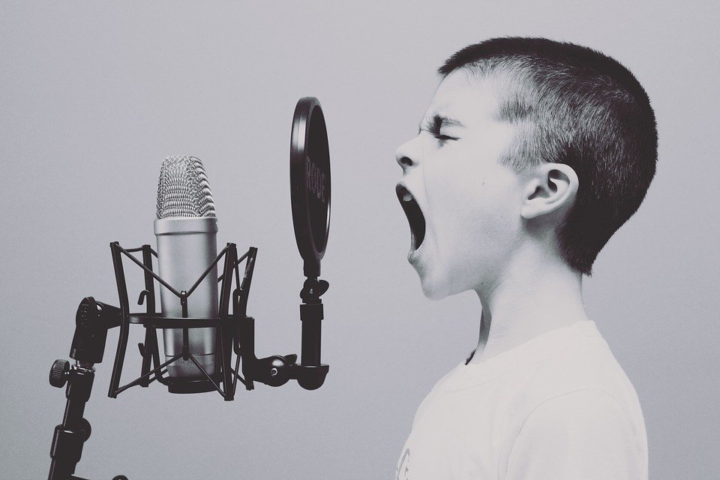
Preparation of Public Speech
3
2020-1-SK01-KA226-SCH-094350

Slide 10
GENERAL INFORMATION
Principles of speech:
Appearance adjustment,
Premeditated form of speech,
Know whom to, where, when, and how long the speech will last
Master the vocal and verbal forms of speech,
Master the non-verbal forms of speech,
Avoid negative signals
2020-1-SK01-KA226-SCH-094350

Slide 11
GENERAL INFORMATION
Preparation of speech:
choose the right topic and purpose, prepare the speech thesis
analyse the audience,
search and choose the support possibilities,
choose a template, style your speech, build up the introduction, conclusion
practice the speech, present the speech.
2020-1-SK01-KA226-SCH-094350

Slide 12
Teaching Materials
4
2020-1-SK01-KA226-SCH-094350

Slide 13
TEACHING MATERIALS
<
Verbal communication– preparation of public speech
2020-1-SK01-KA226-SCH-094350

Slide 14
INTERACTIVE EXERCISES
<
Students will choose the order
in wordwall they will prepare a short speech on given topic
2020-1-SK01-KA226-SCH-094350

Slide 15
INTERACTIVE EXERCISES
<
Students will create teams (2 – 4).
in wordwall within the activity connect the notions to their meanings
2020-1-SK01-KA226-SCH-094350

Slide 16
INTERACTIVE EXERCISES
<
Students will create teams (2 – 4).
in wordwall they will explain the meaning of the assertive rule.
2020-1-SK01-KA226-SCH-094350

Slide 17
SOURCES
Hartmannová, E, Petrufová, M: Spoločenská komunikácia pre 2. ročník obchodných akadémií
BEDNAŘÍK, A. 2001. Riešenie konfliktov. Bratislava: -PDCS. ISBN 80-968095-4-7.

Slide 18
EN The European Commission's support for the production of this publication does not constitute an endorsement of the contents, which reflect the views only of the authors, and the Commission cannot be held responsible for any use which may be made of the information contained therein.
SK Podpora Európskej komisie na výrobu tejto publikácie nepredstavuje súhlas s obsahom, ktorý odráža len názory autorov, a Komisia nemôže byť zodpovedná za prípadné použitie informácií, ktoré sú v nej obsiahnuté.
2020-1-SK01-KA226-SCH-094350

