Slide 1
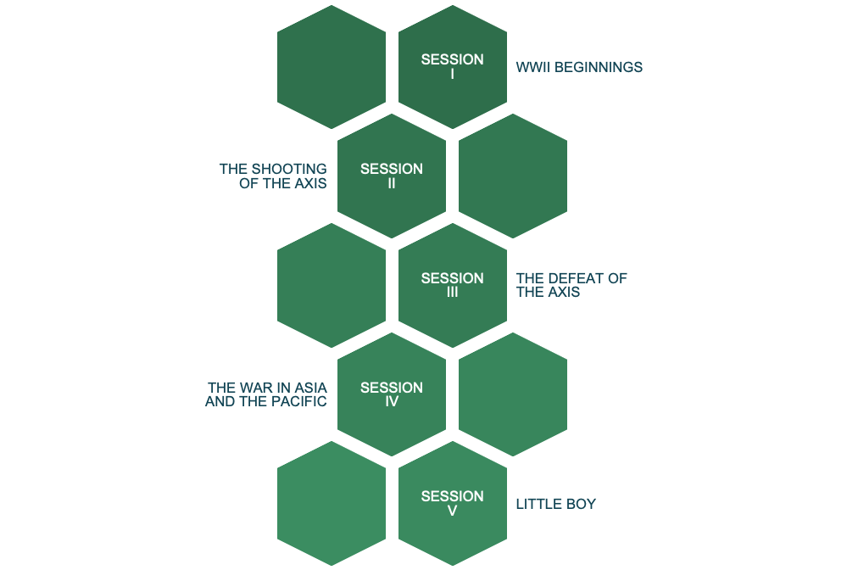
C O N T E N T
04
EDUCATIONAL MATERIALS
2020-1-SK01-KA226-SCH-094350
‹#›

Slide 2
Digi school HISTORY-SPANISH
2020-1-SK01-KA226-SCH-094350

Slide 3
WORLD WAR II
SUBJECT: HISTORY AND SPANISH LANGUAGE
SPECIFICATION: in ENGLISH via CLIL method (level in languages) introducing spanish words.
AGE OF STUDENTS: 15-16
1 LESSON : 55 min
*YOU NEED METAVERSE APP (ANDROID & IOS) AND SCAN EVERY QR CODE YOU WILL FIND IN EACH LESSON WITH THE APP (not with your phone camera).
2020-1-SK01-KA226-SCH-094350
‹#›

Slide 4
THE BEGINNINGS
WWII lessons presented here:
You can learn about WWII and spanish language by yourself with this app.
English is the means of communication to learn the WWII content. .
2020-1-SK01-KA226-SCH-094350
‹#›

Slide 5
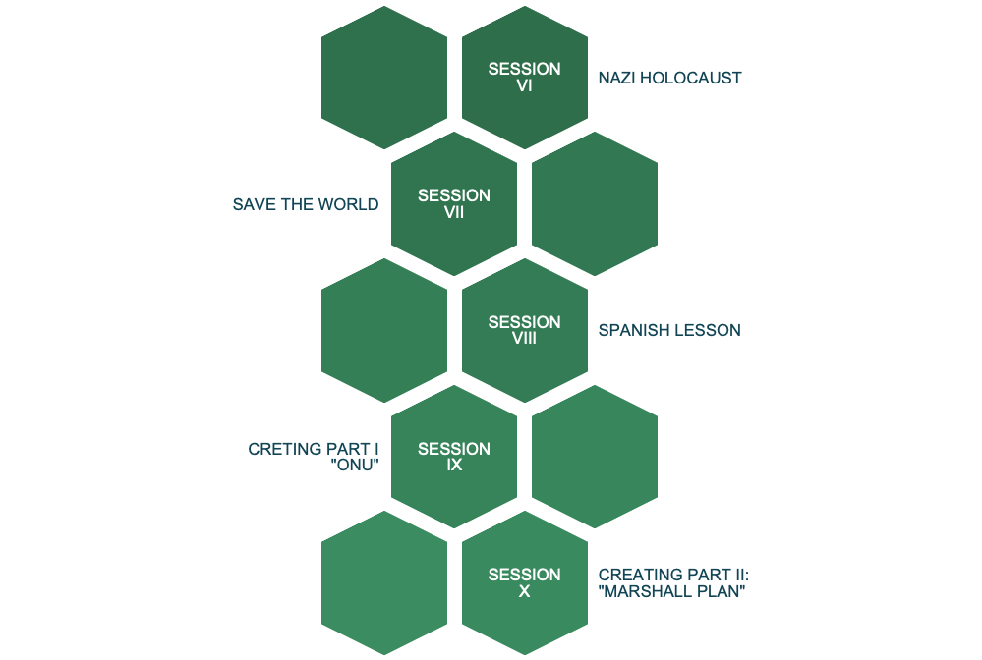
C O N T E N T
04
EDUCATIONAL MATERIALS
2020-1-SK01-KA226-SCH-094350
‹#›

Slide 6
The beginnings
1
WWII BEGINNINGS
2020-1-SK01-KA226-SCH-094350
‹#›

Slide 7
The shooting of the Axis
2
MORE POWER
2020-1-SK01-KA226-SCH-094350
‹#›

Slide 8
The defeat of the Axis
3
THE RESSISTANCE
2020-1-SK01-KA226-SCH-094350
‹#›

Slide 9
The war in Asia and The Pacific
4
PEARL HARBOUR
2020-1-SK01-KA226-SCH-094350
‹#›

Slide 10
Little Boy
5
THE BOMB
2020-1-SK01-KA226-SCH-094350
‹#›

Slide 11
Nazi Holocaust
6
THE HORROR
2020-1-SK01-KA226-SCH-094350
‹#›

Slide 12
Save the World
7
YOU DECIDE
2020-1-SK01-KA226-SCH-094350
‹#›

Slide 13
Spanish lesson
8
LEARNING WORDS IN SPANISH
2020-1-SK01-KA226-SCH-094350
‹#›

Slide 14
Creating part I: UNITED NATIONS ORGANIZATION
9
*In the next two lessons you have to create your own Metaverse
Experience.
So, you must to create an account and logging to
https://studio.gometa.io/discover/me
BE CREATIVE
2020-1-SK01-KA226-SCH-094350
‹#›

Slide 15
Creating part II: Marshan Plan
10
BE MORE CREATIVE
2020-1-SK01-KA226-SCH-094350
‹#›

Slide 16
R E S O U R C E S
www.wikipedia.com WWII information.
www.youtube.com Linked videos.
www.pixabay.com Linked images (copyright free).
2020-1-SK01-KA226-SCH-094350
‹#›

Slide 17
DIGI-SCHOOL DIGI-PROJECT
EN The European Commission's support for the production of this publication does not constitute an endorsement of the contents, which reflect the views only of the authors, and the Commission cannot be held responsible for any use which may be made of the information contained therein.
2020-1-SK01-KA226-SCH-094350
‹#›

