Slide 1
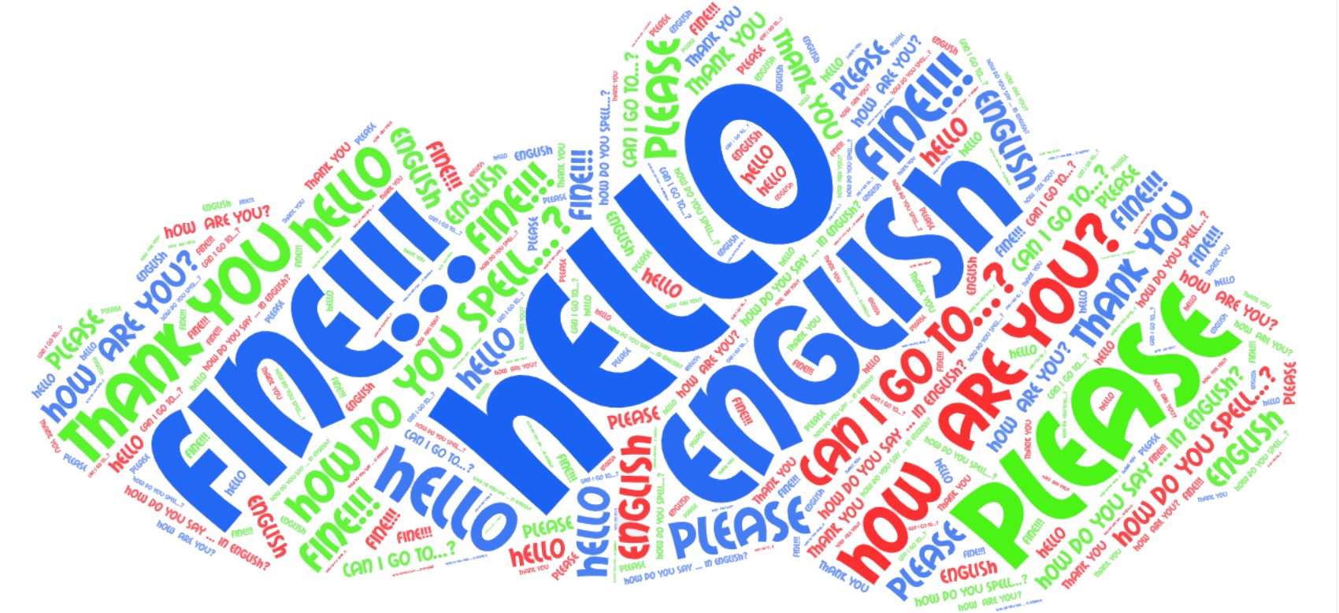
Digi school ENGLISH-SPANISH
2020-1-SK01-KA226-SCH-094350

Slide 2
English Vocabulary
SUBJECT: ENGLISH LANGUAGE
SPECIFICATION: in ENGLISH, introducing English vocabulary words.
AGE OF STUDENTS: 13-14
1 LESSON : 45 min
2020-1-SK01-KA226-SCH-094350
2

Slide 3
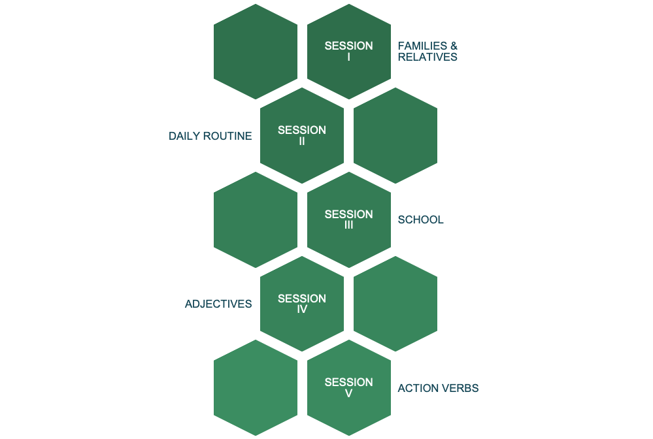
C O N T E N T
04
EDUCATIONAL MATERIALS
2020-1-SK01-KA226-SCH-094350
3

Slide 4
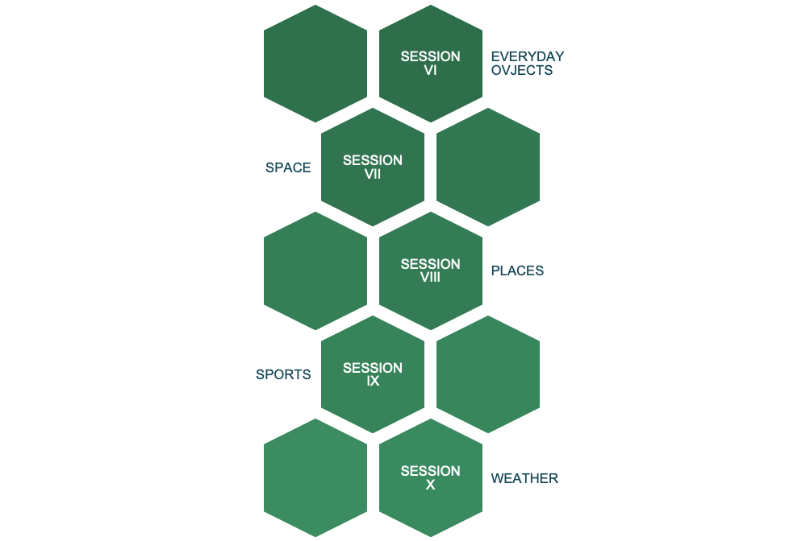
C O N T E N T
04
EDUCATIONAL MATERIALS
2020-1-SK01-KA226-SCH-094350
4

Slide 5
METAVERSE STUDIO APP
1
2020-1-SK01-KA226-SCH-094350
5

Slide 6
METAVERSE STUDIO
Metaverse Studio, is a free application that allows users to create interactive Augmented Reality experiences without any coding. Using Metaverse Studio, users can build AR experiences that incorporate technologies such as 3D objects, 360-degree video, photo filters..., in addition to commonly used features of programming like logic, probability, collection of user input, and session management..
2020-1-SK01-KA226-SCH-094350
6

Slide 7
English language teaching
2
2020-1-SK01-KA226-SCH-094350
7

Slide 8
GENERAL INFORMATION
We have incorporated augmented reality into English classes for vocabulary learning.
In this way, the student is more motivated to learn English vocabulary.
8
2020-1-SK01-KA226-SCH-094350

Slide 9
How does the app work?
3
2020-1-SK01-KA226-SCH-094350
9

Slide 10
How the app works.
The student, through reading clues and observing a drawing, must write the words previously studied.
There will be a total of between 8 and 10 words. When the student correctly writes one word he will go on to observe the clues and drawing for the next one.
10
2020-1-SK01-KA226-SCH-094350

Slide 11
How the app works.
If the student makes a mistake when writing a word, he must go back to the beginning, to the first word. In this way, when he goes back to the beginning he goes over the previous words again to review them.
When the student gets to write all the words correctly, the activity is finished.
2020-1-SK01-KA226-SCH-094350
11

Slide 12
How the app works.
The student must download the app on his/her device (mobile phone, tablet, chromebook, laptop ...)
The app generates a QR code that the student reads with his/her device and then they can carry out the activity.
2020-1-SK01-KA226-SCH-094350
12

Slide 13
Blocks of contents
4
2020-1-SK01-KA226-SCH-094350
13

Slide 14
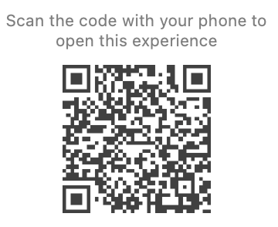
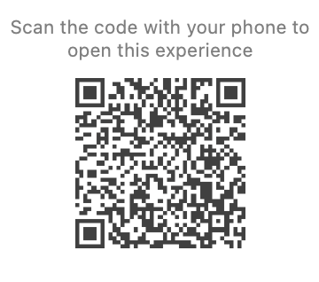
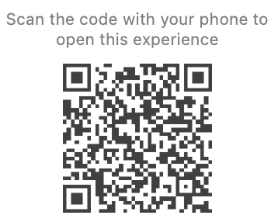
Vocabulary blocks
1. Families and relatives
2. Daily routine
3. School
2020-1-SK01-KA226-SCH-094350
14

Slide 15
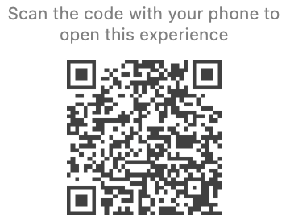
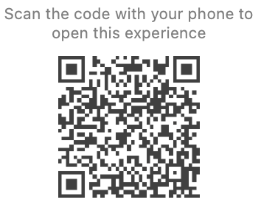
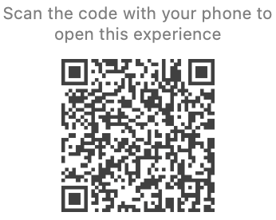
Vocabulary blocks
4. Adjectives
5. Action verbs
6. Everyday objects
2020-1-SK01-KA226-SCH-094350
15

Slide 16
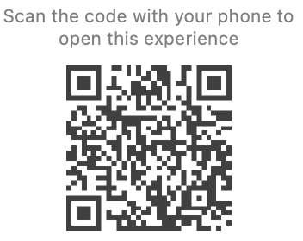
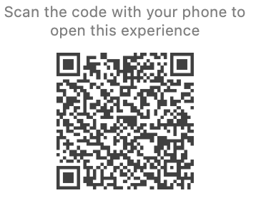
Vocabulary blocks
7. Space
8. Places
2020-1-SK01-KA226-SCH-094350
16

Slide 17
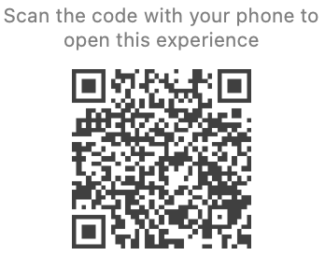
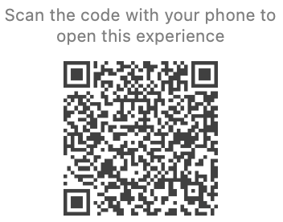
Vocabulary blocks
9. Sports
10. Weather
2020-1-SK01-KA226-SCH-094350
17

Slide 18
R E S O U R C E S
Metaverse Studio App. https://studio.gometa.io
Different web pages with royalty free images, gifs ... (of the creative commons type)
youtube.com
2020-1-SK01-KA226-SCH-094350
18

