Slide 1
Liquid compounds
Project number 2020-1-SK01-KA226-SCH-094350
Gymnázium a Jazyková škola s právem státní jazykové zkoušky Zlín

Slide 2
Liquid compounds
SUBJECT: CHEMISTRY
SPECIFICATION: Chemistry, third
AGE OF STUDENTS: 12 - 13
1 LESSON : 45 min.
2020-1-SK01-KA226-SCH-094350

Slide 3
C O N T E N T
01
Substances and compounds. Types of compounds
02
Solubility of substances
03
Heterogeneous compounds. Videos with experiments
04
Tasks to practise
2020-1-SK01-KA226-SCH-094350

Slide 4
The difference between a chemical substance and a compound
1
Definitions, classification with examples of chemical substances and compounds

Slide 5
Substances classification
Chemical substance
Chemically pure substance
Element
Compound
Chemical compound
Homogeneous compound
Heterogeneous compound

Slide 6
Element
a substance created by similar/the same atoms (or molecules)
example: C (in the picture as a diamond), Fe, S, H₂, O₂
Chemical compound
a substance created by molecules that are formed by atoms held together by chemical bonds
H₂O, NaOH, NaCl (in the picture), NH₃
Chemical compound
a substance created by more chemically pure substances that are possible to be separated by physical separation methods
air, polluted water (in the picture), oil + water
Definice látek

Slide 7
Chemical compound
Homogeneous
Heterogeneous
With substances of the same state
With substances of different state
Liquid
Gaseous
Solid
Types of compounds

Slide 8
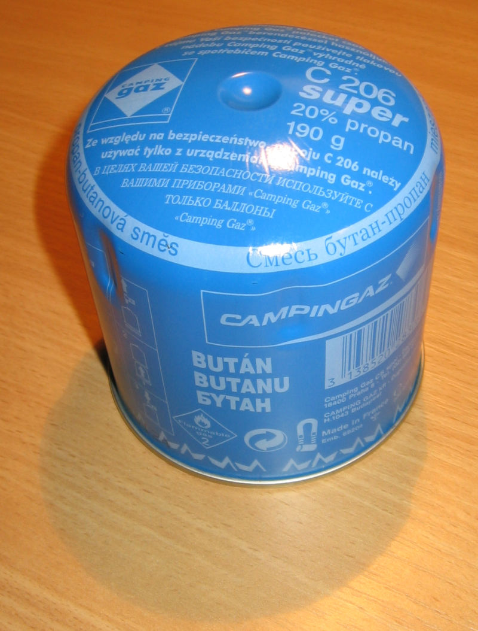
Homogeneous compounds
Homogeneous compound – formed by substances of the same state. The compound particles are so small that they are not visible to the naked eye or under a microscope.
Examples: clean air, a compound of propane – butane,
salt dissolved in water, alcohol with water, alloys,
glass, plastics….

Slide 9
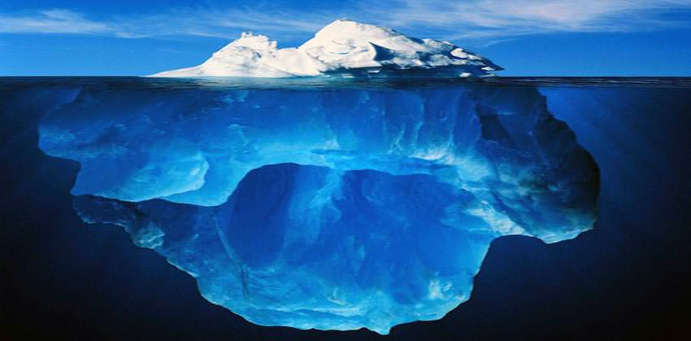
Heterogeneous compounds
Heterogeneous compound – formed by substances of different or the same states. The compound particles are visible to the naked eye or under a microscope.
Examples: polluted air, oil-water compound, salt dissolved in water, sand and water, rocks, polystyrenes, foam, ice in water….

Slide 10
Solubility of compounds, compounds formation
2
Substance solubility in polar and non-polar solvent

Slide 11
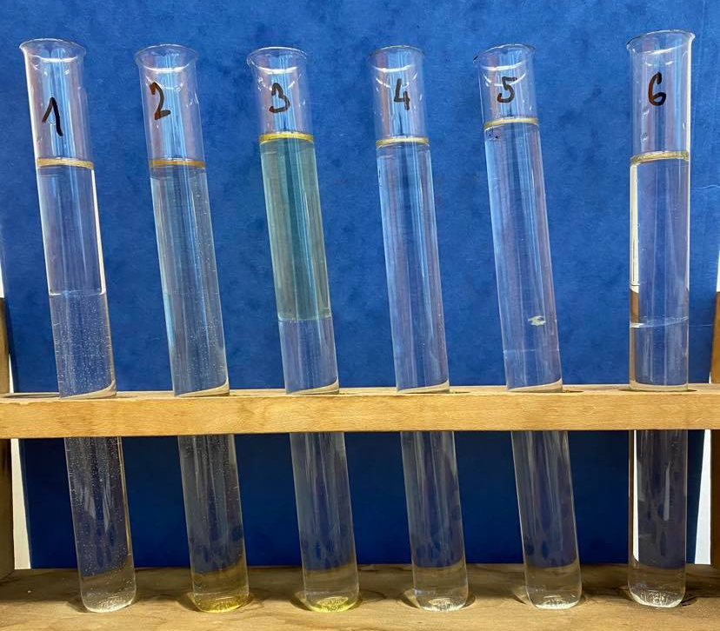
Solubility of substances in water:
The following substances were added to the test tubes with water :
1. cyclohexane
2. acetic acid
3. gasoline
4. alcohol
5. acetone
6. benzene
Water soluble are: acetic acid, alcohol and acetone

Slide 12
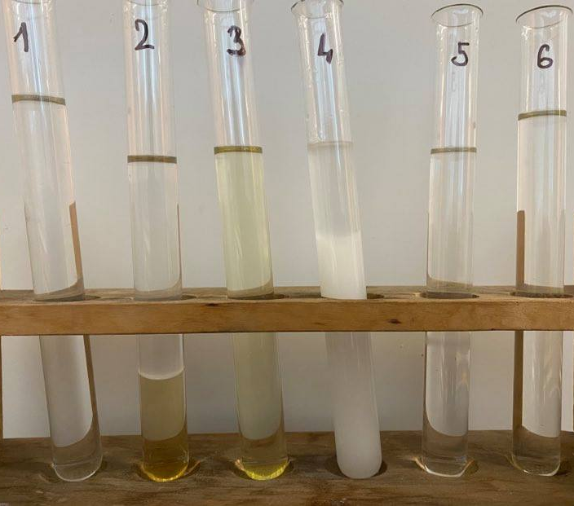
Solubility of substances in benzene:
The following substances were added to the test tubes with benzene :
1. cyclohexane
2. acetic acid
3. gasoline
4. alcohol
5. acetone
6. cyclohexanone
Benzene soluble are: cyclohexane, gasoline, acetone, cyclohexanone

Slide 13
One compound – two constituents:
A heterogeneous compound is seen in the test tube. It is created by two liquid compound particles. These particles are not miscible with each other.
The compound particles differ in some properties - e. g. density, colour, etc.
so called phase transition

Slide 14
What is the solubility of substance influenced by?
Substance solubility depends on the polarity of a solvent and the substance itself but also on other factors such as on a molar mass of the substance, on pH, on dissociation of ions, ….
The rules of substance solubility:
a polar solvent dissolves polar (and ion) substances
a non-polar solvent dissolves non-polar substances

Slide 15
Heterogeneous compounds
3
The separation of compound particles of a heterogeneous compound using a funnel. A “lava lamp” experiment.

Slide 16
A motivational experiment: heterogeneous compounds and their classification:
Link for a video:
There are two non-miscible liquids in the funnel– water and benzene.
Benzene is of lower density than water and it is the upper phase.
We add several crystals of potassium permanganate – not soluble in benzene but soluble in water – a purple solution is formed.
A funnel is used to separate heterogeneous liquid compounds. We let the liquid with the higher density out using a tap/cock into the beaker.
https://drive.google.com/drive/folders/1qkNsu0FPmQMhYolFULDeCrIsTZNqFPQShttps://drive.google.com/drive/folders/1qkNsu0FPmQMhYolFULDeCrIsTZNqFPQS
Benzene density is app 0,88 g/cm³
Water density is 1,00 g/cm³
Potassium permanganate – KMnO₄ – salt
Salts are soluble in water

Slide 17
A motivational experiment with a heterogeneous compound – so called “lava lamp”:
We need: a higher narrow beaker (e. g. a cylinder, a higher narrow flask), water, oil, food colouring, an effervescent tablet
Procedure:
pour water into the beaker and colour it with the food colouring to get a greater effect
cover the water with a higher layer of oil
put the effervescent tablet into the beaker
Principle: water and oil create a heterogeneous compound; the tablet sinks to the bottom (into the water phase). During the tablet dissolving in water, carbon dioxide is released and rises making both liquids mix.

Slide 18
Video to the experiment:
https://drive.google.com/drive/folders/1qkNsu0FPmQMhYolFULDeCrIsTZNqFPQS

Slide 19
TASKS to do
4
TASKS to practise

Slide 20
Classify the following substances as pure substances and compounds
Task 1:
Decide whether the following substances are pure chemical substances or compounds.
copper plate
soda
smoke
distilled water
vinegar
bronze
soil
glucose
blood

Slide 21
Classify the following substances
Task 1 - key:
Decide whether the following substances are pure chemical substances or compounds.
pure chemical substance: compound:
copper plate
soda
distilled water
bronze
glucose
smoke
vinegar
soil
blood

Slide 22
Classify the following substances
Task 2:
Decide whether the following substances are homogeneous or heterogeneous compounds.
soup
smoke
soda
bronze
seawater
vinegar
soil
granite
blood

Slide 23
Classify the following substances
Task 2 - key:
Decide whether the following substances are homogeneous or heterogeneous compounds.
homogeneous compounds: heterogeneous compounds:
vinegar
soda
seawater
soup
bronze
smoke
granite
soil
blood

Slide 24
Do the following tasks using books or the internet:
decide what compound type is the compound of hexane with water
find a formula and a systematic name of alcohol
find a formula and a systematic name of an acetic acid
what is a chemical composition of gasoline?
if there is an oil spill into the water:
does the oil float on the surface or does it sink to the bottom?
is water soluble in water?
in what way is it possible to separate oil from water during the oil spill?

Slide 25
Do the following tasks using books or the internet - key:
hexane and water- heterogenous compound (two liquid phases)
formula and systematic name of alcohol: C₂H₅OH, ethanol
formula and systematic name of acetic acid: C₂H₅COOH, ethanoic acid
the chemical composition of gasoline: liquid alkanes with from 5 to 11 atoms of carbon
what there is an oil spill to water:
oil floats on the surface
no, oil is non-polar while water is polar
it is possible to separate the oil from water using baffles that border the spill in the water and then the oil is pumped out of water or is absorbed by an absorbent chemical substance

Slide 26
Zdroje:
1) Mareček A., Honza J.: Chemie pro čtyřletá gymnázia, 1. díl
2) Benešová M., Pfeiferová E., Satrapová H.: Odmaturuj z chemie
3) Foto – the author
4) Video – the author
5) Pictures used have the licence of Creative Commons

Slide 27
2020-1-SK01-KA226-SCH-094350 DIGI SCHOOL
Délka projektu: 01. 03. 2021 – 28. 02. 2023
Rozpočet partnerství: 101.092,-€
Rozpočet GJŠ Zlín: 20.829,- €
Intelektuální výstupy všech partnerů: ANJ, NEJ, FRJ,SPJ, DEJ, OBN, CHE, GEO, MAT, BIO, EKN, ITK,
HUV, ETV
Intelektuální výstupy GJŠ Zlín v předmětech MAT, GEO, CHE, SPJ
2020-1-SK01-KA226-SCH-094350

Slide 28
EN The European Commission's support for the production of this publication does not constitute an endorsement of the contents, which reflect the views only of the authors, and the Commission cannot be held responsible for any use which may be made of the information contained therein.
ČR Podpora Evropské komise na zhotovení této práce nevyjadřuje názor Komise, obsah je názorem autora a Komise není zodpovědná za informace v práci obsažené.
2020-1-SK01-KA226-SCH-094350

