Slide 1
Metabolism I.
Project number 2020-1-SK01-KA226-SCH-094350
Gymnázium a Jazyková škola s právem státní jazykové zkoušky Zlín
Tato fotka od autora Neznámý autor s licencí CC BY-SA
Tato fotka od autora Neznámý autor s licencí CC BY

Slide 2
Metabolism I.
SUBJECT: CHEMISTRY
SPECIFICATION: Biochemistry lesson
AGE OF STUDENTS: 17-19
1 LESSON : 45 min
2020-1-SK01-KA226-SCH-094350

Slide 3
C O N T E N T
Biological chemistry and living organisms
01
Metabolism, metabolic pathways
02
03
Comparison of catabolism and anabolism
04
Bio-energetics
2020-1-SK01-KA226-SCH-094350

Slide 4
Biological chemistry
Structural biological chemistry concerns substances all living organisms are built of
Dynamic biological chemistry studies changes in living organisms
The changes can be of:
matter
energy

Slide 5
Food intake
Living organism
elimination of metabolic waste
nutrients conversion
Building blocks and energy are gained by nutrients conversion
All these processes are called metabolism

Slide 6
Metabolism
- general information
Metabolism
from a Greek metabolé = change
the set of life-sustaining chemical reactions in organisms
during these reactions the energy in food is converted into energy to run cellular processes
they are enzyme-catalysed reactions
the substances created during these reactions are called metabolites

Slide 7
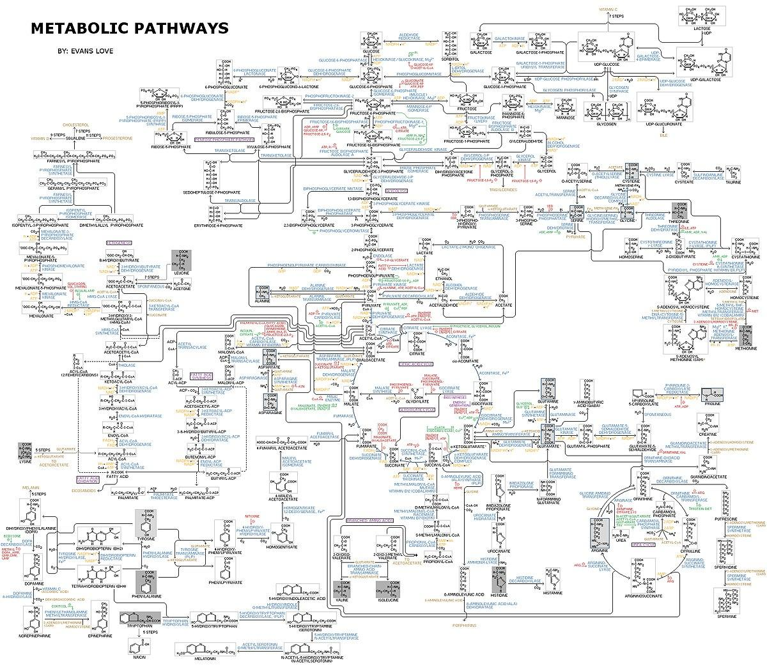
The picture is just to show how complex reactions within organisms are

Slide 8
Basal metabolism
measured for endothermic organisms at rest
basal metabolism
Comprises the processes that the living organism needs to function at rest in a thermally neutral environment
To set BM for an adult person the following is used:
BM (MJ) is approximately 1/10 of mass of a person (in kg)

Slide 9
Metabolic pathways
Chemical reactions of metabolism are organised into metabolic pathways
Metabolic pathways are interconnected
One chemical is transformed through a series of steps into another chemical
Metabolic pathways are:
linear
cyclic

Slide 10
beta-oxidation of fatty acids
glycolysis
linear
gluconeogenesis
amino acids elimination
metabolic pathways
citric acid cycle
urea cycle
cyclic
phosphogluconate pathway
Calvin cycle

Slide 11
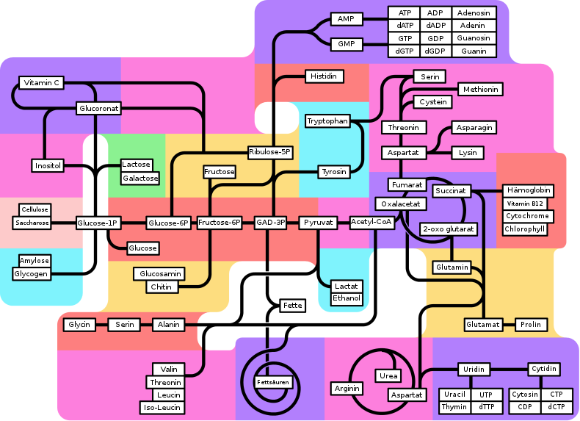
There are cyclic and linear pathways shown in the picture:

Slide 12
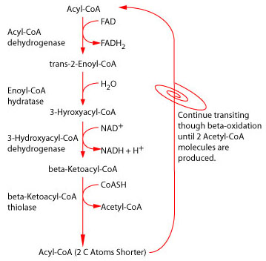
An example of a linear metabolic pathway – beta-oxidation of fatty acids:

Slide 13
An example of cyclic metabolic pathways – citric acid cycle:
Acetyl-Co A
oxaloacetate
citrate
malate
isocitrate
fumarate
alpha-lactoglutarate
succinate
Succinyl-Co A

Slide 14
Two types of metabolic pathways
Catabolic p.
Anabolic p.
catabolism
anabolism
decomposition
digestion
degradation
dissimilation
synthesis
production
assimilation

Slide 15
catabolism
metabolism
anabolism

Slide 16
Relation between catabolism and anabolism
1. They are contradictory
 | catabolism | anabolism
character | degradable | synthetical
reactions | oxidation | reduction
energy | Is created | Is consumed
Primary substances | complex (organic – polysaccharides, lipids, proteins…) | simple (inorganic – water, carbon dioxide, ammonia)
Reactions products | simple (inorganic – water, carbon dioxide, ammonia) | complex (organic – polysaccharides, lipids, proteins…)

Slide 17
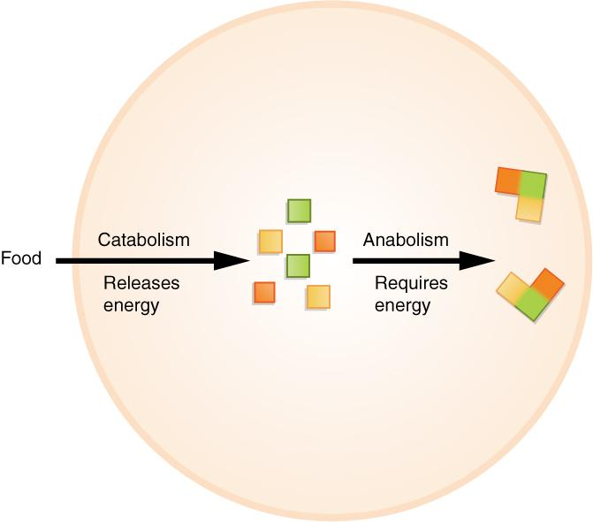
What happens with food in organisms?

Slide 18
Relation between catabolism and anabolism
2. They complement each other
catabolism
Produces substrates (primary substances) for anabolism and consumes products of anabolism
anabolism
Produces substrates for catabolism and consumes products of catabolsim

Slide 19
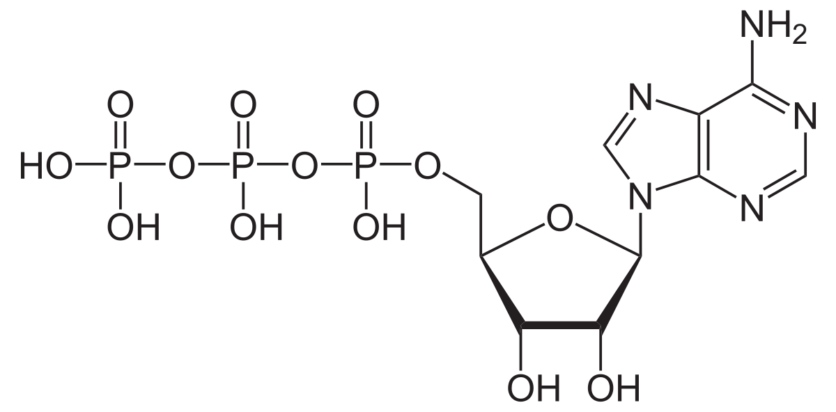
Relation between catabolism and anabolism
3. Use the same energy transport means
ATP = adenosine triphosphate
ATP functions as the energy transport means.
Catabolic reactions produce ATP molecules, ATP is consumed during anabolic reactions.

Slide 20
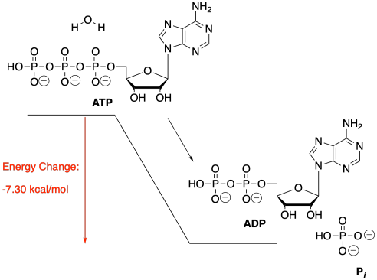
Relation between catabolism and anabolism
ATP = adenosine triphosphate
ADP = adenosine diphospahate
P_{i} = phosphate (orthophosphoric acid anion)
katabolismus
anabolismus

Slide 21
Relation between catabolism and anabolism
4. Use the same means of hydrogen transport
most often oxidoreductase coenzyms act as transport means:
NAD⁺
(nicotinamide adenine dinucleotide)
NADP⁺
(nicotinamide adenine dinucleotide phosphate)
FMN
(flavin mononucleotide)
FAD
(flavin dinucleotide)
Při katabolických reakcích atomy vodíku vznikají
Při anabolických reakcích se atomy vodíku spotřebovávají

Slide 22
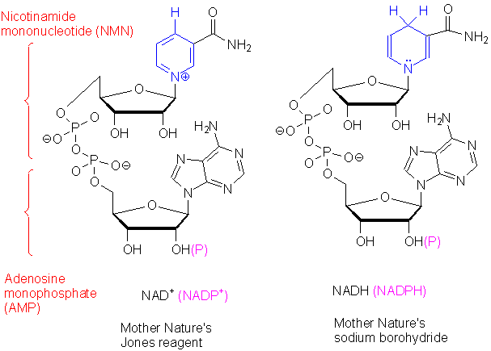
NAD⁺ and NADP^{+ structure}

Slide 23
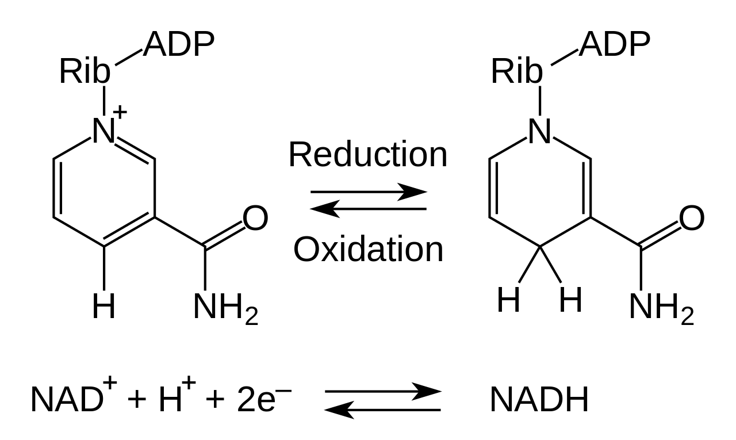
Oxide and redux form of nicotinamide adenine dinucleotide:

Slide 24
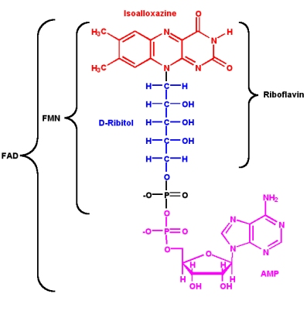
FMN and FAD structure
Tato fotka od autora Neznámý autor s licencí CC BY-SA
Tato fotka od autora Neznámý autor s licencí CC BY-SA-NC

Slide 25
Bioenergetics
Each living organism need a constant flow of energy to sustain life.
The base of these processes is the conversion of one type of energy into another one. This energy is need to work.

Slide 26
The work within an organism
Chemical - synthesis of compounds with higher amount of energy (ATP), to re-new, grow and multiple cells. Most energy consumed.
Mechanical - the whole life is linked to this (muscles work, hearth activity, protoplasm flow in plant cells)
Osmotic - to transport molecules and ions actively.

Slide 27
The work within an organism
Electrical – to transfer stimuli within a cell and transport substances through a cell membrane
Structural – to create surface and phase margins, to organise molecules into biological structures
Regulative – for regulative processes- to regulate interactions of complex compounds, introduces order, lowers entropy
Heat - to keep the body’s temperature
Light - bioluminescence (light emission) of some species e. g. fireflyes

Slide 28
EN The European Commission's support for the production of this publication does not constitute an endorsement of the contents, which reflect the views only of the authors, and the Commission cannot be held responsible for any use which may be made of the information contained therein.
ČR Podpora Evropské komise na zhotovení této práce nevyjadřuje názor Komise, obsah je názorem autora a Komise není zodpovědná za informace v práci obsažené.
2020-1-SK01-KA226-SCH-094350

Slide 29
2020-1-SK01-KA226-SCH-094350 DIGI SCHOOL
Délka projektu: 01. 03. 2021 – 28. 02. 2023
Rozpočet partnerství: 101.092,-€
Rozpočet GJŠ Zlín: 20.829,- €
Intelektuální výstupy všech partnerů: ANJ, NEJ, FRJ,SPJ, DEJ, OBN, CHE, GEO, MAT, BIO, EKN, ITK,
HUV, ETV
Intelektuální výstupy GJŠ Zlín v předmětech MAT, GEO, CHE, SPJ
2020-1-SK01-KA226-SCH-094350

