Slide 1
Metabolism II.
Project number 2020-1-SK01-KA226-SCH-094350
Gymnázium a Jazyková škola s právem státní jazykové zkoušky Zlín
Tato fotka od autora Neznámý autor s licencí CC BY

Slide 2
Metabolism II.
SUBJECT: CHEMISTRY
SPECIFICATION: Biochemistry lesson
AGE OF STUDENTS: 17-19
1 LESSON : 45 min
2020-1-SK01-KA226-SCH-094350

Slide 3
C O N T E N T
Acetyl-CoA – the importance and formation
01
02
Metabolic pathways interconnections
03
Three phases of catabolism
04
Final test
2020-1-SK01-KA226-SCH-094350

Slide 4
Metabolic pathways interconnection
Metabolic pathways are interconnected
The same substance Acetyl–CoA is formed within metabolism of three basic nutrients
Acetyl-CoA enters the citric acid cycle

Slide 5
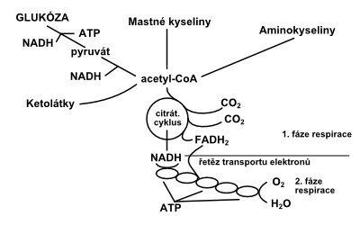
Nutrients catabolic pathways interconnection in an organism:
Saccharides
Lipids
Proteins
Acetyl-CoA
Tato fotka od autora Neznámý autor s licencí CC BY

Slide 6
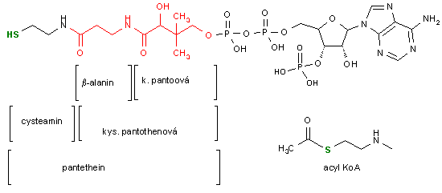
Coenzyme A molecule

Slide 7
Acetyl-CoA formation
CoA
acetic acid
coenzyme A
acetyl-CoA

Slide 8
saccharides
glycolyse
lipids
VMK beta-oxidation
proteins
proteins metabolism
pyruvate
Acetyl-CoA
α – amino acids
CoA
2H₂O
α –keto-acids
citric acid cycle
GTP
GDP + P_{i}
2CO₂
3NADH/H⁺
FADH₂
FAD
3NAD⁺
respiratory chain
n ADP + P_{i}
2O₂
4H₂O
n ATP

Slide 9
polysaccharides, oligosaccharides
starch, sucrose, lactose, maltose
monosaccharides
glucose, fructose, galactose
glycerol
glucose-6-phosphate
CoA
glycolysis
Pentose phosphate pathway
pyruvate
Acetyl-CoA
reduction
citric acid cycle
ribose
lactate
respiratory chain

Slide 10
Lipids
fats, oils
fatty acids
palmitic a., stearic a., oleic a.…
glycerol
beta-oxidation
CoA
Acetyl-CoA
citric acid cycle
respiratory chain

Slide 11
Proteins
amino-acids
(20 proteinogenic AMK)
the urea cycle
NH₃
urea (carbamide)
CoA
various ways of elimination
Acetyl-CoA
citric acid cycle
respiratory chain

Slide 12
Phases of catabolism
Catabolism of individual nutrients can be divided into three phases.
These phases differ from each other in:
substances at the beginning of each phase and those that are formed
conditions under which the reaction run
process location (organ and/or cell)
energy gain

Slide 13
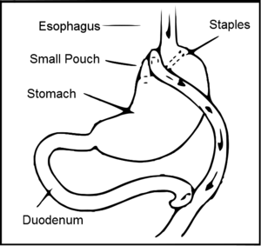
Phase 1
Large molecules break into smaller units
lipids into glycerol and VMK
polysaccharides, oligosaccharides into monosaccharides (glucose, fructose)
proteins into amino-acids (20 basic amino-acids)
A smaller number of simple units are formed out of large a number of molecules
2) Fission is run by hydrolases (hydrolysis of a bond)
3) Anaerobic reactions
4) Take place in gastrointestinal trackt
5) No energy gain

Slide 14
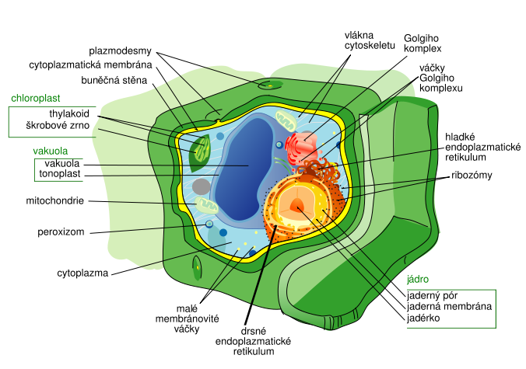
Phase 2
Substances formed in the phase 1 are transported into pyruvate and Acetyl-CoA
2) Fission is run by oxidoreductase enzymes (dehydrogenation of substrates)
3) Takes place in cell cytoplasm and mitochondrion
4) Small energy gain – the energy is stored in acetic acid (Acetyl-CoA).
Hydrogen atoms are formed with the energy to be used

Slide 15
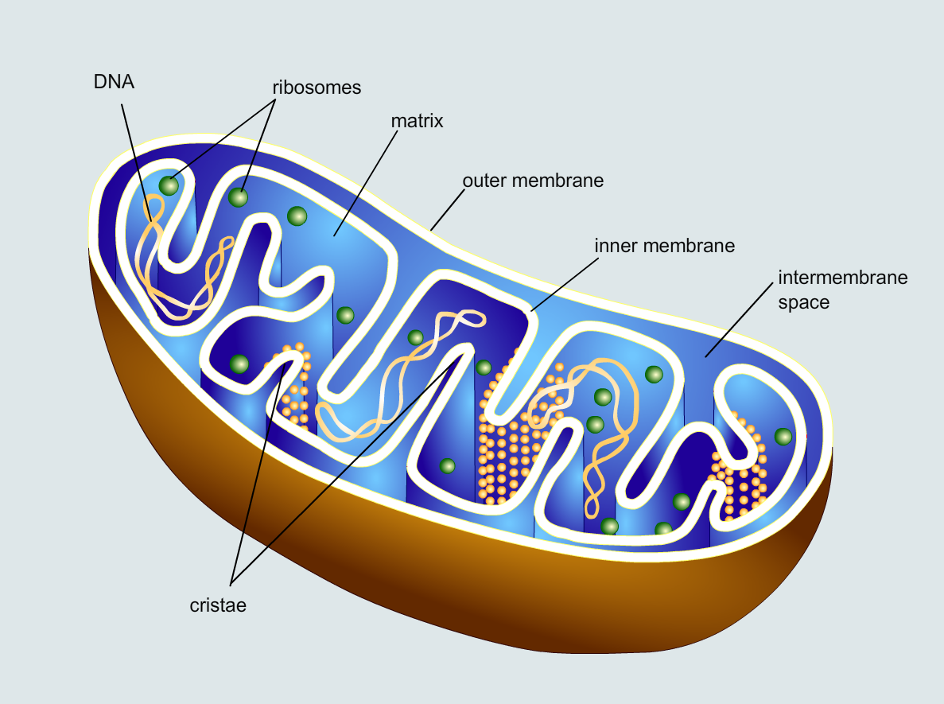
Phase 3
1) So called Krebs (citric acid) cycle which is linked to respiratory chain.
2) Acetyl-CoA oxidises to carbon dioxide. 8 atoms of hydrogen are formed out of 1 molecule of Acetyl-CoA; the atoms join with oxygen to form water and release energy.
3) Run in mitochondrion.
4) Large energy gain. The energy is stored in an ATP molecule.

Slide 16
Final test

Slide 17
2020-1-SK01-KA226-SCH-094350 DIGI SCHOOL
Délka projektu: 01. 03. 2021 – 28. 02. 2023
Rozpočet partnerství: 101.092,-€
Rozpočet GJŠ Zlín: 20.829,- €
Intelektuální výstupy všech partnerů: ANJ, NEJ, FRJ,SPJ, DEJ, OBN, CHE, GEO, MAT, BIO, EKN, ITK,
HUV, ETV
Intelektuální výstupy GJŠ Zlín v předmětech MAT, GEO, CHE, SPJ
2020-1-SK01-KA226-SCH-094350

Slide 18
EN The European Commission's support for the production of this publication does not constitute an endorsement of the contents, which reflect the views only of the authors, and the Commission cannot be held responsible for any use which may be made of the information contained therein.
ČR Podpora Evropské komise na zhotovení této práce nevyjadřuje názor Komise, obsah je názorem autora a Komise není zodpovědná za informace v práci obsažené.
2020-1-SK01-KA226-SCH-094350

