Slide 1
Natural pH indicators
Project number 2020-1-SK01-KA226-SCH-094350
Gymnázium a Jazyková škola s právem státní jazykové zkoušky Zlín

Slide 2
Natural pH indicators
SUBJECT: CHEMISTRY
SPECIFICATION: Chemie, 2. ročník
AGE OF STUDENTS: 16 - 17
1 LESSON : 45 min. teoretická příprava + 45 min. praktická část
2020-1-SK01-KA226-SCH-094350

Slide 3
C O N T E N T
01
Indicators – theory
02
Natural indicators
03
Practical part – preparation and use of the red cabbage indicator. Videos
04
Tasks
2020-1-SK01-KA226-SCH-094350

Slide 4
pH indicator
1
Definition and use of indicators. An overview of the most well-known ones

Slide 5
What is an indicator?
The term indicator comes from Latin (indicare = show) and is used in various scientific fields, it may refer to:
biology indicator – a plant or an animal which indicates certain conditions in an environment; for example: a canary indicates the presence of dangerous gases in mines; a heath in blossom indicates acid soil…
in mathematics the term is linked with sets functions
social indicator – a phenomenon indicating certain phenomena in society
in engineering

Slide 6
Chemical indicator
Is a substance indicating a change of the environment that could not be observed in any other way.
The example can be pH indicators that react to change by changing the colour of a mixture. From the chemical point of view they are complex organic substances or solutions. They determine either acidity or basicity

Slide 7
pH indicators
The most common pH indicators and their colour in acidic and alkaline environment:
Indicator | Colour in acid environment | Colour in alkaline environment
Phenolphthalein | Colourless | Purple-pink
Methyl orange | Orange | Yellow
Methyl red | Red | Yellow
Litmus | Red | Purple

Slide 8
Colour changes of some pH indicators depending on the pH:
Tato fotka od autora Neznámý autor s licencí CC BY-SA-NC

Slide 9
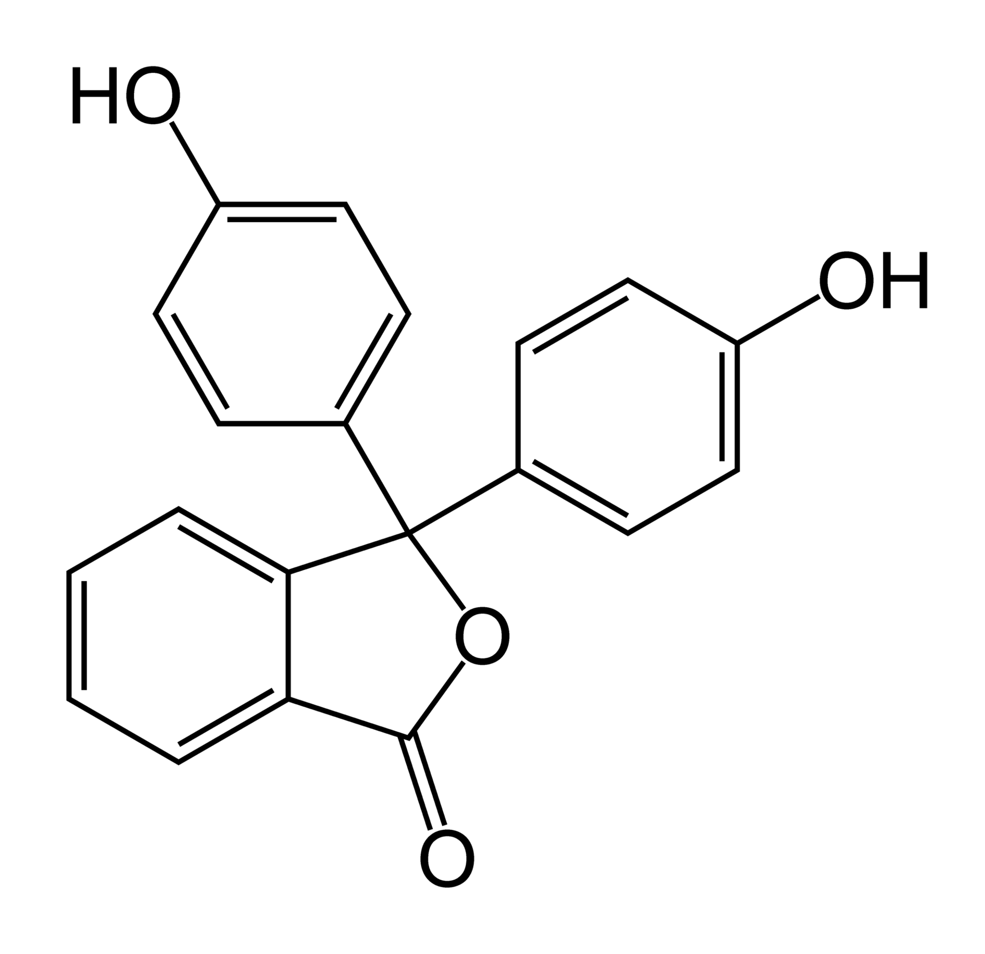
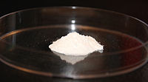
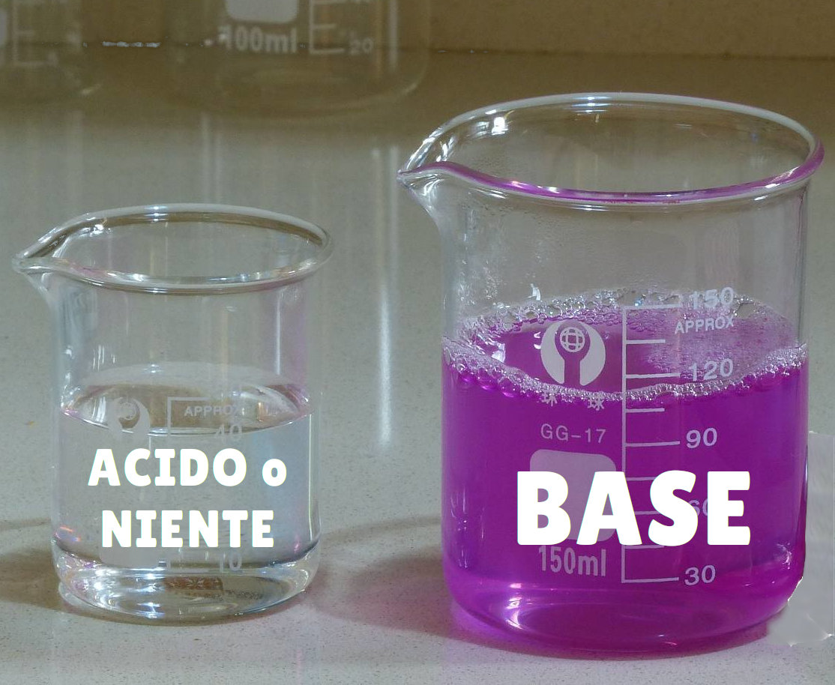
Phenolphthalein:
White powder soluble in ethanol, used as a laxative but now being removed from laxatives because of concern over carcinogenicity
Coloration of phenolphthalein solution in acid and basic
environment:
ACID

Slide 10
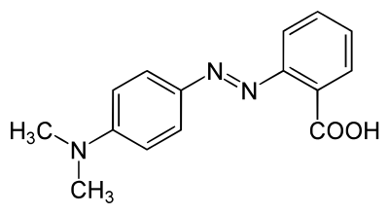
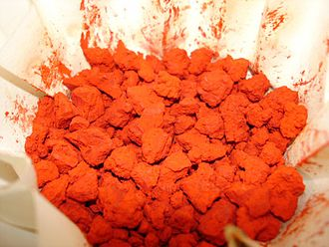
Methyl red Methyl orange
Belong to azo dyes – organic compounds bearing the functional group –N = N –
Water soluble.
Tato fotka od autora Neznámý autor s licencí CC BY-SA

Slide 11
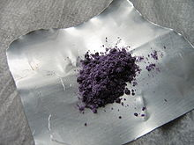
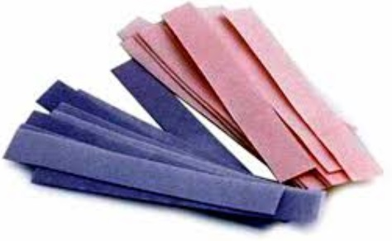
Litmus
Purple powder extracted from lichens, water soluble.
Often used in the form of litmus paper –
blue litmus paper, red litmus paper:
Tato fotka od autora Neznámý autor s licencí CC BY-SA-NC

Slide 12
Natural pH indicator
2
Occurrence and use

Slide 13
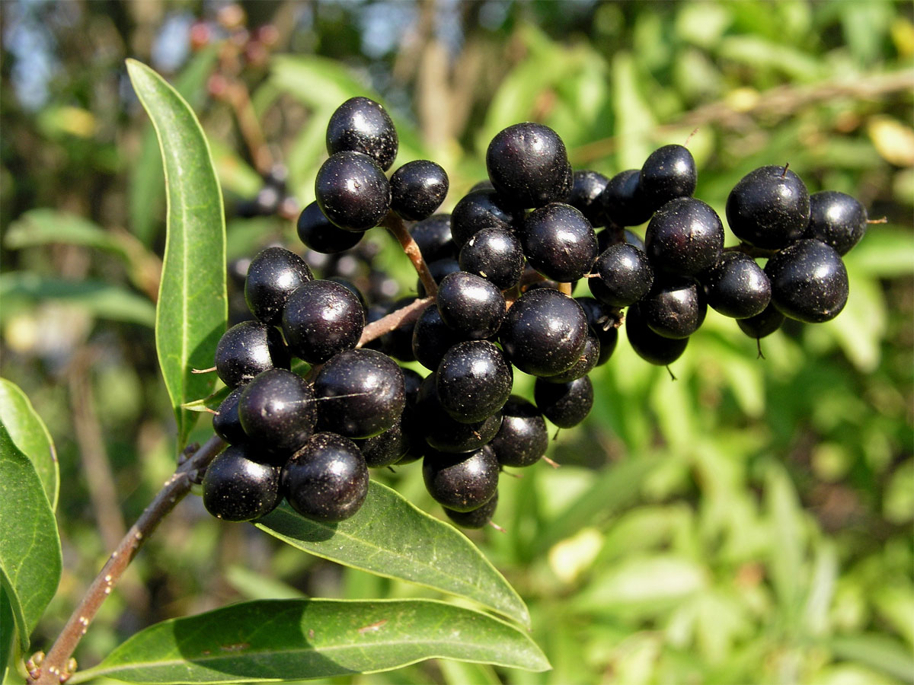
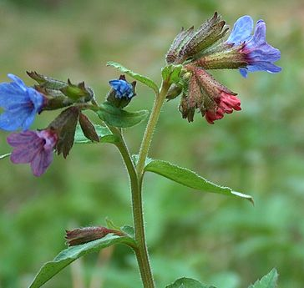
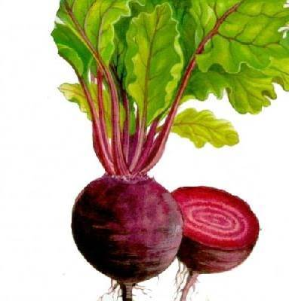
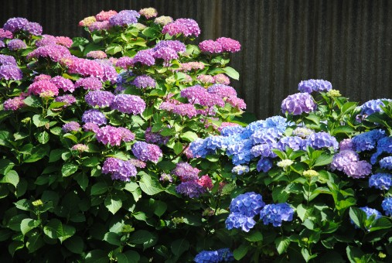
Natural pH indicators
Anthocyanisms/anthocyans – colour plants and flowers, occur in tissues of higher plants. The colour changes depend on pH.
Anthocyans are used as food colorants (E 163) – e. g. to colour sweets, ice cream, lemonades, alcoholic drinks and so on.
Examples of plants:
blossoms - forget-me-knot blossoms, lung wort, hortensia, roses, poppy blossoms
fruits – redcurrant, wild privet, blueberry
leaves and other parts– red cabbage, beetroot
wild privet lung wort beetroot hortensia
Tato fotka od autora Neznámý autor s licencí CC BY-SA-NC

Slide 14
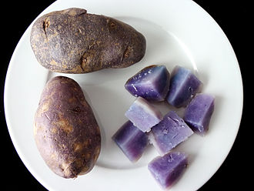
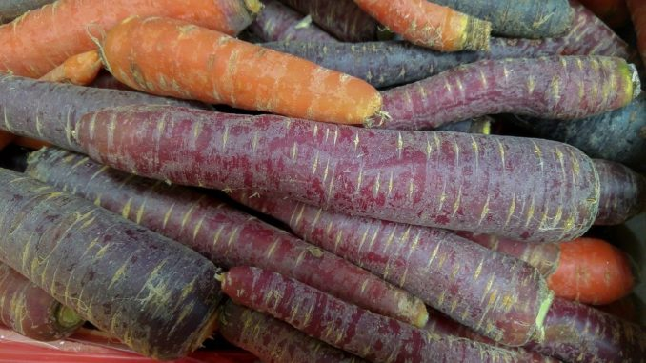
Potatoes and carrots may be purple coloured due to the content of anthocyans as well:
Anthocyans belong to polyphenoles – substances having a polyphenol structure with several hydroxyl groups –OH. They have positive effects on human health; they are anti-inflammatori, they inhibit oxidation – a reaction that can produce free radicals and protect human body against cancer and health diseasses.

Slide 15
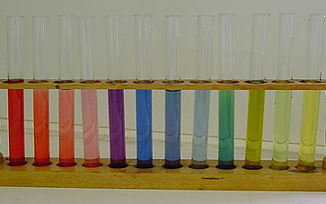
Natural pH indicators change their colouring in the whole spectrum of the pH scale:
Tato fotka od autora Neznámý autor s licencí CC BY-SA-NC

Slide 16
Practical part
3
Natural pH indicator preparation and its used

Slide 17
Task: Prepare an indicator from red cabbage leaves and verify its properties
We need: beakers, set of test tubes, knife, kettle, spoon, a piece of cloth (sieve, filter paper, …), pipette, grater, chopping board.
To examine the indicator colouring, it is possible to use various solutions. From the common substances, we can use e. g. vinegar, lemon juice, various drinks, soap solution, water, bicarbonate solution, cosmetics…..
In a lab there are much wider possibilities to use a wider range of substances from strongly acid to strong bases.
Do not forget safety rules when working with chemicals!

Slide 18
Instruction:
1) Cut or grate cabbage. Boil water in the kettle. 2) ) Put the grated cabbage into a bigger beaker, pour boiling water on the cabbage so that it is just covered with it, mix and leave to leach for about 30 minutes. 3) Prepare the examined substances into test tubes; solid substances need to be dissolved in water, the solution concentration is not important.
4) Filter the red cabbage infusion into another beaker through filter paper, sieve, or a piece of cloth.
5) Pour the red cabbage infusion into individual test tubes, stir if necessary and observe changes in colours.

Slide 19
Instructions in a video:
Link for a video:
https://drive.google.com/drive/folders/1qkNsu0FPmQMhYolFULDeCrIsTZNqFPQS

Slide 20
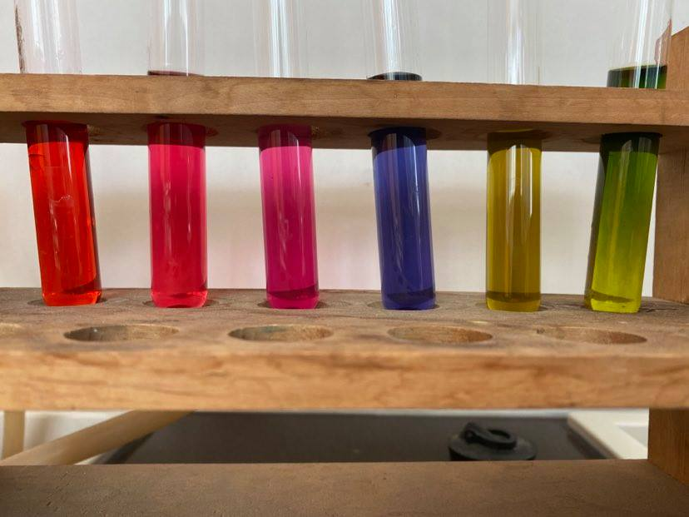
Indicator colouring in examined solutions:
1 2 3 4 5 6
Solutions used:
hydrochloric acid (5%)
vinegar
citric acid (5%)
water
ammonia (5%)
potassium hydroxide water solution (5%)

Slide 21
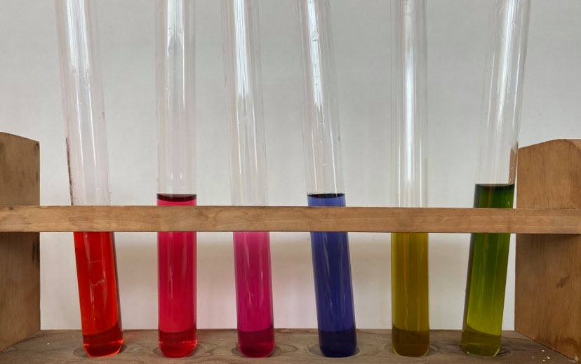
The solutions are order from the most acidic (in the left) to the most alkaline:
1 2 3 4 5 6
pH of different solutions:
(measured by a portable pH-metre)
pH = 0,5
pH = 2,4
pH = 3,5
pH = 6,8
pH = 12,3
pH = 13,6

Slide 22
Tasks:
1) Explain:
a) what does “colour transition of an indicator” mean
b) what food contains polyphenols
c) what azo dyes are used for
2) Explain what happens when you wash your hands dirty of blueberry with water ad soap. What would happen if you used lemon juice afterwards?
3) What can some flowers be of different colours when we fertilize them with either acid or alkaline fertilizer?

Slide 23
Conduct the experiment:
1) Prepare indicators from red cabbage and from beetroot
2) Using the prepared indicators verify the character of various solutions
3) Compare the colouring in the solutions and explain the differences

Slide 24
Resources:
1) Mareček A., Honza J.: Chemie pro čtyřletá gymnázia, 1. díl až 3. díl
2) Benešová M., Pfeiferová E., Satrapová H.: Odmaturuj z chemie
3) Foto - author
4) Video - author
5) Použité obrázky mají licenci Creative Commons

Slide 25
2020-1-SK01-KA226-SCH-094350 DIGI SCHOOL
Délka projektu: 01. 03. 2021 – 28. 02. 2023
Rozpočet partnerství: 101.092,-€
Rozpočet GJŠ Zlín: 20.829,- €
Intelektuální výstupy všech partnerů: ANJ, NEJ, FRJ,SPJ, DEJ, OBN, CHE, GEO, MAT, BIO, EKN, ITK,
HUV, ETV
Intelektuální výstupy GJŠ Zlín v předmětech MAT, GEO, CHE, SPJ
2020-1-SK01-KA226-SCH-094350

Slide 26
EN The European Commission's support for the production of this publication does not constitute an endorsement of the contents, which reflect the views only of the authors, and the Commission cannot be held responsible for any use which may be made of the information contained therein.
ČR Podpora Evropské komise na zhotovení této práce nevyjadřuje názor Komise, obsah je názorem autora a Komise není zodpovědná za informace v práci obsažené.
2020-1-SK01-KA226-SCH-094350

