Slide 1
Saccharides
Project number 2020-1-SK01-KA226-SCH-094350
Gymnázium a Jazyková škola s právem státní jazykové zkoušky Zlín

Slide 2
Saccharides
SUBJECT: CHEMISTRY
SPECIFICATION: Biochemistry workshop
AGE OF STUDENTS: 17-19
1 LESSON : 45 min
2020-1-SK01-KA226-SCH-094350

Slide 3
C O N T E N T
01
Introduction – interesting facts
02
Saccharides – definiton,
composition, properties, formation
03
Types of saccharides formulae
04
Chiral centres, Anomers
2020-1-SK01-KA226-SCH-094350

Slide 4
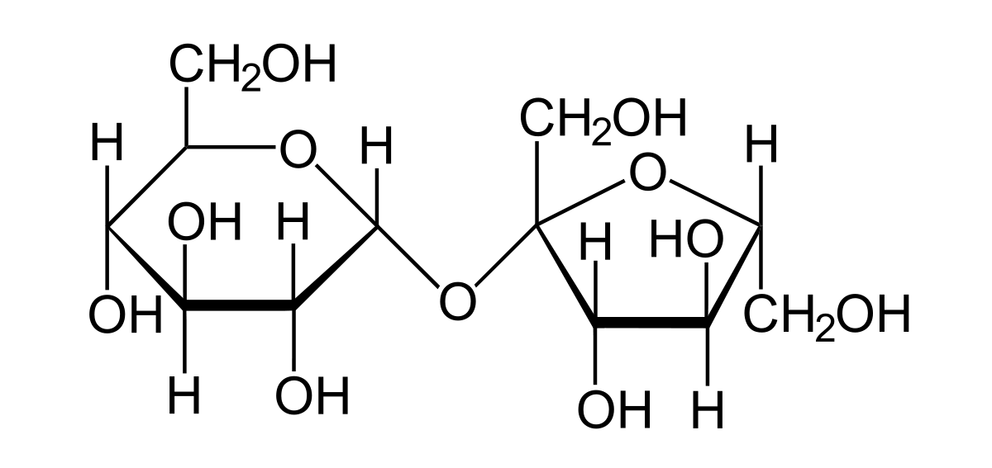
A few facts to think about
To sweeten drinks and meals people have always used beet or cane sugar
Chemically it is sucrose – a disaccharide composing of glucose and fructose

Slide 5
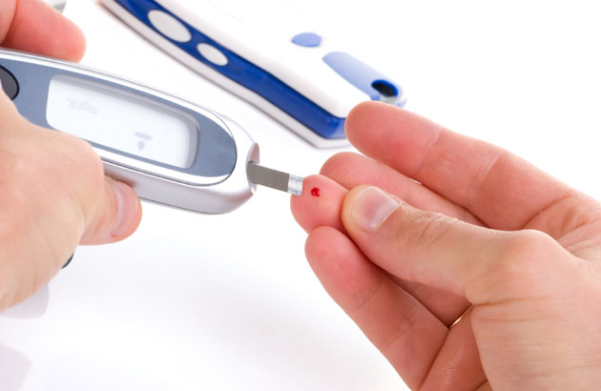
Glucose – a building unit of sucrose
Glucose and fructose are formed by biological hydrolysis of sucrose
Glucose is found as blood sugar in human bodies. The blood sugar content of a healthy person in the short-term fasting state is from 3,9 to 5,6 mmol/l.
The glucose content of the blood is regulated by hormones like insulin and glucagon.
Glucagon is a peptide hormone, belongs to polypeptides (complex saccharides)

Slide 6
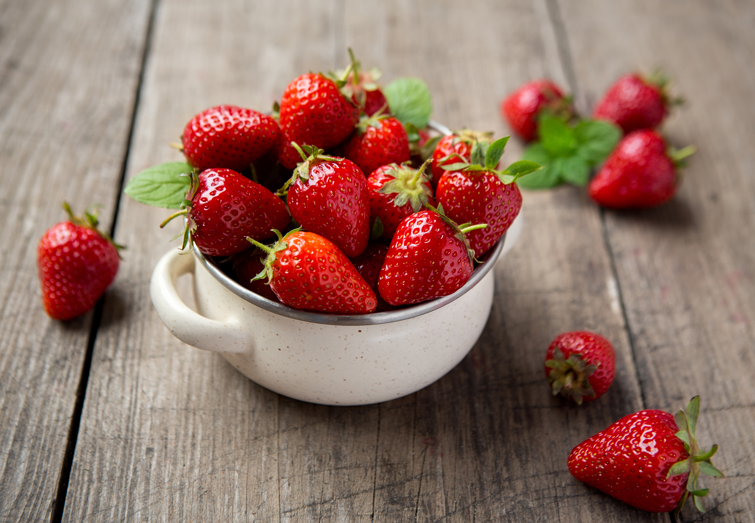
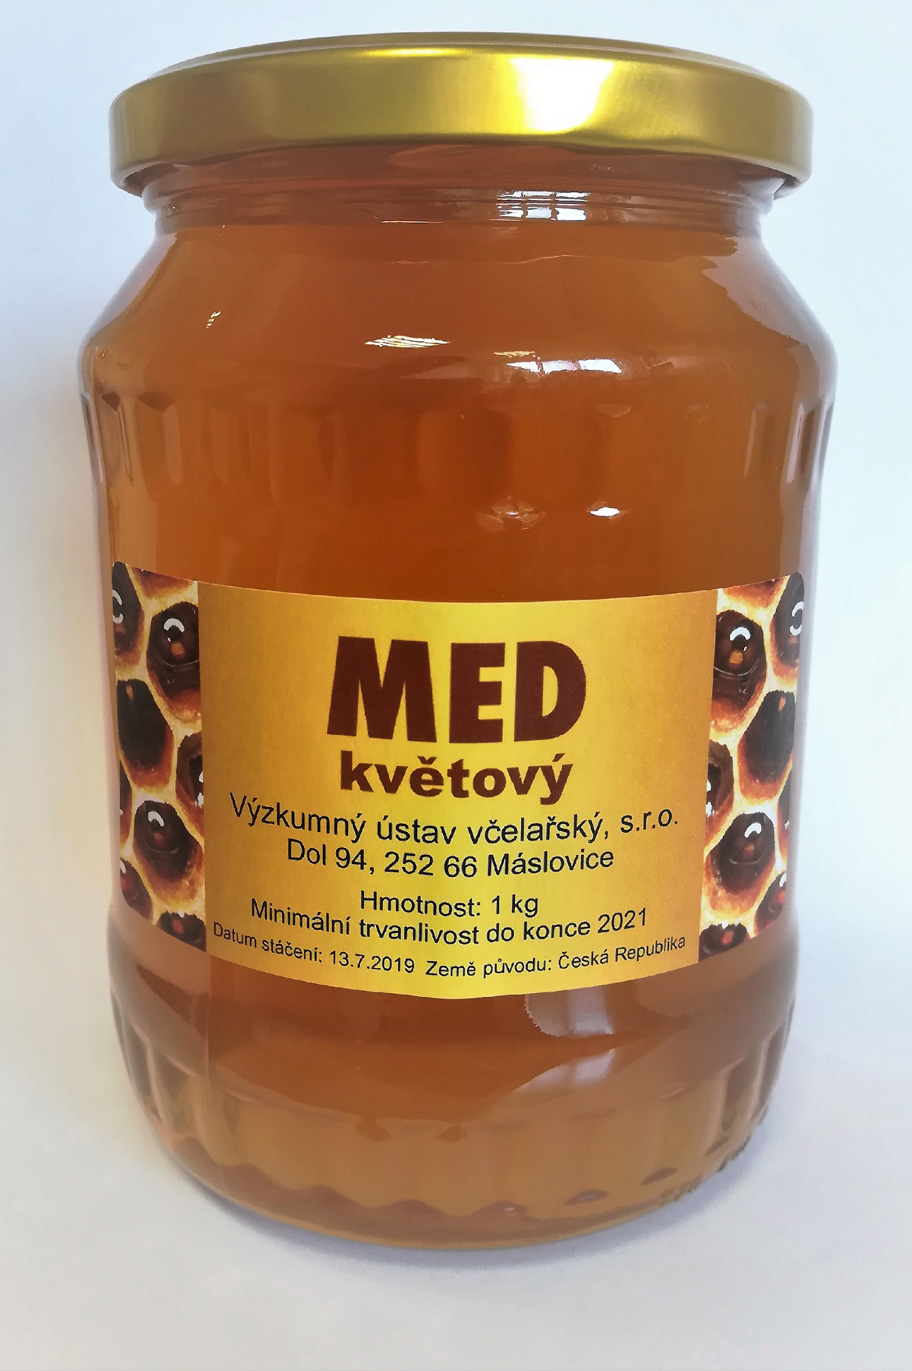
Fructose – a building unit of sucrose
Fructose – also called fruit sugar – is found in honey, fruits and berries, and some vegetables (water melon, onion, sweet potatoes)
Commercially, fructose is derived from sugar beets, sugar cane, and maize
Fructose in honey is formed by converting sucrose to a mixture of glucose and fructose by the bee’s digestive enzymes hydrolyze
Fructose has the highest relative sweetness. It is used as a cheap sweetener. But its high consumption has a negative effect on humans in mainly in increasing weight gain and health problems related to it.

Slide 7
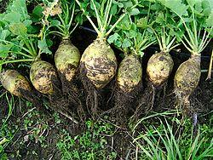
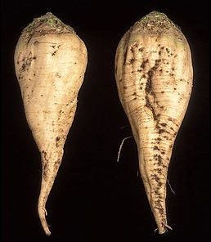
Sugar beet
Sugar content of a sugar beet is
16 – 18 %,
There is about 80 – 13 g of sugar (sucrose) in a taproot.

Slide 8
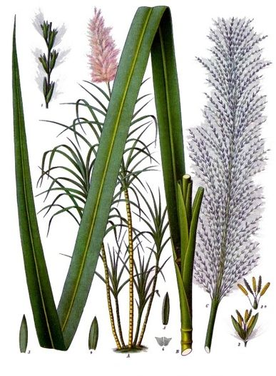
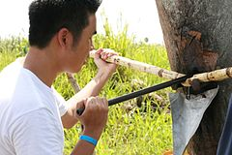
Sugar cane
Sugar content of sugar cane is up to 20 % of sugar (sucrose). Except of sucrose it also includes glucose, fructose, and molasses.

Slide 9
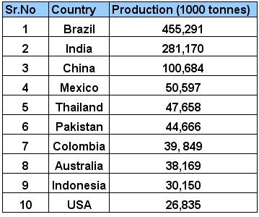
Global sugar production

Slide 10
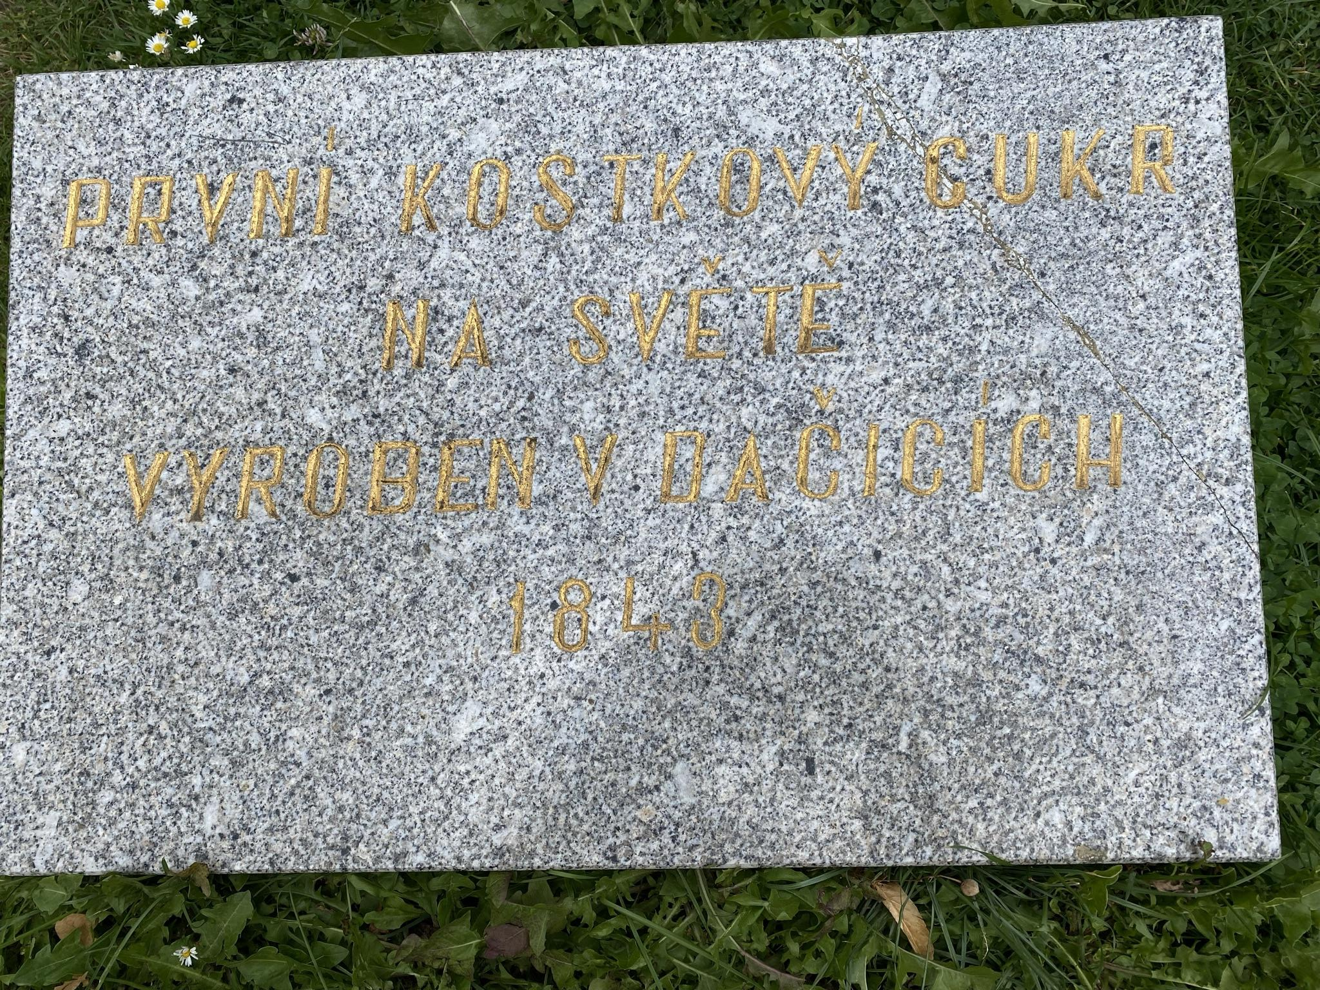
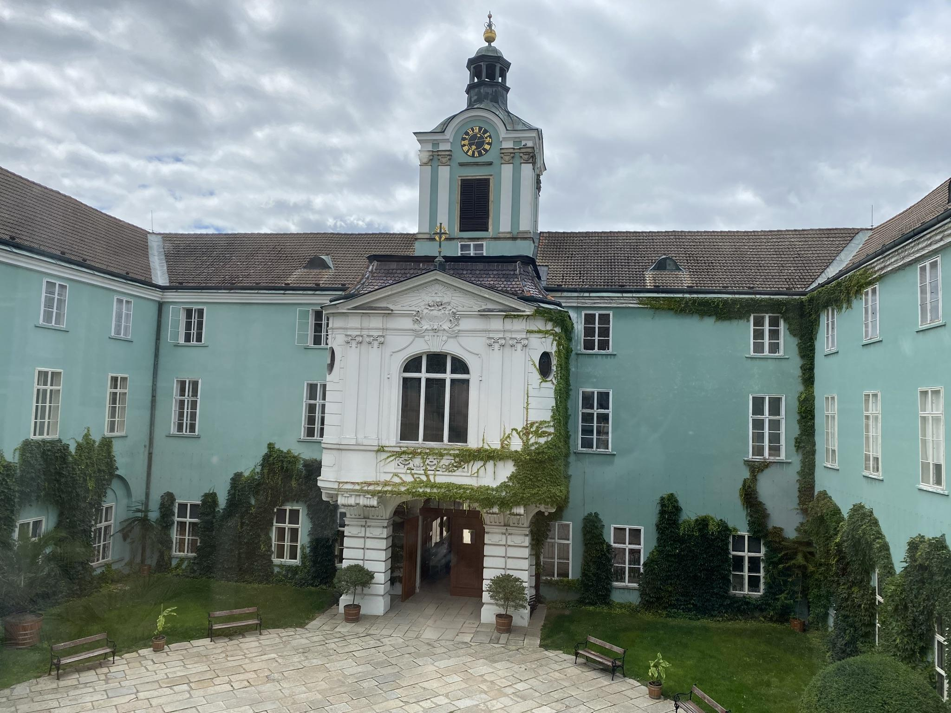
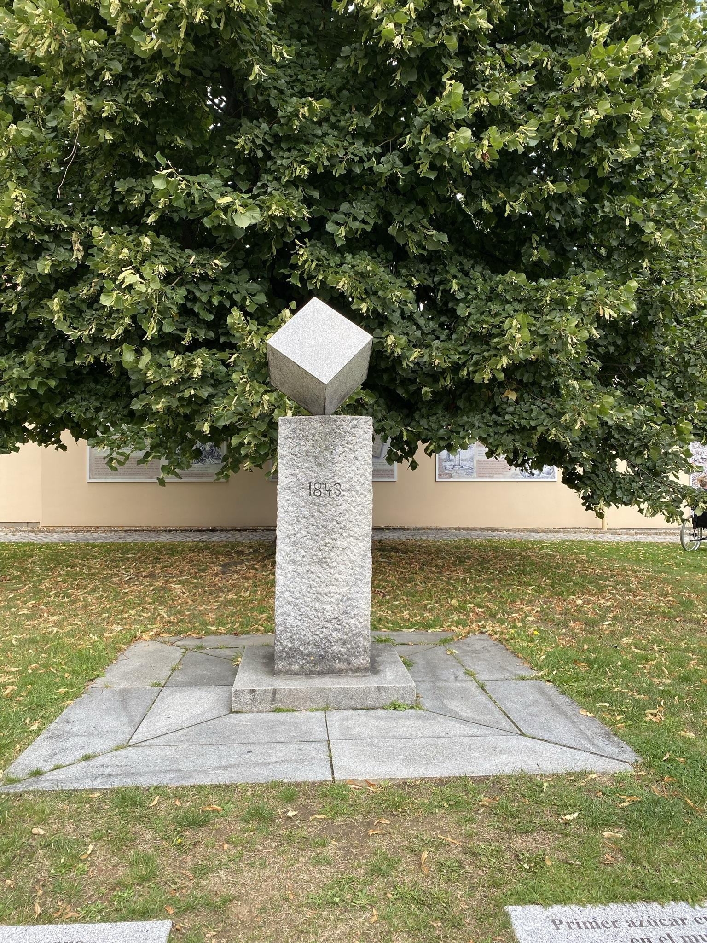
The first sugar cube?
Dačice, the Czech Republic, 1843

Slide 11
33 kg
The consumption of sugar per one person a year
On average the mankind use twice as much sugar as it is recommended!

Slide 12
Saccharides
- definition
- composition
Natural substances present in almost all living organisms
Consist of C, H a O
The empirical formula: C_{n}(H₂O) _{n}
They are derived from hydrocarbons
There are two groups:
Hydroxyl group: - OH
Carbonyl group: C = O
Chemical reactions of saccharides are the same as these of alcohols, aldehydes, and ketones

Slide 13
Saccharides
- The importance
An energy source of metabolism (1g of saccharide contains app 18 kJ of energy)
Building material (part of cell walls)
A storage material
A part of nucleosides and nucleotides
A part of physiologically active substances (organic cofactors, hormones, antibiotics, glycosides)
The most widespread natural compounds
They are found in living organisms organs (e. g. cell membrane, liver, spleen, cerebral cortex)

Slide 14
saccharides
- formation
Monosaccharides are synthesised from carbon dioxide and water converting light energy through an organic cofactor chlorophyll in green plants
This process is called photosynthesis
The overall equation of photosynthesis is:
6 H₂O + 6 CO₂ → C₆H₁₂O₆ + 6 O₂
or:
12 H₂O + 6 CO₂ → C₆H₁₂O₆ + 6 H₂O + 6 O₂
Monosaccharides are turned into more complex saccharides

Slide 15
According to the number of carbon atoms in molecules (saccharide units)
monosacharides so called sugars (sweet, soluble in water)
oligosacharides
polysacharides
According to the carbonyl group
aldoses
ketoses
Saccharides nomenclature:
1) general: a Greek numeral that signals the number of carbon atoms + suffix -ose + prefix aldo-/keto-
e. g. ketohexose (ketose group, 6 atoms of C)
2) simple names: e. g. glucose, galactose…
saccharides
- classification
- nomenclature

Slide 16
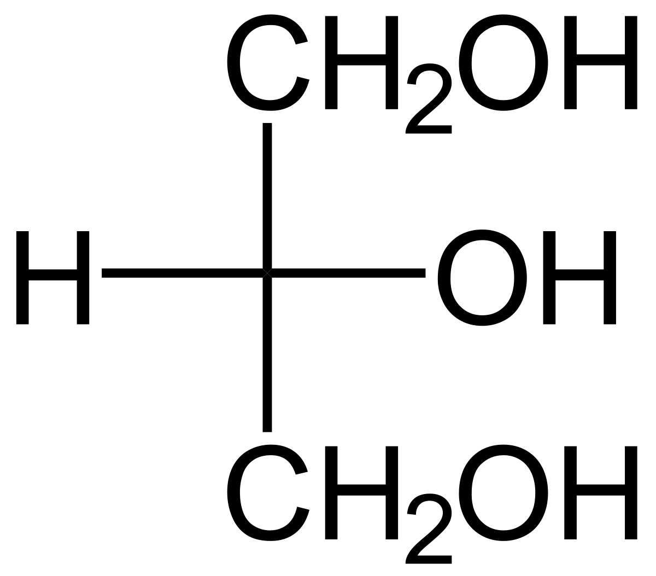
Monosaccharides
Contain from 3 to 7 atoms of carbon
Cannot be split further into even simpler saccharides
Products of oxidation of polyhydric alcohols
The simplest monosaccharides are derived from glycerol
(propane–1,2,3–triol):

Slide 17
primary secondary
alcohol alcohol
group group
glyceraldehyde glycerole dihydroxyacetone
simplest sugars

Slide 18
Glyceraldehyde
- The simplest of all common aldoses (aldotriose)
- Optically active saccharide
- Chiral centre is on carbon n. 2
- Glyceraldehyde exists in two different enantiomers with opposite optical rotation (+) … right
(-) … left
1
1
CHO
CHO
2
2
HO
C
H
H
C
OH
3
3
CH₂OH
CH₂OH
L – glyceraldehyde
D – glyceraldehyde

Slide 19
Dihydroxyacetone
- The simplest ketotriose
- No optical activity
- No chiral centre
- Does not curve the plain of the polarized light
CH₂OH
C
O
CH₂OH

Slide 20
Isomers
The above mentioned trioses are (glyceraldehyde and dihydroxyacetone) are
Structural isomers
(as the other aldoses and ketoses with the same number of carbon atoms)
CHO
CH₂OH
H
C
OH
C
O
CH₂OH
CH₂OH
The summative (molecular) formula:
C₃H₆O₃

Slide 21
Types of formulae
To write down saccharides, the following projections are used:
Fisher projection
Tollens projection
Haworth projection
Fisher projection – is a systematic way of drawing formulae of acyclic saccharides. These formulae were first suggested by Hermann Emil Fisher in 1891. They are best to be used to write down formulae of organic substances molecules with more chiral centres.
Tollens (Bernhard Tollens was a German chemist) and Haworth projections (created by a British chemist Sir Walter Norman Haworth) represent saccharides in their cyclic states

Slide 22
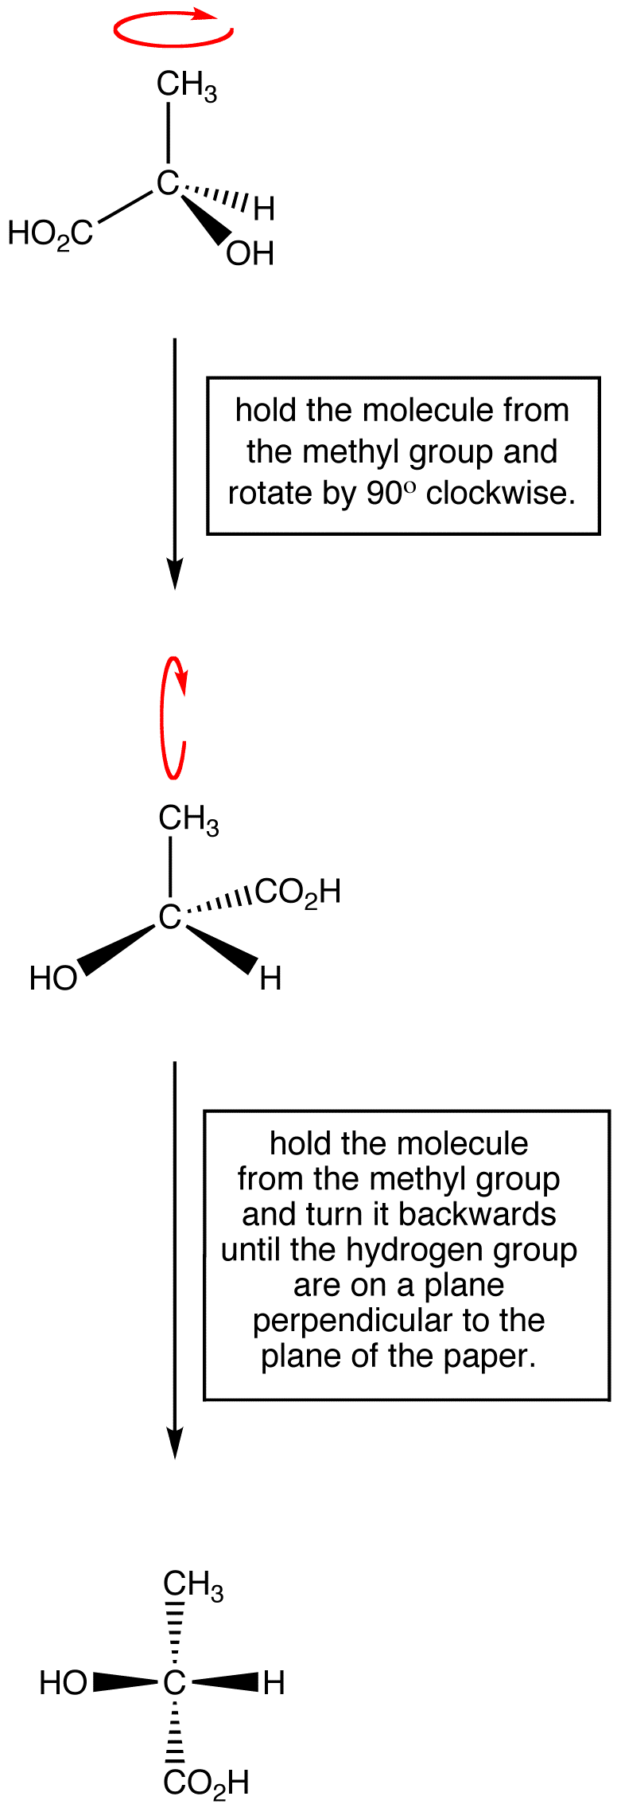
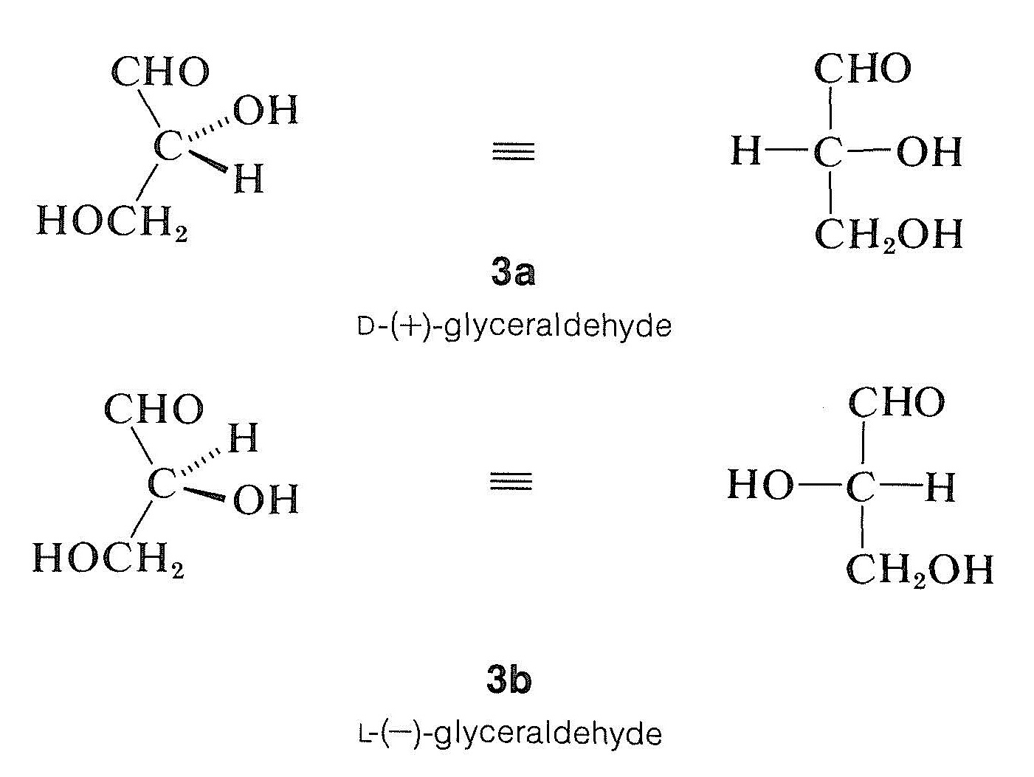
Fisher projection
Fisher projection of a glyceraldehyde molecule:

Slide 23
A simplified Fisher projection
Glyceraldehyde in simplified Fisher projection:
CHO
CHO
CHO
HO
H
H
OH
CH₂OH
CH₂OH
CH₂OH
L – glyceraldehyde D – glyceraldehyde D – glyceraldehyde
(the place of the alcohol group is indicated only)

Slide 24
The creation of a cyclic glucose
How to proceed to close the cyclic form of monosaccharide (pyranose in this case) using Fischer projection on an example of D-glucose. a. Fisher projection of D-glucose b. rotation by 90 ° in the plain c. appropriate rotation of the last atom of carbon d. Haworth projection of α-D-glucopyranose e. Tollens projection of α-D-glucopyranose.

Slide 25
Haworth projection
The cyclic form of saccharides is not planar.
The most convenient layout (with the smallest amount of energy) is the chair conformation.

Slide 26
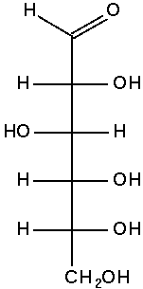
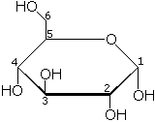
Chiral centres
When a cyclic form of a monosaccharide is derived/formed one more chiral centre is created:
1
2
3
4
5
6
D – glucose
Non-cyclic form has got four chiral carbons (č. 2, 3, 4, 5)
D – glucose
There is a new chiral centre at carbon n. 1 in a cyclic form

Slide 27
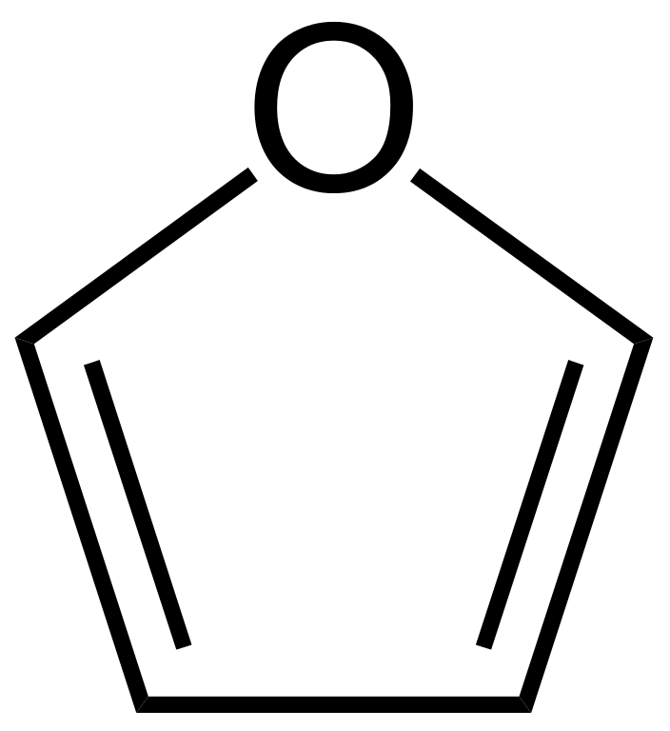
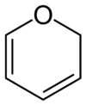
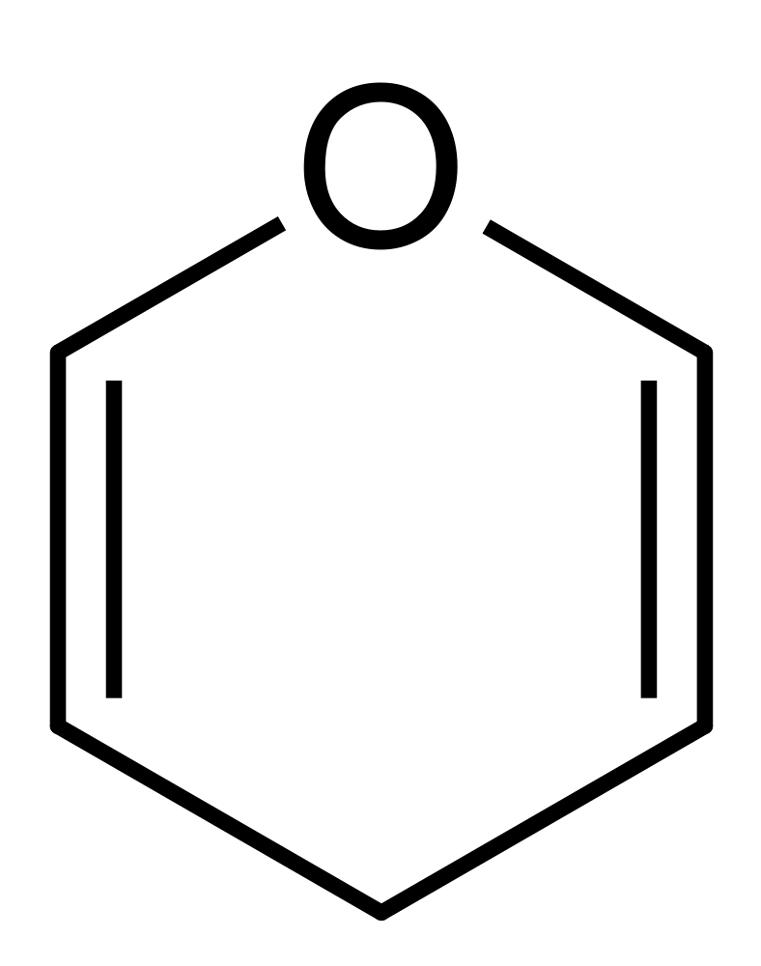
Haworth projection
furan 2H-pyrane 4H-pyrane
Cyclic forms of saccharides are derived either from a five-membered ring of furan or from a six-membered pyrane. Both substances belong to heterocyclic organic compounds.
The type of the cycle is given in the name of the saccharide:
The cyclic form of D – glucose is then called D - glucopyranose

Slide 28
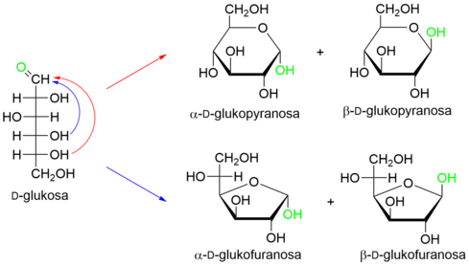
Anomers
So called anomers are distinguished in cyclic forms of saccharides - they differ in the location of -OH group on carbon n. 1:

Slide 29
Resources:
1) Mareček A., Honza J.: Chemie pro čtyřletá gymnázia, 3. díl
2) Benešová M., Pfeiferová E., Satrapová H.: Odmaturuj z chemie
3) Photo – the author
4) Pictures used have the licence of Creative Commons

Slide 30
2020-1-SK01-KA226-SCH-094350 DIGI SCHOOL
Délka projektu: 01. 03. 2021 – 28. 02. 2023
Rozpočet partnerství: 101.092,-€
Rozpočet GJŠ Zlín: 20.829,- €
Intelektuální výstupy všech partnerů: ANJ, NEJ, FRJ,SPJ, DEJ, OBN, CHE, GEO, MAT, BIO, EKN, ITK,
HUV, ETV
Intelektuální výstupy GJŠ Zlín v předmětech MAT, GEO, CHE, SPJ
2020-1-SK01-KA226-SCH-094350

Slide 31
EN The European Commission's support for the production of this publication does not constitute an endorsement of the contents, which reflect the views only of the authors, and the Commission cannot be held responsible for any use which may be made of the information contained therein.
ČR Podpora Evropské komise na zhotovení této práce nevyjadřuje názor Komise, obsah je názorem autora a Komise není zodpovědná za informace v práci obsažené.
2020-1-SK01-KA226-SCH-094350

