Slide 1
Separation processes I. extraction
Project number 2020-1-SK01-KA226-SCH-094350
Gymnázium a Jazyková škola s právem státní jazykové zkoušky Zlín

Slide 2
Separation processes I. extraction
SUBJECT: CHEMISTRY
SPECIFICATION: Chemistry, laboratory exercises- second, third grade
AGE OF STUDENTS: 11 - 13
1 LESSON : 45 min.
2020-1-SK01-KA226-SCH-094350

Slide 3
C O N T E N T
01
Separation process– theory
02
Basic separation techniques
03
Extraction - principles
04
Practical part– beta-carotene extraction
2020-1-SK01-KA226-SCH-094350

Slide 4
Use of study materials
Teoretical lessons in the lower classes of a Gymnasium. Materials contain photos and video, that shows the separation processes - extraction.
It is a manual for a practical laboratory classes.

Slide 5
Separation process
1
Definition, basic separation techniques

Slide 6
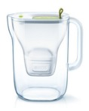
Separation techniques
used to convert a mixture or solution of chemical substances into two or more constituents separation = division
they are used
in quantitative as well as qualitative chemistry – to prove the presence of a substance in a mixture, to purify a substance (separation of two or more constituents), separation of a mixture before further use.
in our daily life– filters to purify water (in the picture), settling, filter coffee, separation of metals particles using a magnet…

Slide 7
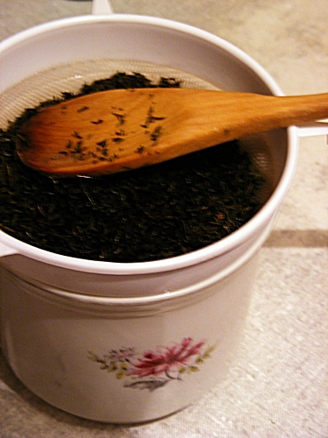
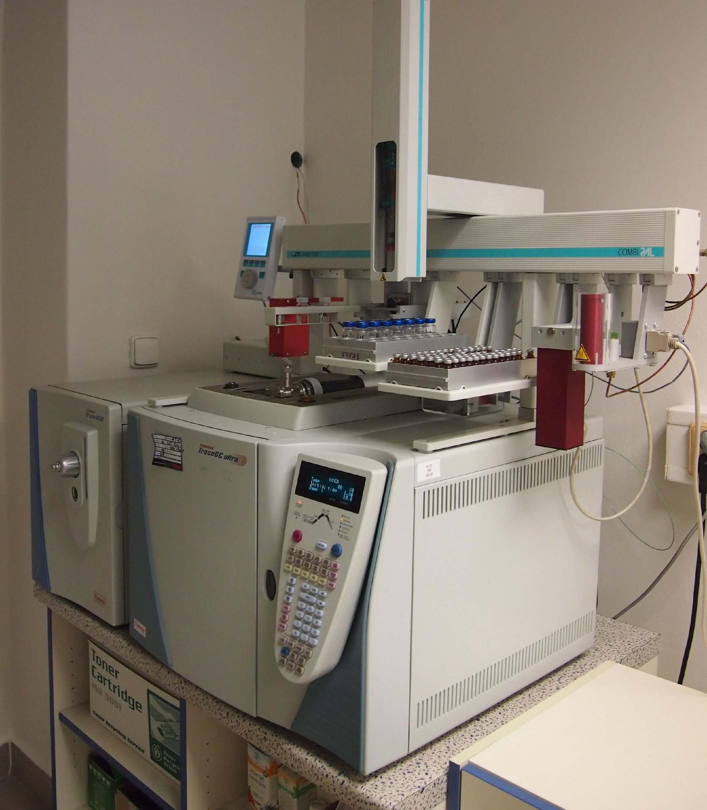
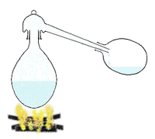
Separation techniques
Can be done by the use of simple equipment (pouring through a sieve, separation of metal particles using a magnet, etc.) or more complex laboratory equipment – chemical production, sample analyses in a laboratory.
paper filtration
chromatography simple distillation gas chromatography

Slide 8
Separation techniques
To separate mixtures different physical and chemical properties of individual constituents are used:
state (gas, liquid, solid)
boiling point (freezing point)
solubility
sublimation properties
size of particles
density
adsorption
magnetic properties
electrophoresis
What is the difference between
ABSORPTION
and
ADSORPTION?

Slide 9
Choosing an appropriate separation technique
The appropriate technique is chosen according to:
solution and individual constituent properties
required purity of separated constituents
whether we need to get all constituents or just some of them. E. g. if we vaporise a dissolving agent from a solution of salt, we get just one constituent (salt). If we need to get the other constituent (dissolving agent) as well, we have to use e.g. distillation
the tools and equipment we have – there are different possibilities at home or in a well-equipped laboratory

Slide 10
Basic separation techniques
TECHNIQUE | PROPERTY THAT IS DIFFERENT FOR INDIVIDUAL SOLUTION CONSTITUENTS (THE SEPARATION IS BASED ON)
FILTRATION | PARTICLES SIZE
DISTILLATION | BOILING POINT
CRYSTALLIZATION | DIFFERENT DISSOLUBILITY
PHASE TRANSITION | THE ABILITY OF A SUBSTANCE TO CHANGE DIRECTLY FROM THE SOLID TO THE LIQUID STATE
EXTRACTION | DISSOLUBILITY
DEPOSITION | DENSITY
CHROMATOGTAPHY | DIFFERENT INTERACTION WITH A MATERIAL
ELECTROPHORESIS | DIFFERENT INTERACTION OF MOLECULES UNDER AN ELECTRIC POTENTIAL

Slide 11
Extraction
2
Theory. Practical use

Slide 12
Extraction
extraction (or leaching) is a separation process consisting of the separation of a substance from a matrix (often natural)
the extracted substance get to the solvent (during either hot or cold extraction); the extracted substance can be further extracted from the solvent through evaporation or distillation (to thicken the extract)
this technique is used to get fats (soluble in gasoline, benzene, toluene), natural dyes and so on
it is possible to extract a solute from a solid as well as liquid compound

Slide 13
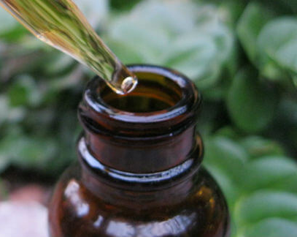
Extraction in daily life
Extraction is used on a daily basis. It may be making tea or preparing herbal infusions.

Slide 14
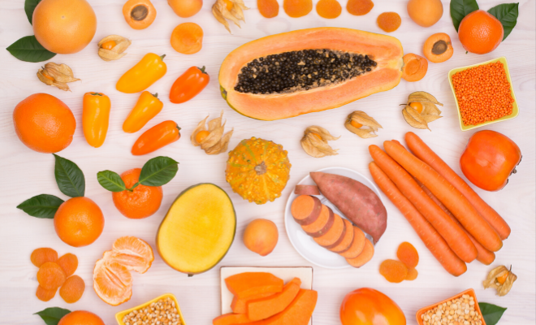
Beta-Carotene
Beta-Carotene is a member of the carotenes which are organic, strongly coloured red-orange pigment abundant in fungi, fruits, and vegetable (see the picture).
There are two more types of carotene in a carrot (alpha and gamma). However, these two do not influence the provitamin A production that much.

Slide 15
Beta-Carotene molecule

Slide 16
The importance of beta-carotene
one molecule of beta-carotene can be cleaved into two molecules of A vitamin

Slide 17
Practical part– beta-carotene extraction:
We need: carrot, water, oil, grater, a glass (or a cylinder), sieve, glass stirring rod or a teaspoon
Procedure:
scrape the carrot, grater it on a grater and pour water on it (to cover the carrot) in the glass or cylinder; a note: a larger graduated cylinder was used in our lab;
leave to leach for a few minutes and pour some oil into the glass and mix both phases well; leave to settle (oil and water phases separate again)
separate both phases and compare their colouring

Slide 18
Carotene extraction– practice:
Link for a video
https://drive.google.com/drive/folders/1qkNsu0FPmQMhYolFULDeCrIsTZNqFPQS
Tato fotka od autora Neznámý autor s licencí CC BY-SA-NC

Slide 19
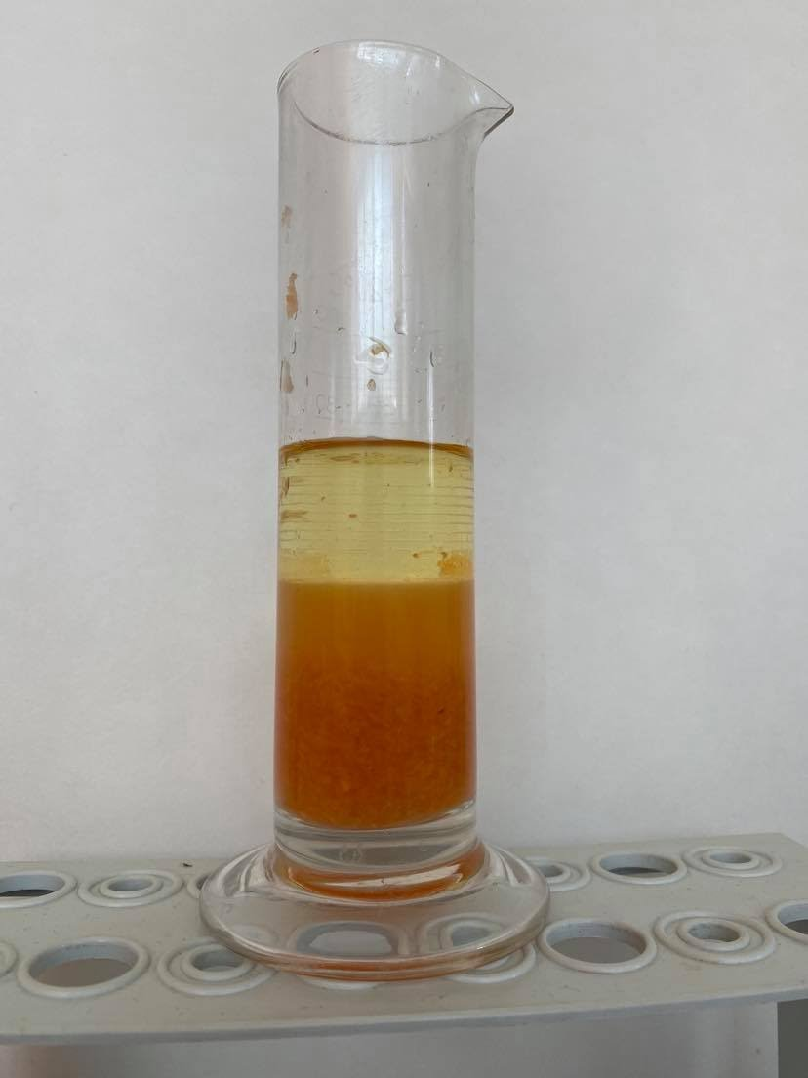
Separation of beta-carotene from a carrot by extraction is based of the fact that beta-carotene does not dissolve in water well but dissolves in fats. Water and fat (oil respectively) cannot be blended.
We can see two layers in the graduated cylinder in the picture:
lower layer = water with the grated carrot
upper layer = oil
Both layers were mixed, but they are separated again in the picture (the lighter oil phase is the upper one). Beta-carotene got to the oil, which is coloured in orange thanks to this.

Slide 20
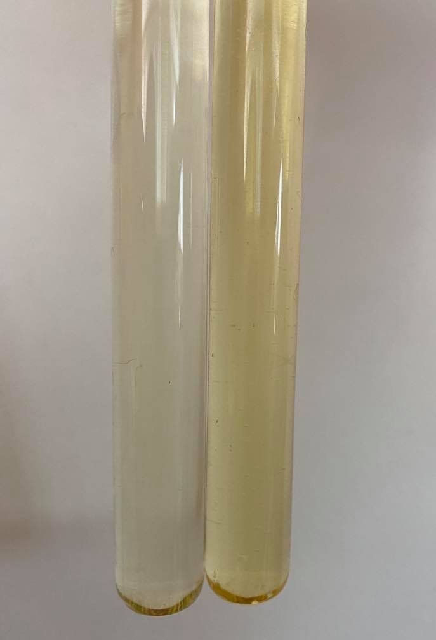
Oil colours comparison – oil and oil with beta-carotene
Left test tube: pure oil (the original one)
Right test tube: the separated oil after the beta-carotene extraction.
There is a visible difference in colours: there is coloured oil with dissolved beta-carotene in the right test tube.

Slide 21
Zdroje:
1) Mareček A., Honza J.: Chemie pro čtyřletá gymnázia, 1. díl a 2. díl
2) Benešová M., Pfeiferová E., Satrapová H.: Odmaturuj z chemie
3) Foto – the author
4) Video – the author
5) Pictures used have the licence of Creative Commons

Slide 22
2020-1-SK01-KA226-SCH-094350 DIGI SCHOOL
Délka projektu: 01. 03. 2021 – 28. 02. 2023
Rozpočet partnerství: 101.092,-€
Rozpočet GJŠ Zlín: 20.829,- €
Intelektuální výstupy všech partnerů: ANJ, NEJ, FRJ,SPJ, DEJ, OBN, CHE, GEO, MAT, BIO, EKN, ITK,
HUV, ETV
Intelektuální výstupy GJŠ Zlín v předmětech MAT, GEO, CHE, SPJ
2020-1-SK01-KA226-SCH-094350

Slide 23
EN The European Commission's support for the production of this publication does not constitute an endorsement of the contents, which reflect the views only of the authors, and the Commission cannot be held responsible for any use which may be made of the information contained therein.
ČR Podpora Evropské komise na zhotovení této práce nevyjadřuje názor Komise, obsah je názorem autora a Komise není zodpovědná za informace v práci obsažené.
2020-1-SK01-KA226-SCH-094350

