Slide 1
Separation techniques II sublimation
Project number 2020-1-SK01-KA226-SCH-094350
Gymnázium a Jazyková škola s právem státní jazykové zkoušky Zlín

Slide 2
Separation techniques II sublimation
SUBJECT: CHEMISTRY
SPECIFICATION: Laboratory exercises, second and third grade
AGE OF STUDENTS: 11 - 13
1 LESSON : 45 min. theoretical preparation+ laboratory classes
2020-1-SK01-KA226-SCH-094350

Slide 3
C O N T E N T
01
Sublimation – principles and the method
02
Practical part – benzoic acid sublimation
03
Tasks
04
Test – Kahoot link
2020-1-SK01-KA226-SCH-094350

Slide 4
Layout
Separation techniques
Theoretical introduction
Basic separation techniques
2) Extraction
The method and its use
Practical part – beta-carotene extraction
3) Sublimation
The method and its use
Practical part – benzoic acid sublimation/phase transition
4) Tasks

Slide 5
Use of study materials
Theoretical lessons in the lower classes of a Gymnasium. Materials contain photos and video showing the separation and extraction processes.
It is a manual for a practical laboratory classes.

Slide 6
Sublimation/phase transition
1
The method; practical examples

Slide 7
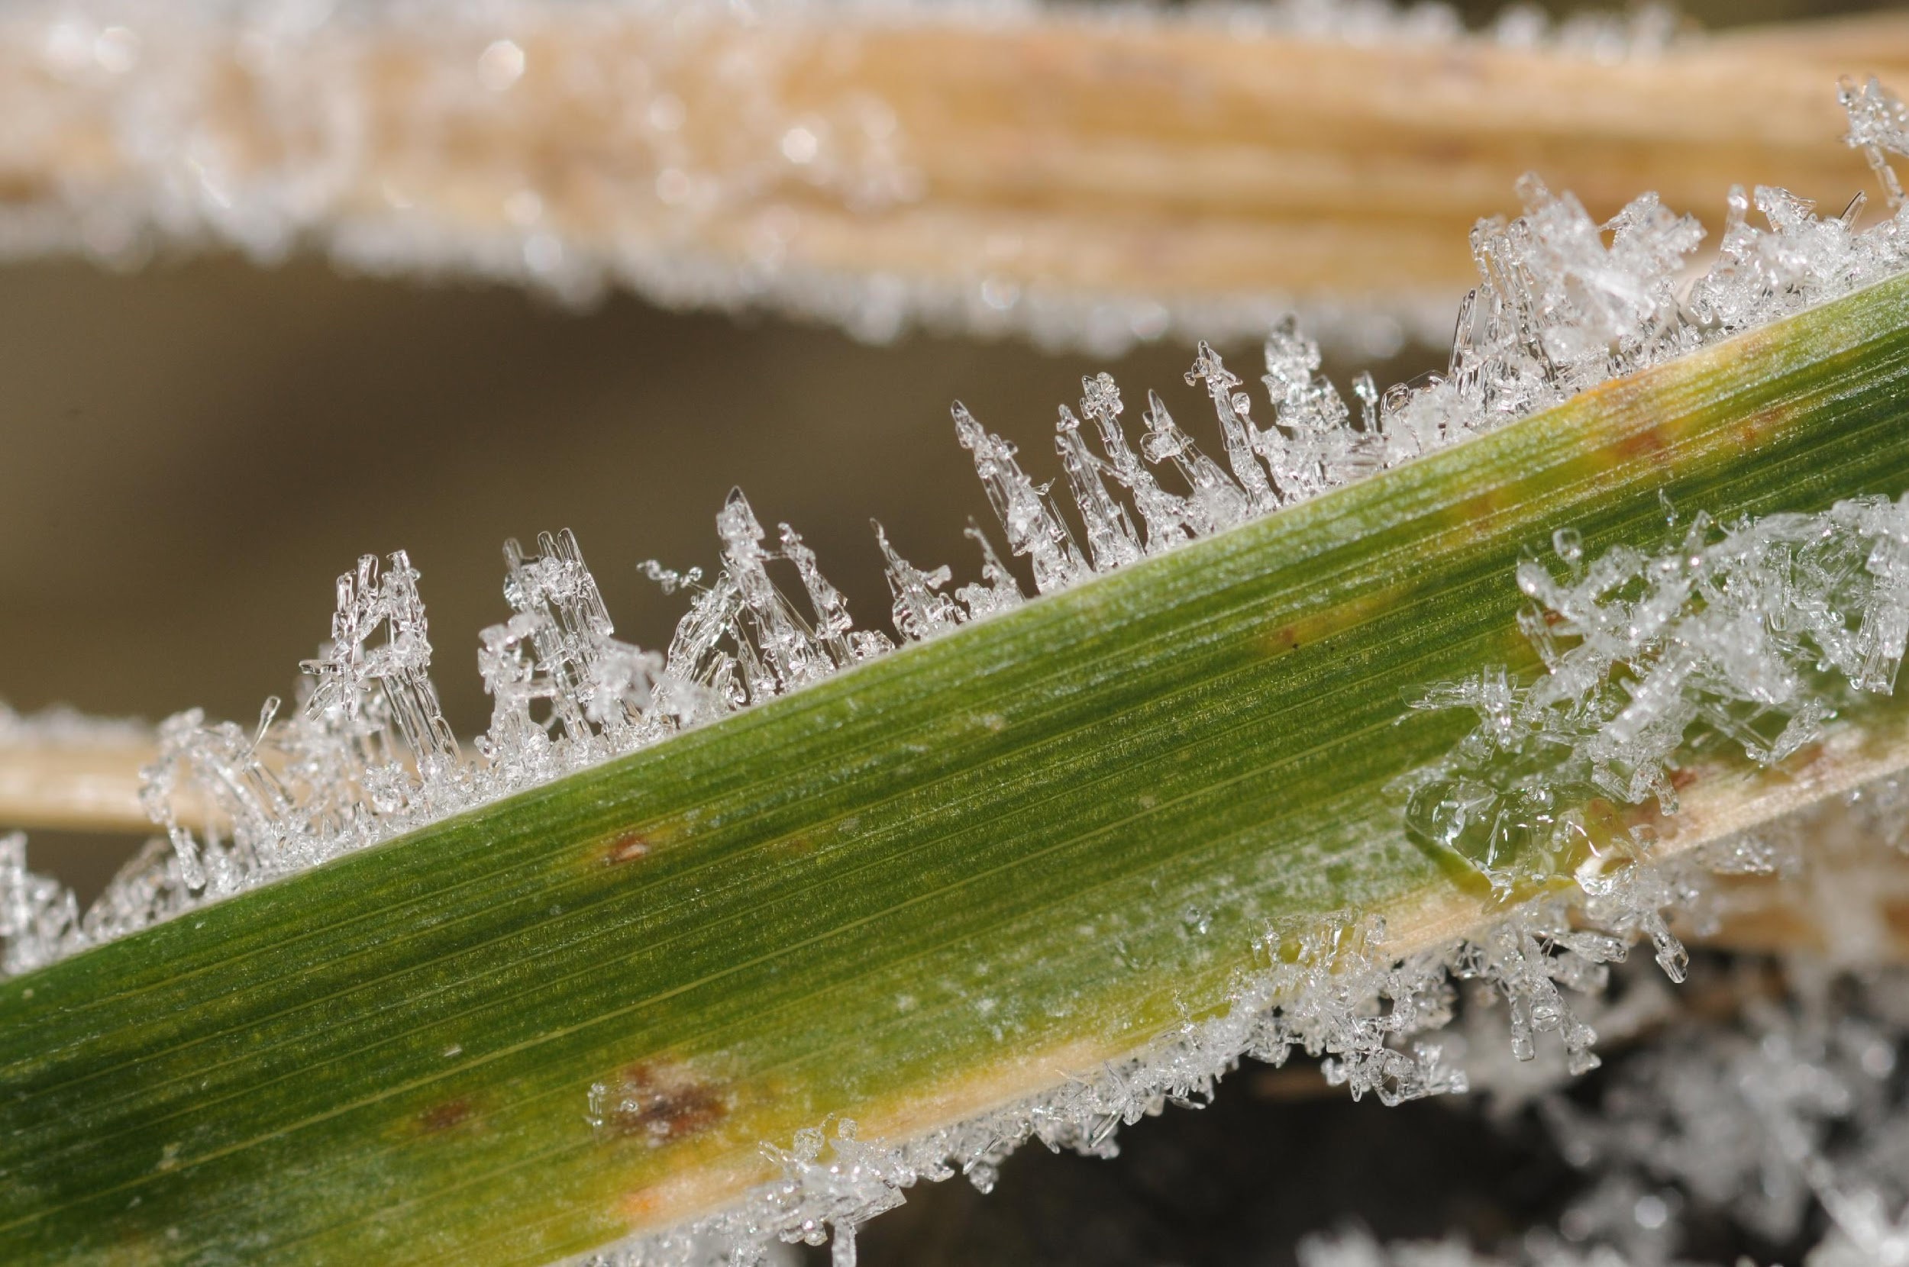
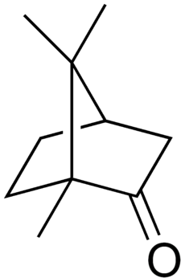
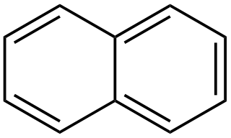
Phase transition
Sublimation is the transition of a substance directly from the solid to the gas state without passing through the liquid state.
This process occurs at temperatures and pressure below the substance’s triple point.
The reverse process is called desublimation/deposition – a substance passes directly from a gas to a solid state.
The product of sublimation is a pure substance:
(in the picture)
Substances subliming at atmospheric pressure:
ice, dry ice (solid carbon dioxide), benzoic acid, camphor, iodine, naphthalene, uranium hexafluoride. Majority of substances sublime at lower pressures.
molecule of camphor
molecule of naphthalene

Slide 8
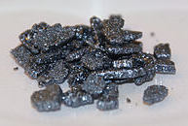
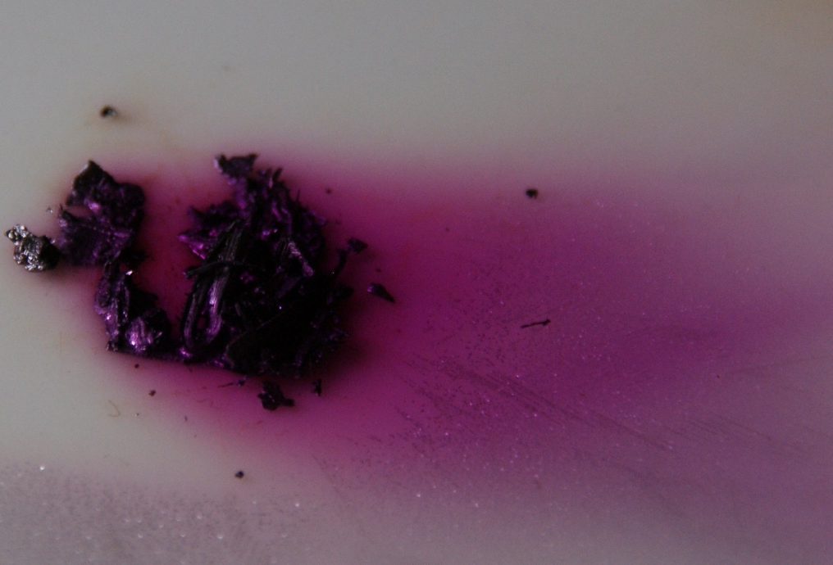
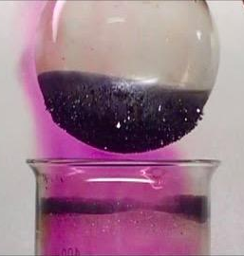
Iodine sublimation:
Iodine purple vapour when being heated
Solid iodine
A flask with cold water so that iodine at the bottom can de-sublime easily
product
(pure iodine)
A beaker with a mixture of iodine and sand. The beaker is heated slowly above a burner.
Tato fotka od autora Neznámý autor s licencí CC BY-SA

Slide 9
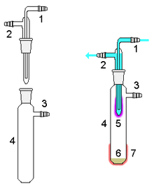
A device for micro-sublimation:
Cold liquid (cooling vapours of the subliming substance)
Product (pure substance)
Mixture of substances
(warmed above a burner)

Slide 10
Sublimation
2
Benzoic acid phase transition Procedure

Slide 11
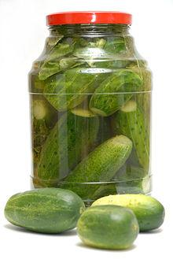
Practical part – benzoic acid sublimation:
Benzoic acid is separated from a substance for pickling gherkins, vegetable, and so on. (DEKO)
We need: DEKO, flask, watch glass, burner, gauze mat, teaspoon
Procedure:
put two teaspoons of DEKO into the flask and cover it with the watch glass (the glass can be cooled with an ice cube);
heat slowly above the burner not to melt the substance inside;
observe appearing the pure product – benzoic acid sublime on the bottom part of the watch glass; what remains in the beaker?
Tip: you can insert a branch of a conifer into the flask; the benzoic acid crystals will create a “frost” on its needles.

Slide 12
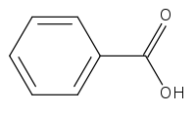
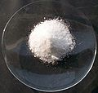
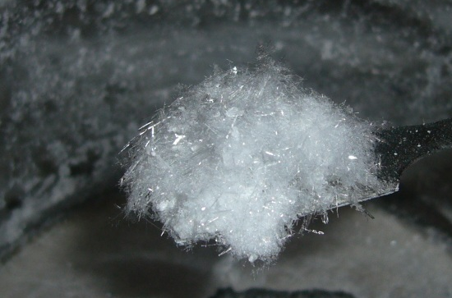
Benzoic acid
A white solid; the simplest aromatic carboxylic acid naturally occurring in plants – resins or oleoresins. It is used as food preservatives or for the skin treatment in medicine.
Benzoic acid
Benzoic acid sublime

Slide 13
Tasks:
📖
1) Give at least 5 examples of a daily life filtration.
2) What is the importance of vitamin A for health? What are the signs of its lack?
3) Use the internet to find the meaning of the term “sublimation” in psychology.
4) One’s mineral name is “sublime”. Find its formula and nomenclature and find out whether the substance sublimes.

Slide 14
Tasks:
📖
5) What is the composition of DEKO?
6) Iodine sublimation is bets done in a well aired room, why?
7) Find out what the term “maceration” means.
8) Suggest separation techniques to separate substances in the following mixtures:
ethanol + water
oil + water
sand + water

Slide 15
Complete the table with missing separation techniques
📖
first
???
Crystalline salt
Water and salt solution
A mixture of several liquids
???
Distilled alcohol
Sand and water mixture
???
Filtrate

Slide 16
The final test is found in the following link:
📖
https://create.kahoot.it/share/duplicate-of-metody-deleni-smesi-extrakce-a-sublimace/6645ad5f-f20a-41ec-8a27-2c29277ecdc1

Slide 17
Zdroje:
1) Mareček A., Honza J.: Chemie pro čtyřletá gymnázia, 1. díl a 3. díl
2) Benešová M., Pfeiferová E., Satrapová H.: Odmaturuj z chemie
3) Foto – the author
4) Video – the author
5) Pictures used have the licence of Creative Commons

Slide 18
2020-1-SK01-KA226-SCH-094350 DIGI SCHOOL
Délka projektu: 01. 03. 2021 – 28. 02. 2023
Rozpočet partnerství: 101.092,-€
Rozpočet GJŠ Zlín: 20.829,- €
Intelektuální výstupy všech partnerů: ANJ, NEJ, FRJ,SPJ, DEJ, OBN, CHE, GEO, MAT, BIO, EKN, ITK,
HUV, ETV
Intelektuální výstupy GJŠ Zlín v předmětech MAT, GEO, CHE, SPJ
2020-1-SK01-KA226-SCH-094350

Slide 19
EN The European Commission's support for the production of this publication does not constitute an endorsement of the contents, which reflect the views only of the authors, and the Commission cannot be held responsible for any use which may be made of the information contained therein.
ČR Podpora Evropské komise na zhotovení této práce nevyjadřuje názor Komise, obsah je názorem autora a Komise není zodpovědná za informace v práci obsažené.
2020-1-SK01-KA226-SCH-094350

