Slide 1
Operations with intervals
2020-1-SK01-KA226-SCH-094350
DIGI SCHOOL
Gymnázium a Jazyková škola s právem státní jazykové zkoušky Zlín
Michal Heczko

Slide 2
2020-1-SK01-KA226-SCH-094350 | DIGI SCHOOL
SUBJECT: MATHEMATICS
SPECIFICATION: in ENGLISH via CLIL method (level in languages)
AGE OF STUDENTS: 12-14
1 LESSON : 45 min

Slide 3
Basic operations with sets
Unions
include all the elements that are members of at least one set
we record it: $A∪B$
Intersections
include all elements that are members of both sets
we record it: $A∩B$
Subtractions
include all elements that are members of $A$ but are not members of $B$
we record it: $A\backslash B$

Slide 4
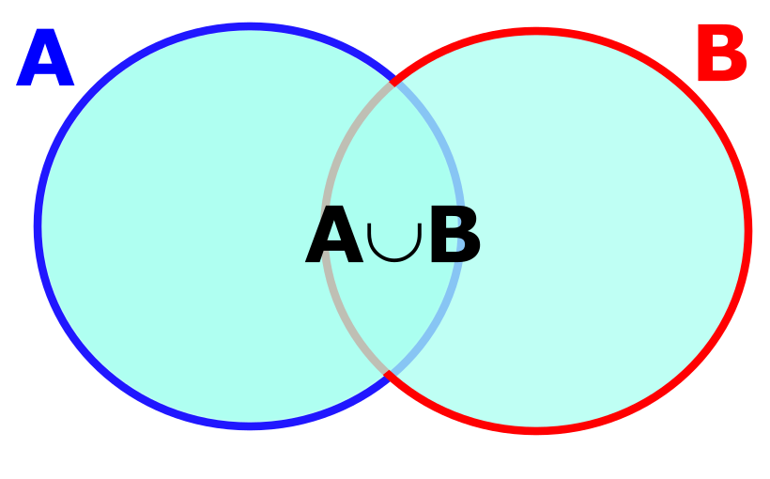
Unions
$A=\left\{1;2;3;4;5\right\}$
$B=\{4;5;6;7\}$
In a sets union we name all the elements that are members of A and all elements that are members of B the way that we name all common elements just once.
$A∪B=\{1;2;3;4;5;6;7\}$

Slide 5
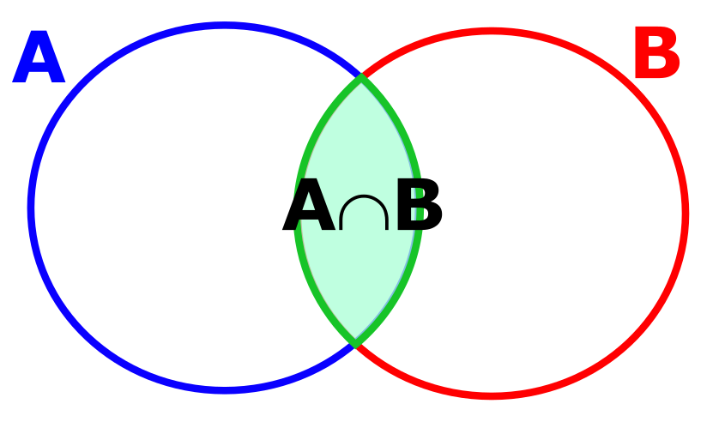
Intersection
$A=\left\{1;2;3;4;5\right\}$
$B=\{4;5;6;7\}$
In a sets intersection we name only those elements that are members of both sets at the same time.
$A∩B=\{4;5\}$

Slide 6
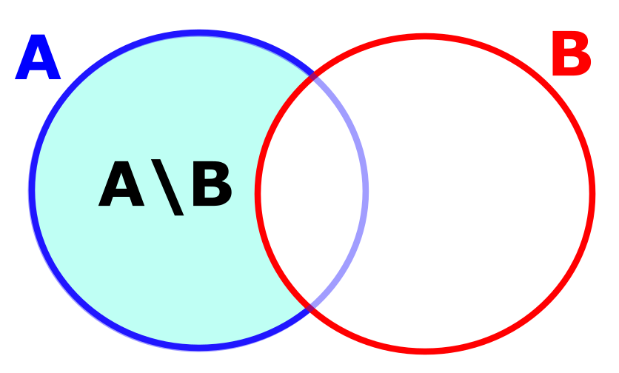
Sets subtraction
$A=\left\{1;2;3;4;5\right\}$
$B=\{4;5;6;7\}$
A subtraction of A and B includes only those elements of A that are not members of B
$A\backslash B=\{1;2;3\}$

Slide 7
Unions of intervals I
$A=\left\langle 2;7\right\rangle$
$B=\left(5;9\right)$
2
5
7
9
$A∪B=\left\langle 2;7\right\rangle ∪\left(5;9\right)$
$A∪B=\left\langle 2;\left.9\right)\right.$

Slide 8
Unions of intervals II
$A=\left(1;+∞\right)$
$B=\left(\left.−∞;3\right\rangle \right.$
1
3
$A∪B=\left(1;+∞\right)∪\left(\left.−∞;3\right\rangle \right.$
$A∪B=\left(−∞;+∞\right)$

Slide 9
Intervals intersections I
$A=\left\langle 2;7\right\rangle$
$B=\left(5;9\right)$
2
5
7
9
$A∩B=\left\langle 2;7\right\rangle ∩\left(5;9\right)$
$A∩B=\left(\left.5;7\right\rangle \right.$

Slide 10
Intervals intersections I
$A=\left(1;+∞\right)$
$B=\left(\left.−∞;3\right\rangle \right.$
1
3
$A∩B=\left(1;+∞\right)∩\left(\left.−∞;3\right\rangle \right.$
$A∩B=\left(\left.1;3\right\rangle \right.$

Slide 11
Subtraction of intervals I
$A=\left\langle 2;7\right\rangle$
$B=\left(5;9\right)$
2
5
7
9
$A\backslash B=\left\langle 2;7\right\rangle \backslash \left(5;9\right)$
$A\backslash B=\left\langle 2;5\right\rangle$

Slide 12
Subtraction of intervals II
$A=\left(1;+∞\right)$
$B=\left(\left.−∞;3\right\rangle \right.$
1
3
$A\backslash B=\left(1;+∞\right)\backslash \left(\left.−∞;3\right\rangle \right.$
$A\backslash B=\left(3;+∞\right)$

Slide 13
Exercises
Determine $A∪B$, $A∩B$, $A\backslash B$ a $B\backslash A$:
$A=\left(0;5\right);B=\left(2;8\right)$
$A=\left(−∞;5\right);B=\left(10;+∞\right)$
$A=\left(\left.−1;4\right\rangle ;\right. B=\left\langle 0;\left.5\right)\right.$
$A=\left\langle 0;10\right\rangle ;B=\left(2;4\right)$
$A=\left(−3;\left.1\right\rangle \right.;B=\left\langle 0;\left.2\right)\right.$

Slide 14
Solution
task |  | $$A∪B$$ | $$A∩B$$ | $$A\backslash B$$ | $$B\backslash A$$
a | $$A=\left(0;5\right);B=\left(2;8\right)$$ | $$\left(0;8\right)$$ | $$\left(2;5\right)$$ | $$\left(\left.0;2\right\rangle \right.$$ | $$\left\langle \left.5;8\right)\right.$$
b | $$A=\left(−∞;5\right);B=\left(10;+∞\right)$$ | $$\left(−∞;5\right)∪\left(10;+∞\right)$$ | $$∅$$ | $$\left(−∞;5\right)$$ | $$\left(10;+∞\right)$$
c | $$A=\left(\left.−1;4\right\rangle ;\right. B=\left\langle 0;\left.5\right)\right.$$ | $$\left(−1;5\right)$$ | $$\left\langle 0;4\right\rangle$$ | $$\left(−1;0\right)$$ | $$\left(4;5\right)$$
d | $$A=\left\langle 0;10\right\rangle ;B=\left(2;4\right)$$ | $$\left\langle 0;10\right\rangle$$ | $$\left(2;4\right)$$ | $$\left\langle 0;2\right\rangle ∪\left\langle 4;10\right\rangle$$ | $$∅$$
e | $$A=\left(−3;\left.1\right\rangle \right.;B=\left\langle 0;\left.2\right)\right.$$ | $$\left(−3;2\right)$$ | $$\left\langle 0;1\right\rangle$$ | $$\left(−3;0\right)$$ | $$\left(1;2\right)$$

Slide 15
QUIZIZZ
To practise: Operations with intervals
Link:
https://quizizz.com/admin/quiz/61bb669cb5f46f001dc30a03
Play QUIZIZZ

Slide 16
2020-1-SK01-KA226-SCH-094350
DIGI SCHOOL
EN The European Commission's support for the production of this publication does not constitute an endorsement of the contents, which reflect the views only of the authors, and the Commission cannot be held responsible for any use which may be made of the information contained therein.
CZ Podpora Evropské komise na zhotovení této práce nevyjadřuje názor Komise, obsah je názorem autora a Komise není zodpovědná za informace v práci obsažené.

Slide 17
2020-1-SK01-KA226-SCH-094350
DIGI SCHOOL
Gymnázium a Jazyková škola s právem státní jazykové zkoušky Zlín
Délka projektu: 01. 03. 2021 – 28. 02. 2023
Rozpočet partnerství: 101 092 €
Rozpočet GJŠ Zlín: 20 829 €
Intelektuální výstupy všech partnerů: ANJ, NEJ, FRJ, SPJ, DEJ, OBN, CHE, GEO, MAT, BIO, EKN, ITK, HUV, ETV
Intelektuální výstupy GJŠ Zlín: MAT, GEO, CHE, SPJ

