Slide 1
Sections of three-dimensional spaces
2020-1-SK01-KA226-SCH-094350
DIGI SCHOOL
Gymnázium a Jazyková škola s právem státní jazykové zkoušky Zlín
Michal Heczko

Slide 2
2020-1-SK01-KA226-SCH-094350 | DIGI SCHOOL
SUBJECT: MATHEMATICS
SPECIFICATION: in ENGLISH via CLIL method (level in languages)
AGE OF STUDENTS: 16-18
1 LESSON : 45 min

Slide 3
KAHOOT!
To revise: the position of lines and planes to each other
Link:
https://create.kahoot.it/share/relative-position-of-lines-and-planes/c29fc2de-cfc4-4bae-94a9-0d235bba23ec
Play KAHOOT!

Slide 4
Rule 1
If two different points lie in the same plain, thereafter the line determined by these two points lies in the same plain as well.
The consequence: If two different points of a section lie in the plain of one face, the line linking these two points lies in the plain of this face as well.

Slide 5
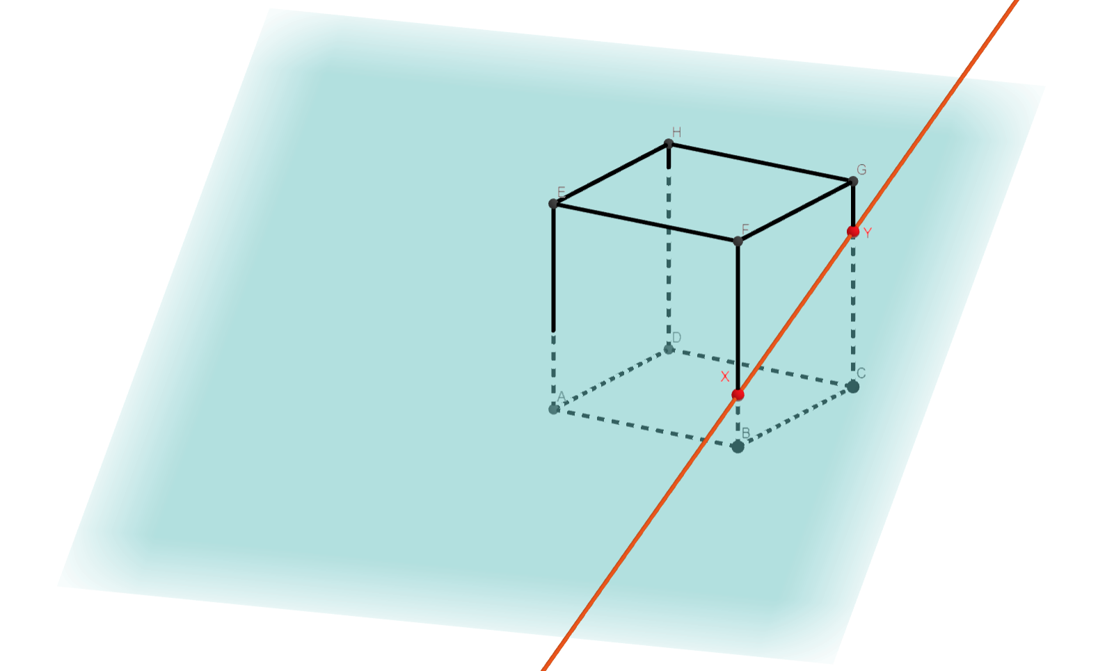
Rule 1

Slide 6
Rule 2
If two of the given plains are parallel and the third one is divergent to both, thereafter the two lines of intersections are parallel.
The consequence: If the plains of two faces parallel but divergent to the plain of the section at the same time, the lines of intersection of the plain of the section with the plains of these faces parallel.

Slide 7
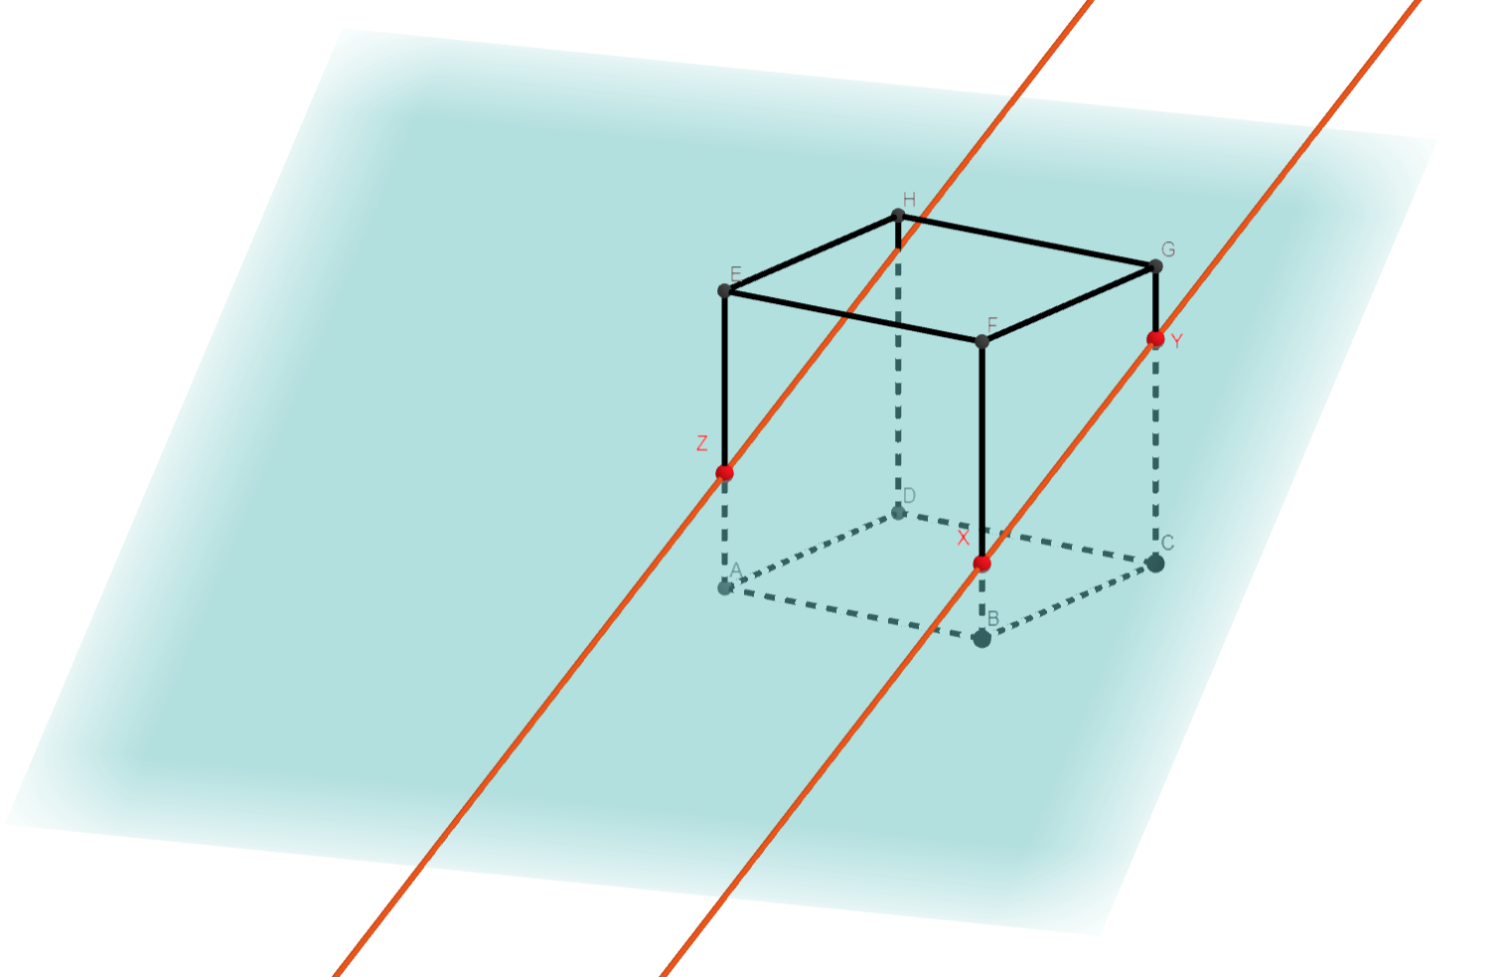
Rule 2

Slide 8
Rule 3
If each two of the given plains are divergent in the way that each two lines of intersections are divergent as well, then all three plains and their lines of intersections go through just one common point.
The consequence: The lines of intersections of the plains of two faces that have their edges with the plain of the section and the line, in which the common edge lies, intersect in one point.

Slide 9
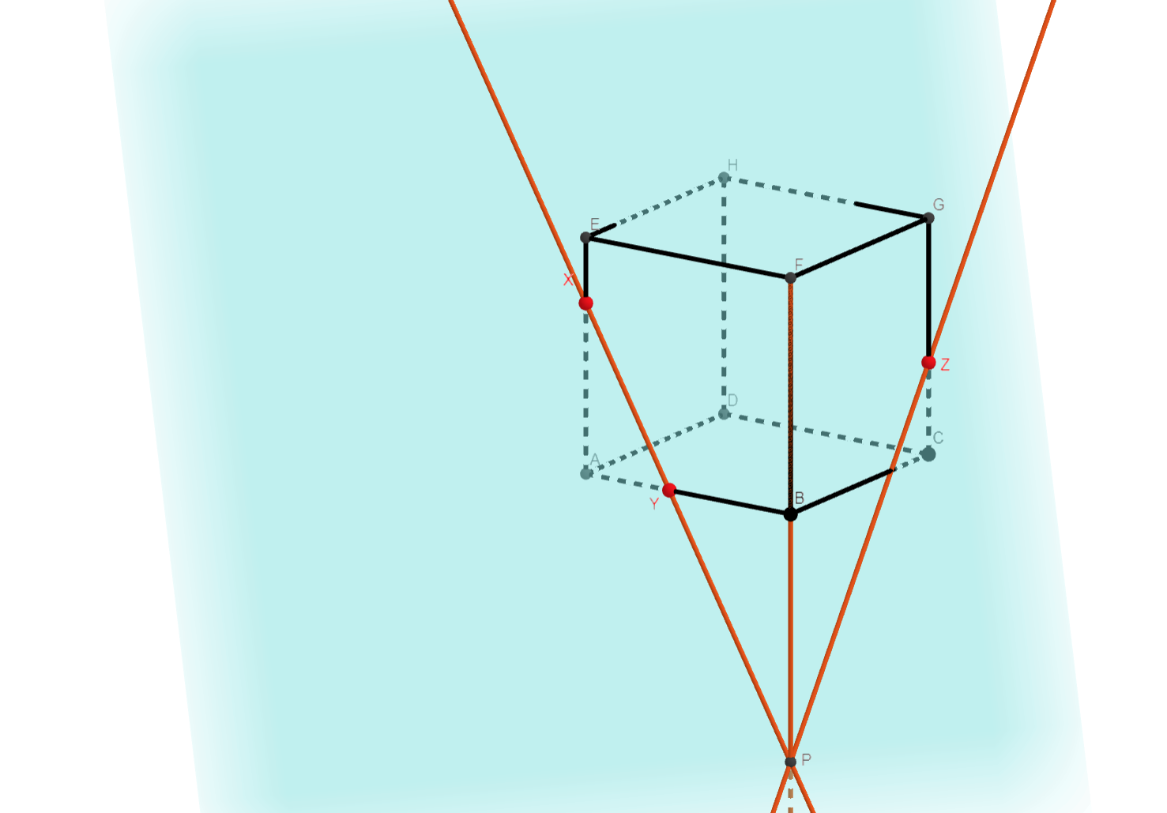
Rule 3

Slide 10
Example 1
Construct a section of a cube ABCDEFGH through the plain ACH

Slide 11
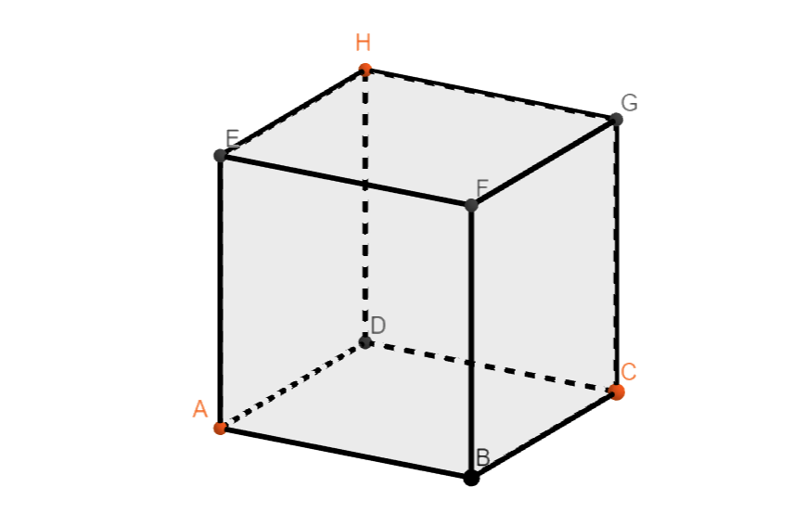
Example 1
Construct a section of a cube ABCDEFGH through the plain ACH

Slide 12
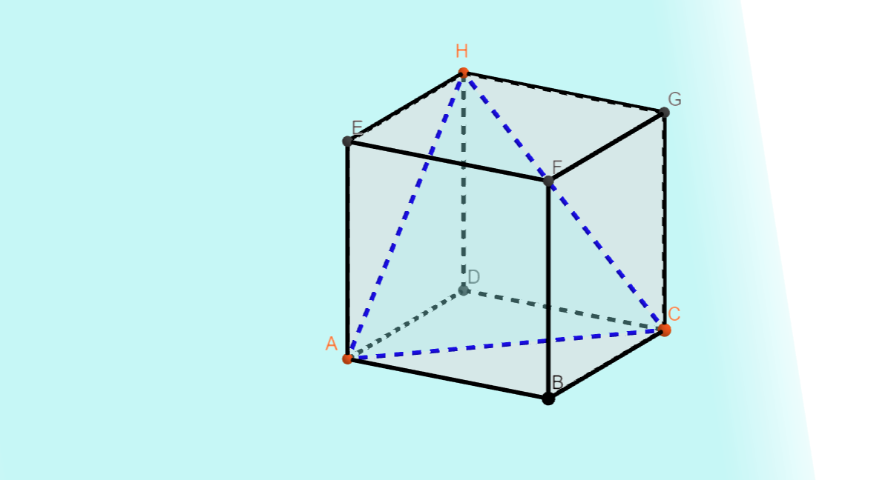
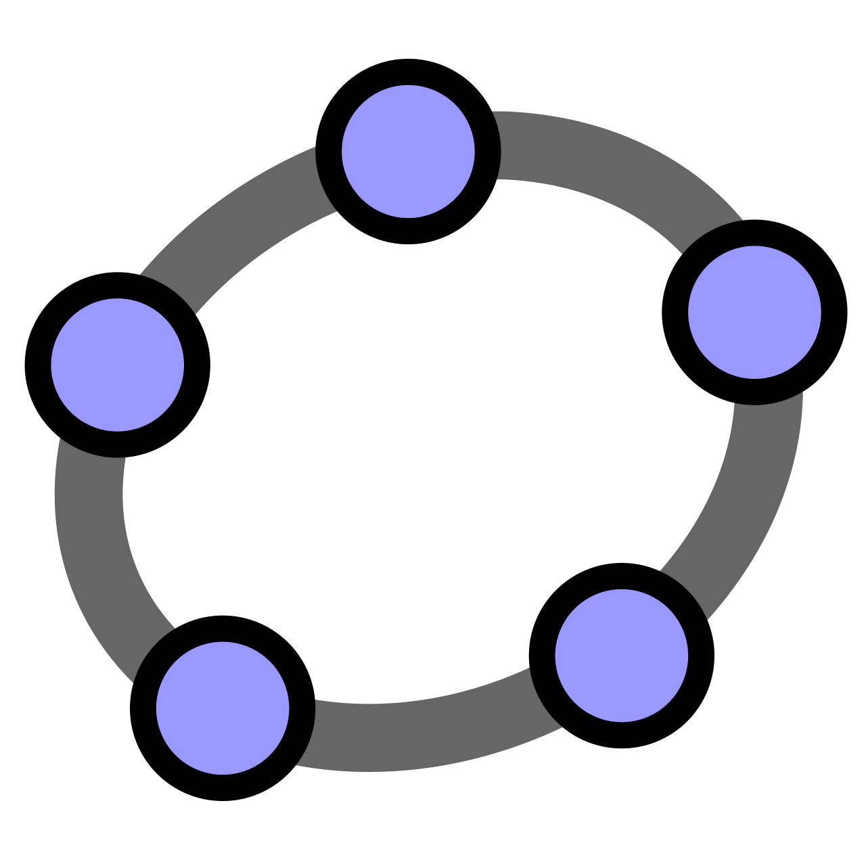
Example 1
Construct a section of a cube ABCDEFGH through the plain ACH
Play in GeoGebra

Slide 13
Example 2
Construct a section of a cube ABCDEFGH through the plain AXY (where X is the centre of BC and Y is the centre of CG)

Slide 14
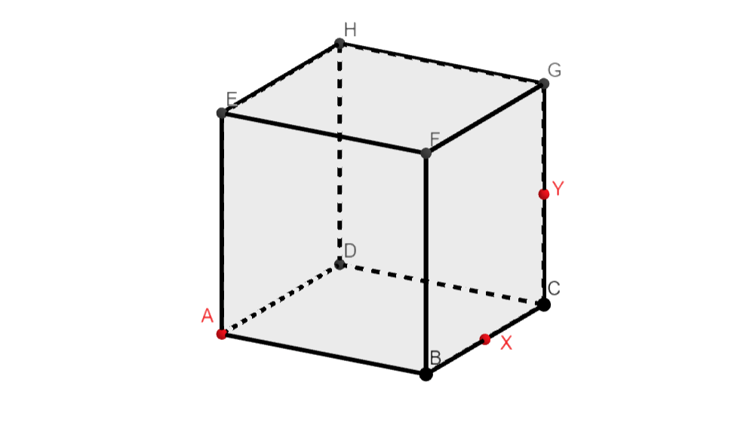
Example 2
Construct a section of a cube ABCDEFGH through the plain AXY (where X is the centre of BC and Y is the centre of CG)

Slide 15
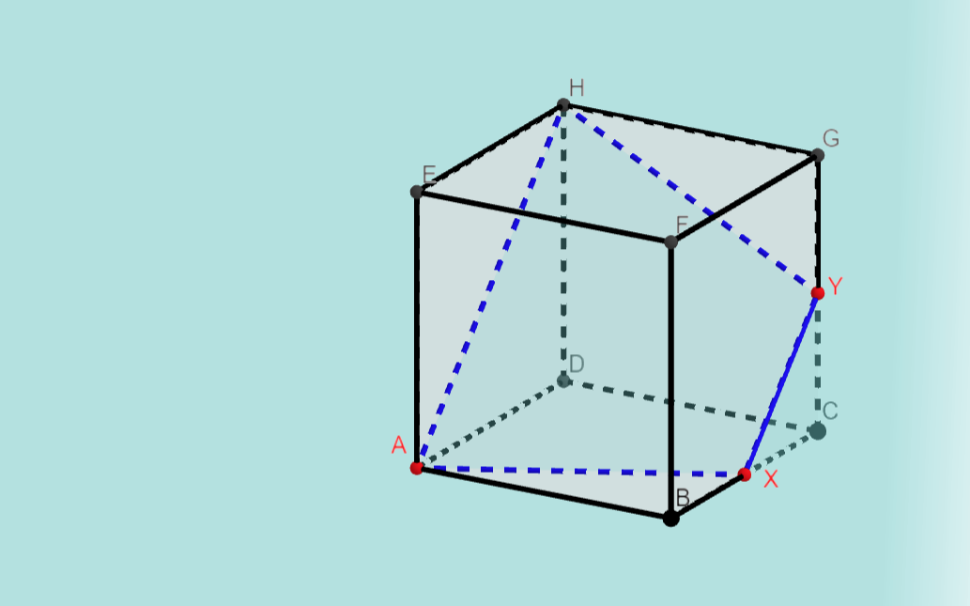
Example 2
Construct a section of a cube ABCDEFGH through the plain AXY (where X is the centre of BC and Y is the centre of CG)
Přehrát konstrukci v aplikaci GeoGebra

Slide 16
Example 3
Construct a section of a cube ABCDEFGH through the plain XYZ (where X is the centre of AE, Y is the centre of AE and Z is the centre of GH)

Slide 17
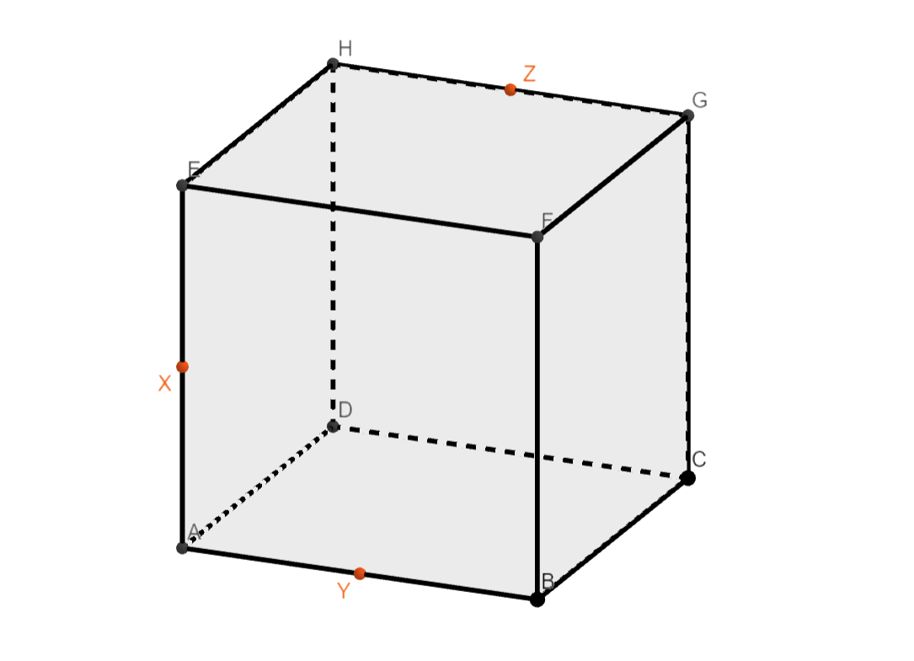
Example 3
Construct a section of a cube ABCDEFGH through the plain XYZ (where X is the centre of AE, Y is the centre of AE and Z is the centre of GH)

Slide 18
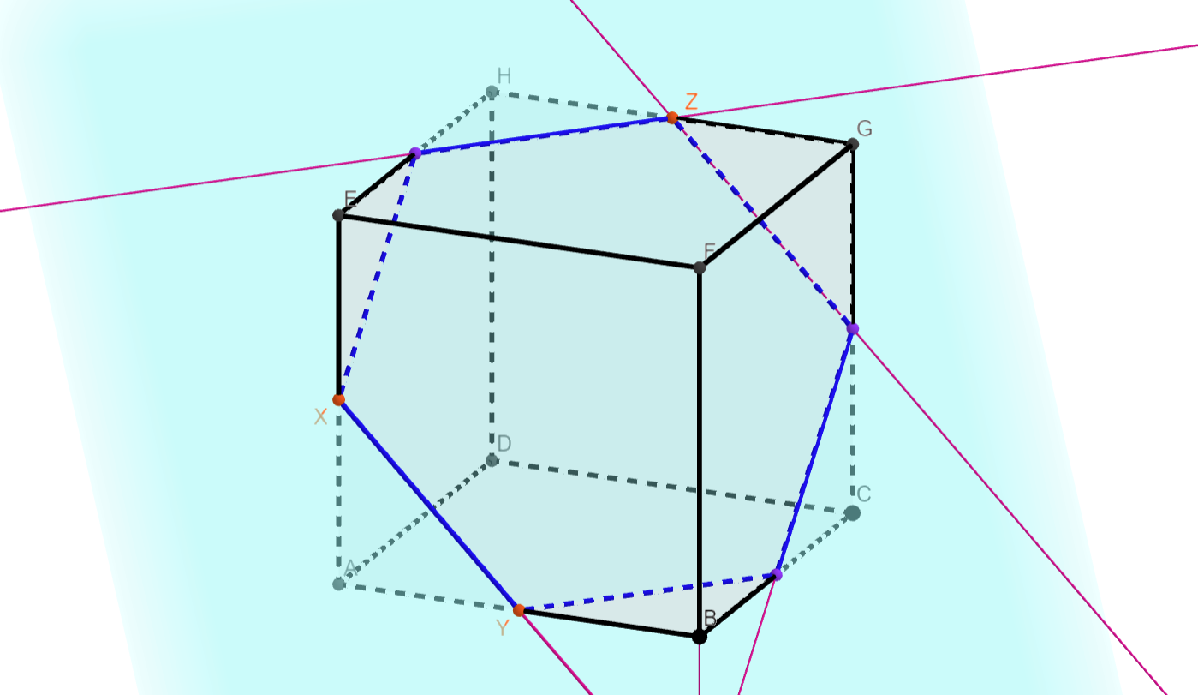
Example 3
Construct a section of a cube ABCDEFGH through the plain XYZ (where X is the centre of AE, Y is the centre of AE and Z is the centre of GH)
Play in GeoGebra

Slide 19
2020-1-SK01-KA226-SCH-094350
DIGI SCHOOL
EN The European Commission's support for the production of this publication does not constitute an endorsement of the contents, which reflect the views only of the authors, and the Commission cannot be held responsible for any use which may be made of the information contained therein.
CZ Podpora Evropské komise na zhotovení této práce nevyjadřuje názor Komise, obsah je názorem autora a Komise není zodpovědná za informace v práci obsažené.

Slide 20
2020-1-SK01-KA226-SCH-094350
DIGI SCHOOL
Gymnázium a Jazyková škola s právem státní jazykové zkoušky Zlín
Délka projektu: 01. 03. 2021 – 28. 02. 2023
Rozpočet partnerství: 101 092 €
Rozpočet GJŠ Zlín: 20 829 €
Intelektuální výstupy všech partnerů: ANJ, NEJ, FRJ, SPJ, DEJ, OBN, CHE, GEO, MAT, BIO, EKN, ITK, HUV, ETV
Intelektuální výstupy GJŠ Zlín: MAT, GEO, CHE, SPJ

