Slide 1
Sine and cosine functions I
2020-1-SK01-KA226-SCH-094350
DIGI SCHOOL
Gymnázium a Jazyková škola s právem státní jazykové zkoušky Zlín
Michal Heczko

Slide 2
2020-1-SK01-KA226-SCH-094350 | DIGI SCHOOL
SUBJECT: MATHEMATICS
SPECIFICATION: in ENGLISH via CLIL method (level in languages)
AGE OF STUDENTS: 16-18
1 LESSON : 45 min

Slide 3
Introduction
1
Sine and cosine in a right-angled triangle

Slide 4
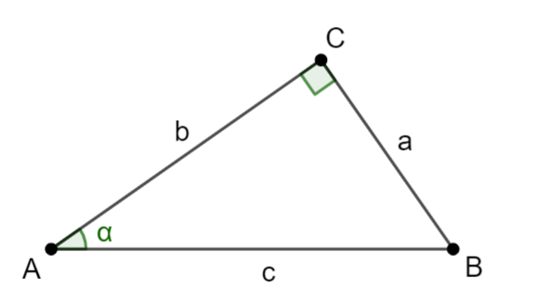
Sine and cosine in a right-angled triangle
$$\sin{α}=\frac{a}{c}$$
Sine α expresses the ratio of the opposite and the hypotenuse.
$$\cos{α}=\frac{b}{c}$$
Cosine α expresses the ratio of the adjacent and the hypotenuse.

Slide 5
Values of sine and cosine functions
Angle | $0°$ $(0)$ | $30°$ $\left(\frac{π}{6}\right)$ | 4$5°$ $\left(\frac{π}{4}\right)$ | $60°$ $\left(\frac{π}{3}\right)$ | $90°$ $\left(\frac{π}{2}\right)$
$$sin α$$ | $$0$$ | $$\frac{1}{2}$$ | $$\frac{\sqrt{2}}{2}$$ | $$\frac{\sqrt{3}}{2}$$ | $$1$$
$$cos α$$ | $$1$$ | $$\frac{\sqrt{3}}{2}$$ | $$\frac{\sqrt{2}}{2}$$ | $$\frac{1}{2}$$ | $$0$$

Slide 6
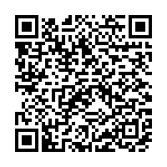
KAHOOT!
Revision: Basic values of sine and cosine functions in a right-angled triangle
Link:
https://create.kahoot.it/share/sinus-and-cosinus-in-right-angled-triangle/693a4bc9-6269-4b19-b60f-01a31613e240
Play KAHOOT!

Slide 7
Determining the values of sine and cosine
2

Slide 8
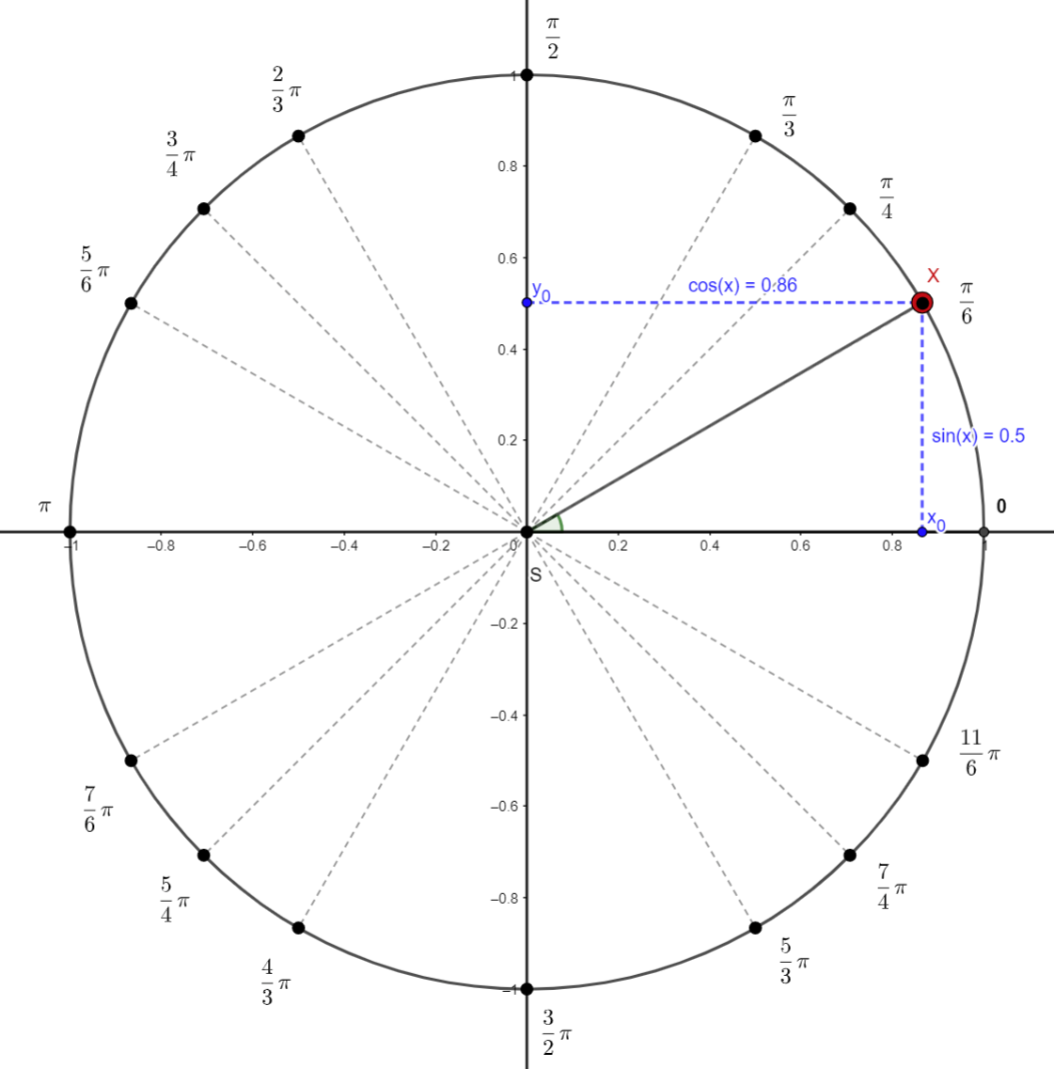
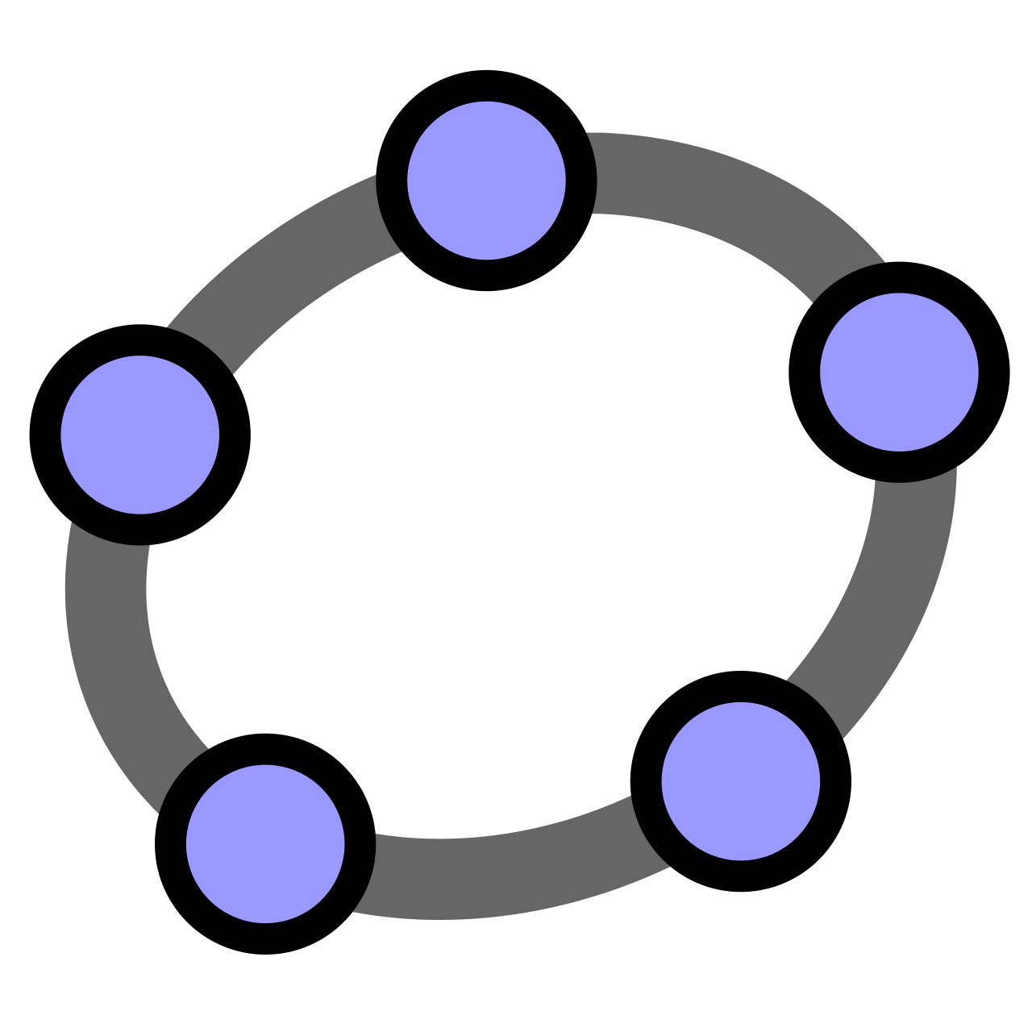
Quadrant I
$\sin\left(x\right)$… on the y-axis … positive
$\cos\left(x\right)$… on the x-axis … positive
The value is determined right from the table or using a calculator.
show in GeoGebra

Slide 9
Quadrant II
$\sin\left(x\right)$… on the y-axis … positive
$\cos\left(x\right)$… on the x-axis … negative
In this case the axial symmetry is used; according to the y-axis axial symmetry the angle is transferred to Quadrant I (the angles marked in red and green are of the same size).
The sum of the given angle and the angle in Quadrant I is π.
$$\sin\left(\frac{2}{3}π\right)=\sin\left(π−\frac{2}{3}π\right)=sin\left(\frac{π}{3}\right)=\frac{\sqrt{3}}{2}$$
Quadrant II summary:
sine … positive
cosine … negative
the angle size conversion … $π−x$
$$\cos\left(\frac{2}{3}π\right)=−cos\left(π−\frac{2}{3}π\right)=−cos\left(\frac{π}{3}\right)=−\frac{1}{2}$$

Slide 10
Quadrant III
$\sin\left(x\right)$… on the y-axis … negative
$\cos\left(x\right)$… on the x-axis … negative
In this case the point reflexion is used; according to the point reflexion origin, the angle is transferred to Quadrant I (the angles marked in red and green are of the same size).
When we subtract the given angle and the angle in Quadrant I we get π.
$$\sin\left(\frac{4}{3}π\right)=−sin\left(\frac{4}{3}π−π\right)=−sin\left(\frac{π}{3}\right)=−\frac{\sqrt{3}}{2}$$
Quadrant III summary:
sine … negative
cosine … negative
the angle size conversion … $x−π$
$$\cos\left(\frac{4}{3}π\right)=−cos\left(\frac{4}{3}π−π\right)=−cos\left(\frac{π}{3}\right)=−\frac{1}{2}$$

Slide 11
Quadrant IV
$\sin\left(x\right)$… on the y-axis … negative
$\cos\left(x\right)$… on the x-axis … negative
In this case axial symmetry is used; according to the x-axis axial symmetry, the angle is transferred to Quadrant I (the angles marked in red and green are of the same size).
The sum of the given angle and the angle in Quadrant I is $2π$.
$$\sin\left(\frac{5}{3}π\right)=−sin\left(2π−\frac{5}{3}π\right)=−sin\left(\frac{π}{3}\right)=−\frac{\sqrt{3}}{2}$$
Quadrant IV summary:
sine … negative
cosine … positive
the angle size conversion … $2π−x$
$$\cos\left(\frac{5}{3}π\right)=\cos\left(2π−\frac{5}{3}π\right)=cos\left(\frac{π}{3}\right)=\frac{1}{2}$$

Slide 12
To practise
3

Slide 13
To practise
Determine the values of $sin⁡(x)$ and $cos⁡(x)$ for the following $x$:
$x=\frac{5}{6}π$
$x=\frac{3}{2}π$
$x=\frac{7}{4}π$
$x=\frac{5}{4}π$
$x=\frac{7}{6}π$
$x=\frac{1}{2}π$
$x=\frac{11}{6}π$
$x=\frac{4}{3}π$

Slide 14
To practise
Determine the values of $sin⁡(x)$ and $cos⁡(x)$ for the following $x$:
$x=\frac{5}{6}π$
$x=\frac{3}{2}π$
$x=\frac{7}{4}π$
$x=\frac{5}{4}π$
$x=\frac{7}{6}π$
$x=\frac{1}{2}π$
$x=\frac{11}{6}π$
$x=\frac{4}{3}π$
$\sin\left(x\right)=\frac{1}{2};\cos\left(x\right)=−\frac{\sqrt{3}}{2}$
$\sin\left(x\right)=−1;\cos\left(x\right)=0$
$\sin\left(x\right)=−\frac{\sqrt{2}}{2};\cos\left(x\right)=\frac{\sqrt{2}}{2}$
$\sin\left(x\right)=−\frac{\sqrt{2}}{2};\cos\left(x\right)=−\frac{\sqrt{2}}{2}$
$\sin\left(x\right)=−\frac{1}{2};\cos\left(x\right)=−\frac{\sqrt{3}}{2}$
$\sin\left(x\right)=1;\cos\left(x\right)=0$
$\sin\left(x\right)=−\frac{1}{2};\cos\left(x\right)=\frac{\sqrt{3}}{2}$
$\sin\left(x\right)=−\frac{1}{2};\cos\left(x\right)=\frac{\sqrt{3}}{2}$

Slide 15
2020-1-SK01-KA226-SCH-094350
DIGI SCHOOL
EN The European Commission's support for the production of this publication does not constitute an endorsement of the contents, which reflect the views only of the authors, and the Commission cannot be held responsible for any use which may be made of the information contained therein.
CZ Podpora Evropské komise na zhotovení této práce nevyjadřuje názor Komise, obsah je názorem autora a Komise není zodpovědná za informace v práci obsažené.

Slide 16
2020-1-SK01-KA226-SCH-094350
DIGI SCHOOL
Gymnázium a Jazyková škola s právem státní jazykové zkoušky Zlín
Délka projektu: 01. 03. 2021 – 28. 02. 2023
Rozpočet partnerství: 101 092 €
Rozpočet GJŠ Zlín: 20 829 €
Intelektuální výstupy všech partnerů: ANJ, NEJ, FRJ, SPJ, DEJ, OBN, CHE, GEO, MAT, BIO, EKN, ITK, HUV, ETV
Intelektuální výstupy GJŠ Zlín: MAT, GEO, CHE, SPJ

