Slide 1
Tangent and cotangent in a right-angled triangle I
2020-1-SK01-KA226-SCH-094350
DIGI SCHOOL
Gymnázium a Jazyková škola s právem státní jazykové zkoušky Zlín
Michal Heczko

Slide 2
2020-1-SK01-KA226-SCH-094350 | DIGI SCHOOL
SUBJECT: MATHEMATICS
SPECIFICATION: in ENGLISH via CLIL method (level in languages)
AGE OF STUDENTS: 16-18
1 LESSON : 45 min

Slide 3
Introduction
1
Tangent and cotangent in a right-angled triangle

Slide 4
KAHOOT!
Revision: Basic values of tangent and cotangent in a right-angled triangle
Link:
https://create.kahoot.it/share/tangens-and-cotangens-in-right-angled-triangle/fb44a033-c422-49c5-8539-55b7456df921
Play KAHOOT!

Slide 5
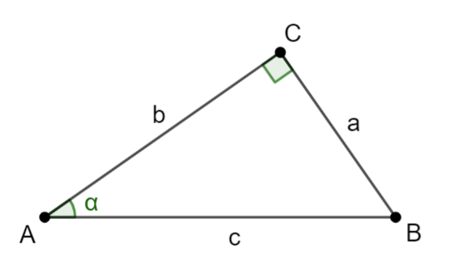
Tangent and cotangent in a right-angled triangle
$$\tan{α}=\frac{a}{b}$$
Tangent α expresses the ratio of the opposite and the adjacent.
$$\cot{α}=\frac{b}{a}$$
Cotangent α expresses the ratio of the adjacent and the opposite.

Slide 6
The values of the tangent and cotangent functions
angle | $0°$ $(0)$ | $30°$ $\left(\frac{π}{6}\right)$ | 4$5°$ $\left(\frac{π}{4}\right)$ | $60°$ $\left(\frac{π}{3}\right)$ | $90°$ $\left(\frac{π}{2}\right)$
$$tan α$$ | $$0$$ | $$\frac{\sqrt{3}}{2}$$ | $$1$$ | $$\sqrt{3}$$ | $$∅$$
$$cot α$$ | $$∅$$ | $$\sqrt{3}$$ | 1 | $$\frac{\sqrt{3}}{2}$$ | $$0$$

Slide 7
Unit circle
2

Slide 8
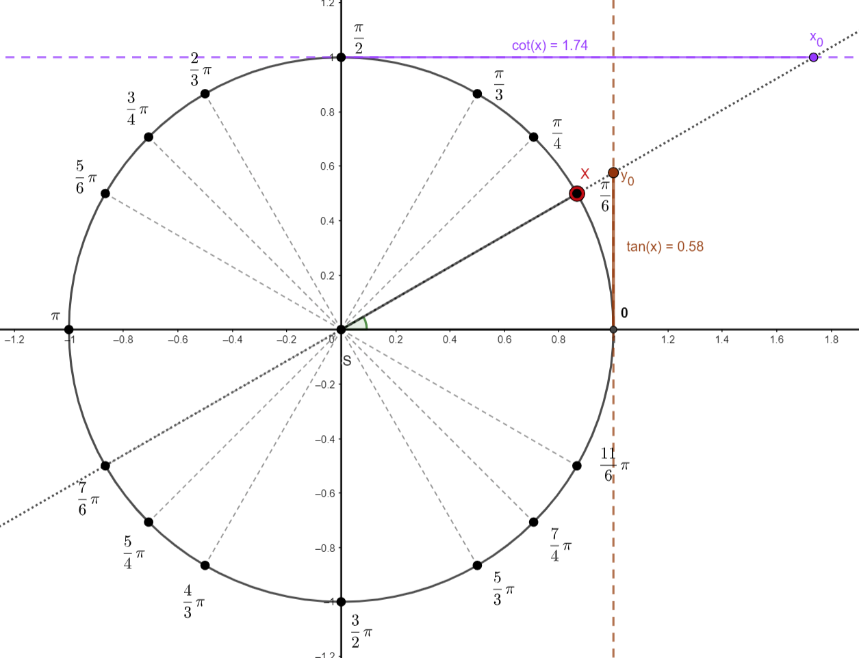
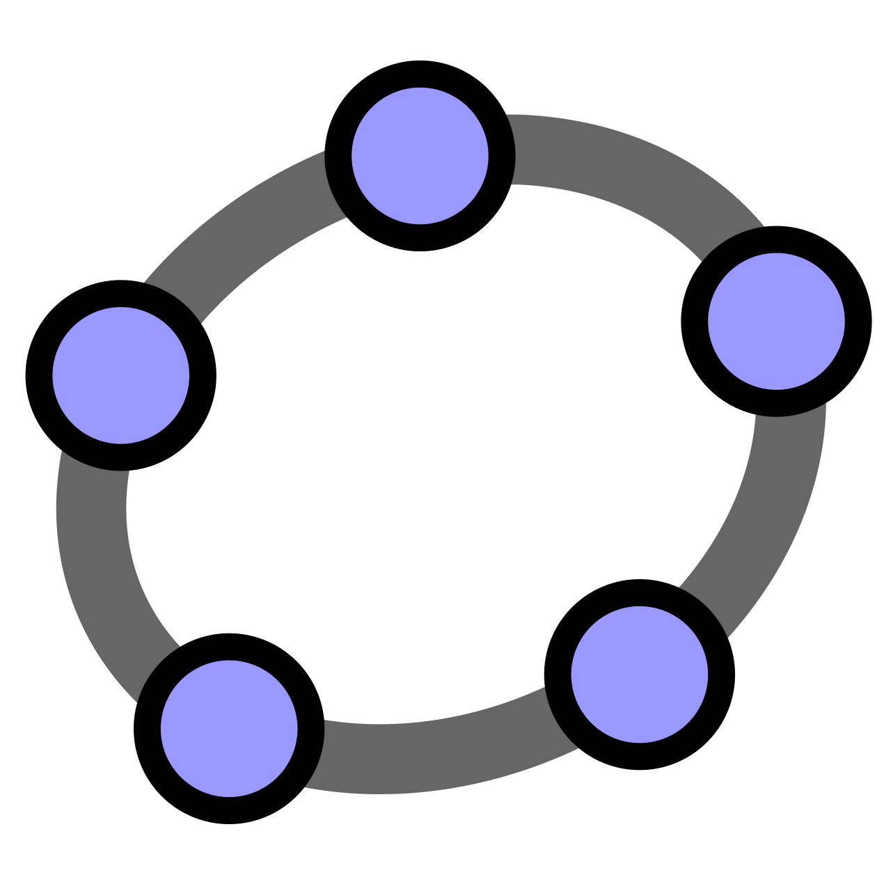
Unit circle
The values of sin a cos functions are determined on x-axis (cos) and y-axis (sin).
The values of tangent (x) are determined on a tangent line to the circle at a point $\left[1;0\right].$
The value of cotangent (x)is determined on a tangent line to the circle at a point $\left[0;1\right].$
show in GeoGebra

Slide 9
Determining values of tangent and cotangent
3

Slide 10
Quadrant I
$\tan\left(x\right)$… on a tangent line parallel to the y-axis … positive
$\cot\left(x\right)$… on a tangent line parallel to the x-axis … positive
The value is determined directly from a table or using a calculator.
show in GeoGebra

Slide 11
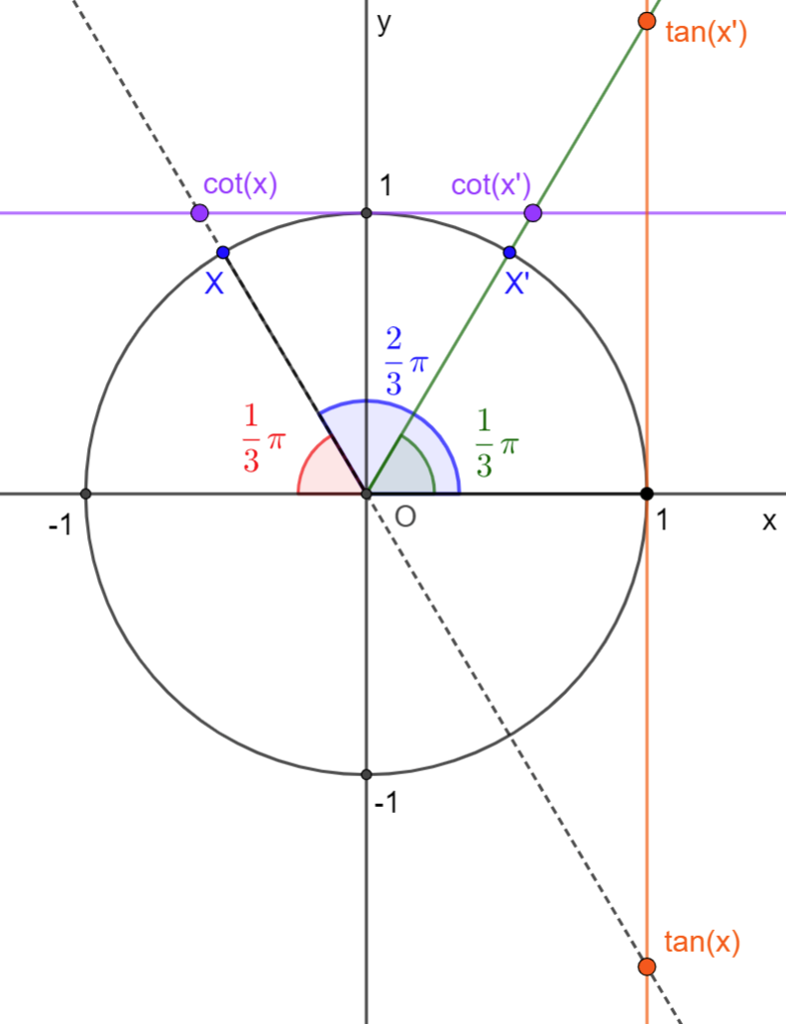
Quadrant II
$\tan\left(x\right)$… on a tangent line at [1;0] … negative
$\cot\left(x\right)$… on a tangent line at [0;1] … negative
In this case axial symmetry is used; according to the y-axis axial symmetry, the angle is transferred to Quadrant I (the angles marked in red and green are of the same size).
Thanks to this the sum of the given angle and the transferred angle in Quadrant I is π.
$$\tan\left(\frac{2}{3}π\right)=−tan\left(π−\frac{2}{3}π\right)=−tan\left(\frac{π}{3}\right)=−\sqrt{3}$$
Quadrant II summary:
tangent … negative
cotangent … negative
the angle size conversion is … $π−x$
$$\cot\left(\frac{2}{3}π\right)=−cot\left(π−\frac{2}{3}π\right)=−cot\left(\frac{π}{3}\right)=−\frac{\sqrt{3}}{3}$$

Slide 12
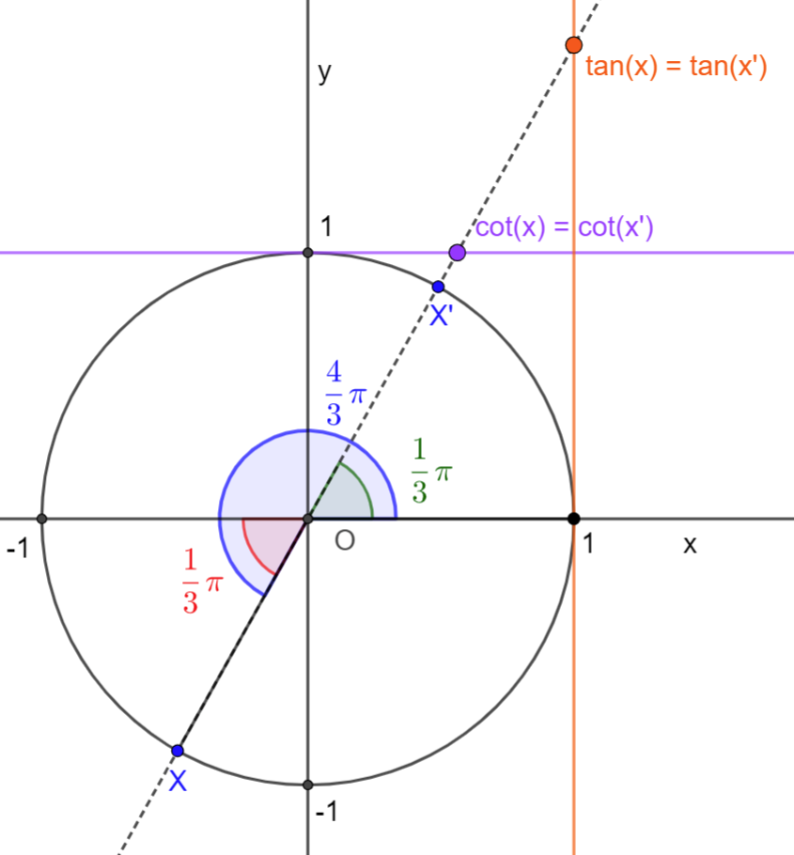
Quadrant III
$\tan\left(x\right)$… on a tangent line at [1;0] … positive
$\cot\left(x\right)$… on a tangent line at [0;1] … positive
In this case point reflexion is used; according to the point reflexion the angle is transferred to Quadrant I (the angles marked in red and green are of the same size).
When we subtract the given angle and the angle in Quadrant I we get π.
$$\tan\left(\frac{4}{3}π\right)=\tan\left(\frac{4}{3}π−π\right)=tan\left(\frac{π}{3}\right)=\sqrt{3}$$
Quadrant III summary:
tangent … positive
cotangent … positive
the angle size conversion is… $x−π$
$$\cot\left(\frac{4}{3}π\right)=−cot\left(\frac{4}{3}π−π\right)=cot\left(\frac{π}{3}\right)=\frac{\sqrt{3}}{3}$$

Slide 13
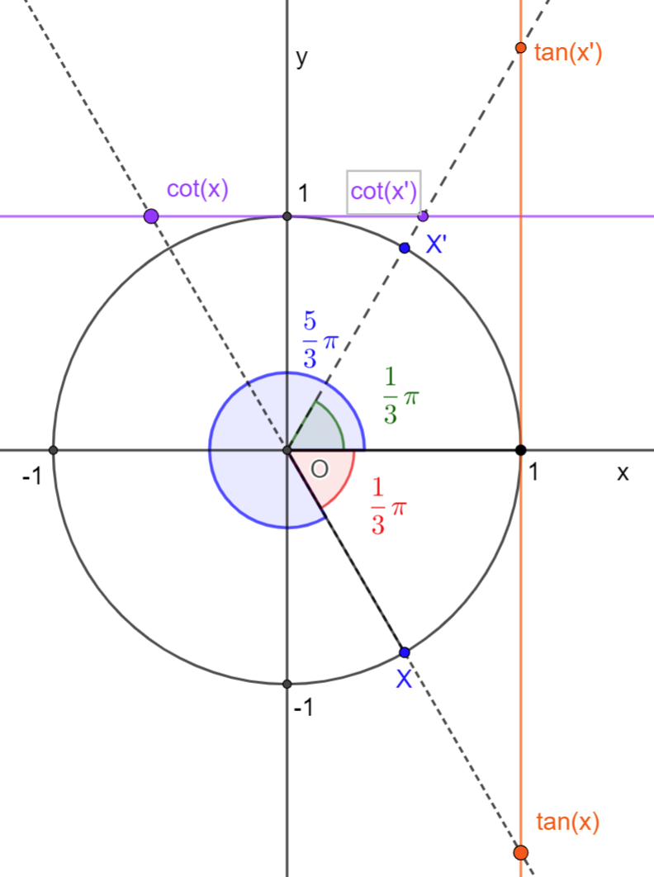
Quadrant IV
$\tan\left(x\right)$… on a tangent line at [1;0] … positive
$\cot\left(x\right)$… on a tangent line at [0;1] … positive
In this case axial symmetry is used; according to the x-axis axial symmetry the angle is transferred to Quadrant I (the angles marked in red and green are of the same size).
Díky tomu je součet zadaného úhlu a úhlu v I. kvadrantu $2π$.
$$\tan\left(\frac{5}{3}π\right)=−\tan\left(2π−\frac{5}{3}π\right)=−tan\left(\frac{π}{3}\right)=−\sqrt{3}$$
Quadrant IV summary:
tangent … negative
cotangent … negative
the angle size conversion … $2π−x$
$$\cot\left(\frac{5}{3}π\right)=−cot\left(2π−\frac{5}{3}π\right)=−cot\left(\frac{π}{3}\right)=−\frac{\sqrt{3}}{3}$$

Slide 14
To practise
D$etermine tan⁡(x)$ and $cot⁡(x)$ f$or the following x$:
$x=\frac{5}{6}π$
$x=\frac{3}{2}π$
$x=\frac{7}{4}π$
$x=\frac{5}{4}π$
$x=\frac{7}{6}π$
$x=\frac{1}{2}π$
$x=\frac{11}{6}π$
$x=\frac{4}{3}π$

Slide 15
To practise
D$etermine tan⁡(x)$ and $cot⁡(x)$ f$or the following x$:
$x=\frac{5}{6}π$
$x=π$
$x=\frac{7}{4}π$
$x=\frac{5}{4}π$
$x=\frac{7}{6}π$
$x=\frac{1}{2}π$
$x=\frac{11}{6}π$
$x=\frac{4}{3}π$
$\operatorname{tg}\left(x\right)=−\frac{\sqrt{3}}{3};\operatorname{cotg}\left(x\right)=−\sqrt{3}$
$\operatorname{tg}\left(x\right)=0;\operatorname{cotg}\left(x\right)=∅$
$\operatorname{tg}\left(x\right)=−1;\operatorname{cotg}\left(x\right)=−1$
$\operatorname{tg}\left(x\right)=1;\operatorname{cotg}\left(x\right)=1$
$\operatorname{tg}\left(x\right)=−\frac{\sqrt{3}}{3};\operatorname{cotg}\left(x\right)=−\sqrt{3}$
$\operatorname{tg}\left(x\right)=∅;\operatorname{cotg}\left(x\right)=0$
$\operatorname{tg}\left(x\right)=−\frac{\sqrt{3}}{3};\operatorname{cotg}\left(x\right)=−\sqrt{3}$
$\operatorname{tg}\left(x\right)=−\sqrt{3};\operatorname{cotg}\left(x\right)=−\frac{\sqrt{3}}{3}$

Slide 16
2020-1-SK01-KA226-SCH-094350
DIGI SCHOOL
EN The European Commission's support for the production of this publication does not constitute an endorsement of the contents, which reflect the views only of the authors, and the Commission cannot be held responsible for any use which may be made of the information contained therein.
CZ Podpora Evropské komise na zhotovení této práce nevyjadřuje názor Komise, obsah je názorem autora a Komise není zodpovědná za informace v práci obsažené.

Slide 17
2020-1-SK01-KA226-SCH-094350
DIGI SCHOOL
Gymnázium a Jazyková škola s právem státní jazykové zkoušky Zlín
Délka projektu: 01. 03. 2021 – 28. 02. 2023
Rozpočet partnerství: 101 092 €
Rozpočet GJŠ Zlín: 20 829 €
Intelektuální výstupy všech partnerů: ANJ, NEJ, FRJ, SPJ, DEJ, OBN, CHE, GEO, MAT, BIO, EKN, ITK, HUV, ETV
Intelektuální výstupy GJŠ Zlín: MAT, GEO, CHE, SPJ

