Slide 1
Equations with sine and cosine functions
2020-1-SK01-KA226-SCH-094350
DIGI SCHOOL
Gymnázium a Jazyková škola s právem státní jazykové zkoušky Zlín
Michal Heczko

Slide 2
2020-1-SK01-KA226-SCH-094350 | DIGI SCHOOL
SUBJECT: MATHEMATICS
SPECIFICATION: in ENGLISH via CLIL method (level in languages)
AGE OF STUDENTS: 16-18
2 LESSONS : 90 min

Slide 3
Basic values revision
1

Slide 4
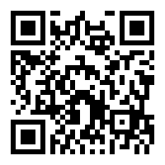
WORDWALL
Revision: Angles and quadrants
Link:
https://wordwall.net/cs/resource/26629923
Play WORDWALL

Slide 5
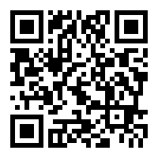
WORDWALL
Revision: Sine and cosine values
Link:
https://www.wordwall.net/resource/23095749
Play WORDWALL

Slide 6
Simple equations
2

Slide 7
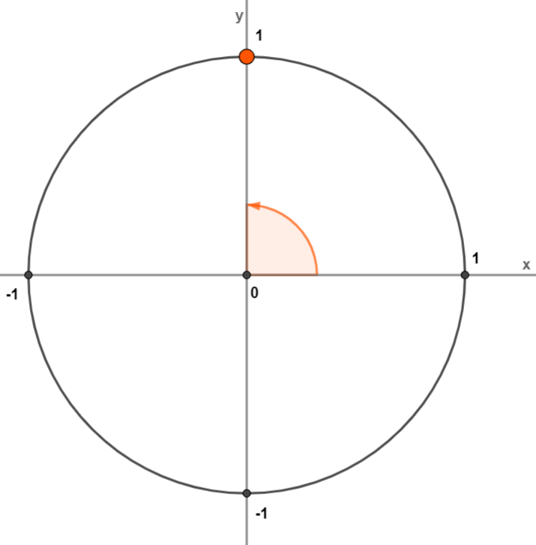
Simple equations
Example 1: $\sin\left(x\right)=1$
The value of sine is read on the y axis.
The solution is the point $\left[0; 1\right]$ on the unit circle.
T$he solution is the angle x=\frac{π}{2}$.
It is a periodic function with the
period $2π$, it is recorded as the following $x=\frac{π}{2}+2kπ$
$$x∈\bigcup_{k∈ℤ}{\left\{\frac{π}{2}+2kπ\right\}}$$

Slide 8
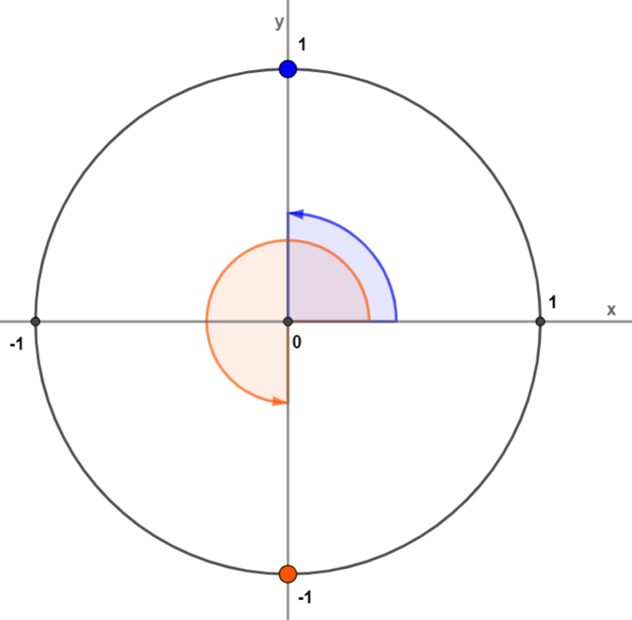
Simple equations
Example 2: $\cos\left(x\right)=0$
The value of cos is read on x axis.
The solutions are the points of $\left[0; 1\right]$ and $\left[0;−1\right]$ on the unit circle.
The solution is $x=\frac{π}{2}$ a $x=\frac{3π}{2}$.
The period of the function is$2π$, recorded as the following $x=\frac{π}{2}+2kπ$ and $x=\frac{3π}{2}+2kπ$, which can be shorten to $x=\frac{π}{2}+kπ$.
$$x∈\bigcup_{k∈ℤ}{\left\{\frac{π}{2}+kπ\right\}}$$

Slide 9
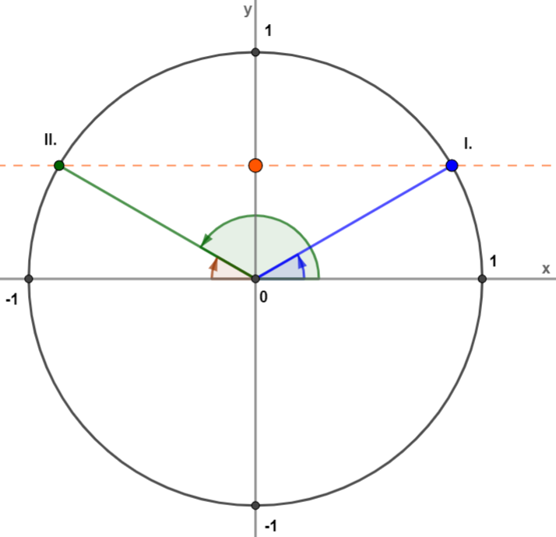
Simple equations
Example 3: $\sin\left(x\right)=\frac{1}{2}$
The basic table value $x_{0}=\frac{π}{6}$
$\sin{x}$ is positive in Quadrants I and II.
Quadrant I:
$x=\frac{π}{6}+2kπ$
Quadrant II:
$x=π−\frac{π}{6}+2kπ$
$$x∈\bigcup_{k∈ℤ}{\left\{\frac{π}{6}+2kπ;\frac{5}{6}π+2kπ\right\}}$$
$x=\frac{5π}{6}+2kπ$

Slide 10
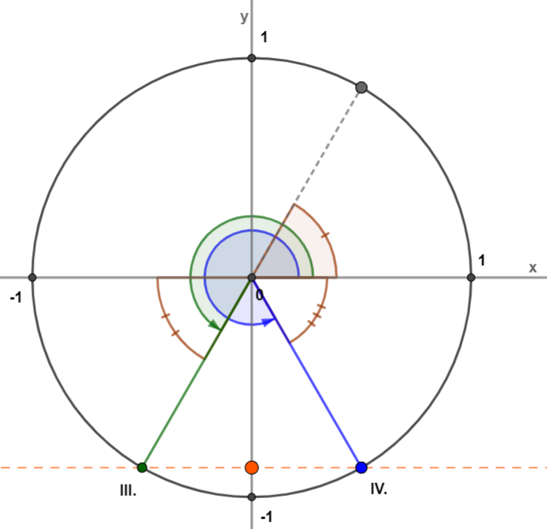
Simple equations
4: $\sin\left(x\right)=−\frac{\sqrt{3}}{2}$
The basic table value $x_{0}=\frac{π}{3}$
$\sin{x}$ is negative in Quadrants III and IV.
Quadrant III:
$x=π+\frac{π}{3}+2kπ$
$x=\frac{4π}{3}+2kπ$
Quadrant IV:
$x=2π−\frac{π}{3}+2kπ$
$$x∈\bigcup_{k∈ℤ}{\left\{\frac{4}{3}π+2kπ;\frac{5}{3}π+2kπ\right\}}$$
$x=\frac{5π}{3}+2kπ$

Slide 11
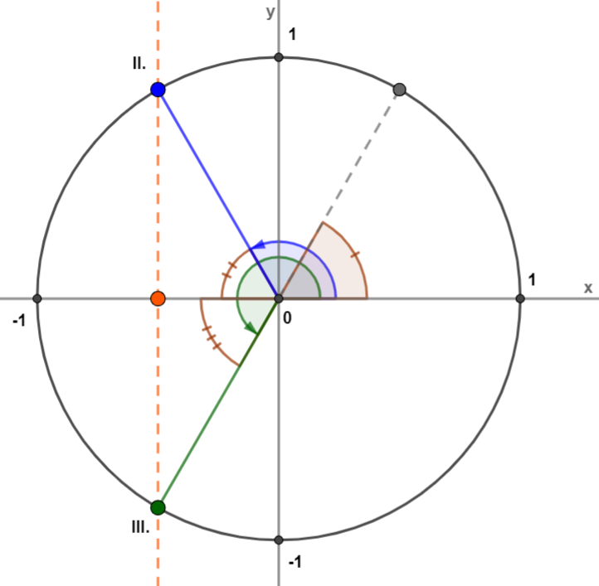
Simple equations
Example 5: $\cos\left(x\right)=−\frac{\sqrt{2}}{2}$
The basic table value $x_{0}=\frac{π}{4}$
$\cos{x}$ is negative in Quadrants II and III.
Quadrant II:
$x=π−\frac{π}{4}+2kπ$
$x=\frac{3π}{4}+2kπ$
Quadrant III:
$x=π+\frac{π}{4}+2kπ$
$$x∈\bigcup_{k∈ℤ}{\left\{\frac{3}{4}π+2kπ;\frac{5}{4}π+2kπ\right\}}$$
$x=\frac{5π}{4}+2kπ$

Slide 12
More complex equations
3

Slide 13
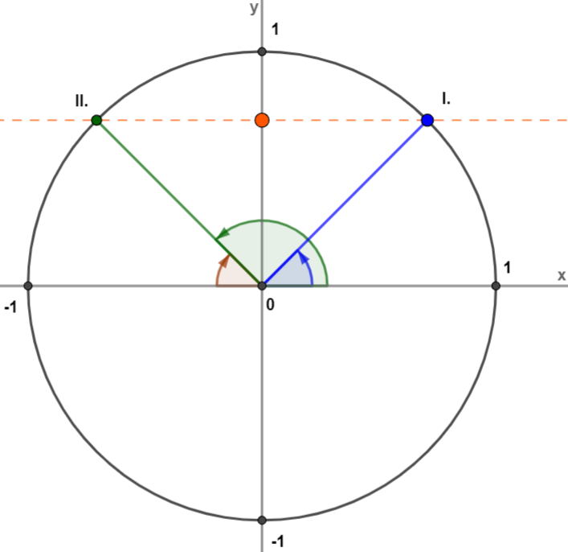
More complex equations
Example 6: $\sin\left(2x−\frac{π}{4}\right)=\frac{\sqrt{2}}{2}$
Substitution $2x−\frac{π}{4}=y$ is introduced
$\sin{y}=\frac{\sqrt{2}}{2}$
The basic table value $y_{0}=\frac{π}{4}$
$\sin{y}$ is positive in Quadrants I and II.

Slide 14
More complex equations
$$x∈\bigcup_{k∈ℤ}{\left\{\frac{π}{4}+kπ;\frac{π}{2}+kπ\right\}}$$
Example 6: $\sin\left(2x−\frac{π}{4}\right)=\frac{\sqrt{2}}{2}$
Quadrant I:
Quadrant II:
$y=\frac{π}{4}+2kπ$
$y=π−\frac{π}{4}+2kπ$
$2x−\frac{π}{4}=\frac{π}{4}+2kπ$
$2x−\frac{π}{4}=\frac{3π}{4}+2kπ$
$2x=\frac{π}{4}+\frac{π}{4}+2kπ=\frac{π}{2}+2kπ$
$2x=\frac{3π}{4}+\frac{π}{4}+2kπ=π+2kπ$
$x=\frac{π}{4}+kπ$
$x=\frac{π}{2}+kπ$

Slide 15
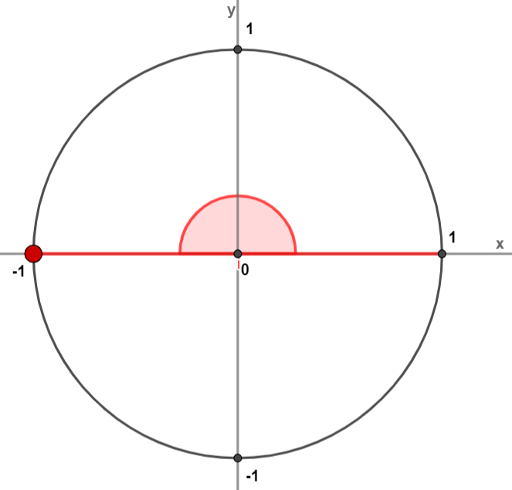
More complex equations
Back from the substitution
(1) $y=−1$
Example 7: $\cos^{2}{x}−\cos{x}−2=0$
$\cos{x}=−1$
$x=π+2kπ$
Substitution $\cos{x}=y$ is introduced
(2) $y=2$
$\cos{x}=2$
$y^{2}−y−2=0$
$x∈∅$
$y=\frac{−b±\sqrt{b^{2}−4ac}}{2a}$
$2∉H_{f}$ … $H_{f}=\left\langle −1;1\right\rangle$
$$x∈\bigcup_{k∈ℤ}{\left\{π+2kπ\right\}}$$
$y=\frac{1±\sqrt{{(−1)}^{2}−4∙1∙(−2)}}{2}=\frac{1±3}{2}$
$$y∈\left\{−1;2\right\}$$

Slide 16
The table for the conclusion
4

Slide 17
Table
Quadrant | SIN | COS | Angle conversion
$$I$$ | $$+$$ | $$+$$ | $$x_{0}$$
$$II$$ | $$+$$ | $$−$$ | $$π−x_{0}$$
$$III$$ | $$−$$ | $$−$$ | $$π+x_{0}$$
$$IV$$ | $$−$$ | $$+$$ | $$2π−x_{0}$$

Slide 18
Sine and cosine values
angle | $0°$ $(0)$ | $30°$ $\left(\frac{π}{6}\right)$ | 4$5°$ $\left(\frac{π}{4}\right)$ | $60°$ $\left(\frac{π}{3}\right)$ | $90°$ $\left(\frac{π}{2}\right)$
$$sin α$$ | $$0$$ | $$\frac{1}{2}$$ | $$\frac{\sqrt{2}}{2}$$ | $$\frac{\sqrt{3}}{2}$$ | $$1$$
$$cos α$$ | $$1$$ | $$\frac{\sqrt{3}}{2}$$ | $$\frac{\sqrt{2}}{2}$$ | $$\frac{1}{2}$$ | $$0$$

Slide 19
Excercises
5

Slide 20
Excercises
1: $\sin{x}=0$
5: $\sin{x}=\frac{\sqrt{3}}{2}$
2: $\cos{x}=1$
6: $\cos\left(x−\frac{π}{8}\right)=−\frac{\sqrt{2}}{2}$
3: $\sin{x}=−\frac{\sqrt{2}}{2}$
7: $\cos\left(3x−\frac{π}{6}\right)=\frac{1}{2}$
4: $\cos{x}=−\frac{\sqrt{2}}{2}$
8: $\sin^{2}{x}+5\sin{x}+4=0$

Slide 21
Results
1: $\sin{x}=0$
$$x∈\bigcup_{k∈ℤ}{\left\{kπ \right\}}$$
2: $\cos{x}=1$
$$x∈\bigcup_{k∈ℤ}{\left\{2kπ \right\}}$$
3: $\sin{x}=−\frac{\sqrt{2}}{2}$
$$x∈\bigcup_{k∈ℤ}{\left\{\frac{5}{4}π+kπ ;\frac{7}{4}π+kπ\right\}}$$
4: $\cos{x}=−\frac{\sqrt{2}}{2}$
$$x∈\bigcup_{k∈ℤ}{\left\{\frac{3}{4}π+kπ ;\frac{5}{4}π+kπ\right\}}$$

Slide 22
Results
5: $\sin{x}=\frac{\sqrt{3}}{2}$
$$x∈\bigcup_{k∈ℤ}{\left\{\frac{π}{3}+2kπ ;\frac{2π}{3}+2kπ\right\}}$$
6: $\cos\left(x−\frac{π}{8}\right)=−\frac{\sqrt{2}}{2}$
$$x∈\bigcup_{k∈ℤ}{\left\{\frac{7π}{8}+2kπ;\frac{11π}{8}+2kπ\right\}}$$
7: $\cos\left(3x−\frac{π}{6}\right)=\frac{1}{2}$
$$x∈\bigcup_{k∈ℤ}{\left\{\frac{π}{6}+\frac{2kπ}{3};\frac{11π}{18}+\frac{2kπ}{3}\right\}}$$
8: $\sin^{2}{x}+5\sin{x}+4=0$
$$x∈\bigcup_{k∈ℤ}{\left\{\frac{3π}{2}+2kπ \right\}}$$

Slide 23
2020-1-SK01-KA226-SCH-094350
DIGI SCHOOL
EN The European Commission's support for the production of this publication does not constitute an endorsement of the contents, which reflect the views only of the authors, and the Commission cannot be held responsible for any use which may be made of the information contained therein.
CZ Podpora Evropské komise na zhotovení této práce nevyjadřuje názor Komise, obsah je názorem autora a Komise není zodpovědná za informace v práci obsažené.

Slide 24
2020-1-SK01-KA226-SCH-094350
DIGI SCHOOL
Gymnázium a Jazyková škola s právem státní jazykové zkoušky Zlín
Délka projektu: 01. 03. 2021 – 28. 02. 2023
Rozpočet partnerství: 101 092 €
Rozpočet GJŠ Zlín: 20 829 €
Intelektuální výstupy všech partnerů: ANJ, NEJ, FRJ, SPJ, DEJ, OBN, CHE, GEO, MAT, BIO, EKN, ITK, HUV, ETV
Intelektuální výstupy GJŠ Zlín: MAT, GEO, CHE, SPJ

