Slide 1
Tangens and cotangens functions equations
2020-1-SK01-KA226-SCH-094350
DIGI SCHOOL
Gymnázium a Jazyková škola s právem státní jazykové zkoušky Zlín
Michal Heczko

Slide 2
2020-1-SK01-KA226-SCH-094350 | DIGI SCHOOL
SUBJECT: MATHEMATICS
SPECIFICATION: in ENGLISH via CLIL method (level in languages)
AGE OF STUDENTS: 16-18
2 LESSONS : 90 min

Slide 3
The revision of basic values
1

Slide 4
KAHOOT!
Revison: The values of trigonometric functions and the unit circle
Link:
https://create.kahoot.it/share/values-of-goniometrical-functions/0dd951a9-8538-45d7-8635-8517d099ba16
Play KAHOOT!

Slide 5
Simple equations
2

Slide 6
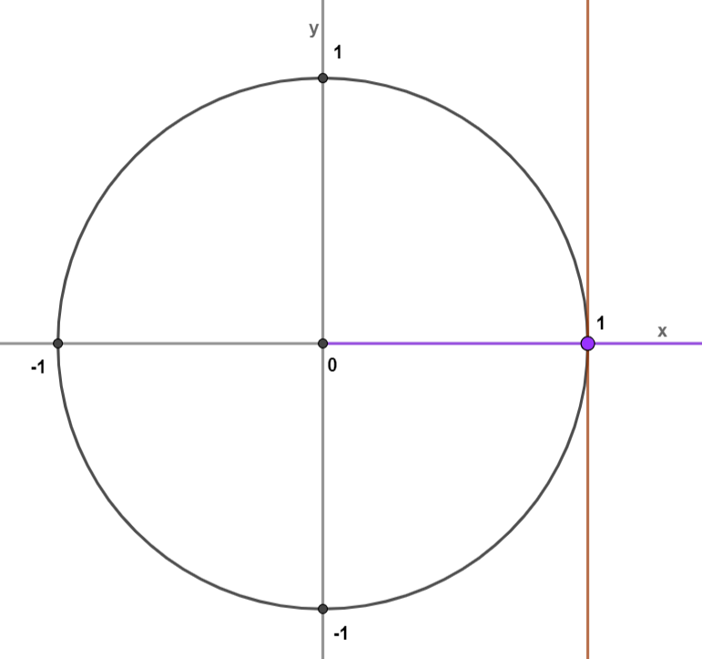
Simple equations
Example 1: $\operatorname{tg}\left(x\right)=0$
The value of tg is read on a tangent line going through the point $\left[1;0\right]$. To solve we need to find the coordinate y of the intersection of the angle and this tangent lineúhlu s touto tečnou.
The solution is the angle $x=0$.
As this is a periodic function with the period$π$, we record it as
$$x=0+kπ=kπ$$
$$x∈\bigcup_{k∈ℤ}{\left\{kπ\right\}}$$

Slide 7
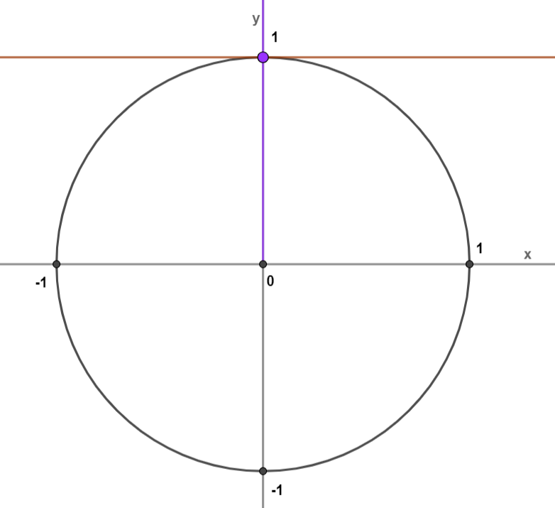
Simple equations
Example 1: $\operatorname{cotg}\left(x\right)=0$
The value of cotg is read on the tangent line going through the point $\left[0;1\right]$. To solve we need to seek for the coordinate x of the intersection of the angle and this tangent line.
The solution is the angle $x=\frac{π}{2}$.
As it is a periodic function with the period $π$, we record it as $x=\frac{π}{2}+kπ$
$$x∈\bigcup_{k∈ℤ}{\left\{\frac{π}{2}+kπ\right\}}$$

Slide 8
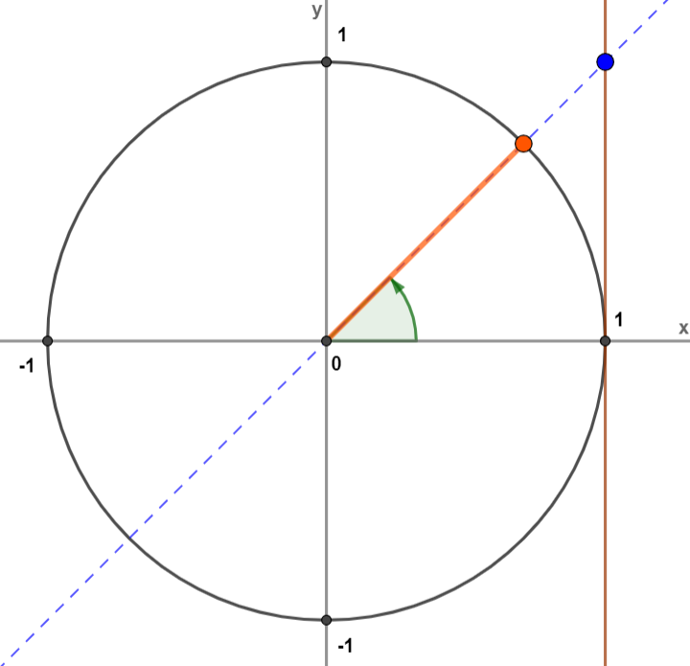
Simple equations
Example 3: $\operatorname{tg}\left(x\right)=1$
The basic table value $x_{0}=\frac{π}{4}$
$\operatorname{tg}{x}$ is positive in Quadrants I and III (considering the period $π$ just Quadrant I is solved.
Quadrant I:
$x=\frac{π}{4}+kπ$
$$x∈\bigcup_{k∈ℤ}{\left\{\frac{π}{4}+kπ\right\}}$$

Slide 9
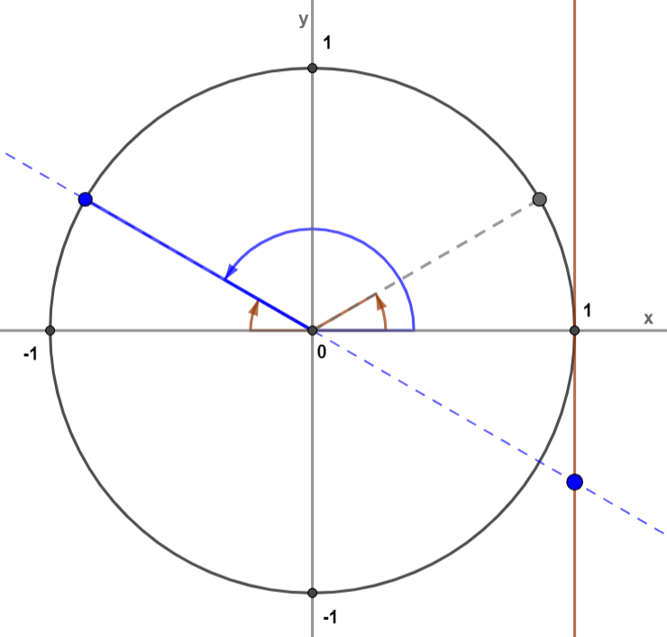
Simple eqautions
Example 3: $\operatorname{tg}\left(x\right)=−\frac{\sqrt{3}}{3}$
The basic table value $x_{0}=\frac{π}{6}$
$\operatorname{tg}{x}$ is negative in Quadrants II and IV (considering the period $π$ just Quadrant II is solved).
Quadrant II:
$x=π−\frac{π}{6}+kπ$
$$x∈\bigcup_{k∈ℤ}{\left\{\frac{5}{6}π+kπ\right\}}$$
$x=\frac{5π}{6}+kπ$

Slide 10
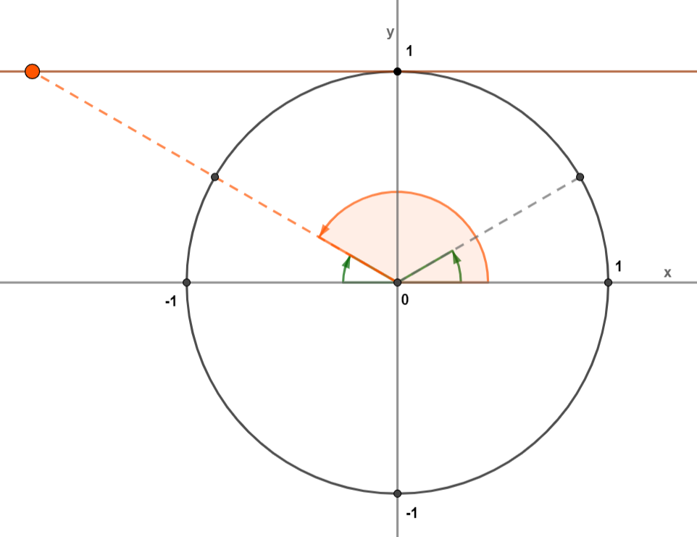
Simple equations
Example 3: $\operatorname{cotg}\left(x\right)=−\sqrt{3}$
The basic table value $x_{0}=\frac{π}{6}$
$\operatorname{cotg}{x}$ is negative in Quadrants II and IV (considering the period $π$ just Quadrant II is solved.
Quadrant II:
$x=π−\frac{π}{6}+kπ$
$$x∈\bigcup_{k∈ℤ}{\left\{\frac{5}{6}π+kπ\right\}}$$
$x=\frac{5π}{6}+kπ$

Slide 11
More complex equations
3

Slide 12
More complex equations
Example 6: $\operatorname{cotg}\left(\frac{1}{3}x+\frac{π}{9}\right)=−\sqrt{3}$
Substitution$\frac{1}{3}x+\frac{π}{9}=y$ is introduced
$\operatorname{cotg}{y}=−\sqrt{3}$
The basic table value $y_{0}=\frac{π}{6}$
$\operatorname{cotg}{y}$ is negative in Quadrant II.

Slide 13
More complex equations
Example 6: $\operatorname{cotg}\left(\frac{1}{3}x+\frac{π}{9}\right)=−\sqrt{3}$
Quadrant II:
$\frac{1}{3}x=\frac{15π}{18}−\frac{2π}{18}+kπ$
$y=π−\frac{π}{6}+kπ$
$\frac{1}{3}x=\frac{13π}{18}+kπ$
$y=\frac{5π}{6}+kπ$
$x=\frac{13π}{6}+3kπ$
$\frac{1}{3}x+\frac{π}{9}=\frac{5π}{6}+kπ$
$$x∈\bigcup_{k∈ℤ}{\left\{\frac{13π}{6}+3kπ\right\}}$$
$\frac{1}{3}x=\frac{5π}{6}−\frac{π}{9}+kπ$

Slide 14
More complex equations
Back from the substitution
(1) $y=0$
Example 7: ${cotg}^{2}{x}−\operatorname{cotg}{x}=0$
$\operatorname{cotg}{x}=0$
$x=\frac{π}{2}+kπ$
Substitution $\operatorname{cotg}{x}=y$ is introduced
(2) $y=1$
$\operatorname{cotg}{x}=1$
$y^{2}−y=0$
$x=\frac{π}{4}+kπ$
$y∙\left(y−1\right)=0$
$$x∈\bigcup_{k∈ℤ}{\left\{\frac{π}{2}+kπ;\frac{π}{4}+kπ\right\}}$$
$y∈\left\{0;1\right\}$

Slide 15
Summarizing table
4

Slide 16
Table
Quadrant | TG | COTG | Angle conversion
$$I$$ | $$+$$ | $$+$$ | $$x_{0}$$
$$II$$ | $$−$$ | $$−$$ | $$π−x_{0}$$
$$III$$ | $$+$$ | $$+$$ | $$π+x_{0}$$
$$IV$$ | $$−$$ | $$−$$ | $$2π−x_{0}$$

Slide 17
Tangent and cotangent values
angle | $0°$ $(0)$ | $30°$ $\left(\frac{π}{6}\right)$ | 4$5°$ $\left(\frac{π}{4}\right)$ | $60°$ $\left(\frac{π}{3}\right)$ | $90°$ $\left(\frac{π}{2}\right)$
$$tg α$$ | $$0$$ | $$\frac{\sqrt{3}}{3}$$ | $$1$$ | $$\sqrt{3}$$ | $$∅$$
$$cotg α$$ | $$∅$$ | $$\sqrt{3}$$ | 1 | $$\frac{\sqrt{3}}{3}$$ | $$0$$

Slide 18
Excercises
5

Slide 19
Excercises
1: $\operatorname{tg}{x}=1$
5: $\operatorname{tg}\left(x+\frac{π}{8}\right)=\frac{\sqrt{3}}{3}$
2: $\operatorname{cotg}{x}=0$
6: $\operatorname{cotg}\left(2x−\frac{π}{6}\right)=−\sqrt{3}$
3: $\operatorname{tg}{x}=−1$
7: $3∙co{tg}^{2}{x}−1=0$
4: $\operatorname{cotg}{x}=\frac{\sqrt{3}}{3}$
8: ${tg}^{2}{x}−1=0$

Slide 20
Results
1: $\operatorname{tg}{x}=1$
$$x∈\bigcup_{k∈ℤ}{\left\{\frac{π}{4}+kπ \right\}}$$
2: $\operatorname{cotg}{x}=0$
$$x∈\bigcup_{k∈ℤ}{\left\{\frac{π}{2}+kπ \right\}}$$
3: $\operatorname{tg}{x}=−1$
$$x∈\bigcup_{k∈ℤ}{\left\{\frac{3}{4}π+kπ \right\}}$$
4: $\operatorname{cotg}{x}=\frac{\sqrt{3}}{3}$
$$x∈\bigcup_{k∈ℤ}{\left\{\frac{π}{3}+kπ \right\}}$$

Slide 21
Results
5: $\operatorname{tg}\left(x+\frac{π}{8}\right)=\frac{\sqrt{3}}{3}$
$$x∈\bigcup_{k∈ℤ}{\left\{\frac{π}{24}+kπ \right\}}$$
6: $\operatorname{cotg}\left(2x−\frac{π}{6}\right)=−\sqrt{3}$
$$x∈\bigcup_{k∈ℤ}{\left\{k\frac{π}{2} \right\}}$$
7: $3∙co{tg}^{2}{x}−1=0$
$$x∈\bigcup_{k∈ℤ}{\left\{\frac{π}{3}+kπ;\frac{2}{3}π+kπ\right\}}$$
8: ${tg}^{2}{x}−1=0$
$$x∈\bigcup_{k∈ℤ}{\left\{\frac{π}{4}+kπ;\frac{3}{4}π+kπ\right\}}$$

Slide 22
2020-1-SK01-KA226-SCH-094350
DIGI SCHOOL
EN The European Commission's support for the production of this publication does not constitute an endorsement of the contents, which reflect the views only of the authors, and the Commission cannot be held responsible for any use which may be made of the information contained therein.
CZ Podpora Evropské komise na zhotovení této práce nevyjadřuje názor Komise, obsah je názorem autora a Komise není zodpovědná za informace v práci obsažené.

Slide 23
2020-1-SK01-KA226-SCH-094350
DIGI SCHOOL
Gymnázium a Jazyková škola s právem státní jazykové zkoušky Zlín
Délka projektu: 01. 03. 2021 – 28. 02. 2023
Rozpočet partnerství: 101 092 €
Rozpočet GJŠ Zlín: 20 829 €
Intelektuální výstupy všech partnerů: ANJ, NEJ, FRJ, SPJ, DEJ, OBN, CHE, GEO, MAT, BIO, EKN, ITK, HUV, ETV
Intelektuální výstupy GJŠ Zlín: MAT, GEO, CHE, SPJ

