Slide 1
Further trigonometric expressions
2020-1-SK01-KA226-SCH-094350
DIGI SCHOOL
Gymnázium a Jazyková škola s právem státní jazykové zkoušky Zlín
Michal Heczko

Slide 2
2020-1-SK01-KA226-SCH-094350 | DIGI SCHOOL
SUBJECT: MATHEMATICS
SPECIFICATION: in ENGLISH via CLIL method (level in languages)
AGE OF STUDENTS: 16-18
1 LESSONS : 45 min

Slide 3
Expressions overview
1

Slide 4
Expressions overview
$$\sin{2x}=2∙\sin{x}∙\cos{x}$$
$$\sin^{2}{x}+\cos^{2}{x}=1$$
$$\cos{2x}=\cos^{2}{x}−\sin^{2}{x}$$
$$\operatorname{tg}{x}=\frac{\sin{x}}{\cos{x}}$$
$$\left|\sin{\frac{x}{2}}\right|=\sqrt{\frac{1−\cos{x}}{2}}$$
$$\operatorname{cotg}{x}=\frac{\cos{x}}{\sin{x}}$$
$$\left|\cos{\frac{x}{2}}\right|=\sqrt{\frac{1+\cos{x}}{2}}$$
$$\operatorname{tg}{x}∙\operatorname{cotg}{x}=1$$

Slide 5
Expressions overview
$$\sin{(x+y)}=\sin{x}∙\cos{y}+\cos{x}∙\sin{y}$$
$$\sin{x}+\sin{y}=2∙sin{\frac{x+y}{2}}∙\cos{\frac{x−y}{2}}$$
$$\sin{(x−y)}=\sin{x}∙\cos{y}−\cos{x}∙\sin{y}$$
$$\sin{x}−\sin{y}=2∙\cos{\frac{x+y}{2}}∙sin{\frac{x−y}{2}}$$
$$\cos{(x+y)}=\cos{x}∙\cos{y}−\sin{x}∙\sin{y}$$
$$\cos{x}+\cos{y}=2∙cos{\frac{x+y}{2}}∙\cos{\frac{x−y}{2}}$$
$$\cos{(x−y)}=\cos{x}∙\cos{y}+\sin{x}∙\sin{y}$$
$$\cos{x}−\cos{y}=−2∙sin{\frac{x+y}{2}}∙\sin{\frac{x−y}{2}}$$

Slide 6
Trigonometric expressions modifications
2

Slide 7
Example 1: Determine the sine function value
$$\sin{75°}$$
$$\sin{75°}=$$
$$\sin\left(30°+45°\right)=$$
$$=\sin{30°}∙\cos{45°}+\cos{30°}∙\sin{45°}=$$
$$=\frac{1}{2}∙\frac{\sqrt{2}}{2}+\frac{\sqrt{3}}{2}∙\frac{\sqrt{2}}{2}=$$
$$\frac{\sqrt{2}+\sqrt{6}}{4}$$

Slide 8
Example 2: Simplify
1 How to solve:
$$\cos{(x+y)}=\cos{x}∙\cos{y}−\sin{x}∙\sin{y}$$
$$\cos\left(\frac{π}{2}+x\right)−\cos\left(\frac{π}{2}−x\right)$$
$$\cos{(x−y)}=\cos{x}∙\cos{y}+\sin{x}∙\sin{y}$$
$$=\left(\cos{\frac{π}{2}∙\cos{x}−\sin{\frac{π}{2}}∙\sin{x}}\right)−\left(\cos{\frac{π}{2}∙\cos{x}+\sin{\frac{π}{2}}∙\sin{x}}\right)=$$
$$=cos{\frac{π}{2}∙\cos{x}−\sin{\frac{π}{2}}∙\sin{x}}−\cos{\frac{π}{2}∙\cos{x}−\sin{\frac{π}{2}}∙\sin{x}}=$$
$$=−2∙sin{\frac{π}{2}}∙\sin{x}=$$
$$−2∙1∙\sin{x}=$$
$$−2\sin{x}$$

Slide 9
Example 2: Simplify
2 How to solve:
$$\cos{x}−\cos{y}=−2∙sin{\frac{x+y}{2}}∙\sin{\frac{x−y}{2}}$$
$$\cos\left(\frac{π}{2}+x\right)−\cos\left(\frac{π}{2}−x\right)$$
$$=−2∙sin{\frac{\left(\frac{π}{2}+x\right)+\left(\frac{π}{2}−x\right)}{2}}∙\sin{\frac{\left(\frac{π}{2}+x\right)−\left(\frac{π}{2}−x\right)}{2}}=$$
$$=−2∙sin{\frac{\frac{π}{2}+x+\frac{π}{2}−x}{2}}∙\sin{\frac{\frac{π}{2}+x−\frac{π}{2}+x}{2}=−2∙sin{\frac{2∙\frac{π}{2}}{2}∙sin{\frac{2∙x}{2}}}}=$$
$$=−2∙sin{\frac{π}{2}}∙\sin{x}=$$
$$−2∙1∙\sin{x}=$$
$$−2\sin{x}$$

Slide 10
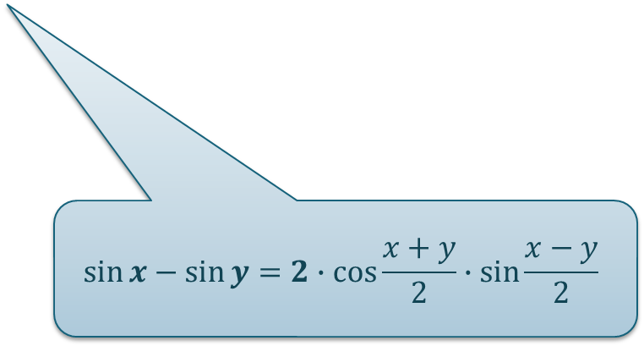
Example 3: Solve the equation
$$\sin{4x}−\sin{\frac{π}{2}}=−1$$
$$\sin{4x}−1=−1$$
$$\sin{4x}=0$$
$$\cos\left(2x+\frac{π}{4}\right)∙\sin\left(2x−\frac{π}{4}\right)=−0,5$$
$$4x=0+kπ$$
$$x=k\frac{π}{4}$$
$$2∙cos\left(2x+\frac{π}{4}\right)∙\sin\left(2x−\frac{π}{4}\right)=−1$$
$$x∈\bigcup_{k∈ℤ}{\left\{k\frac{π}{4}\right\}}$$
$$2∙cos\left(\frac{4x+\frac{π}{2}}{2}\right)∙\sin\left(\frac{4x−\frac{π}{2}}{2}\right)=−1$$
$$\sin{x}−\sin{y}=2∙\cos{\frac{x+y}{2}}∙sin{\frac{x−y}{2}}$$

Slide 11
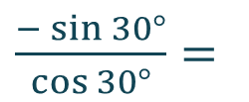
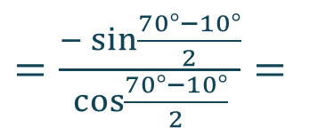

Example 4: Solve
$$\frac{\cos{70°−}\cos{10°}}{\sin{70°−}\sin{10°}}$$
$\frac{−2∙\sin{\frac{70°+10°}{2}}∙\sin{\frac{70°−10°}{2}}}{2∙\sin{\frac{70°+10°}{2}}∙\cos{\frac{70°−10°}{2}}}=$
$\frac{\cos{70°−}\cos{10°}}{\sin{70°+}\sin{10°}}=$
$=\frac{−\sin{\frac{70°−10°}{2}}}{\cos{\frac{70°−10°}{2}}}=$
$\frac{−\sin{30°}}{\cos{30°}}=$
$−\frac{\sqrt{3}}{3}$
$−\operatorname{tg}{30°}=$

Slide 12
Summary
3

Slide 13
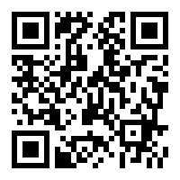
WORDWALL
Summary: Trigonometric expressions II
Link:
https://wordwall.net/resource/26630873
Play WORDWALL

Slide 14
Excercises
4

Slide 15
Excercises
E1: $\cos{15°}$
E2: $\sin\left(\frac{π}{6}−x\right)+\sin\left(\frac{π}{6}+x\right)$
E3:$\sin{105°}−\sin{15°}$
E4: $\cos\left(x+\frac{π}{4}\right)+\cos\left(\frac{π}{4}−x\right)=1$

Slide 16
Excercises
E1: $\cos{15°}$
Result: $\frac{\sqrt{6}+\sqrt{2}}{4}$
E2: $\sin\left(\frac{π}{6}−x\right)+\sin\left(\frac{π}{6}+x\right)$
Result: $cos(x)$
E3:$\sin{105°}−\sin{15°}$
Result: $\frac{\sqrt{2}}{2}$
E4: $\cos\left(x+\frac{π}{4}\right)+\cos\left(\frac{π}{4}−x\right)=1$
Result: $$x∈\bigcup_{k∈ℤ}{\left\{\frac{π}{4}+2kπ;\frac{7}{4}π+2kπ\right\}}$$

Slide 17
2020-1-SK01-KA226-SCH-094350
DIGI SCHOOL
EN The European Commission's support for the production of this publication does not constitute an endorsement of the contents, which reflect the views only of the authors, and the Commission cannot be held responsible for any use which may be made of the information contained therein.
CZ Podpora Evropské komise na zhotovení této práce nevyjadřuje názor Komise, obsah je názorem autora a Komise není zodpovědná za informace v práci obsažené.

Slide 18
2020-1-SK01-KA226-SCH-094350
DIGI SCHOOL
Gymnázium a Jazyková škola s právem státní jazykové zkoušky Zlín
Délka projektu: 01. 03. 2021 – 28. 02. 2023
Rozpočet partnerství: 101 092 €
Rozpočet GJŠ Zlín: 20 829 €
Intelektuální výstupy všech partnerů: ANJ, NEJ, FRJ, SPJ, DEJ, OBN, CHE, GEO, MAT, BIO, EKN, ITK, HUV, ETV
Intelektuální výstupy GJŠ Zlín: MAT, GEO, CHE, SPJ

