Slide 1
Digi school Geomorphology
2020-1-SK01-KA226-SCH-094350

Slide 2
SUBJECT: Geography
SPECIFICATION: may be used for presentation and self-education
AGE OF STUDENTS: 15 – 16
1 LESSON : 45 min
2020-1-SK01-KA226-SCH-094350

Slide 3
The Earth structure
1

Slide 4
Lesson content
01
The Earth exploration
02
The Earth structure
03
04

Slide 5
What is beneath the Earth´s surface?

Slide 6
Exploration of the planet Earth
direct
indirect

Slide 7
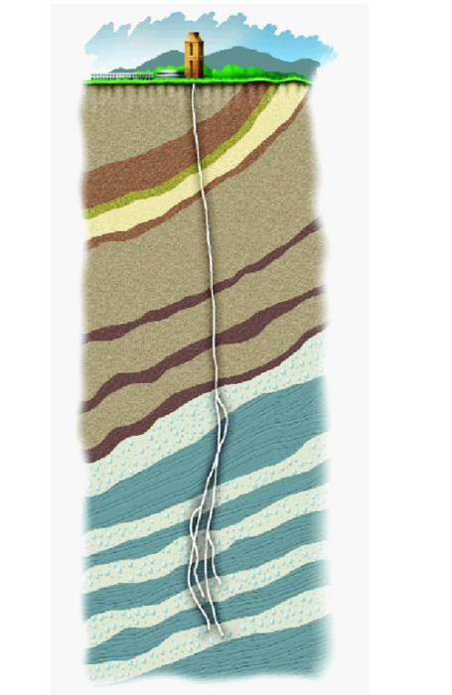
Deep drillings
The deepest in the Czech republic: Jablůnka 1
The deepest in the world: Kola´s superdeep drilling

Slide 8
Jablůnka 1
Depth: 6502 m
Purpose: exploratory drilling from 1982 to locate oil and gas deposits
Location on a map

Slide 9
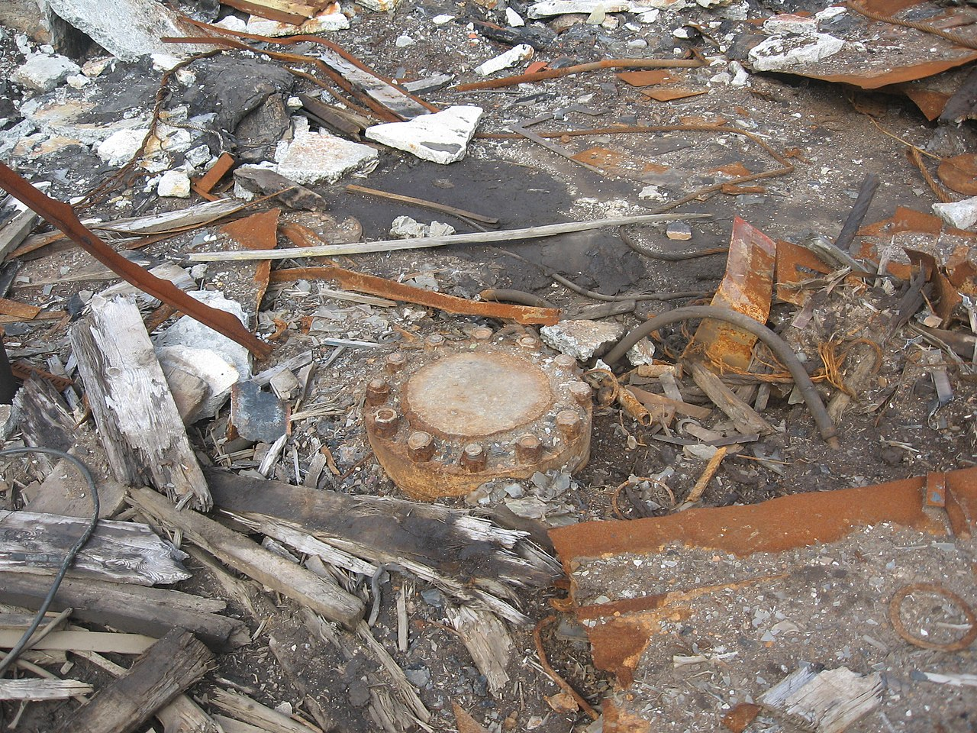
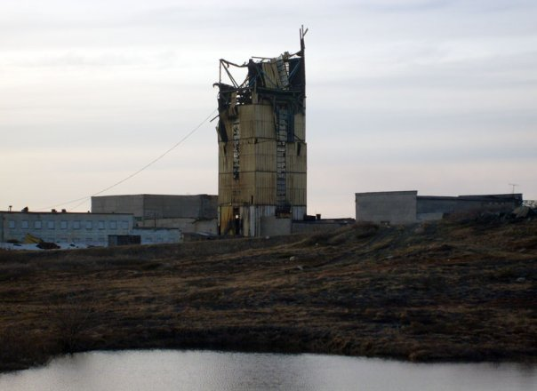
Kola’s superdeep drilling
Depth: 12 226 m
Purpose: geological exploration (1970 – 1994)
Location on a map
Tato fotka od autora Neznámý autor s licencí CC BY-SA
Tato fotka od autora Neznámý autor s licencí CC BY-SA-NC

Slide 10
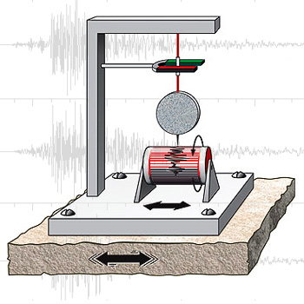
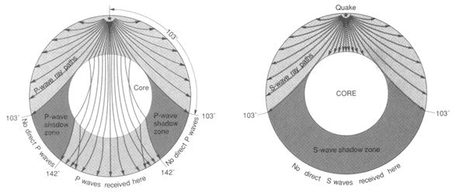
Seismic waves study
Seismic waves
Formed during an earthquake, spread through all directions
When travelling through the planet Earth, they change their speed and direction according to the kind of rock and their physical properties
Different borderlines were discovered in the planet’s body dividing them into several layers thanks to the use of the research of seismic waves.

Slide 11
Seismic waves - video

Slide 12
Structure of the Earth
litosphere
Mohorovičić discontinuity – the border between the lithosphere and the mantel
The velocity of seismic waves suddenly rises
Core-mantle boundary
The boundary between the core the mantle
P waves velocities are much slower while S-waves do not exist
35 km
mantle
2900 km
core
zemské jádro
6378 km

Slide 13
The Core
Includes iron (Fe) and nickel (Ni) oxides
The temperature is around 5 500°C
Outer core
Liquid
From 5100 to 5300 km
Inner core
Solid

Slide 14
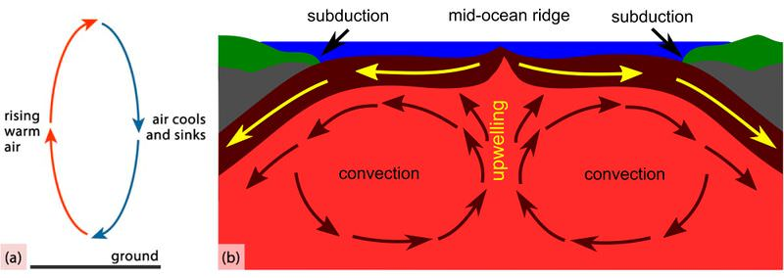
The Mantle
Includes SiO₂ (43%), MgO (37%)
Upper mantle
Created by molten rock
Differences in temperatures within different parts of the upper mantle cause convection currents
Lower mantle

Slide 15
Crust
Composition
Types of crust

Slide 16
Composition of the crust
Includes SiO₂, Al₂O₃
Elements in the crust occur:
On their own (Au, Ag,..)
Form minerals (silicon)
Form rocks:
Igneous (95%) – formed during the crystallization of magma
intrusive: magmatic (e. g. granite)
intrusive: intrusions (e. g. aplite)
extrusive: (e. g. basalt)
Sedimentary – formed by deposition of material, create 75% of the land surface
Metamorphic –created in a process of transformation of existing rock to new types of rock in a process called metamorphism

Slide 17
Types of crust
Continental
Sedimentary, granite and basalt layers
From 30 to 80 km deep
Oceanic
Sedimentary and basalt layers
From 6 to 15 km deep
younger

Slide 18
Kahoot
https://play.kahoot.it/v2/?quizId=7f78e27a-f0a8-418c-8a33-3738ca3d3583

Slide 19
Resources:
MS Office gallery
2020-1-SK01-KA226-SCH-094350

Slide 20
2020-1-SK01-KA226-SCH-094350 DIGI SCHOOL
Délka projektu: 01. 03. 2021 – 28. 02. 2023
Rozpočet partnerství: 101.092,-€
Rozpočet GJŠ Zlín: 20.829,- €
Intelektuální výstupy všech partnerů: ANJ, NEJ, FRJ,SPJ, DEJ, OBN, CHE, GEO, MAT, BIO, EKN, ITK, HUV, ETV
Intelektuální výstupy GJŠ Zlín v předmětech MAT, GEO, CHE, SPJ
2020-1-SK01-KA226-SCH-094350

Slide 21
EN The European Commission's support for the production of this publication does not constitute an endorsement of the contents, which reflect the views only of the authors, and the Commission cannot be held responsible for any use which may be made of the information contained therein.
ČR Podpora Evropské komise na zhotovení této práce nevyjadřuje názor Komise, obsah je názorem autora a Komise není zodpovědná za informace v práci obsažené.
2020-1-SK01-KA226-SCH-094350

